Slide 1
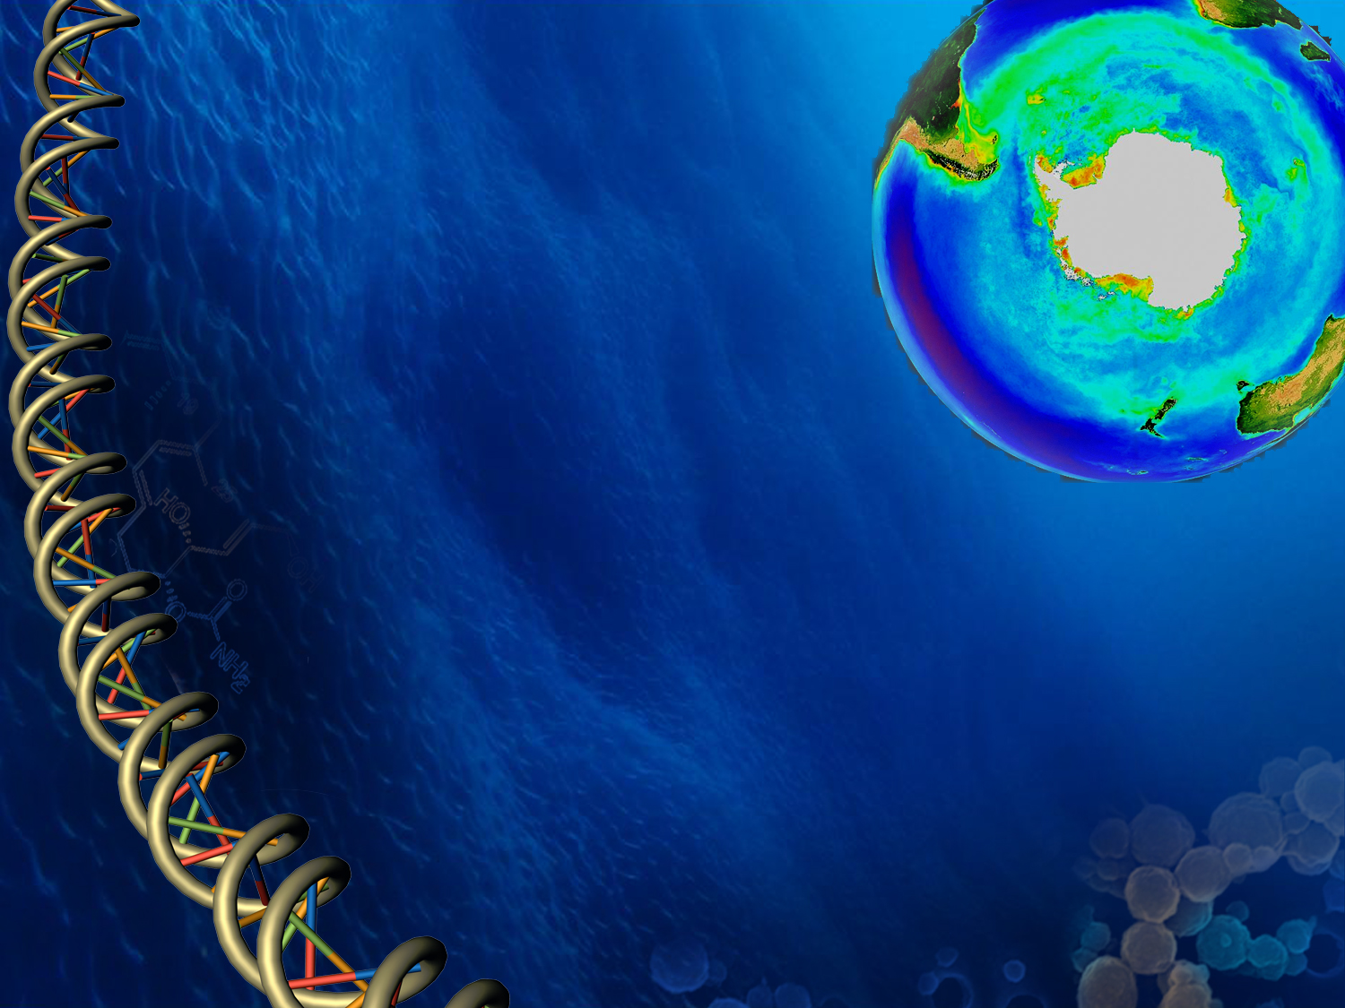

Southern Ocean bacterioplankton: modulators and indicators of ecosystem function
Alison E. Murray
Earth and Ecosystem Sciences
DRI

Slide 2
Musings of why we might want to consider the microbes in a Ross Sea conservation framework:
They are small… but important
The Southern Ocean bacterioplankton harbor a unique diversity
‘omics is revealing new information about function
Climate change impacts
From a microbial perspective…
Potential roles, feedbacks, responses of the
microbes

Slide 3
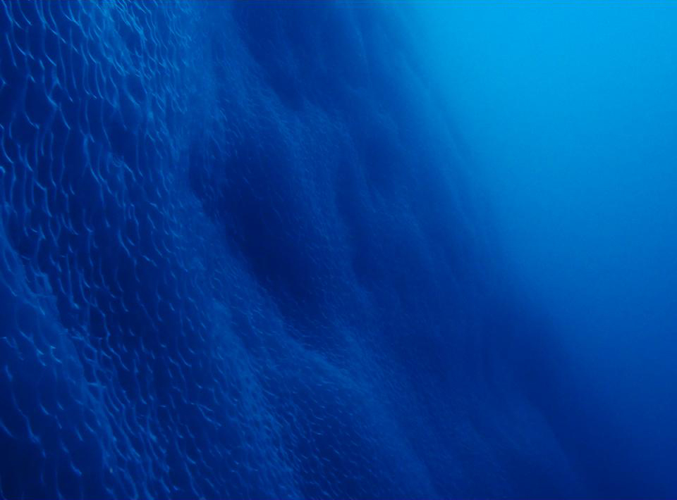
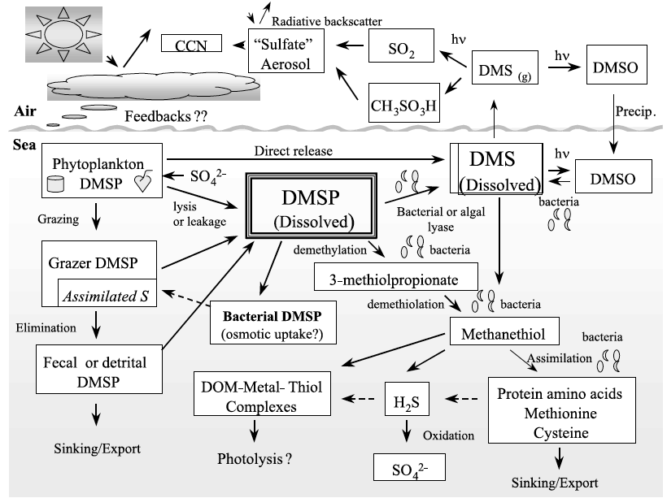
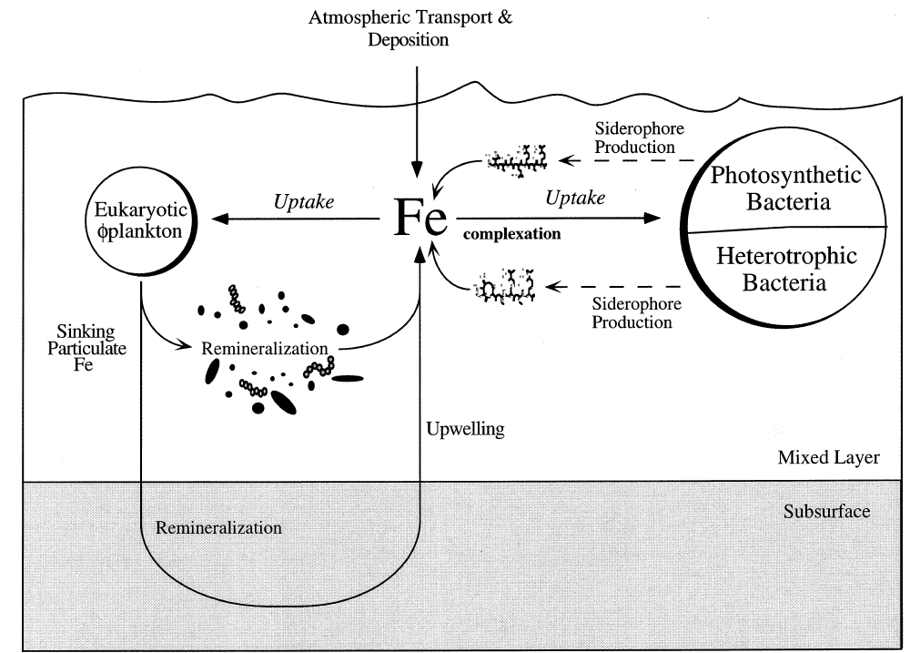
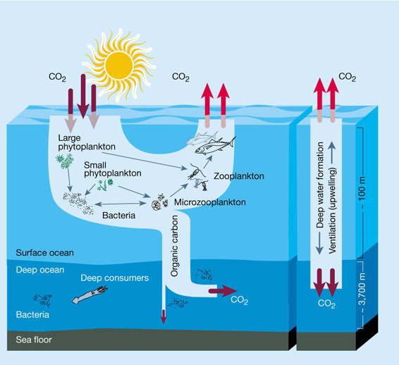
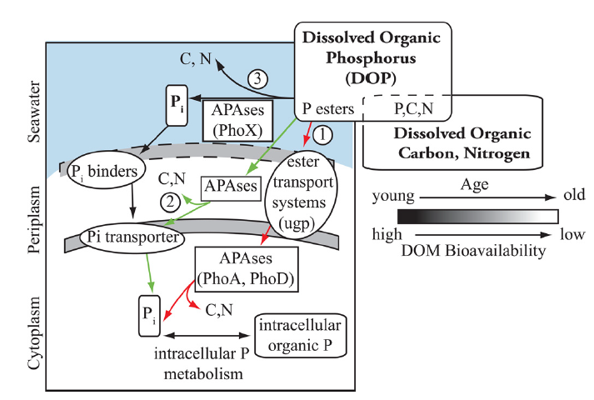
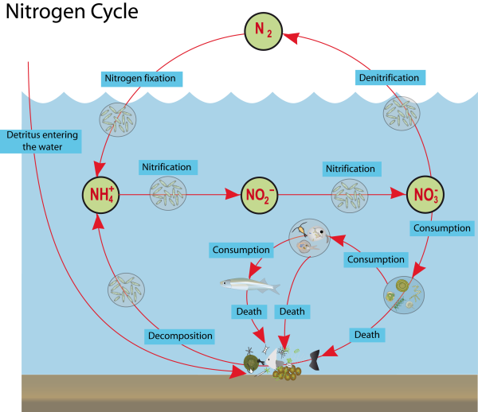
Major role in C-N-S-P-Fe cycling
Sulfur Cycle
Iron Cycle
Carbon Cycle
Nitrogen Cycle
Phosphorus Cycle
Bacterioplankton play critical roles in providing nutrients for other microbes, and the rest of the pelagic biota
Notes:
From Antarctic in the Climate EcosystemThe Southern Ocean presently absorbs about half of the global ocean total and thus provides a vital service for humankind. Whether or not the Southern Ocean will continue to sequester carbon at the same rate is uncertain. Carbon is taken up by the ocean by both the “biological pump” and the “physical pump”. Assessing the ability of these Southern Ocean carbon pumps to continue to contribute to the control of atmospheric CO₂ levels is now one of the major uncertainties in balancing global carbon budgets and their response to climate change.

Slide 4
Major role in C-N-S-P-Fe cycling
Sulfur Cycle
Iron Cycle
Carbon Cycle
Nitrogen Cycle
Phosphorus Cycle
Bacterioplankton play critical roles in providing nutrients for other microbes, and the rest of the pelagic biota
Notes:
From Antarctic in the Climate EcosystemThe Southern Ocean presently absorbs about half of the global ocean total and thus provides a vital service for humankind. Whether or not the Southern Ocean will continue to sequester carbon at the same rate is uncertain. Carbon is taken up by the ocean by both the “biological pump” and the “physical pump”. Assessing the ability of these Southern Ocean carbon pumps to continue to contribute to the control of atmospheric CO₂ levels is now one of the major uncertainties in balancing global carbon budgets and their response to climate change.

Slide 5
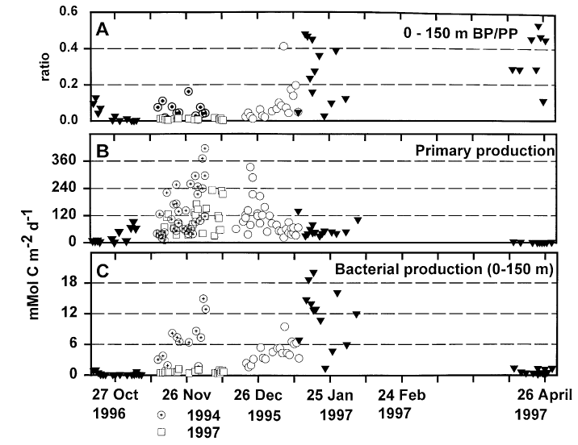
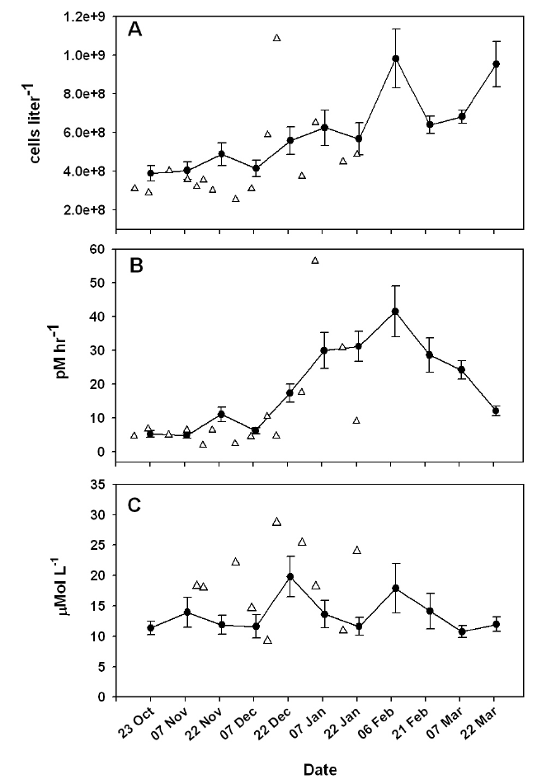
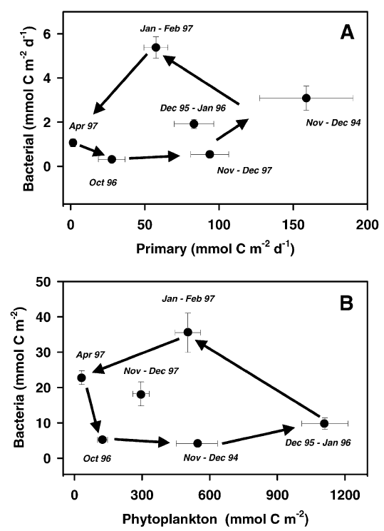
Biomass and growth dynamics
Ross Sea
Peaks in biomass and productivity occur in late spring and summer in the Southern Ocean
Antarctic Peninsula
Ross Sea
Photic zone
Counterclockwise trajectories in time indicate the lag of bacteria behind the phytoplankton development.
Stocks
Ducklow et al. 2001 DSR(II) 48:4199-4221 &
Ducklow et al. 2011 AME 64:205-220.
Notes:
Bacteria biomass in the ross sea was 10% of phytoplankton standing stocks; bacterial production rates are about 5-10% of phytoplankton production; though the demand on phytop
Schematic representation of the ocean food web. On the left is the classic pathway of carbon and energy flow through photosynthetic Eukarya, to herbivores and on to higher trophic levels. Depicted on the right is the microbial food web, which uses energy stored in the non-living, detrital carbon pool to produce microbial biomass that can re-enter the classic pathway of carbon and energy flow. Cell-associated ectoenzymes (Ecto) enable bacteria to use high-molecular-weight (HMW) DOC in addition to the more traditional low-molecular-weight (LMW) and gaseous carbon substances. Also shown in the microbial food web are viral particles and Archaea. At the present time, there is only rudimentary knowledge of the role of Archaea in the oceanic food web. Shown at the bottom of this diagram is the downward flux of particulate carbon (and energy), which is now thought to fuel most subeuphotic zone processes. The classic algae-herbivore grazer pathway (left side) is most important in this regard. Adapted from Karl, D. M. Accurate estimation of microbial loop processes and rates. Microbiol. Ecol 28, 147-150 (1994).
Figure and legend from- DeLong E.F. & Karl D.M.Genomic perspectives in microbial oceanography. Nature 437, 336-342 (2005).

Slide 6
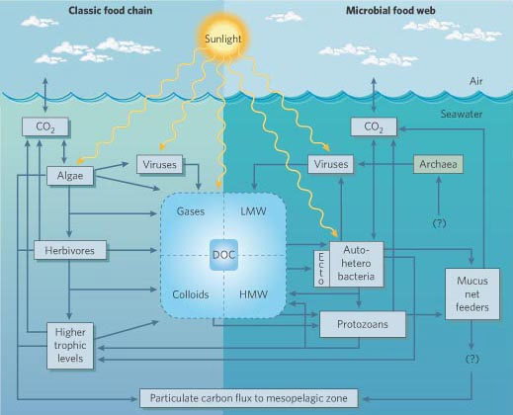
Recognition of the importance of the microbial loop in using detrital carbon to produce microbial biomass
C(org)?
Notes:
Point: What’s specific to the SO here? (1) winter archaea; (2) the size of the boxes are poorly known; (3) the role and influence of sea ice is not well known; (4) the DOC is lower than in other oceanic regions which may influence the balance of heterotrophy
Bacteria biomass in the ross sea was 10% of phytoplankton standing stocks; bacterial production rates are about 5-10% of phytoplankton production; though the demand on phytop
Schematic representation of the ocean food web. On the left is the classic pathway of carbon and energy flow through photosynthetic Eukarya, to herbivores and on to higher trophic levels. Depicted on the right is the microbial food web, which uses energy stored in the non-living, detrital carbon pool to produce microbial biomass that can re-enter the classic pathway of carbon and energy flow. Cell-associated ectoenzymes (Ecto) enable bacteria to use high-molecular-weight (HMW) DOC in addition to the more traditional low-molecular-weight (LMW) and gaseous carbon substances. Also shown in the microbial food web are viral particles and Archaea. At the present time, there is only rudimentary knowledge of the role of Archaea in the oceanic food web. Shown at the bottom of this diagram is the downward flux of particulate carbon (and energy), which is now thought to fuel most subeuphotic zone processes. The classic algae-herbivore grazer pathway (left side) is most important in this regard. Adapted from Karl, D. M. Accurate estimation of microbial loop processes and rates. Microbiol. Ecol 28, 147-150 (1994).
Figure and legend from- DeLong E.F. & Karl D.M.Genomic perspectives in microbial oceanography. Nature 437, 336-342 (2005).

Slide 7
Recognition of the importance of the microbial loop in using detrital carbon to produce microbial biomass
Climate change:???
Role of sea ice??
C(org)?
Notes:
Point: What’s specific to the SO here? (1) winter archaea; (2) the size of the boxes are poorly known; (3) the role and influence of sea ice is not well known; (4) the DOC is lower than in other oceanic regions which may influence the balance of heterotrophy
Bacteria biomass in the ross sea was 10% of phytoplankton standing stocks; bacterial production rates are about 5-10% of phytoplankton production; though the demand on phytop
Schematic representation of the ocean food web. On the left is the classic pathway of carbon and energy flow through photosynthetic Eukarya, to herbivores and on to higher trophic levels. Depicted on the right is the microbial food web, which uses energy stored in the non-living, detrital carbon pool to produce microbial biomass that can re-enter the classic pathway of carbon and energy flow. Cell-associated ectoenzymes (Ecto) enable bacteria to use high-molecular-weight (HMW) DOC in addition to the more traditional low-molecular-weight (LMW) and gaseous carbon substances. Also shown in the microbial food web are viral particles and Archaea. At the present time, there is only rudimentary knowledge of the role of Archaea in the oceanic food web. Shown at the bottom of this diagram is the downward flux of particulate carbon (and energy), which is now thought to fuel most subeuphotic zone processes. The classic algae-herbivore grazer pathway (left side) is most important in this regard. Adapted from Karl, D. M. Accurate estimation of microbial loop processes and rates. Microbiol. Ecol 28, 147-150 (1994).
Figure and legend from- DeLong E.F. & Karl D.M.Genomic perspectives in microbial oceanography. Nature 437, 336-342 (2005).

Slide 8
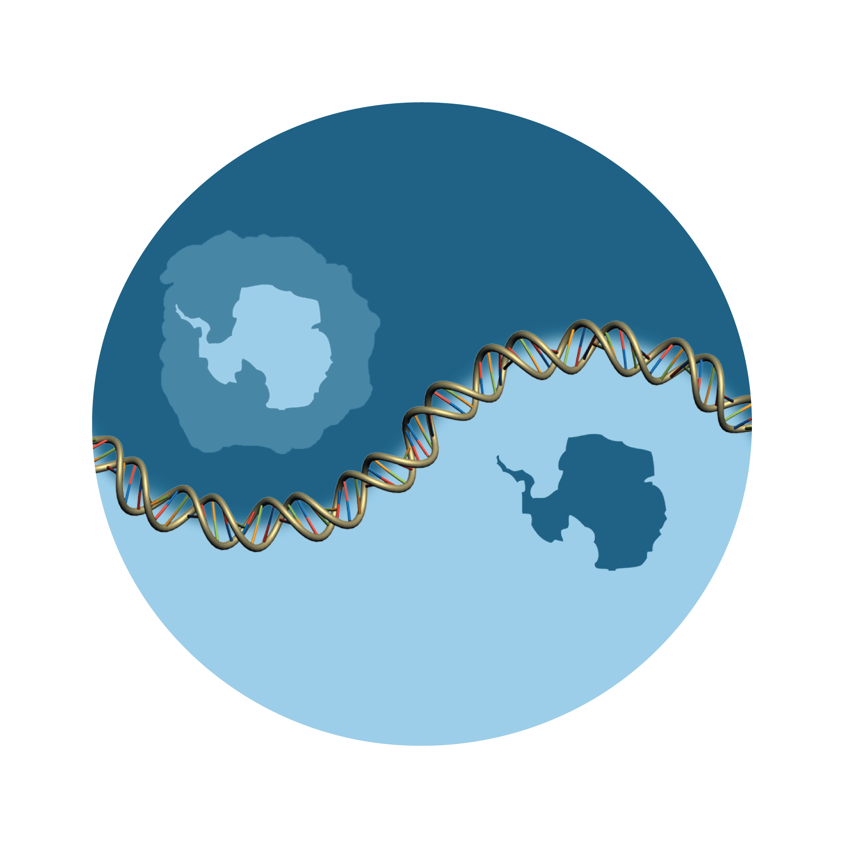
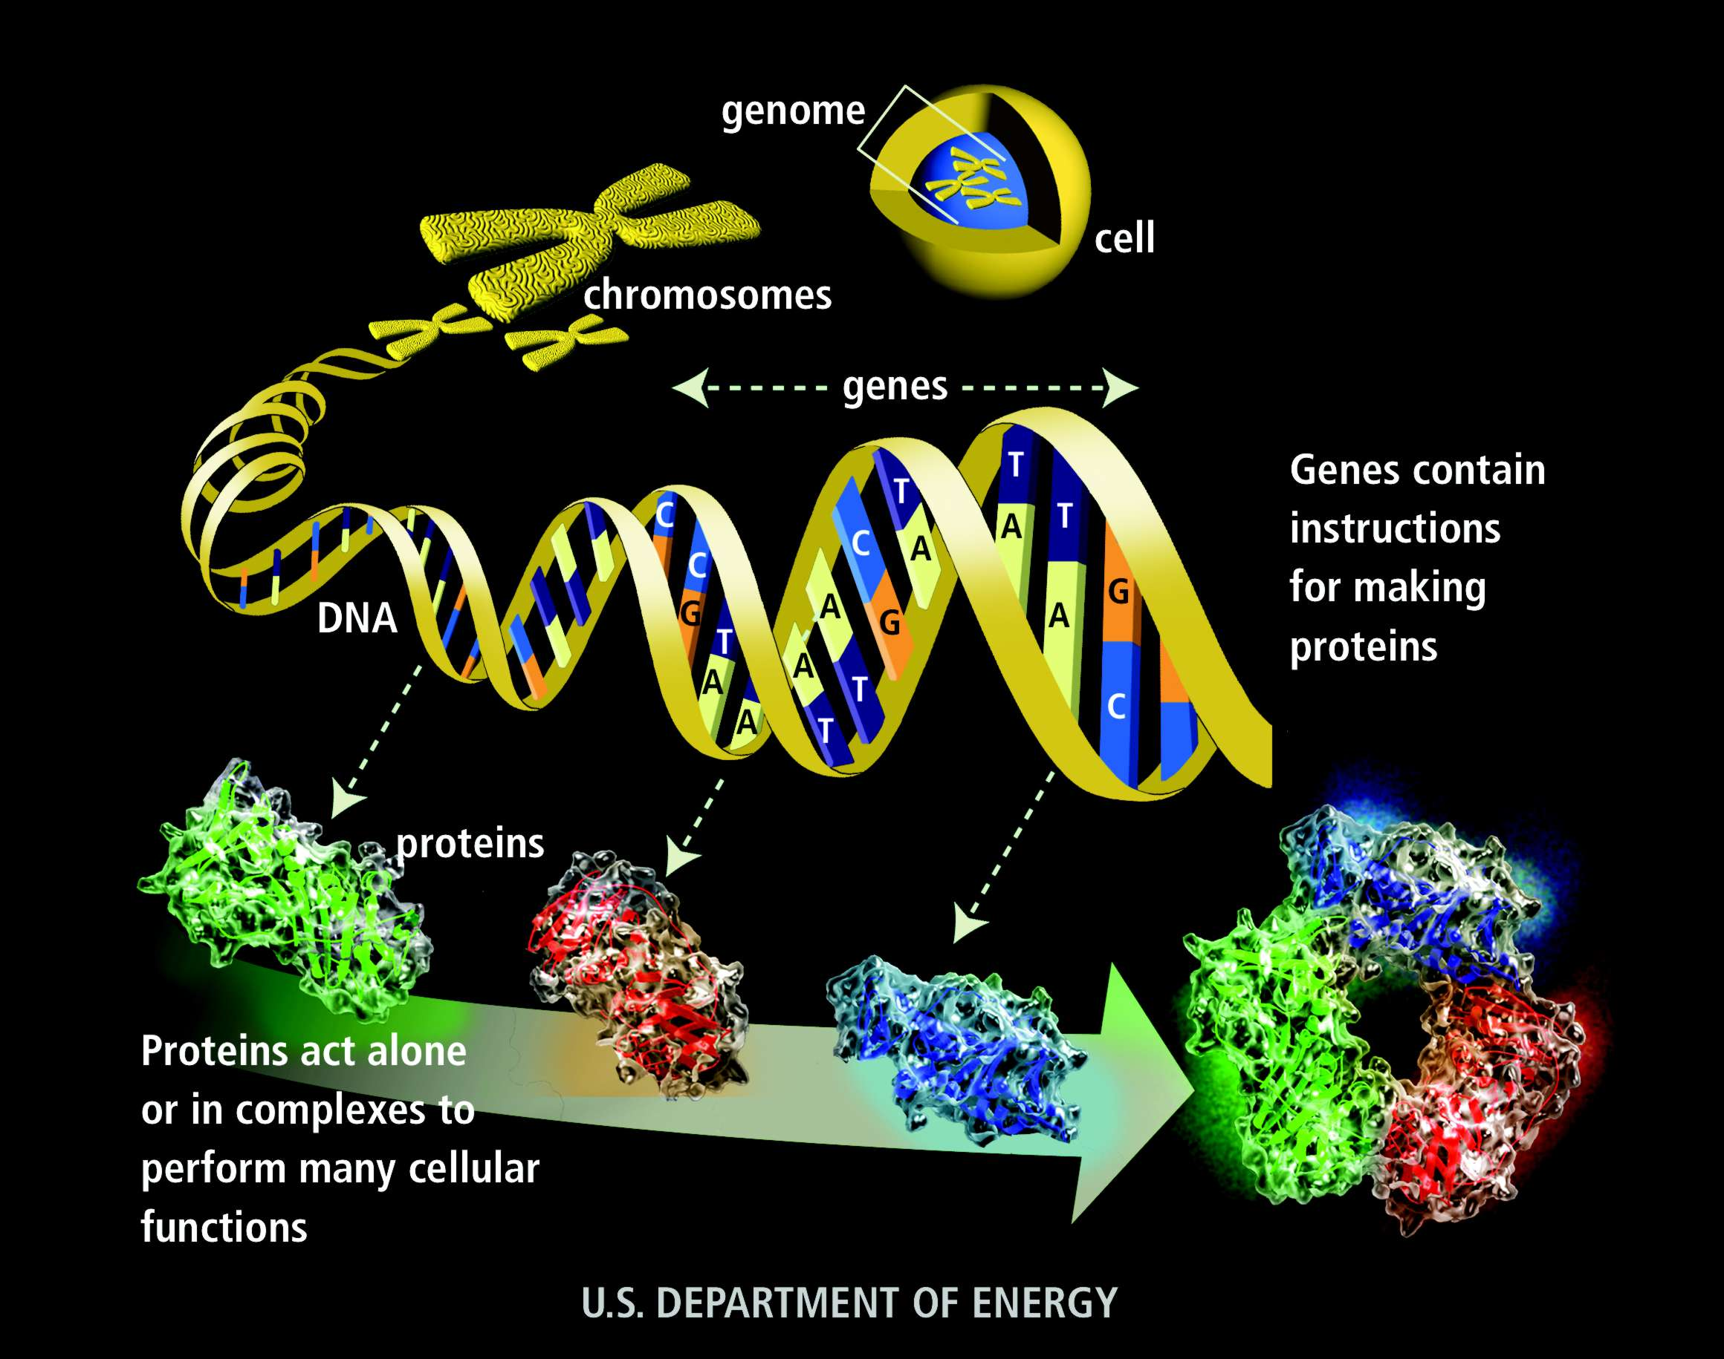
New views on diversity and what ‘omics is revealing about function
Diversity of Southern Ocean bacterioplankton appears to be distinctive
Genome-encoded capacity
Proteome-encoded function

Slide 9
Samples collected from pole to pole
92 samples > 800K rRNA gene sequence tags
* Sequencing support: International Census of Marine Microbes/Census of Antarctic Marine Life
Ghiglione et al. in prep

Slide 10
Pairwise comparisons within the Southern Ocean
n=4700 bacterial types
3100 coastal
930 open ocean
Majority
are rare
34
Open ocean Ross-Sea-Weddell Sea bacterioplankton are 55% similar
Coastal samples over the seasonal cycle show substantial variation (Ghiglione & Murray, 2012)
Ross Sea and Weddell Sea coastal samples are 52% similar
44
40
55
34
48
Murray et al. in prep
Notes:
Our study found total of 4,692 OTUs were detected in the Southern Ocean surface ocean data set (which includes Kerguelen Islands, the Antarctic Peninusla stations sampled on four occasions over the annual cycle, a station in the Amundson sea and transects into the Ross and Weddell Seas sampled at four locations each). Of these we found that the coastal stations harbored more richness than the open ocean stations, such that 3,109 were unique to the coastal stations, 930 were unique to the open ocean stations; and 652 were common to both. The majority (97%) of OTUs are rare (had less than 100 SSU rRNA gene tag sequences per OTU when summed across the coastal or open ocean data sets), as found in other pelagic systems. The composition of bacterioplankton in the southern ocean is unique in comparison to samples from the Atlantic and Mediteranean Sea (referred to as mid-latitude data set). When we compared the Mid-latitude samples (processed using the same methods and work-flow as the Southern Ocean data set) the Southern Ocean surface data set had 4,112 unique OTUs of 10,762 detected in the combined set, 6,071 were unique to the mid-latidude surface data set with only 579 OTUs (or 0.5%) in common. The majority of these unique Southern Ocean OTUs were rare; though over 50 OTUs have more than 100 occurrences when the Southern Ocean data set was summed and is comprised of five phyla (Proteobacteria, Bacteriodetes, Actinobacteria, Verrucomicrobia, Deferribacteres). Inspection at higher taxonomic resolution to the class level for the Proteobacteria showed that 36% of the uniquely Southern Ocean OTUs are assigned to the Gammaproteobacteria, 13% to the Alphaproteobacteria, 6% to the Deltaproteobacteria, and 2% to the Betaproteobacteria, wherease the 30% of the unique OTUs are affiliated with the Bacteriodetes. The other phyla had 4 % or less representation in this data set.

Slide 11
Hierarchical clustering of bacterial rRNA gene sequences from samples collected from pole to pole (44 polar; 48 lower-latitude)
-AOT: Atlantic Ocean Transect (NA)
J
Surface
-AWP: Azores Water Project (AZ)
-BMO: Blanes Bay Microbial Observatory (MS)
-KNX: South Pacific Gyre (SP)
A
Grey = lower latitude samples
Red = Southern Ocean samples
Blue = Arctic Ocean samples
I
Surface
Coastal
B
C
D
Open Ocean
E
F
Polar surface and deep branch to the exclusion of the lower latitude surface samples
Southern Ocean and Arctic Ocean bacteria cluster based on season (summer are most divergent) and coastal vs. open ocean.
There were no cases of Southern and Arctic Ocean samples being nearest neighbors to each other.
G
- NADW: North Atlantic Deep Waters (NA)
H
Deep
- BMO: Blanes Bay Microbial Observatory (MS)
- AWP: Azores Water Project (AZ)
-AOT: Atlantic Ocean Transect (SA-NA)
100
80
60
40
20
0
Ghiglione et al. in prep

Slide 12
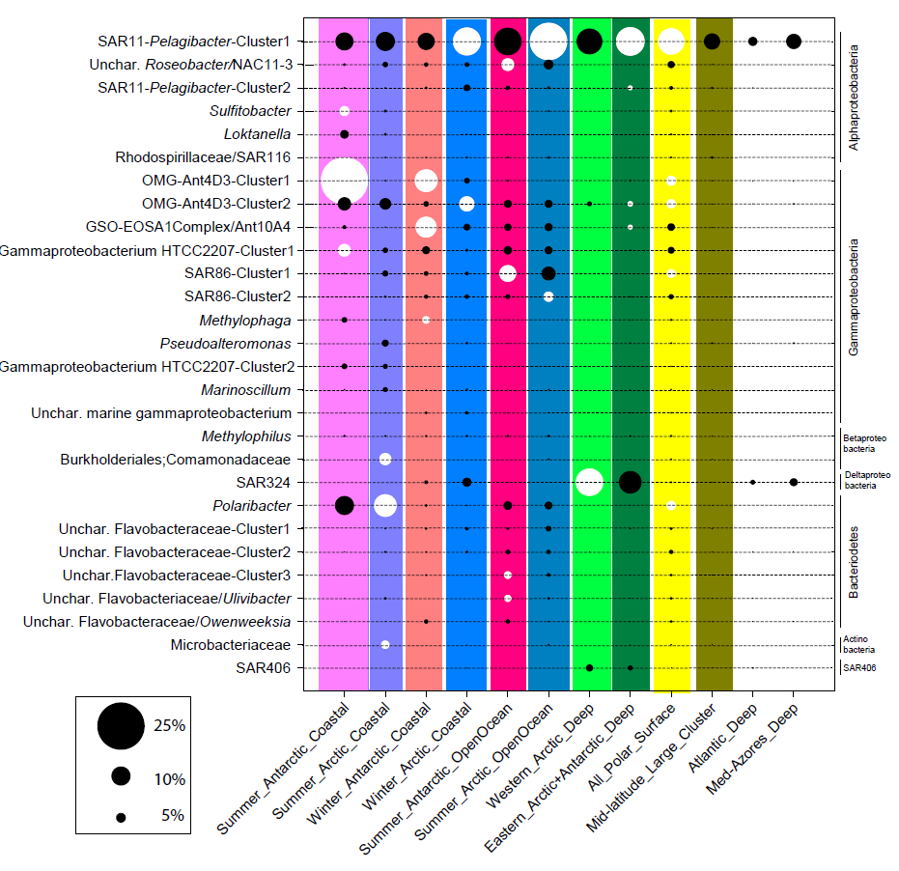
Identifying the Southern Ocean bacterioplankton
Ghiglione et al. in prep

Slide 13
Seasonal comparisons in bacterioplankton
SSU rRNA gene comparisons (full length gene) informs on diversity/identity
141
Winter
47
Summer
Genome-content comparisons at the level of gene clusters (COGs)
21
Winter
Percent shared is 10%
Total richness is 209
360
1680
584
Summer
Grzymski et al. ISMEJ in press

Slide 14
Bacterial carbon fixation pathways
Calvin-Benson Cycle
  ribulose 1,5-bisphosphate carbxoylase
Reverse TCA Cycle
  ATP-dependent citrate lyase, pyruvate:ferredoxin oxidoreductase, 2-oxoglutarate:ferredoxin oxidoreductase
3-hydroxypropionate/4-hydroxybutyrate pathway
  acetyl coezyme A/propionyl-CoA carboxylase
Reductive acetyl-CoA pathway
  carbon monoxide dehydrogenase/acetyl-CoA synthase

Slide 15
RuBisCO genes abundant in the
Antarctic winter metagenome
ANTWFO_09620
n=6
ANTSFO_14030
Sulfur oxidizers
Monterey Bay EBAC080-L31C11 [AAR37722]
Gammaproteobacterium SCGC AAA007-O20 [ADX05602.1]
Thiomicrospira crunogena XCL-2 [YP_390697]
Hydrogenovibrio marinus [Q59458]
Synechococcus sp. WH 7803 [YP_001224401]
Prochlorococcus marinus str. MIT9301 [YP_001090800]
Form IA
Nitrosomonas eutropha C91 [YP_747036]
ANTWFO_02030
Ammonia oxidizers
Deltaproteobacterium SCGC AAA001-C10 [ADX05590]
Mariprofundus ferrooxidans [ZP_01453295]
Solemya velum gill symbiont [Q673V5]
Acidithiobacillus ferrooxidans [AAK00291]
Rhodobacter sphaeroides ATCC 17025 [YP_001170220]
Nitrosococcus oceani ATCC 19707 [YP_342389]
Nitrosospira multiformis ATCC 25196 [YP_411385]
Ammonia oxidizers
ANTWFO_16020
n=2
Form IC
Rhodopseudomonas palustris CGA009 [NP_946905]
Oligotropha carboxidovorans [YP_015620]
Nitrobacter winogradskyi Nb-255 [YP_319531]
Thiobacillus denitrificans ATCC 25259 [YP_316396]
Form II
uncultured SUP05 cluster bacterium [ACX30513]
Candidatus Ruthia magnifica [ABL02438]
Roseobacter sp. MED193 [ZP_01056409]
Octadecabacter antarcticus 307 [ZP_05051550]
Form IV
Not functional
ANTSFO_11650
AWFS_00000880
Grzymski et al. ISMEJ in press

Slide 16
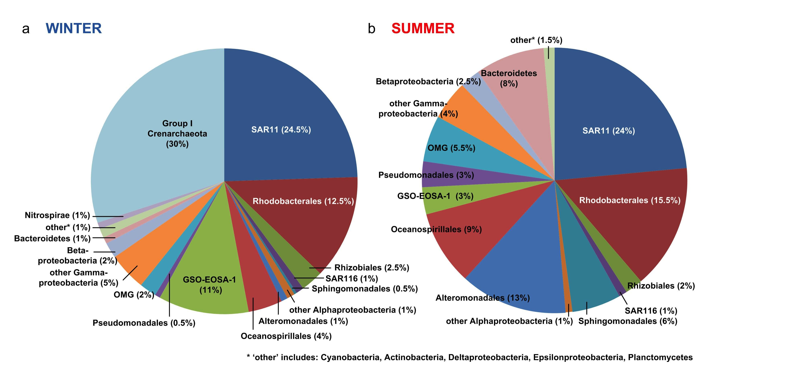
Proteome comparisons support that the organisms are different – based on the proteins identified
Williams et al. ISMEJ in press

Slide 17
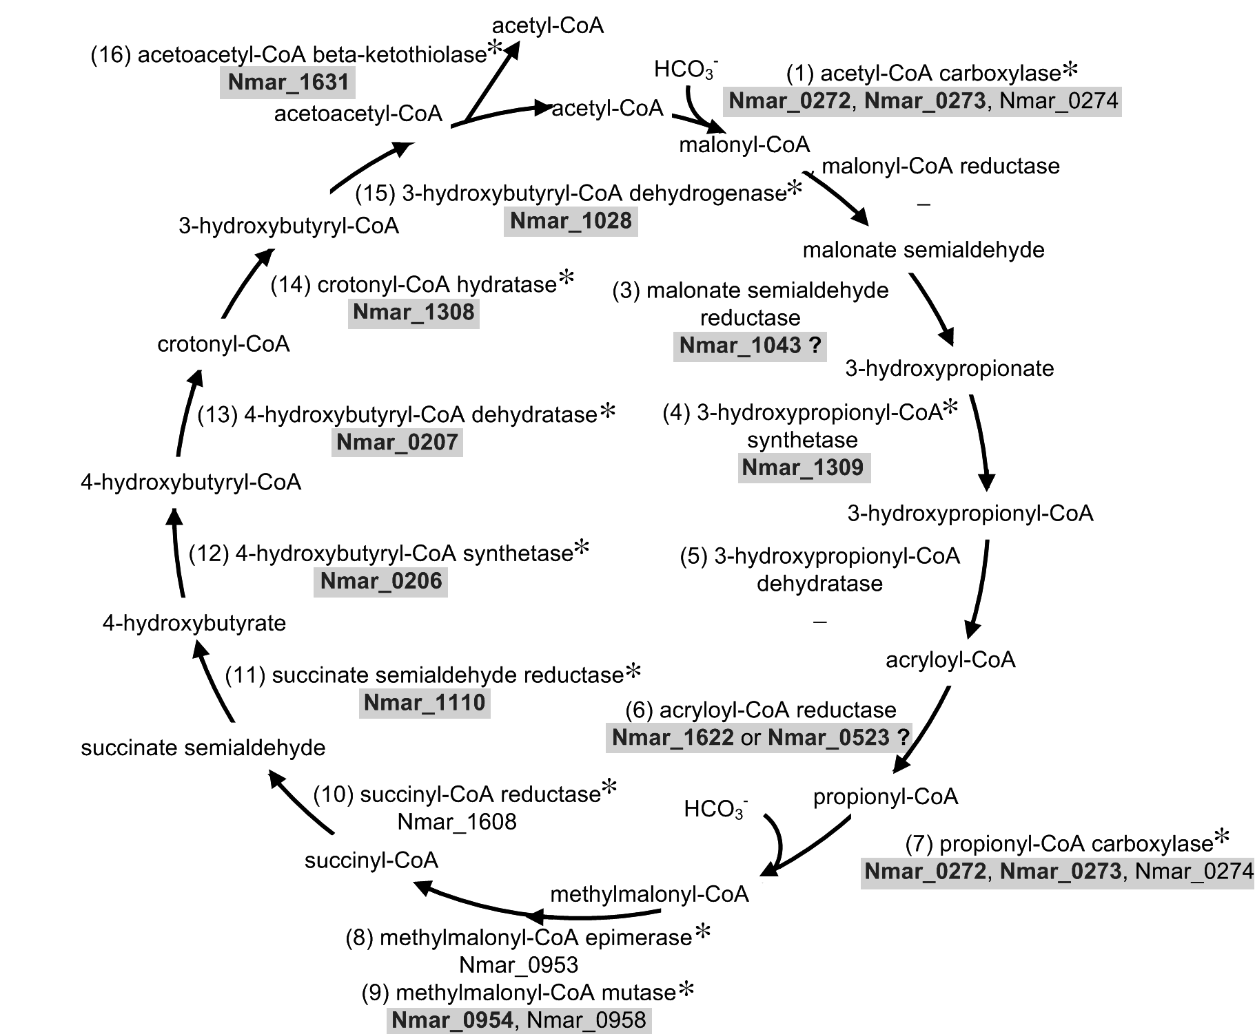
Environmental metaproteome confirms the planktonic archaea (~ 20% of winter bacterioplankton) are fixing CO₂
Environmental expression of the 3-Hydroxyproprionate/4-hydroxybutyrate pathway
A number of the genes and proteins involved in
ammonia transport and oxidation were also detected
Williams et al. ISMEJ in press

Slide 18
Seasonal differences in surface-associated bacterioplankton –
bacterioplankton carbon fixation is a winter-time mode of growth
Grzymski et al. ISMEJ in press
Notes:
What are numbers Joe calculated?

Slide 19
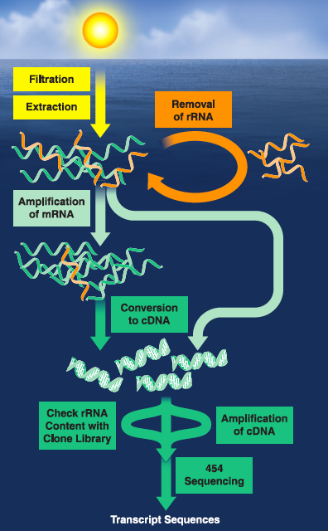
Suggestion: structure (diversity) and functional profiles (transcripts and proteins) from natural microbial communities be used as ecosystem indictors of environmental status?
Plankton are ultimate modulators,
and potentially useful reporters of change
  Variable levels of genome-encoded plasticity
  Vast depth of phylogenetic and physiological diversity to tap
    Signatures of environmental RNA or protein can be used as evidence of ecosystem condition (e.g. nutrient limitation)
Moran, 2009. Microbe.

Slide 20
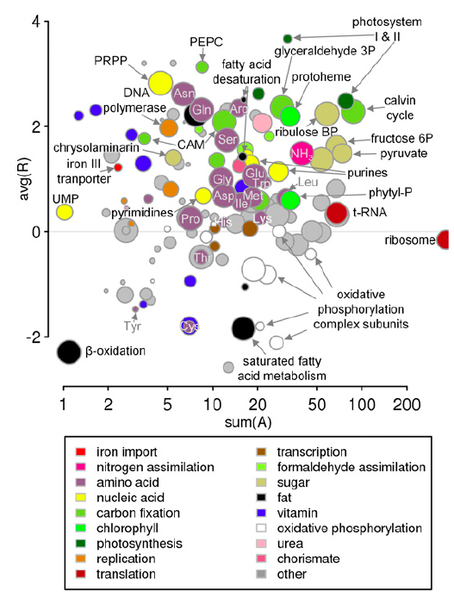
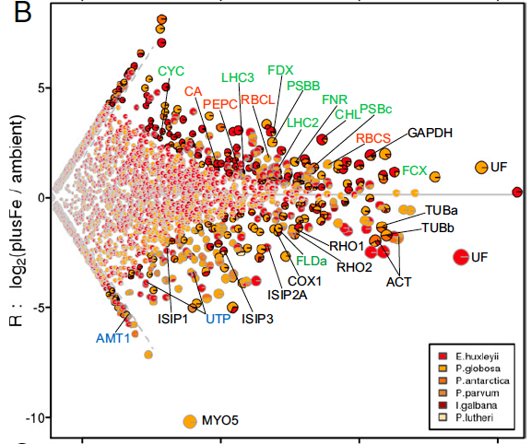
Example: Iron limitation in phytoplankton
Haptophytes
Green = photosynthesis
Orange = carbon fixation
Blue = nitrogen assimilation
Marchetti et al. PNAS 2012 doi:10.1073/pnas.1118408109

Slide 21
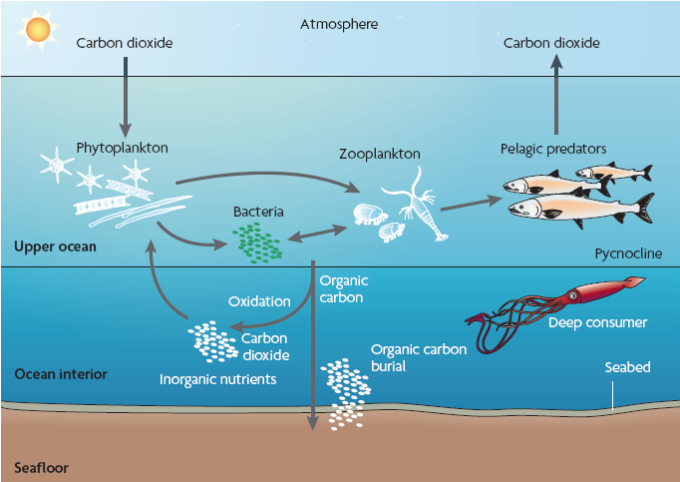
Climate change impacts from a microbial perspective
Falkowski & Oliver, 2007 Nat. Rev. Microbiol. 5:813-819
Notes:
Up to 25% of the total annual primary production in the sea ice zone of the Southern Ocean occurs as algae within the ice itself. ACE researchers are evaluating the relationship between algal growth and the physical properties of the ice in order to assess the impact on this productivity of changes in sea ice area or thickness.
A cartoon of the biological pump. Phytoplankton use solar energy in the upper ocean
to fix carbon dioxide and form particulate organic carbon. Most of the organic carbon is consumed
and respired in the upper ocean by herbivores and bacteria. Approximately 15% of the
organic matter is exported below the thermocline to the ocean interior, where most is consumed
and respired. The flux of the organic matter to the ocean interior, and its subsequent oxidation,
enriches the inorganic nutrient pool below the thermocline. Consequently, the concentration
of inorganic carbon in the ocean interior is more than the equilibrium concentration in the
atmosphere. This enrichment of inorganic carbon, called the biological pump, is responsible for
keeping the ocean approximately 300 parts per million by volume higher in carbon dioxide than
the atmosphere. Only a small fraction (approximately 0.1%) of the organic matter that sinks
into the ocean interior is subsequently buried in the seafloor and incorporated into marine
sediments and sedimentary rocks. This burial represents a sequestration of reductant. On geological
time scales, the consequence of carbon burial is the accumulation of oxygen in the Earth’s
atmosphere. Figure reproduced from one kindly provided by John Delaney, University of
Washington, Washington, USA).

Slide 22
Climate change impacts from a microbial perspective
Acidification
Temperature
Rapid evolution/
Adaptation/selection
Growth rates
Shifts in resource utilization (balance of carbon cycle & increased CO₂ respiration)
?
Shifts in wind-driven mixing
Falkowski & Oliver, 2007 Nat. Rev. Microbiol. 5:813-819
Reduction in sea ice
Distribution of nutrients
Distribution of biogeochemical processes & organisms (size and taxonomic distribution)
Impact on carbon cycle
Habitat loss leading to shifts in microbial diversity
Notes:
Up to 25% of the total annual primary production in the sea ice zone of the Southern Ocean occurs as algae within the ice itself. ACE researchers are evaluating the relationship between algal growth and the physical properties of the ice in order to assess the impact on this productivity of changes in sea ice area or thickness.
A cartoon of the biological pump. Phytoplankton use solar energy in the upper ocean
to fix carbon dioxide and form particulate organic carbon. Most of the organic carbon is consumed
and respired in the upper ocean by herbivores and bacteria. Approximately 15% of the
organic matter is exported below the thermocline to the ocean interior, where most is consumed
and respired. The flux of the organic matter to the ocean interior, and its subsequent oxidation,
enriches the inorganic nutrient pool below the thermocline. Consequently, the concentration
of inorganic carbon in the ocean interior is more than the equilibrium concentration in the
atmosphere. This enrichment of inorganic carbon, called the biological pump, is responsible for
keeping the ocean approximately 300 parts per million by volume higher in carbon dioxide than
the atmosphere. Only a small fraction (approximately 0.1%) of the organic matter that sinks
into the ocean interior is subsequently buried in the seafloor and incorporated into marine
sediments and sedimentary rocks. This burial represents a sequestration of reductant. On geological
time scales, the consequence of carbon burial is the accumulation of oxygen in the Earth’s
atmosphere. Figure reproduced from one kindly provided by John Delaney, University of
Washington, Washington, USA).

Slide 23
Climate change impacts from a microbial perspective
Increased levels of production by smaller cells and enhancement of the microbial loop which may promote carbon remineralization and decrease the ability for CO₂ drawdown
Southward shifts in frontal zones were used as indicators to predict future Sub-Antarctic zone oceanographic conditions (Evans et al. 2011 DSRII 58:2150-2161 )
Low sea ice – melt waters in the Arctic observed increased levels of production and carbohydrate respiration (Montserrat et al. 2010, Polar Biology 33:16833-1694)
Increased production of particulate organic carbon (POC) leads to increased efficiency of remineralization of POC – response is local (Miki et al. 2008, MEPS 366: 1-14)
?
Falkowski & Oliver, 2007 Nat. Rev. Microbiol. 5:813-819
More carbon will be routed through dissolved organic carbon and bacteria (Kirchman et al. 2009 Nat. Rev. Microbiol. 7:451-459)
Potential for reaching temperature-driven tipping point in enzymatic potential for respiration and growth
Notes:
Up to 25% of the total annual primary production in the sea ice zone of the Southern Ocean occurs as algae within the ice itself. ACE researchers are evaluating the relationship between algal growth and the physical properties of the ice in order to assess the impact on this productivity of changes in sea ice area or thickness.
A cartoon of the biological pump. Phytoplankton use solar energy in the upper ocean
to fix carbon dioxide and form particulate organic carbon. Most of the organic carbon is consumed
and respired in the upper ocean by herbivores and bacteria. Approximately 15% of the
organic matter is exported below the thermocline to the ocean interior, where most is consumed
and respired. The flux of the organic matter to the ocean interior, and its subsequent oxidation,
enriches the inorganic nutrient pool below the thermocline. Consequently, the concentration
of inorganic carbon in the ocean interior is more than the equilibrium concentration in the
atmosphere. This enrichment of inorganic carbon, called the biological pump, is responsible for
keeping the ocean approximately 300 parts per million by volume higher in carbon dioxide than
the atmosphere. Only a small fraction (approximately 0.1%) of the organic matter that sinks
into the ocean interior is subsequently buried in the seafloor and incorporated into marine
sediments and sedimentary rocks. This burial represents a sequestration of reductant. On geological
time scales, the consequence of carbon burial is the accumulation of oxygen in the Earth’s
atmosphere. Figure reproduced from one kindly provided by John Delaney, University of
Washington, Washington, USA).

Slide 24
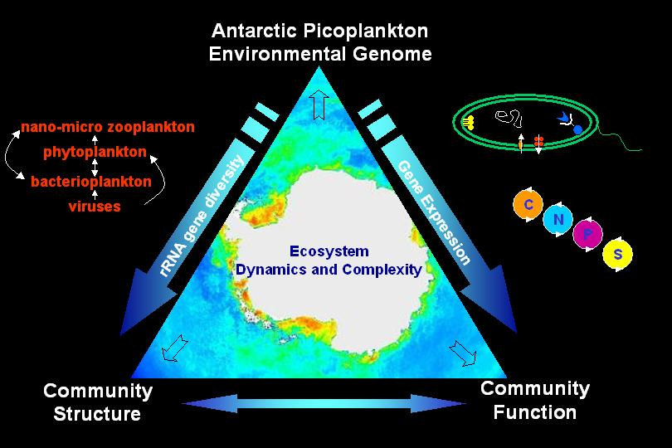
Climate change impacts from a microbial perspective – substantial biogeochemical feedbacks that may be driven by “the unseen majority”
Innovation in physiological complexity is bottom up (resource) driven; perhaps unique to, and extensive in the Southern Ocean
Expression of this innovation is detectable, increasingly more accessible, and informative
New view of seasonality
in biogeochemical cycling
suggests importance of newly
recognized pathways
Potential for increased carbon
production – and the
primary response relies
on how the microbial
loop responds
Ecosystem ‘omic biosignature

Slide 25





Acknowledgements
Support: NSF-OPP
JGI-CSP
Collaborators:
Joe Grzymski (DRI)
Christian Riesenfeld (DRI)
Vivian Peng (DRI)
Hugh Ducklow (MBL)
Kristen Myers (Brown-MBL)
Mathew Erickson (MBL)
Rick Cavicchioli (UNSW)
Tim Williams (UNSW)
Jean-Francois Ghiglione (CNRS-Banyuls)
Carlos Pedros-Alio (CSIC, Barcelona)
Pierre Galand (CNRS-Banyuls)
Thomas Pommier (Univ. Lyon)
Els Maas (NIWA, NZ)
RPSC

