Slide 1

Factors that affect Spatial and Temporal Variations in Phytoplankton Biomass, Flux and Production
Walker O. Smith, Jr.

Slide 2
Factors that can influence spatial and temporal patterns
Currents (including large-scale circulation patterns, mesoscale features, etc.)
Irradiance variations over space
Depth of the mixed layer variations in space
Spatial variations in nutrients and iron supply
Variations in loss processes
But first, what are these spatial and temporal variations?

Slide 3
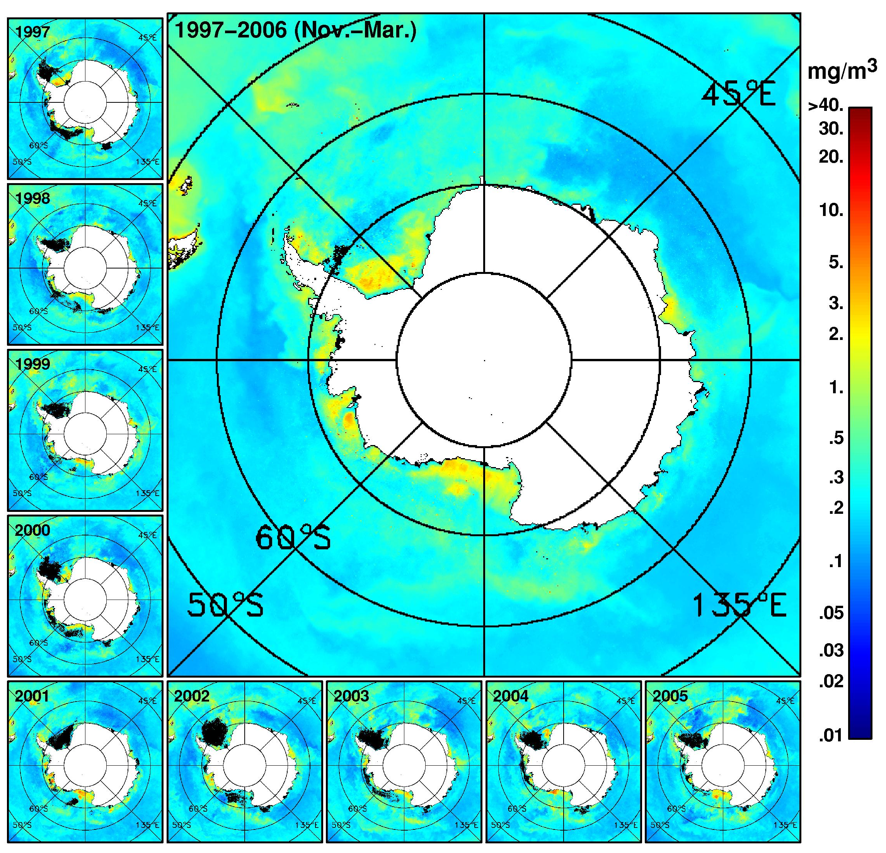
Smith and Comiso, 2008

Slide 4
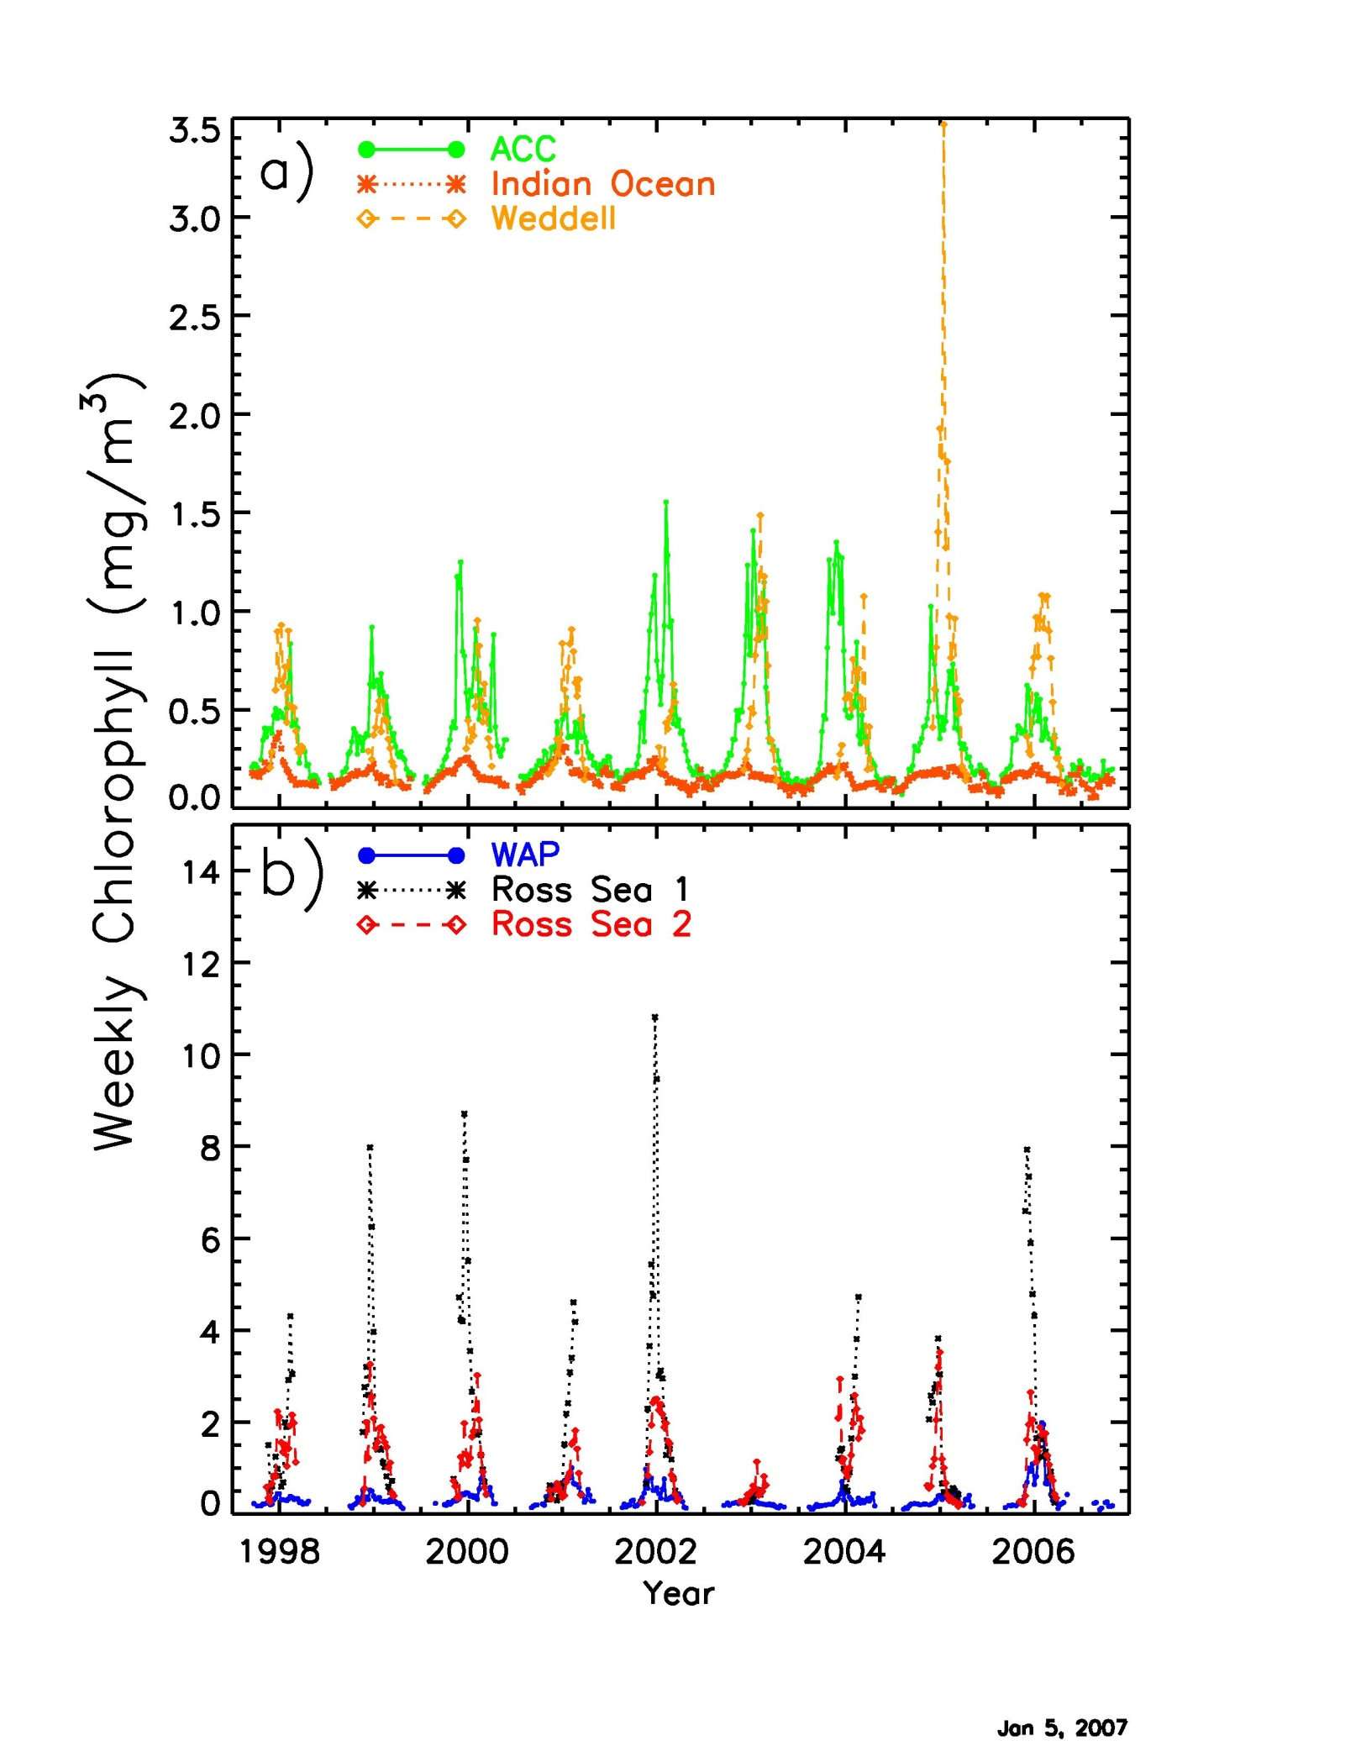
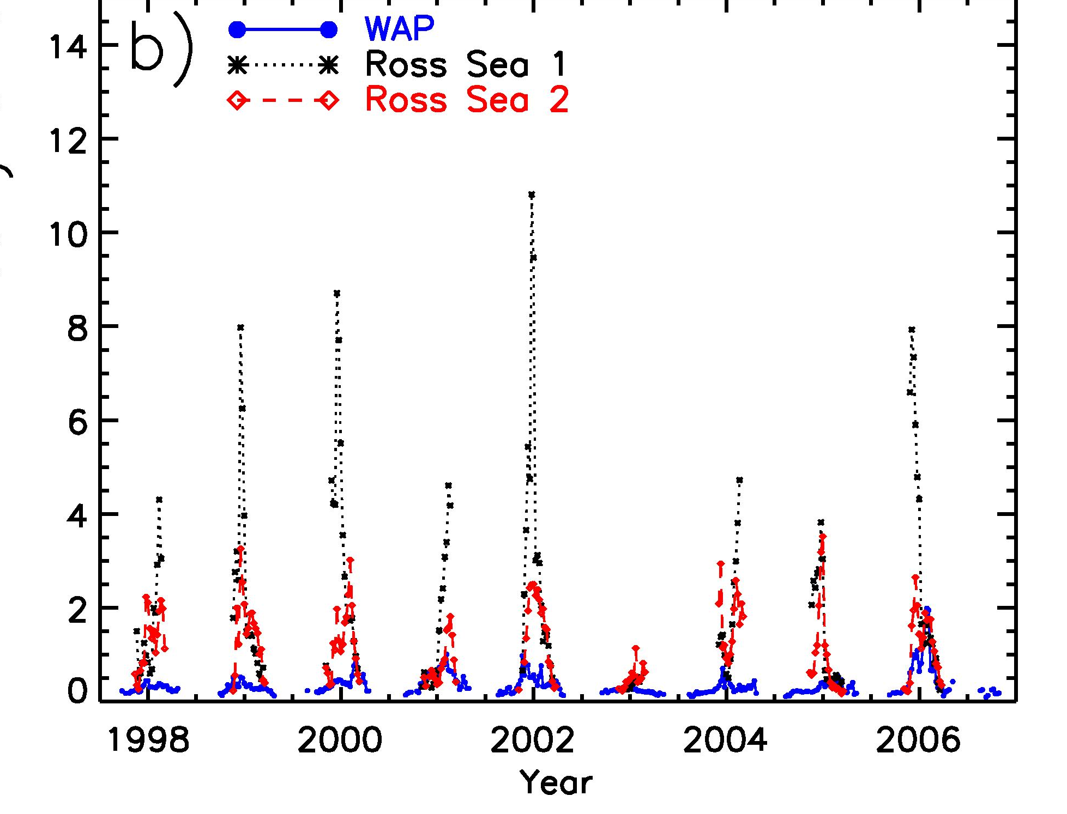
Smith and Comiso, 2008

Slide 5
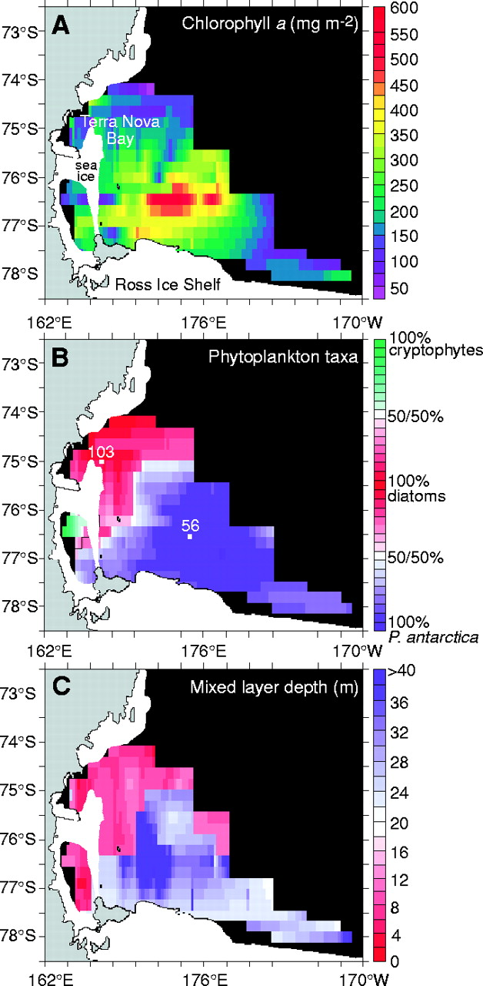
Phytoplankton composition in spring, 1996 (Arrigo et al., 1999)

Slide 6
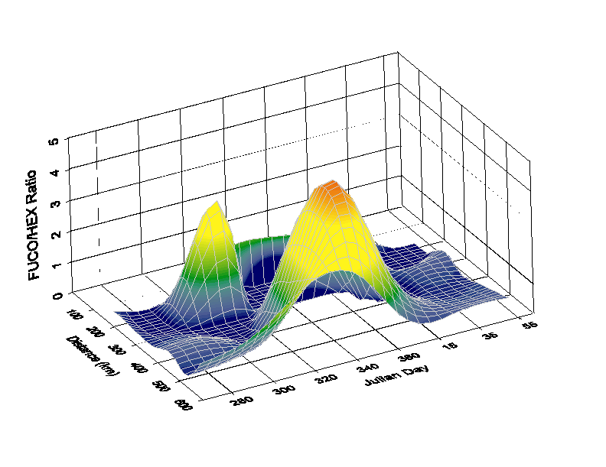
Temporal/Spatial Changes in Assemblage Composition in 1996-97

Slide 7
Currents
Large-scale currents are relatively well known, with the speeds much greater than had originally been thought
Smith et al. (2007)

Slide 8
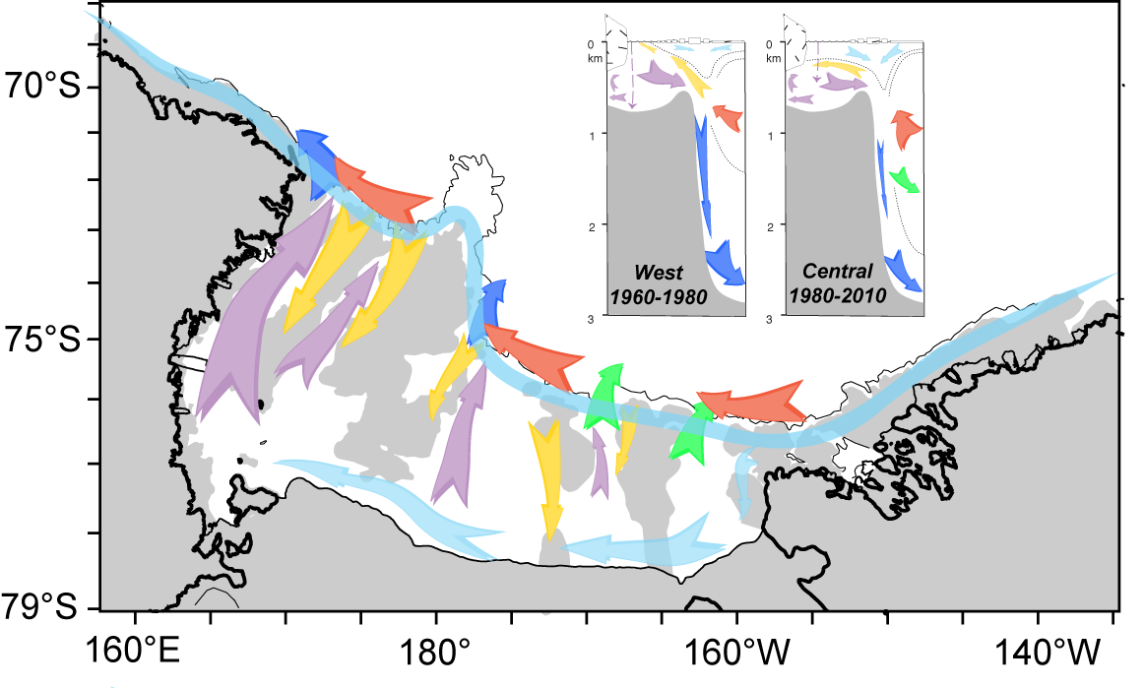
Smith et al. (in press)

Slide 9
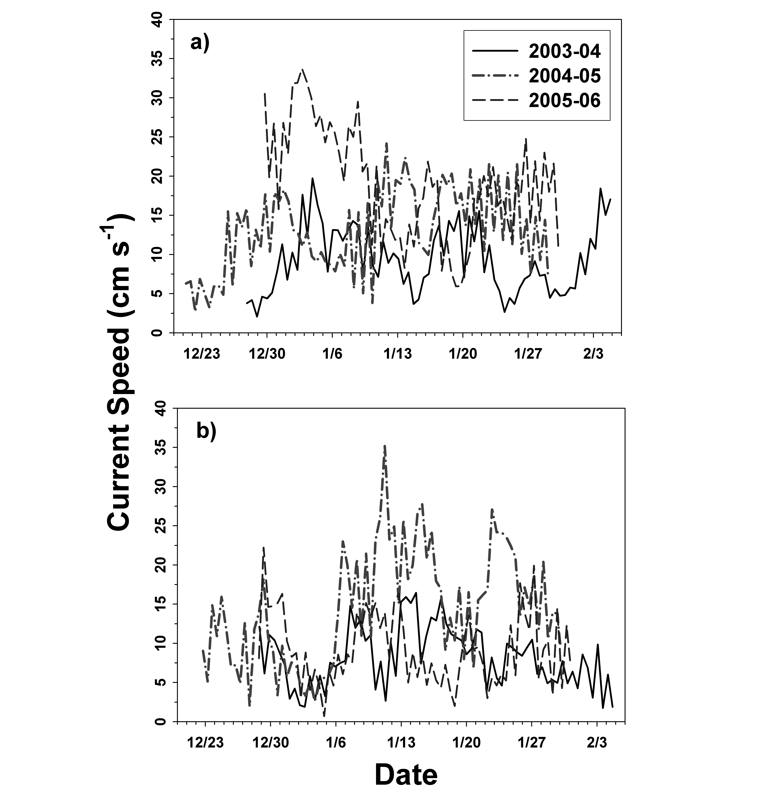
Smith et al. (2011b)

Slide 10
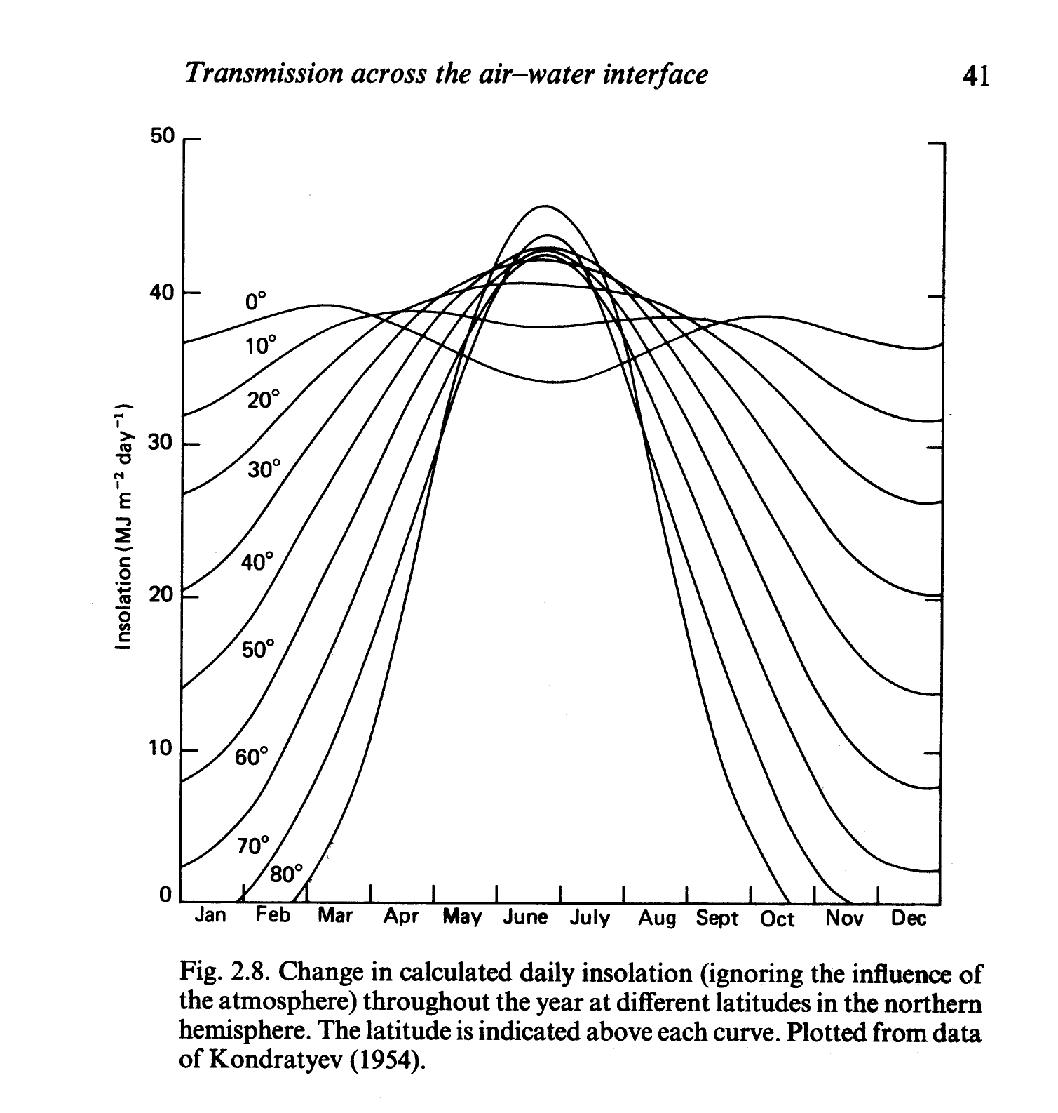
Irradiance Variations in Space and Time
Temporal variations are obvious, well documented, and predictable
Holm-Hansen et al., 1990

Slide 11
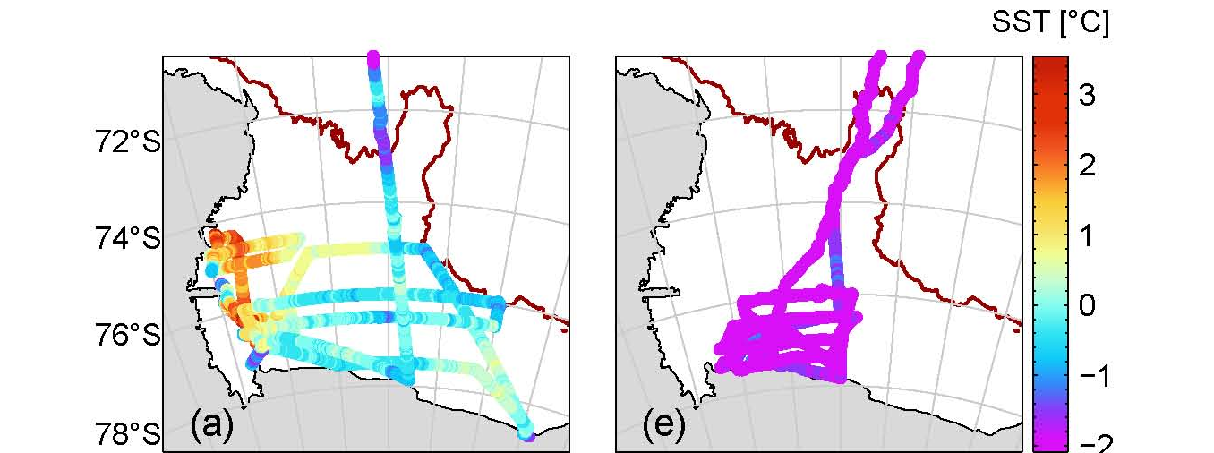
Irradiance Variations in Space and Time
Temporal variations are obvious, well documented, and predictable
but are also influenced by local cloud patterns
which in turn influence heat input, vertical mixing and surface temperatures/heat content
Long, 2010
Summer Spring

Slide 12
Irradiance Variations in Space and Time
A primary control of irradiance in the water is the presence or absence of ice
In turn, ice distribution varies tremendously on short, mesoscale, seasonal and interannual time scales, all of which can influence phytoplankton growth
Short-term (e.g., hourly, daily) are often controlled by winds

Slide 13
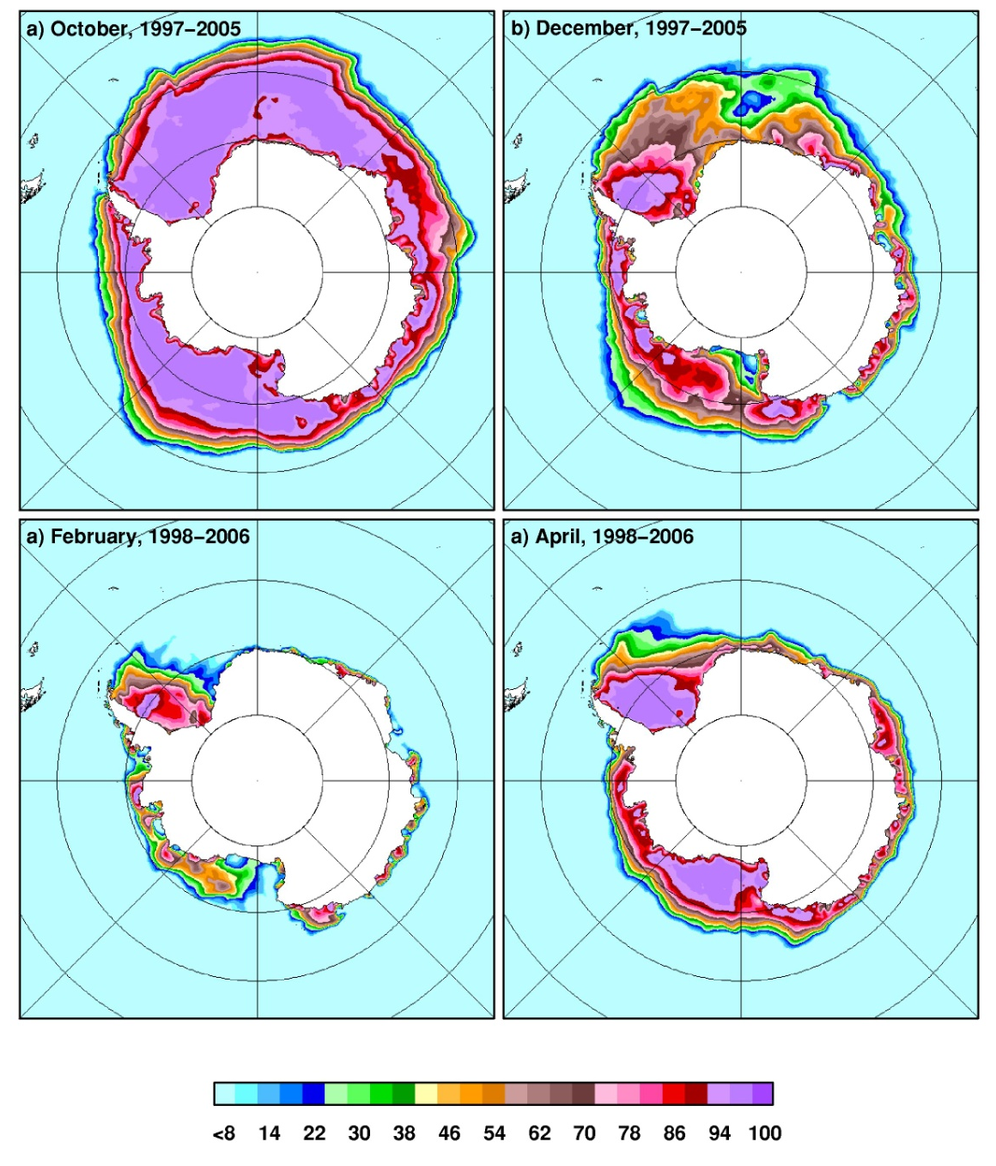
Mesoscale and seasonal variations can be documented by satellite
Data of J. Comiso, Goddard; represent means from 1996 – 2008 from SSMR

Slide 14
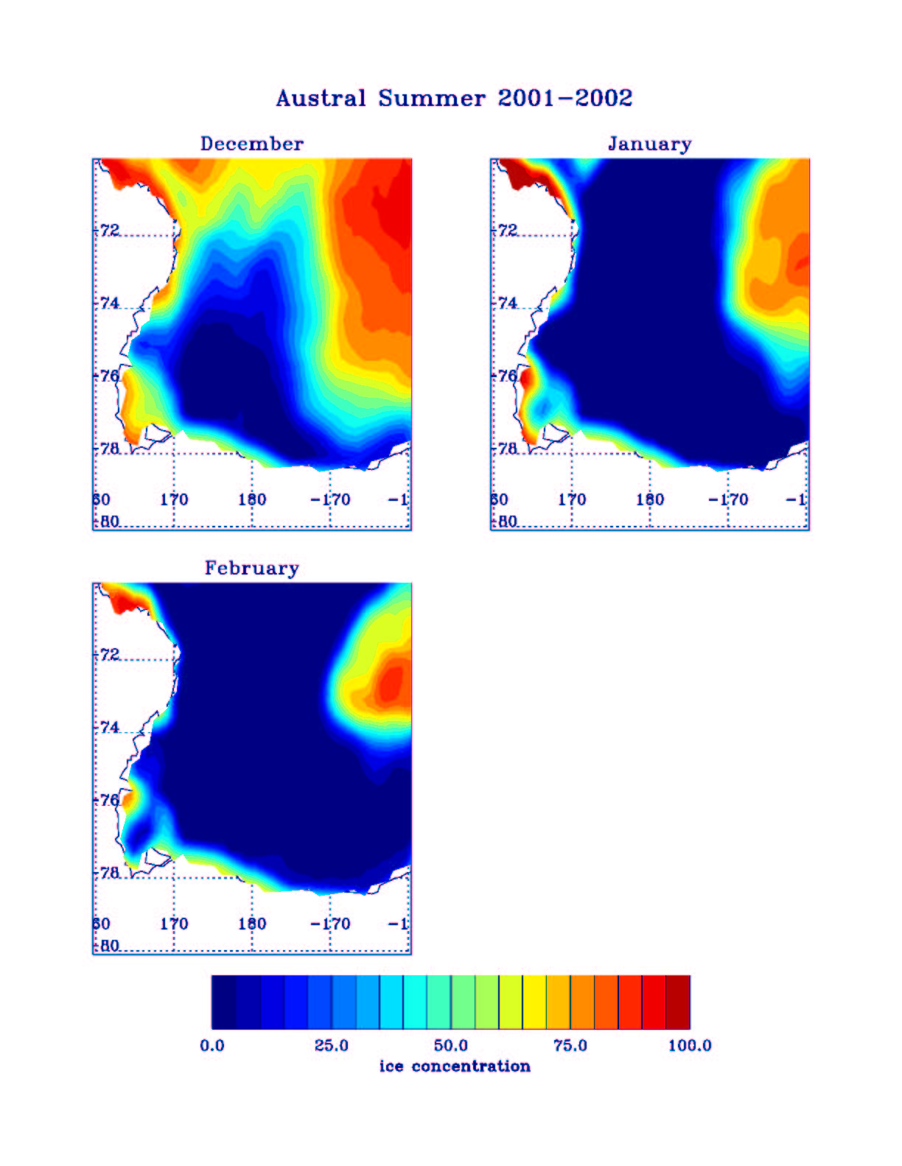
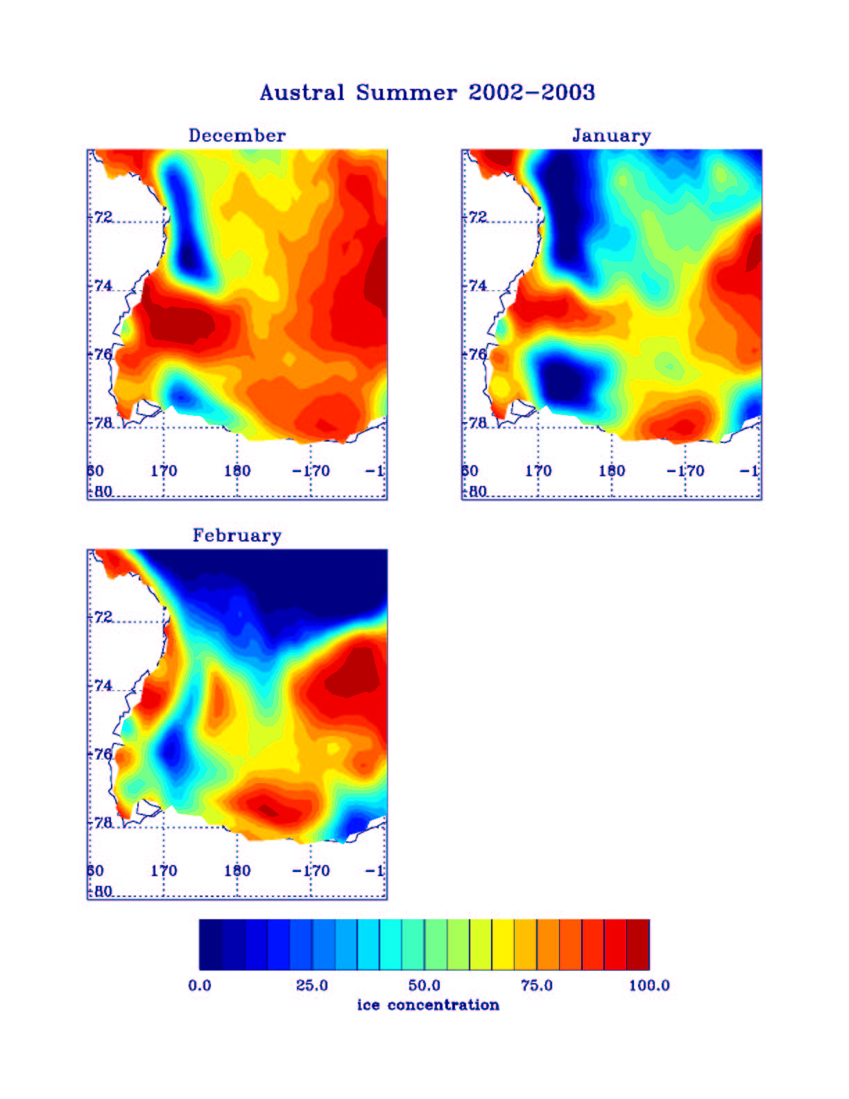
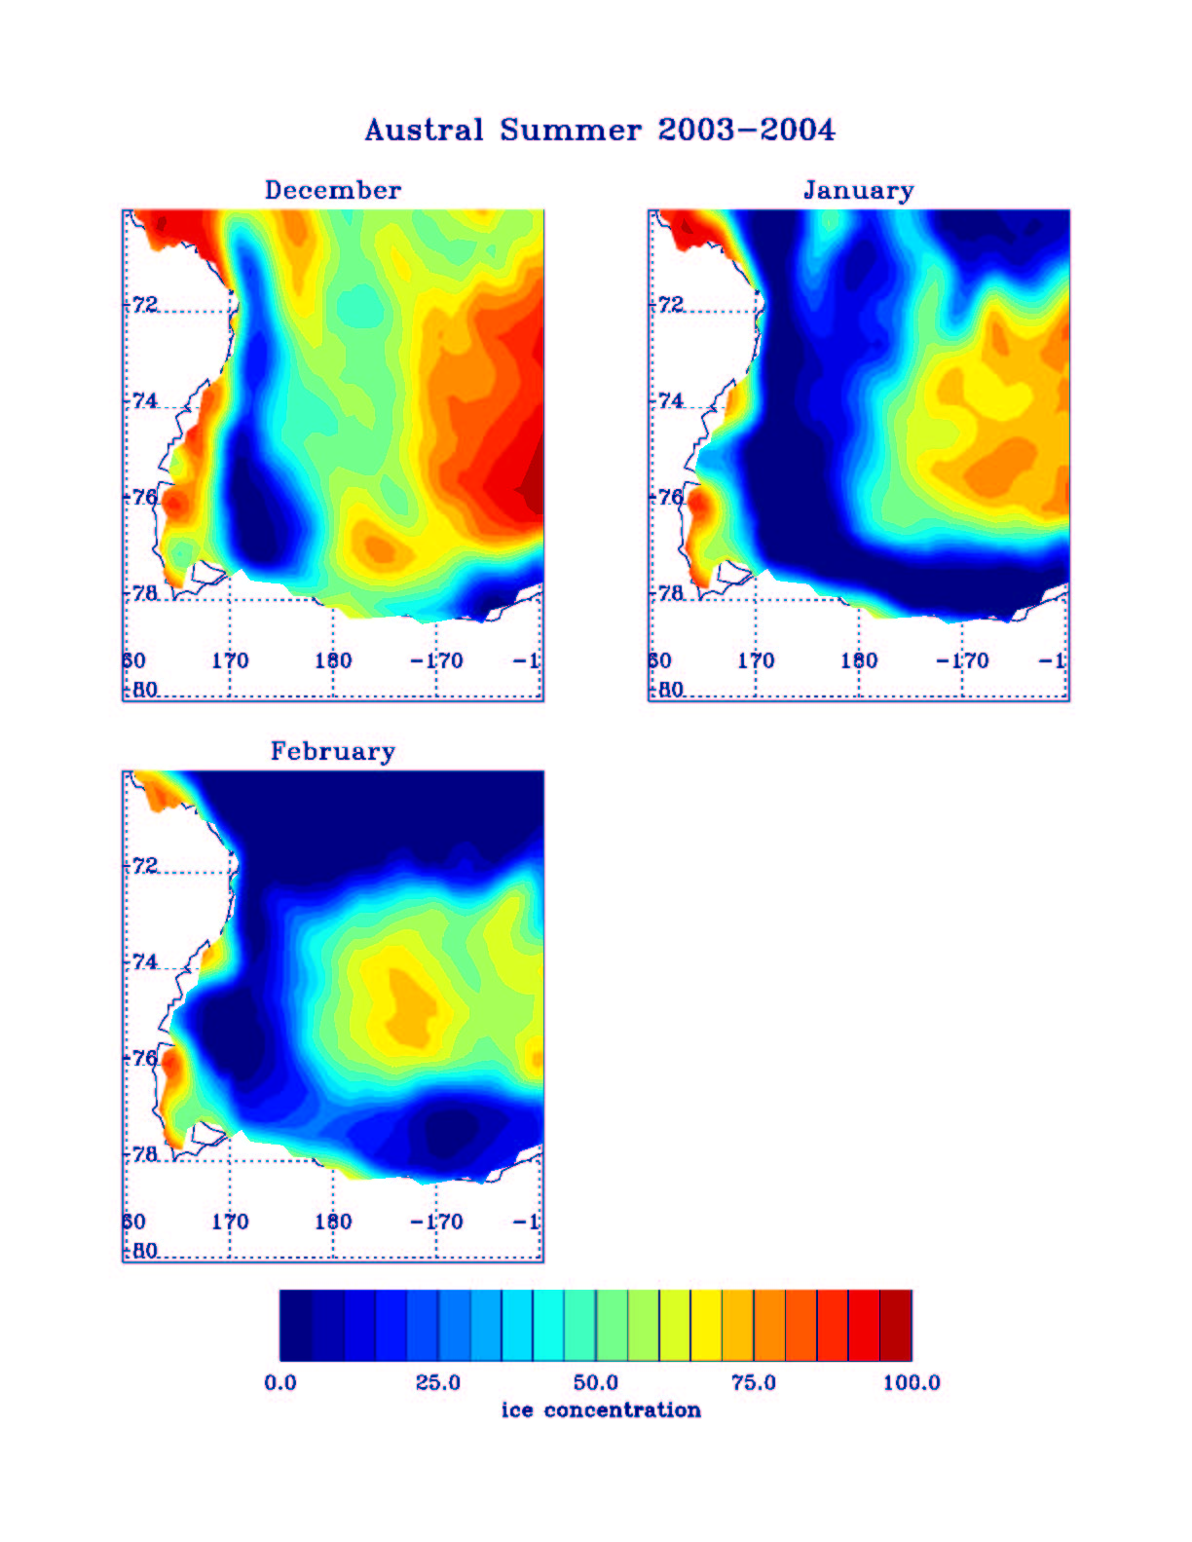
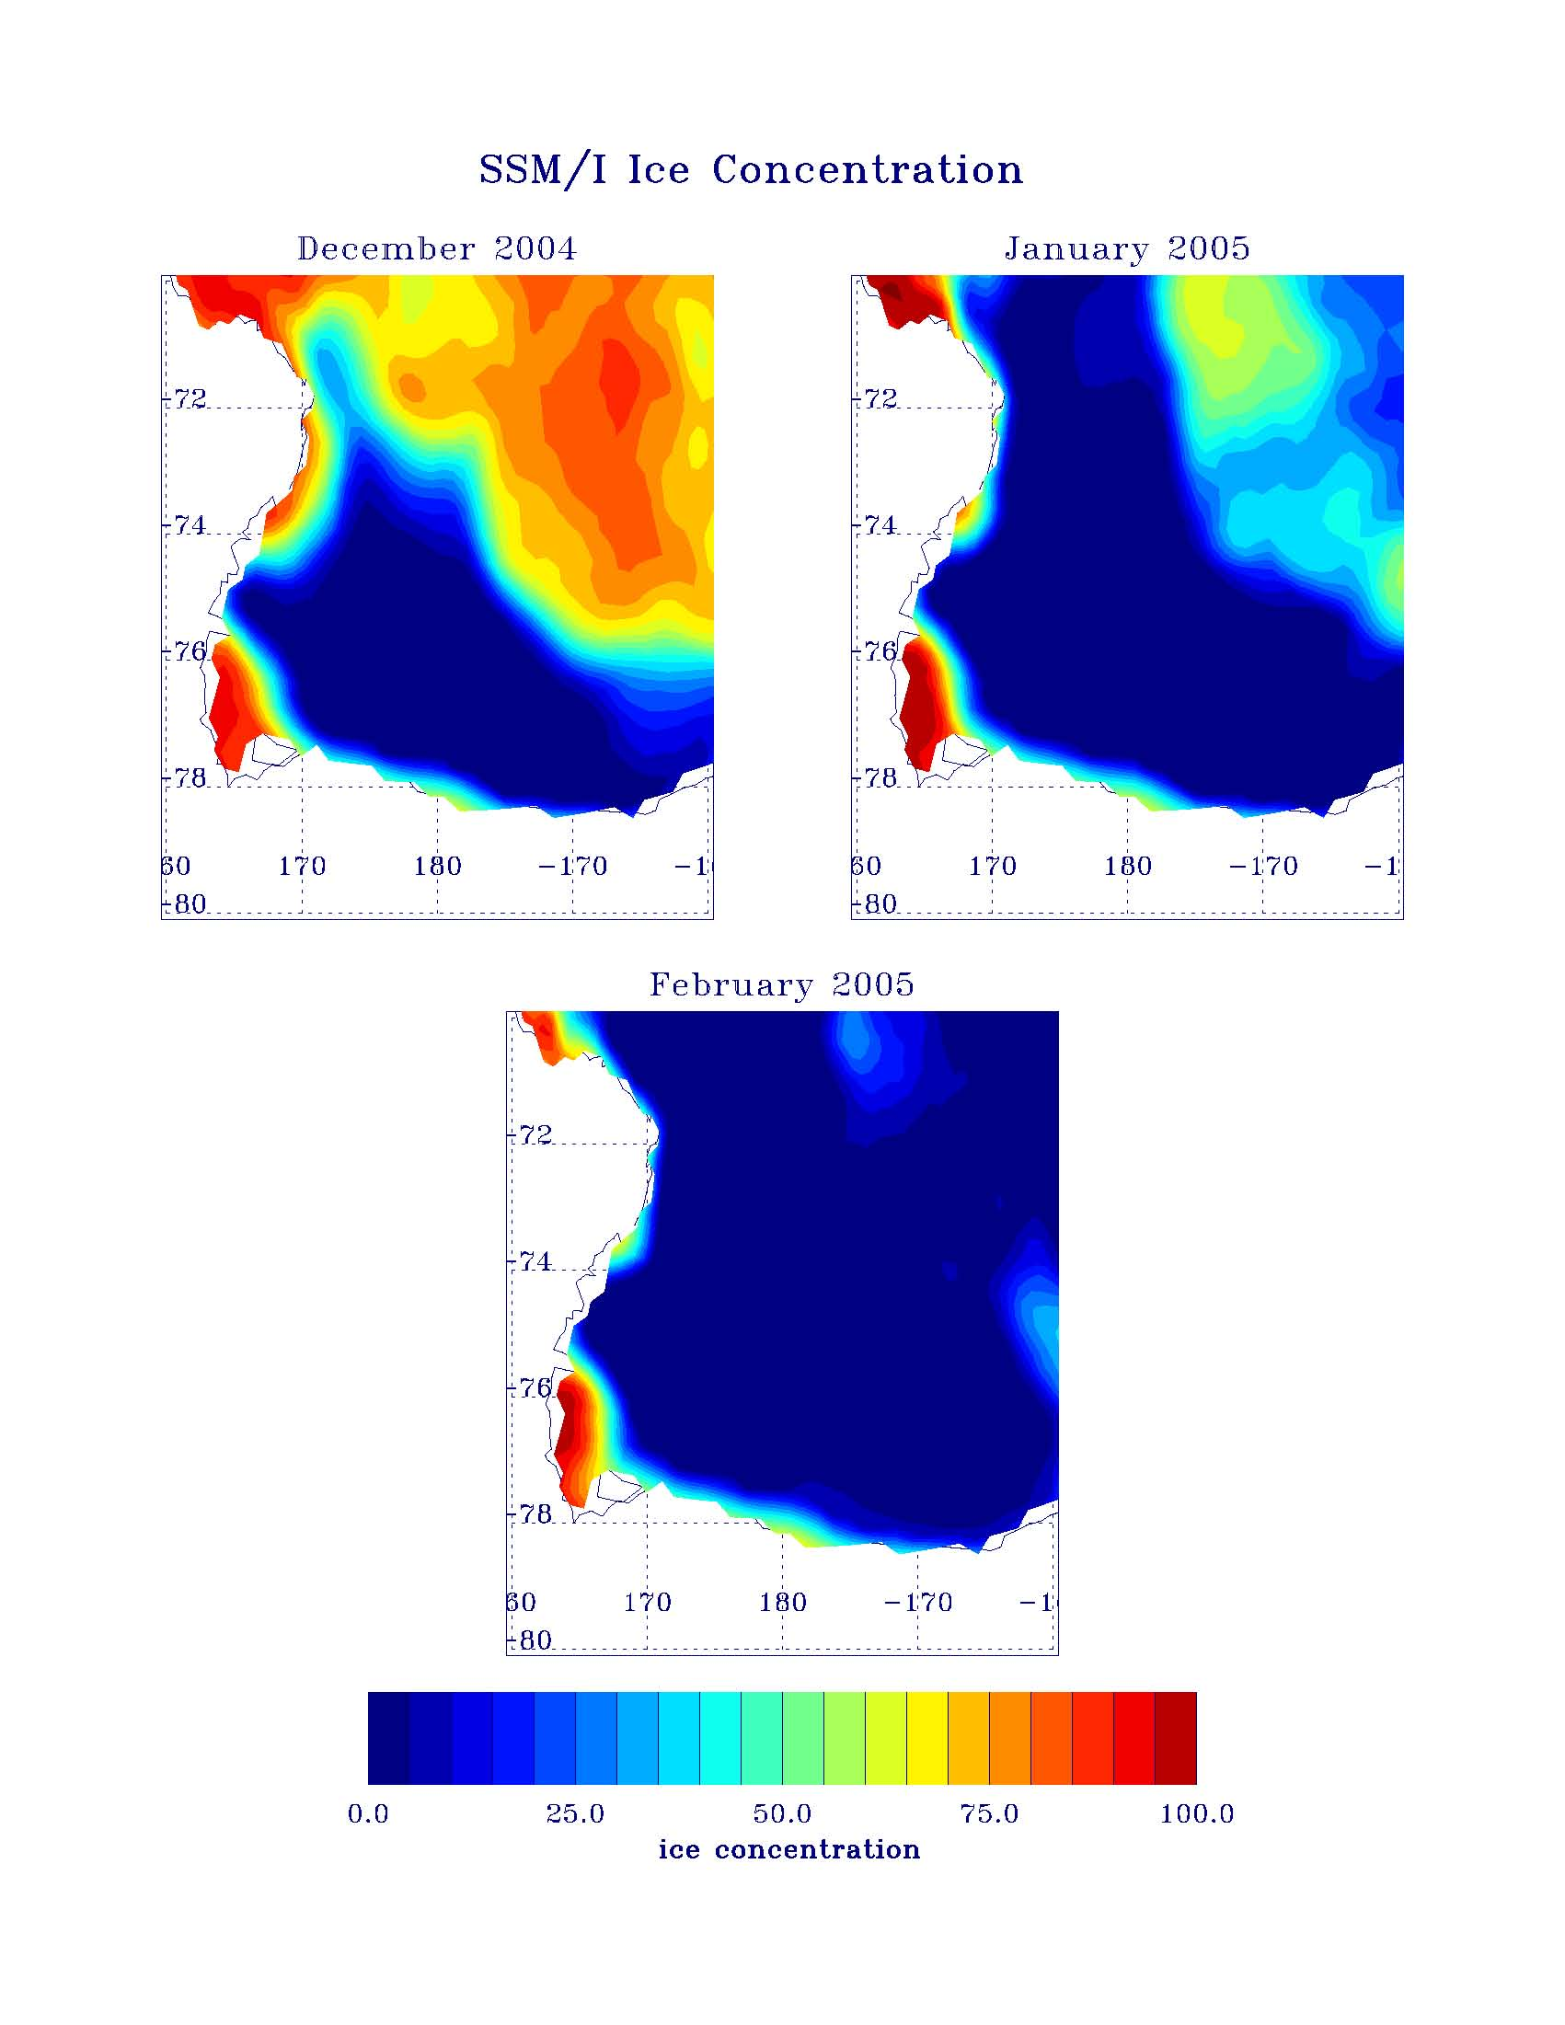
2001-2
2002-3
2003-4
2004-5
December
January
February
Ice Concentration (%)

Slide 15
Irradiance Variations in Space and Time
Because the mean daily irradiance in open waters of the water column is controlled by the depth of mixing (in addition to surface solar inputs), mixed layer depths are considered to be critical in regulating photosynthesis, and also in controlling the functional group composition (e.g., Arrigo et al., 1999)
What follows are results from a 3D ROMS model of Dinniman et al. (2011) that shows the spatial and temporal variations in mixed layers

Slide 16
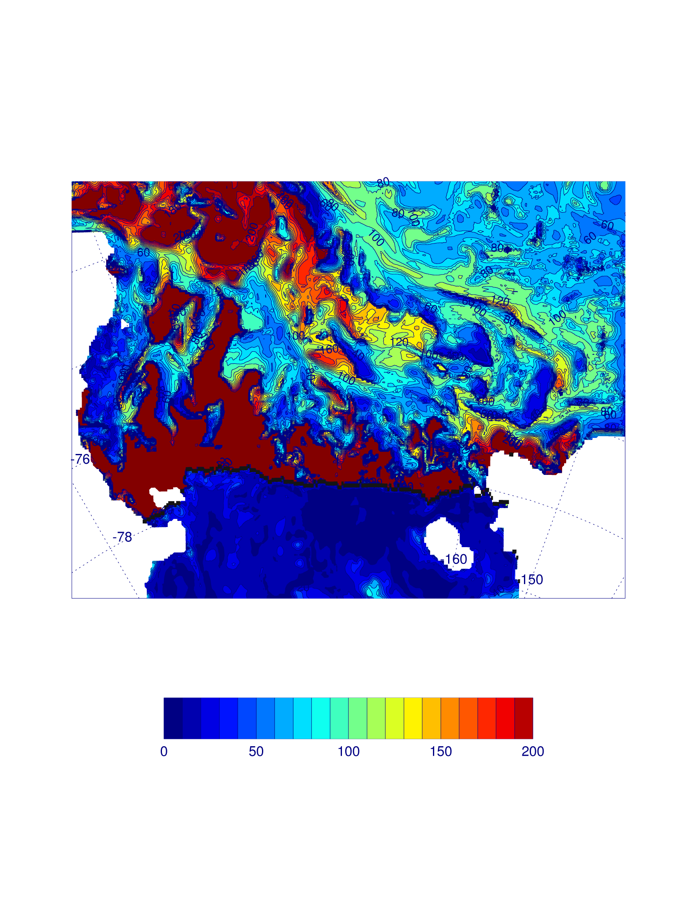
Plots provided by M. Dinniman, ODU
Mixed layer Oct. 1, 2003

Slide 17
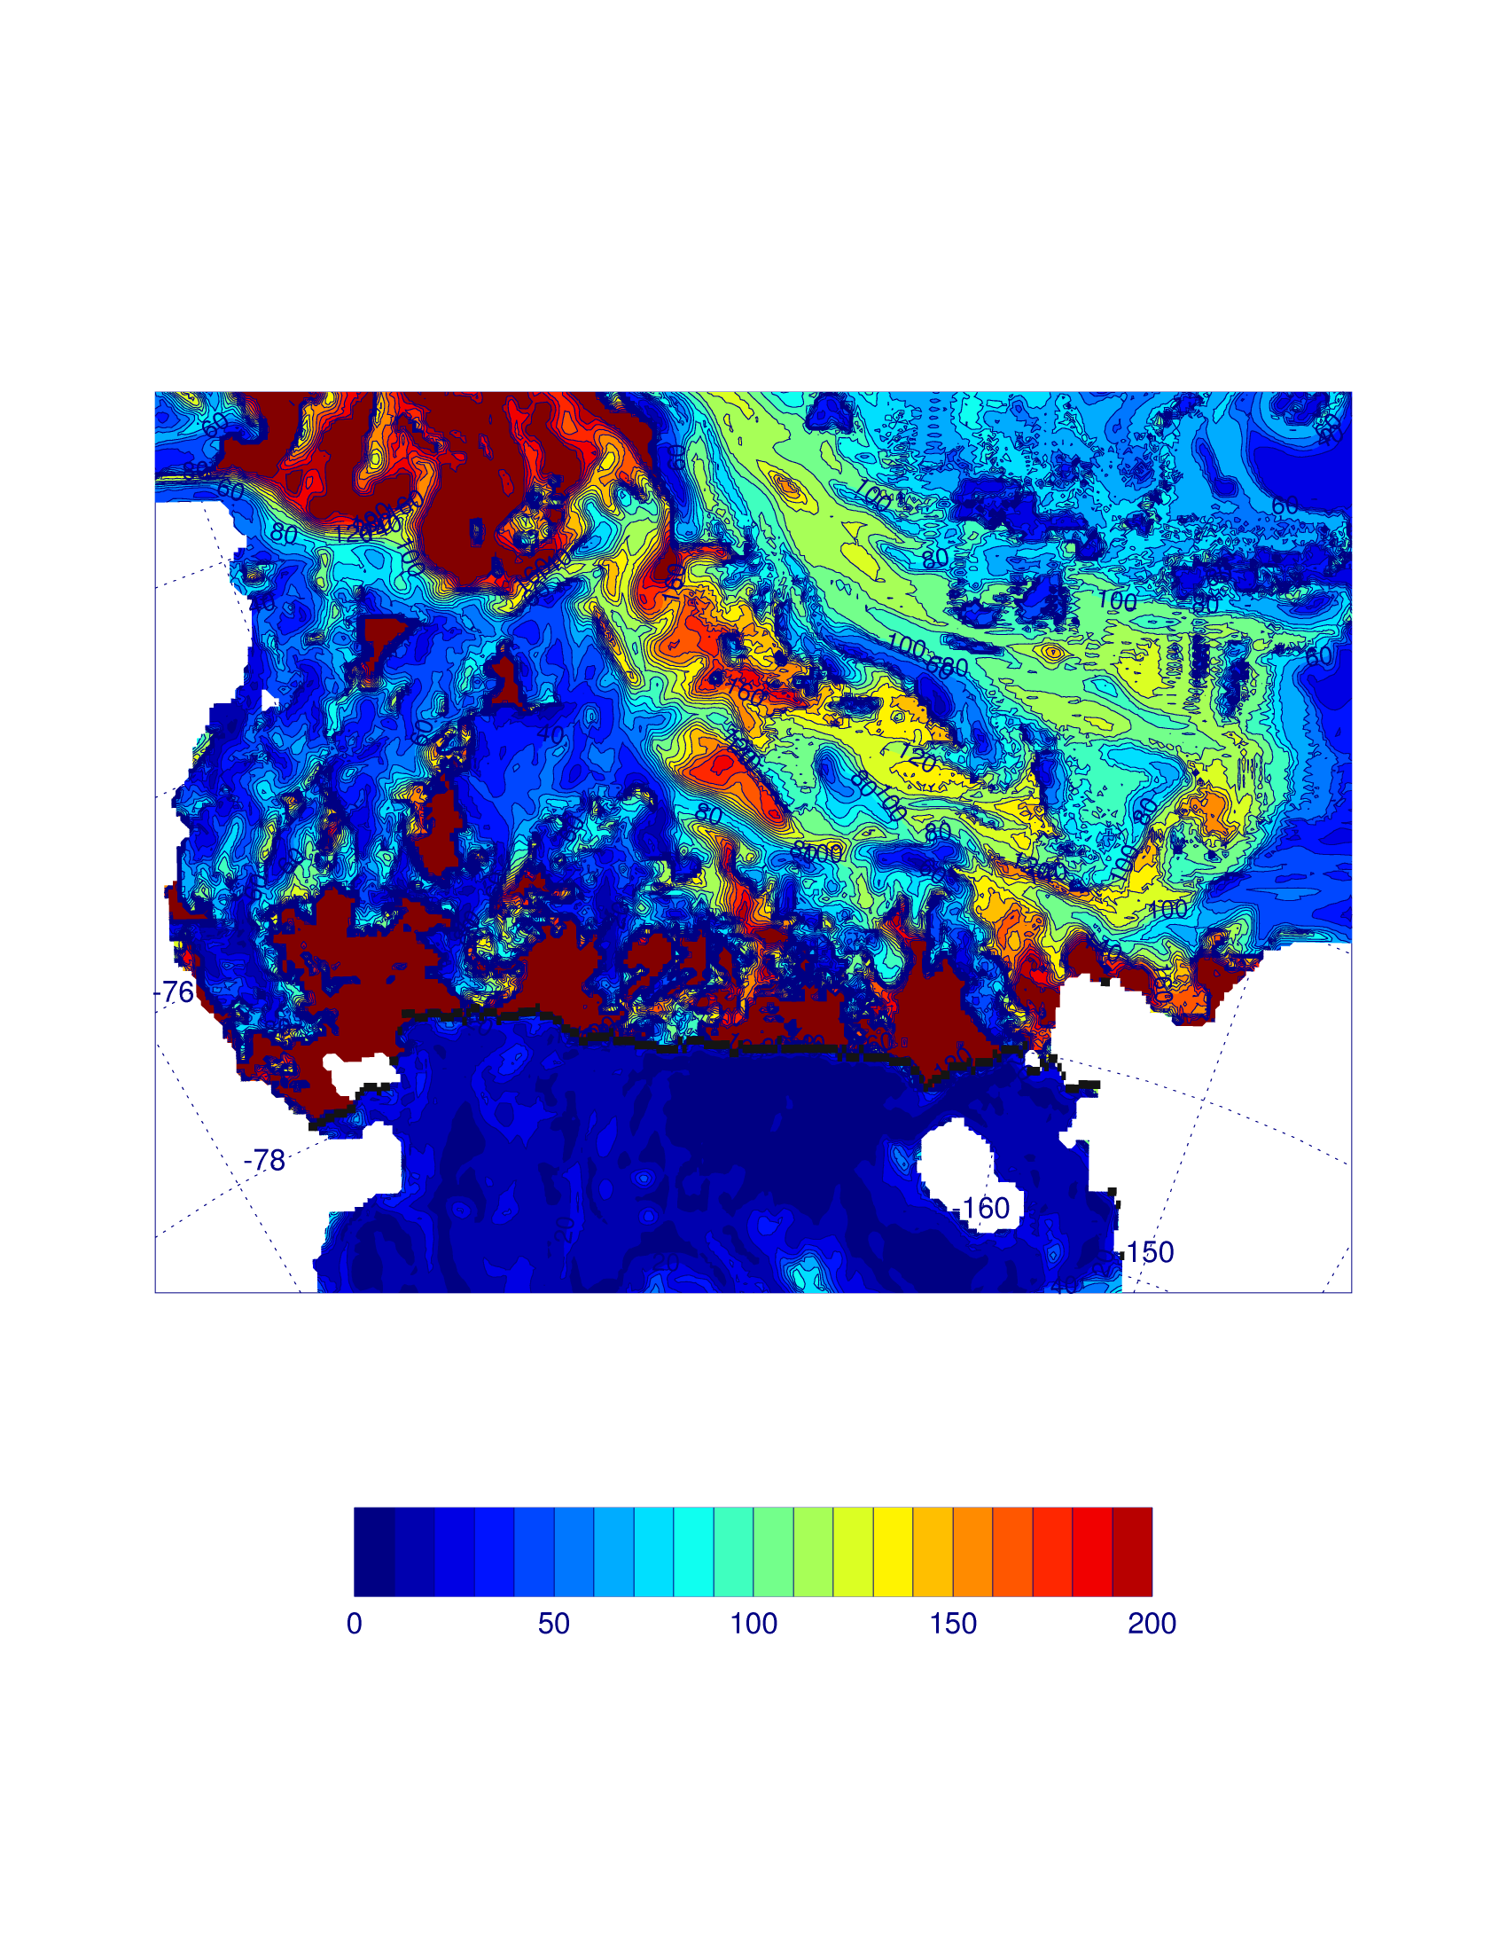
Mixed layer Oct. 31, 2003

Slide 18
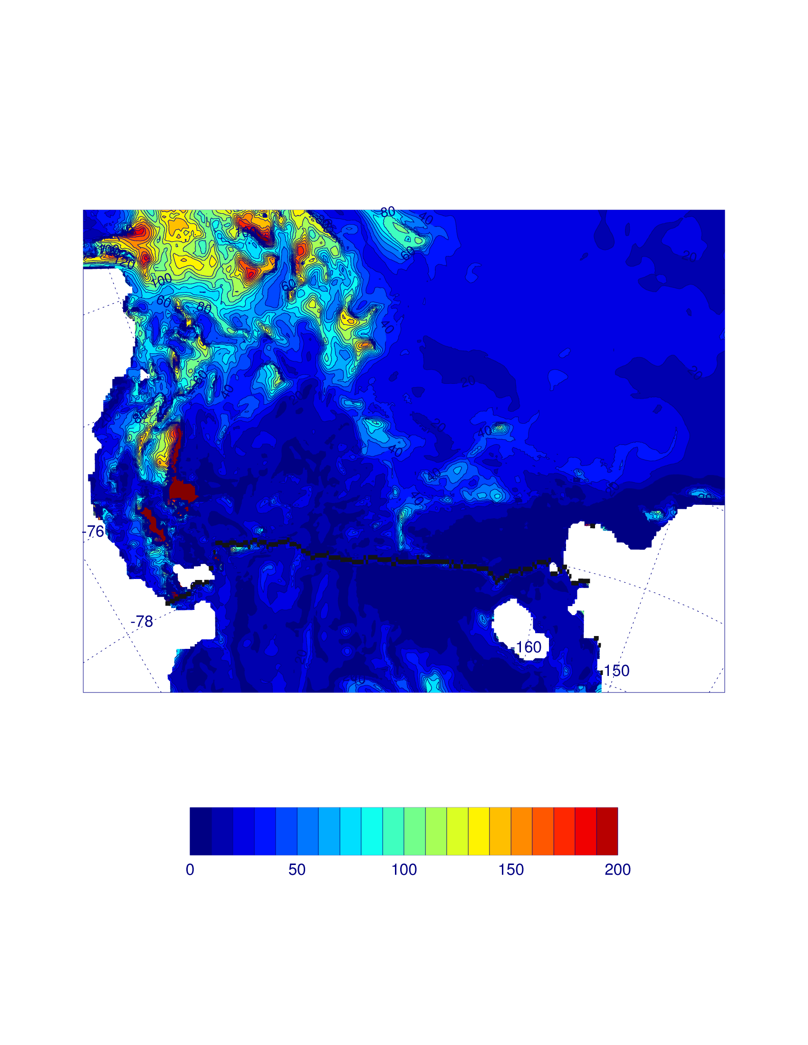
Mixed layer Nov. 31, 2003

Slide 19
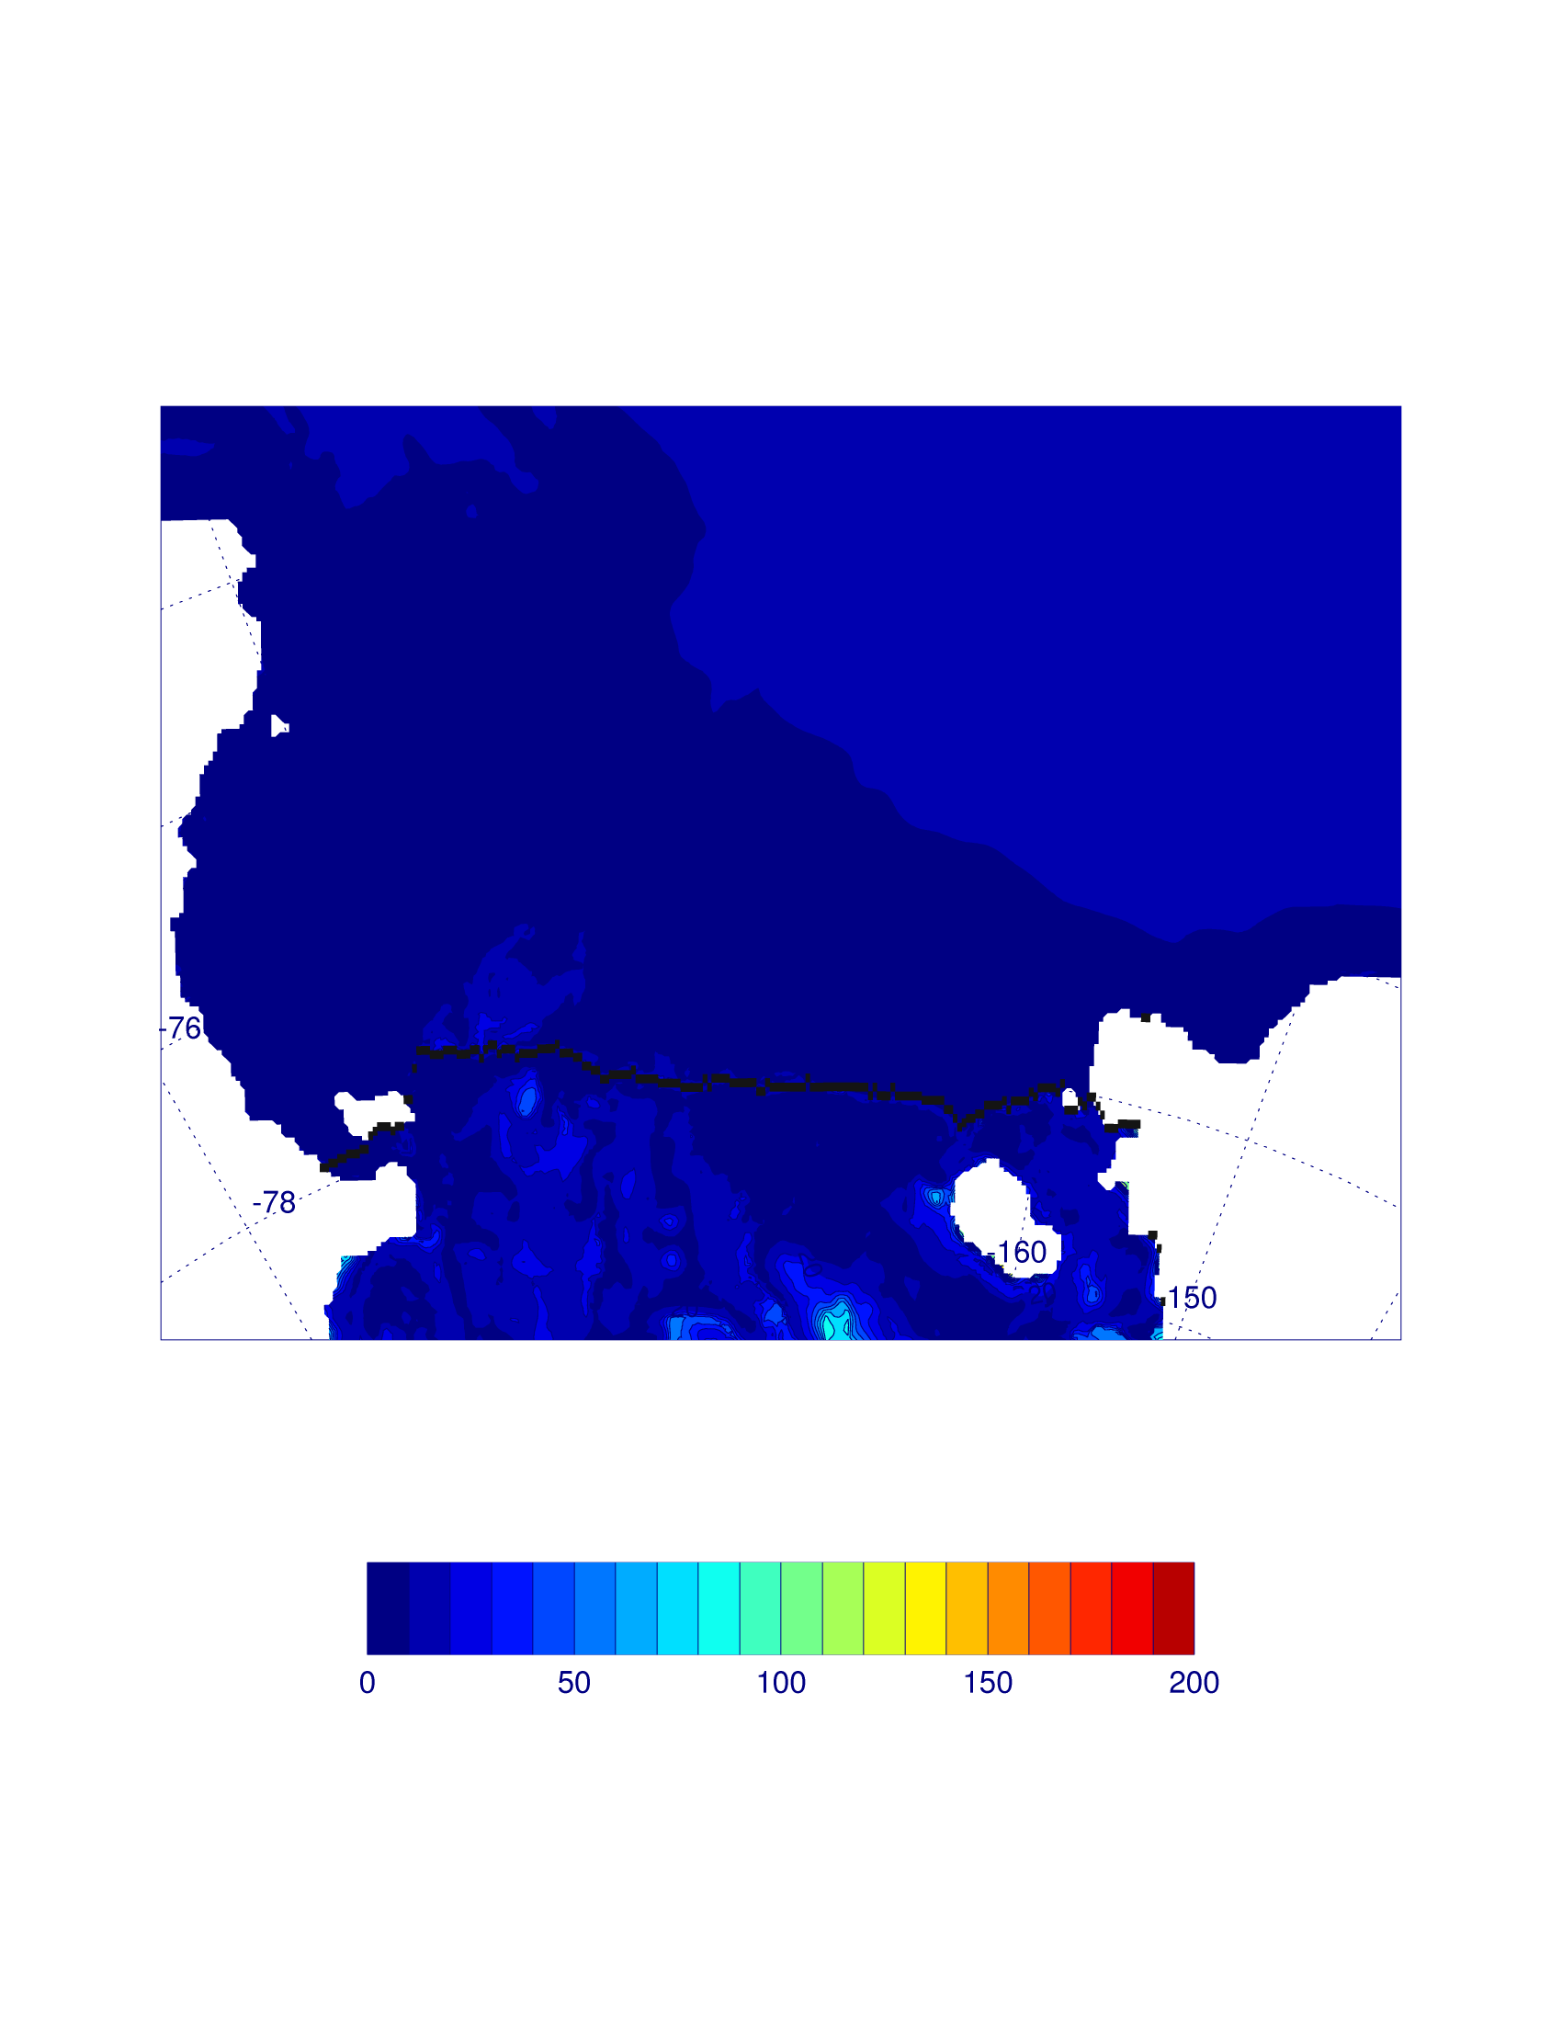
Mixed layer Dec. 31, 2003

Slide 20
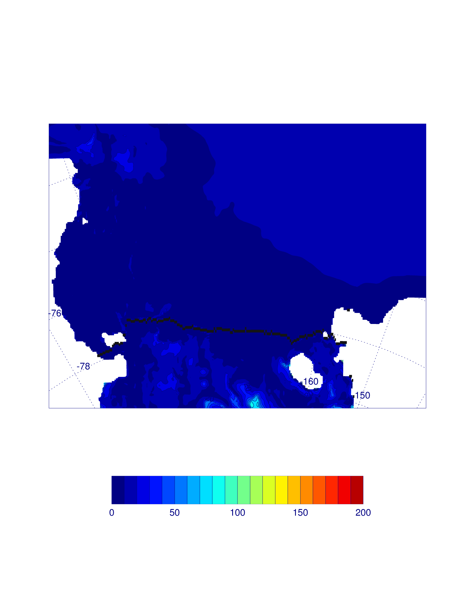
Mixed layer Jan. 31, 2004

Slide 21
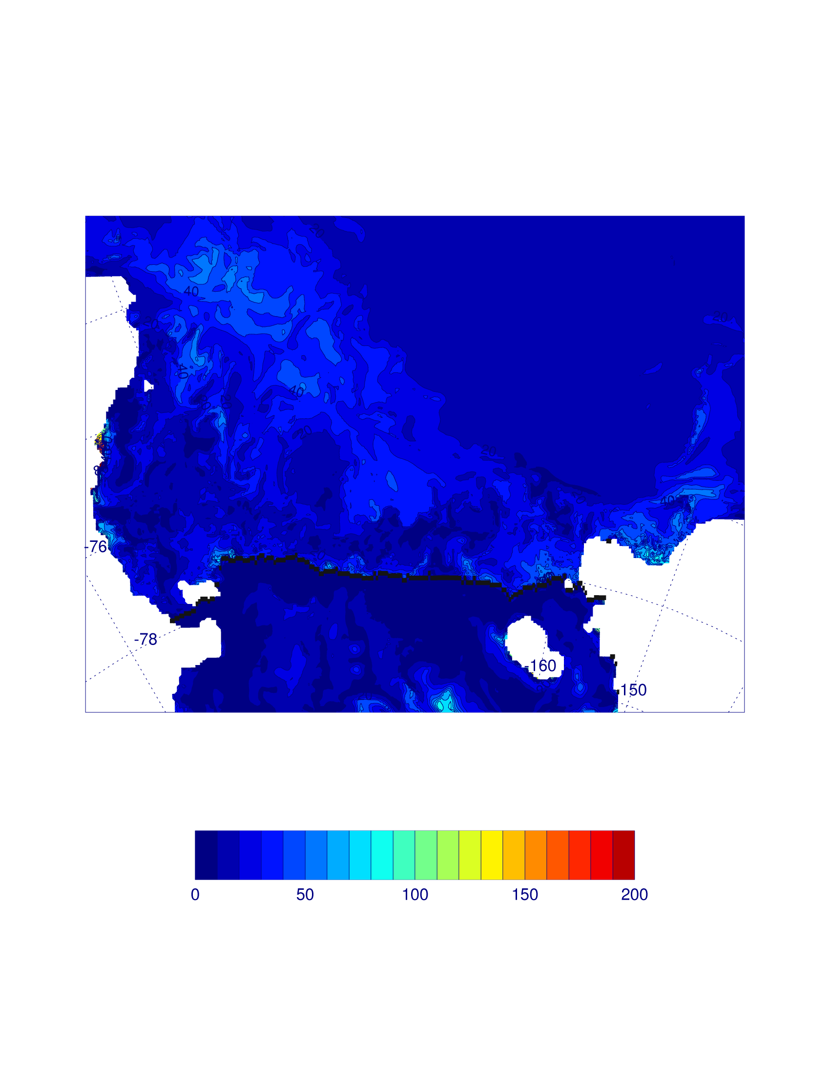
Mixed layer Mar. 1, 2004

Slide 22
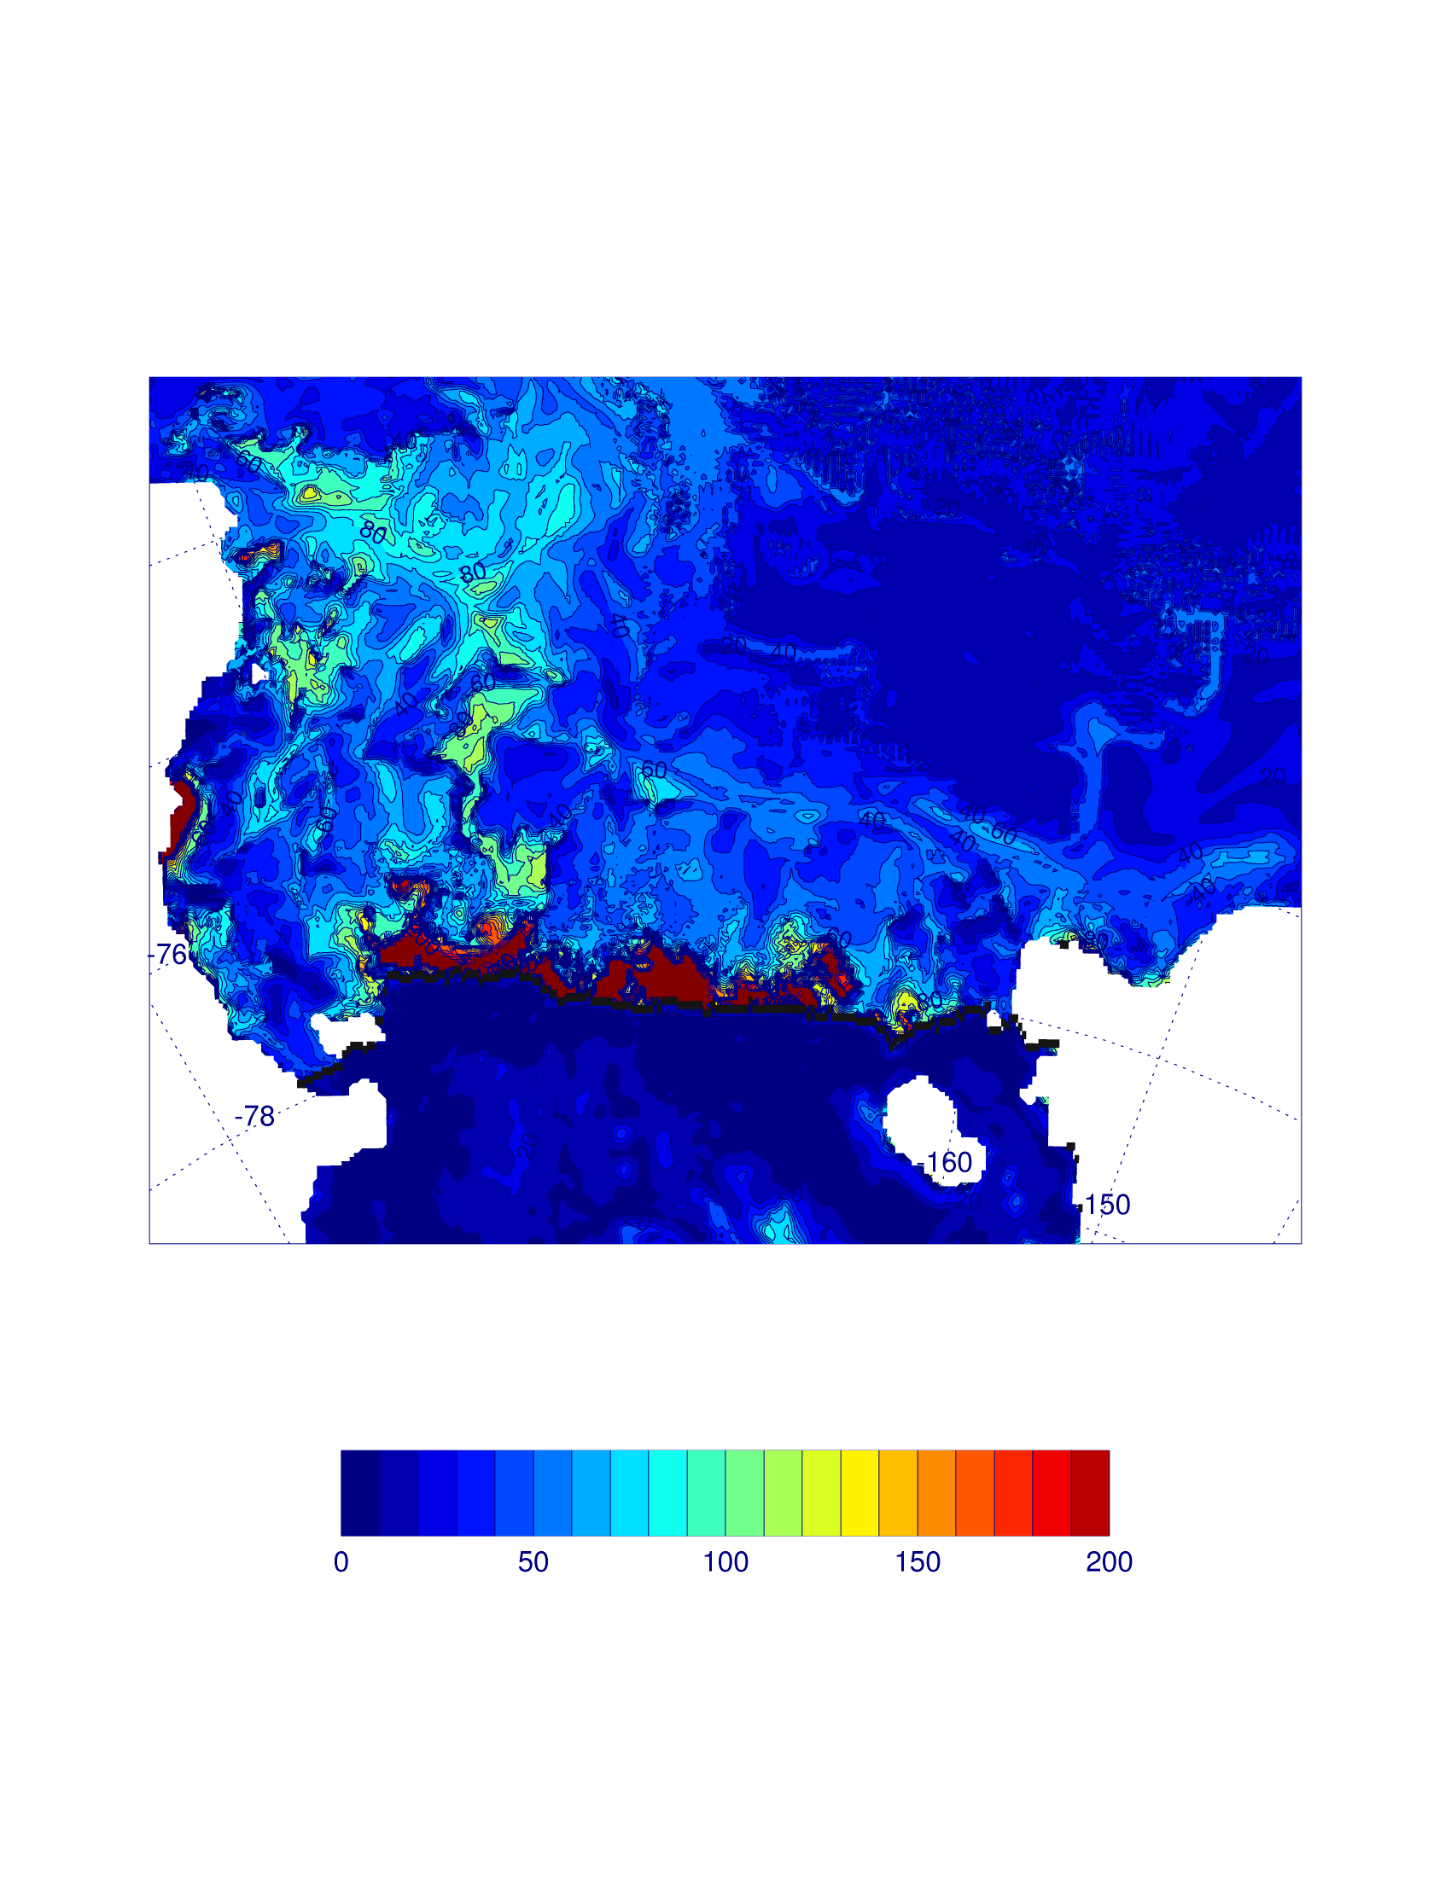
Mixed layer Mar. 31, 2004

Slide 23
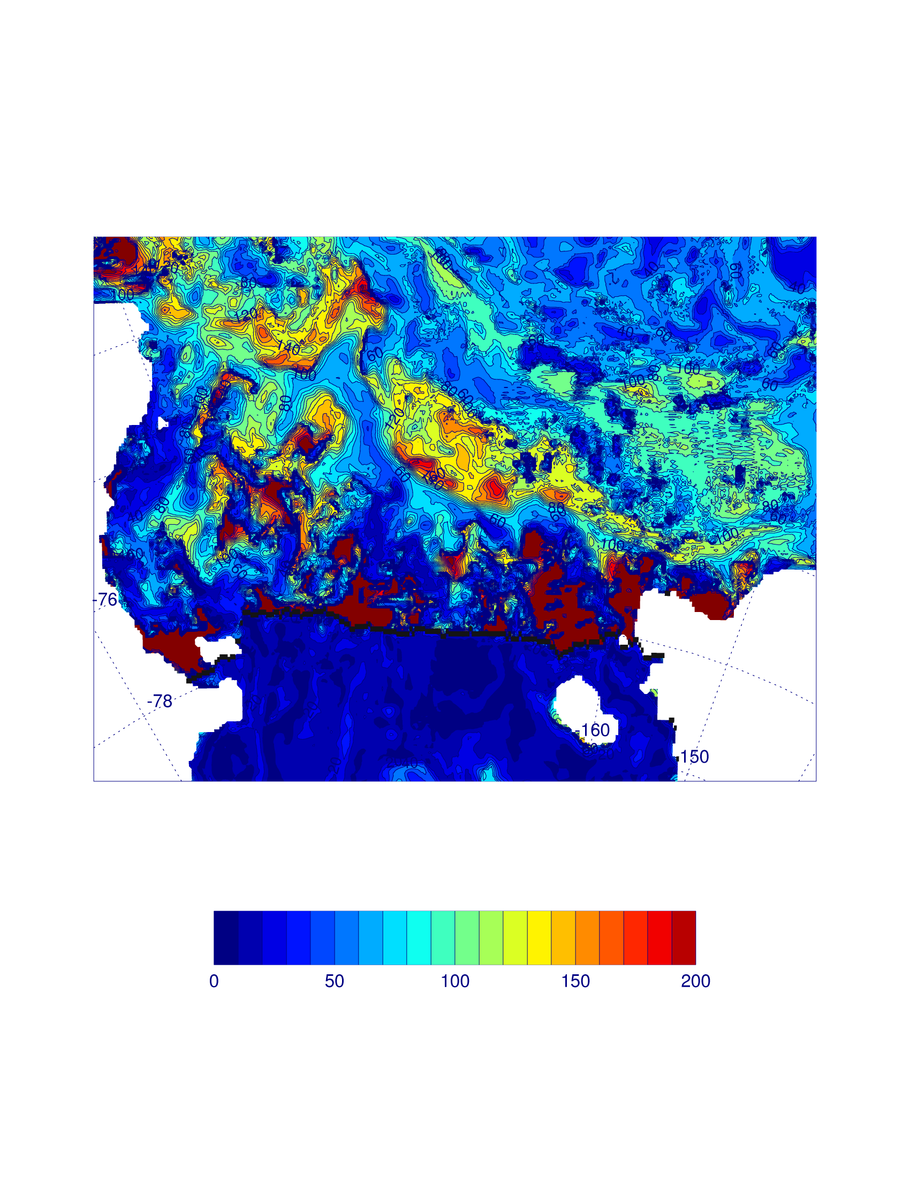
Mixed layer Oct. 1, 2004

Slide 24
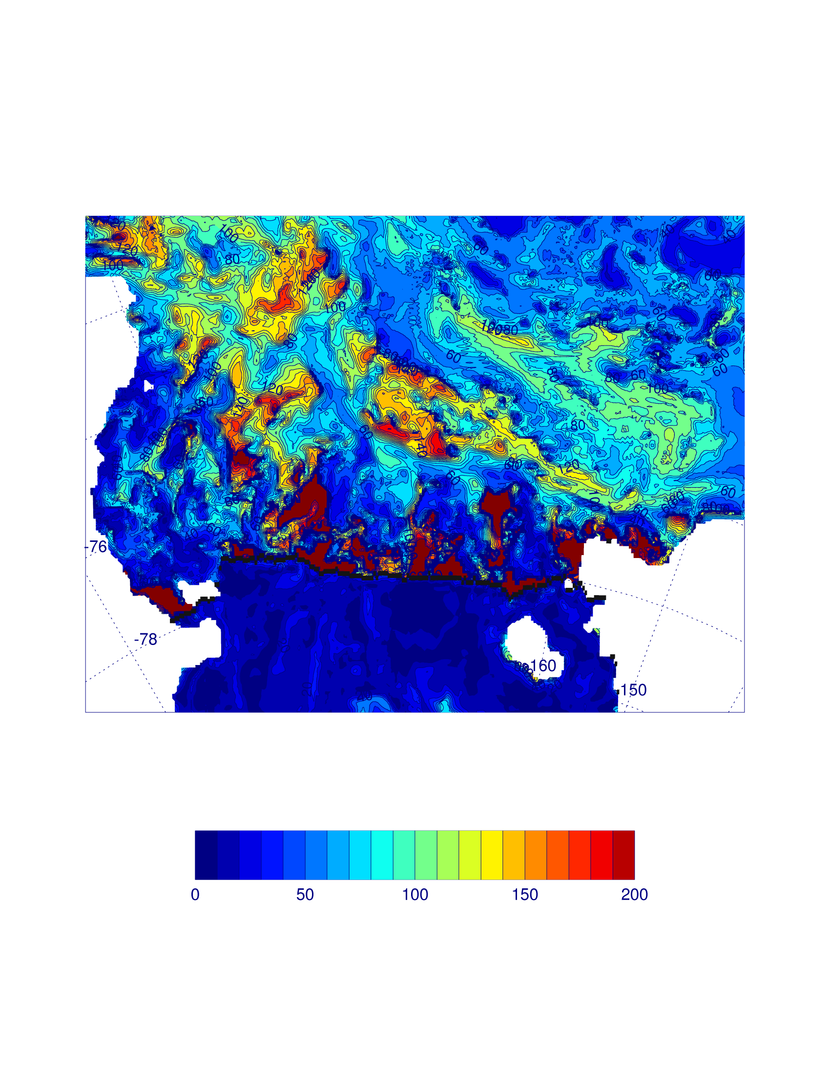
Mixed layer Oct. 31, 2004

Slide 25
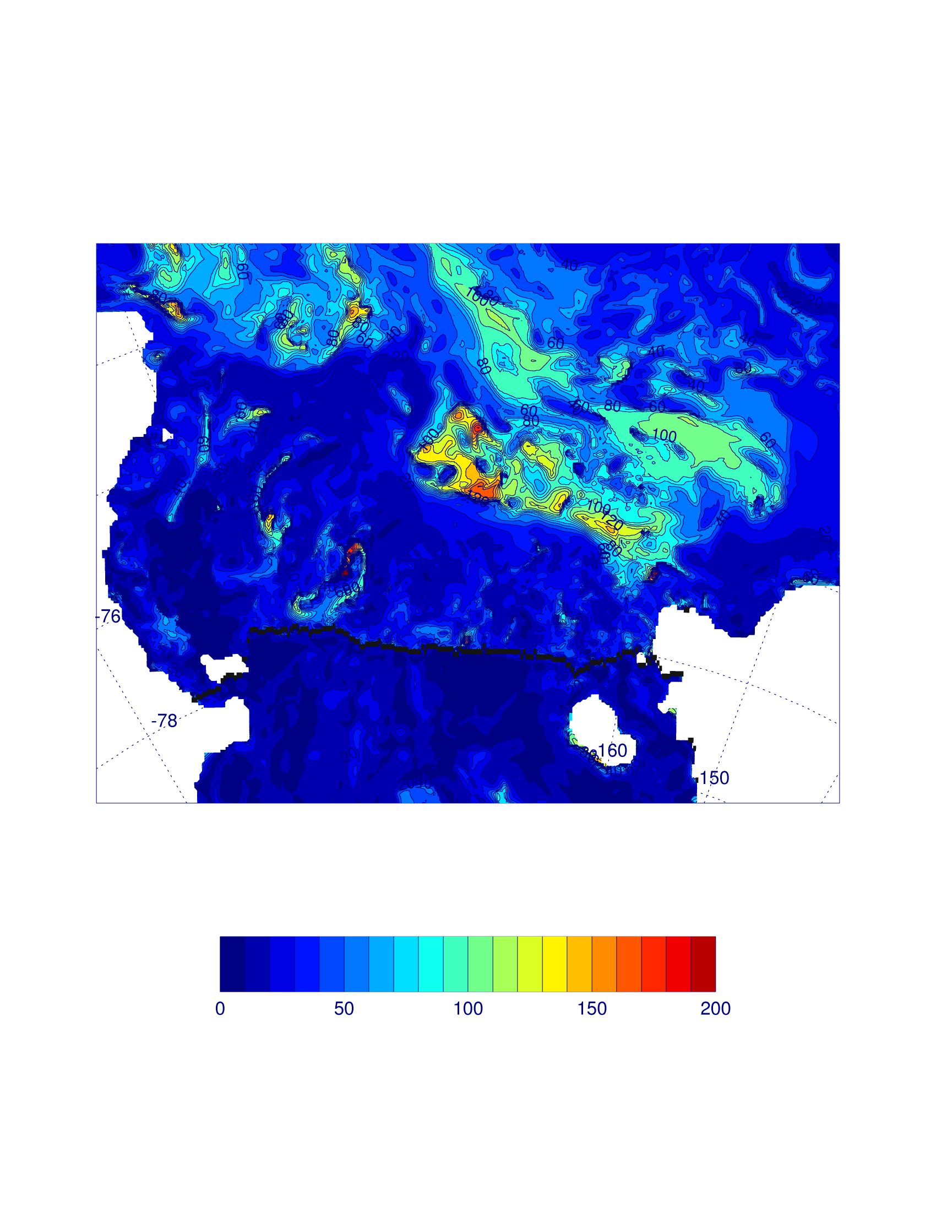
Mixed layer Nov. 31, 2004

Slide 26

Mixed layer Dec. 31, 2004

Slide 27
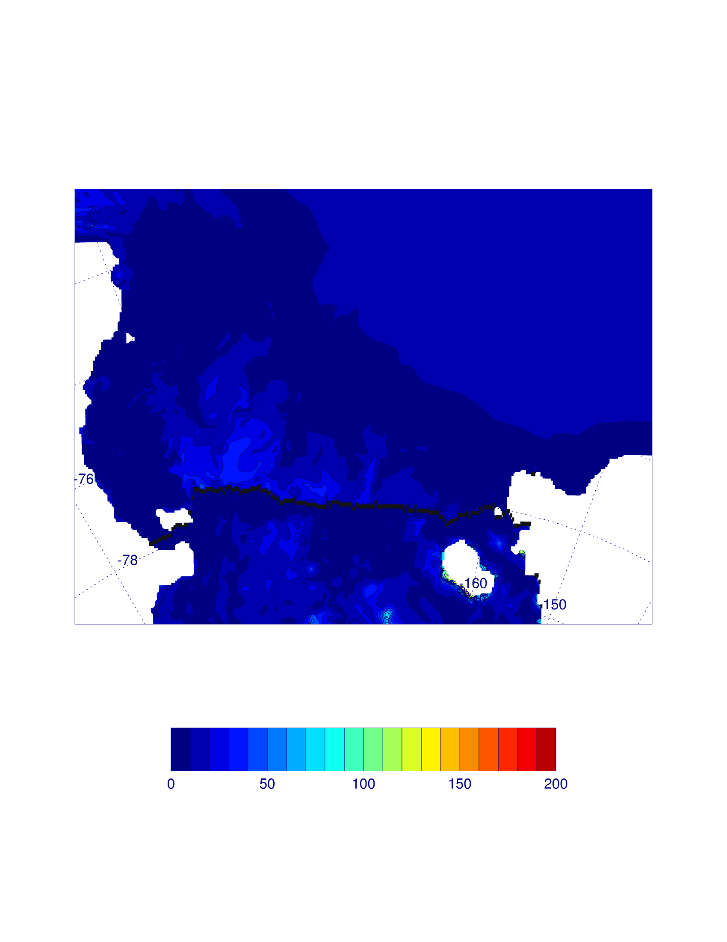
Mixed layer Jan. 31, 2005

Slide 28
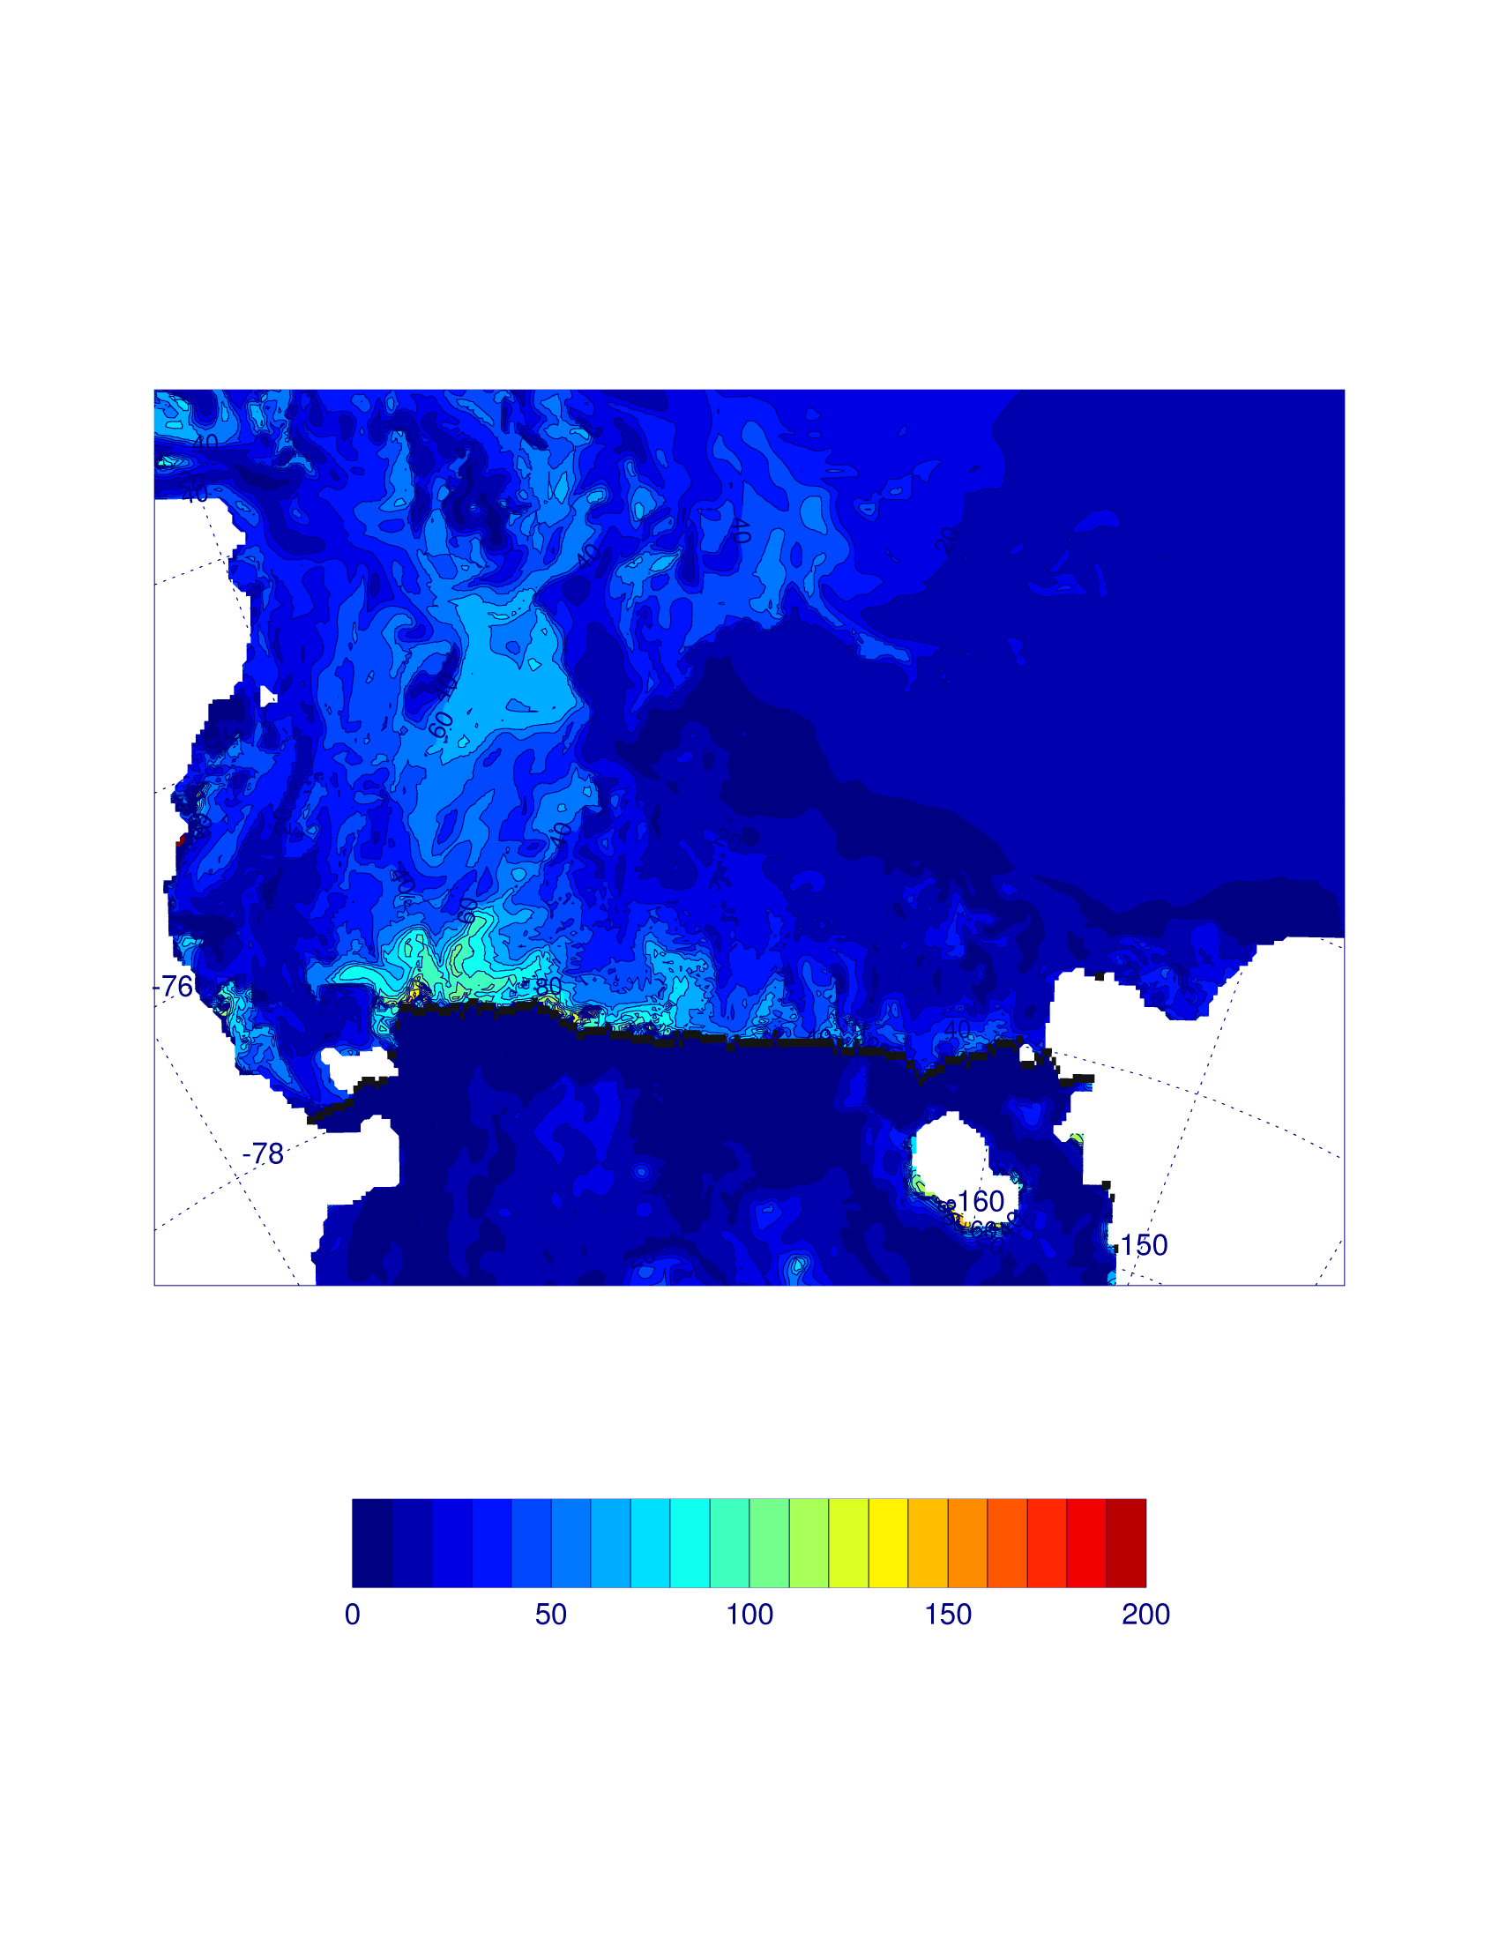
Mixed layer Mar. 1, 2005

Slide 29
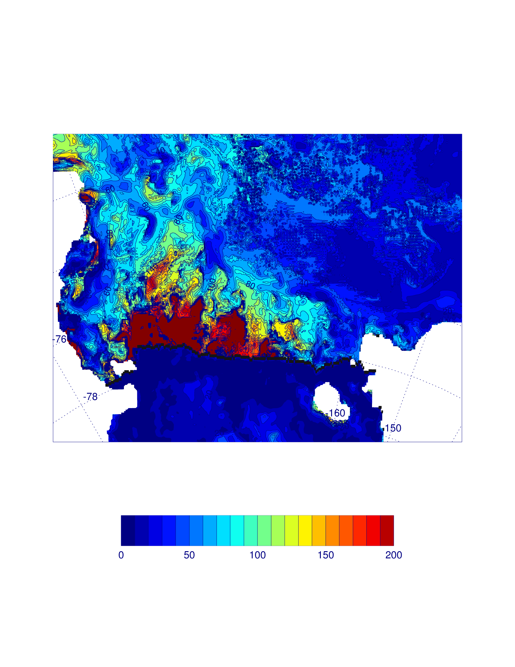
Mixed layer Mar. 31, 2005

Slide 30


Comparison between two years

Slide 31
Conclusion
Spatial variations in mixed layer depth in the model are substantial, and within the range of those observed in situ
Temporal variations – weekly, monthly and interannual variations – are also substantial, potentially influencing growth and distribution of dominant functional groups
Year | n | December Z_{mix} (m) | February Z_{mix} (m) | T_{surface} (ºC) | S_{surface} (psu) | σ_{T} (surface) | σ_{T} (50 m) | σ_{T} (150 m)
2001 - 2002 | 17 | 23.5 ± 8.78 | 36.6 ± 14.1^{a,b} | -0.64 ± 0.30^{b} | 34.31 ± 0.07^{b} | 27.58 ± 0.06^{b} | 27.63 ± 0.07^{d} | 27.76 ± 0.05
2002 -2003 | 2 | 33.5 ± 9.65 | 52.0 ± 5.7^{b} | -1.82 ± 0.05^{b} | 34.09 ± 0.02^{c} | 27.44 ± 0.02^{c,d} | 27.45 ± 0.04^{c} | 27.80 ± 0.01
2003 -2004 | 27 | 19.1 ± 8.59 | 20.4 ± 10.8 | -0.95 ± 0.39 | 33.89 ± 0.15 | 27.26 ± 0.11 | 27.55 ± 0.11 | 27.74 ± 0.09
ª: Significantly different from December, 2001-2 (Student’s t test, p < 0.05)
^{b}: Significantly different from February, 2003-4 (Student’s t test, p < 0.01)
^{c}: Significantly different from February, 2001-2 (Student’s t test, p < 0.01)
^{d}: Significantly different from February, 2003-4 (Student’s t test, p < 0.05)
Smith et al., (2006)

Slide 33
Variations in macronutrients occur, but reflect the dominance and biological uptake of the dominant functional groups (diatoms and haptophytes)
Year and Period | NO₃ (µM) | Si(OH)₄ (µM) | Chloroyll a (µg L⁻¹)
December, 2001 | 23.1 ± 2.03^{a,c} | 77.7 ± 1.44^{a,b} | 5.86 ± 1.99^{b,d}
February, 2002 | 20.2 ± 1.61^{a,b} | 57.6 ± 3.21^{1a,b} | 5.61 ± 1.88^{a,b}
December, 2003 | 21.8 ± 3.21ª | 69.1 ± 4.04ª | 5.74 ± 2.80^{d}
February, 2004 | 17.7 ± 3.07ª | 49.9 ± 7.62ª | 9.44 ± 3.87ª
December climatology | 19.1 ± 3.41 | 73.6 ± 1.65 | 4.97 ± 1.21
February climatology | 17.3 ± 1.04 | 61.9 ± 2.10 | 0.99 ± 0.16
Variations, particularly in silicic acid, can be large
Smith et al. (2006)

Slide 34
Variations in macronutrients occur, but reflect the dominance and biological uptake of the dominant functional groups (diatoms and haptophytes)
Element/ Year | Spring NCP (g C m⁻²) | Daily Spring Production (g C m⁻² d⁻¹) | Summer NCP (g C m⁻²) | Daily Summer Production (g C m⁻² d⁻¹) | Annual NCP (g C m⁻²) | Daily Annual Production (g C m⁻² d⁻¹)
Nitrogen
2001-02 | 51.1 | 1.02 | 13.8 | 0.30 | 61.7 | 0.64
2003-04 | 41.4 | 0.75 | 123 | 2.94 | 252 | 2.60
2004-05 | 56.6 | 1.09 | 20.7 | 0.57 | 72.4 | 0.80
2005-06 | 75.2 | 1.27 | 17.8 | 0.57 | 89.8 | 0.98
Silicon
2001-02 | 10.5 (20.5) | 0.19 | 26.6 (192) | 0.76 | 35.0 (56.7) | 0.36
2003-04 | 14.3 (34.5) | 0.26 | 90.4 (73.3) | 2.15 | 105 (41.5) | 1.08
2004-05 | 20.6 (36.4) | 0.40 | 23.7 (144) | 0.66 | 27.9 (38.6) | 0.31
2005-06 | 8.15 (10.8) | 0.14 | 3.37 (19.0) | 0.11 | 11.5 (12.8) | 0.13
Contribution of diatoms to total annual productivity averages 38% and varies from 13 to 56%
Smith et al. (2011b)

Slide 35
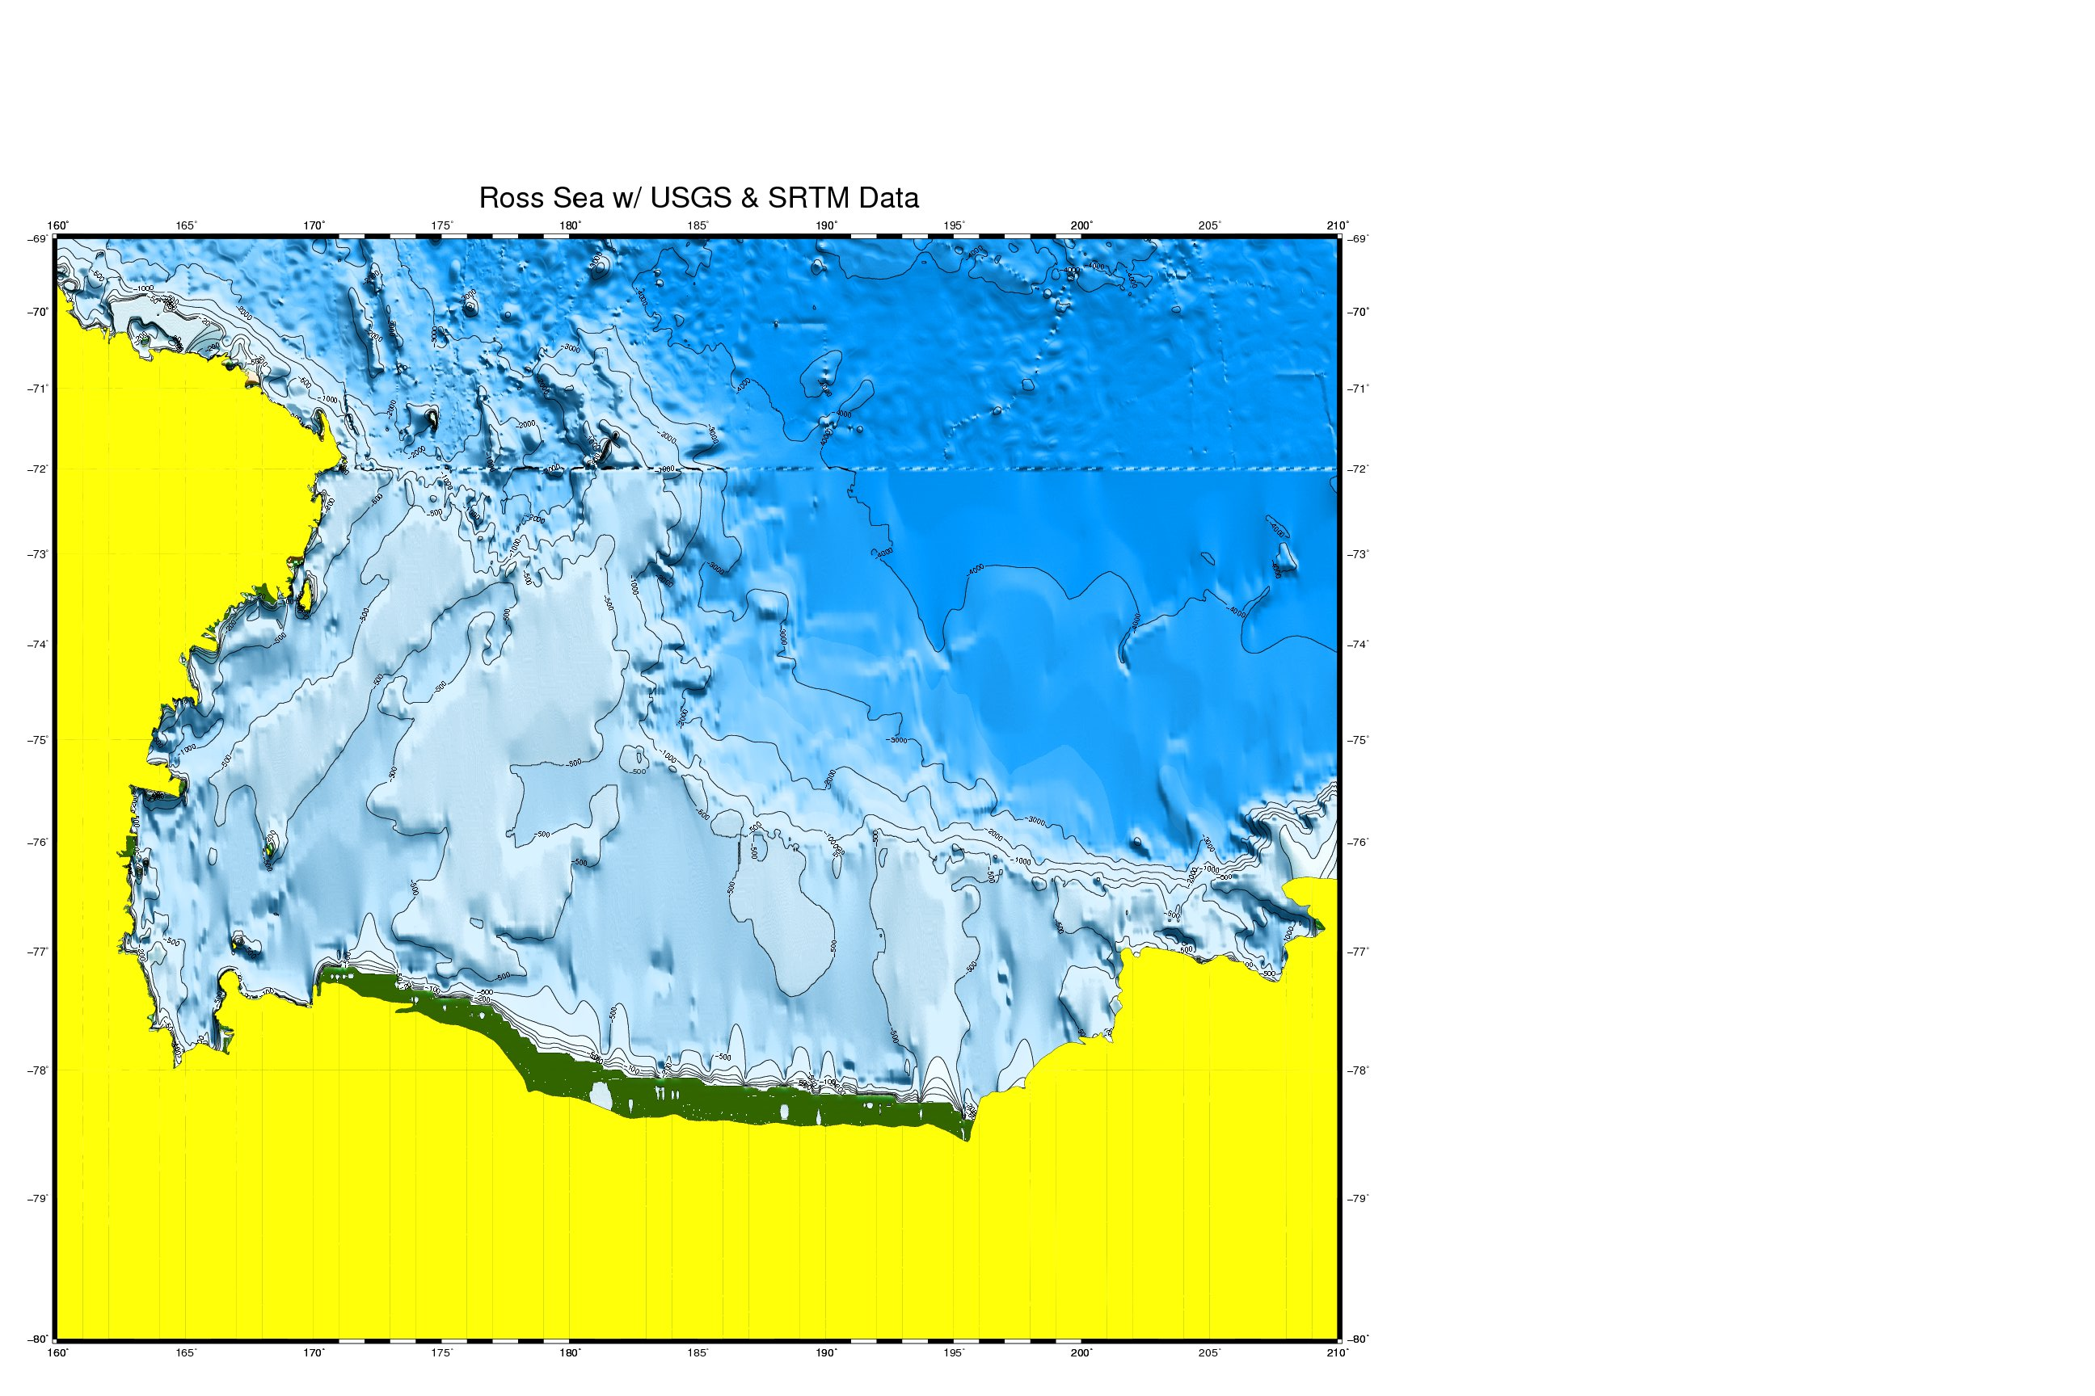
Potential Fe inputs
From land
From Depth
< 500 m
From ice shelf
From sea ice
From vertical mixing
From S. Stammerjohn

Slide 36
All of the potential sources likely vary in time, and certainly vary in space (sea ice inputs; ice shelf inputs)
An additional limitation for deep water sources (e.g., benthic regeneration, ice shelf water, MCDW inputs) is that the mechanism of getting the Fe into the surface layer is unknown, although a number of potential mechanisms exist
Despite these limitations, evidence exists that Fe inputs do indeed occur during summer during some years

Slide 37
Nov
Dec
a)
Jan
Feb
Peloquin and Smith (2007)

Slide 38
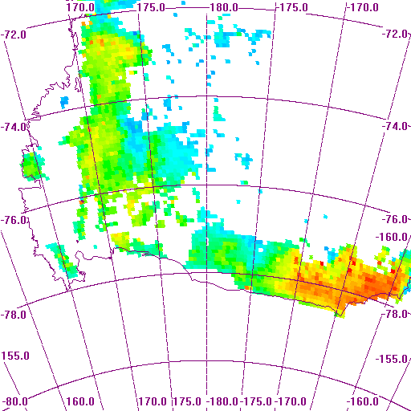
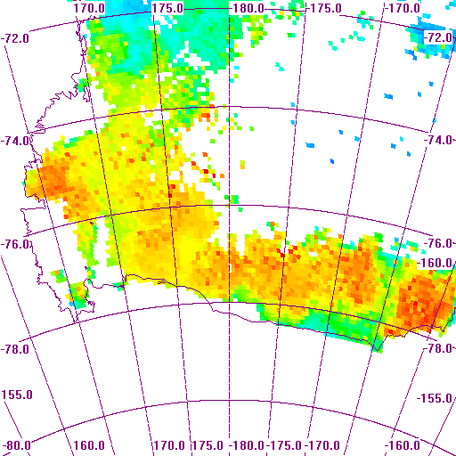

60
10
3
1
0.3
0.03
0.01
Peloquin and Smith (2007)

Slide 39
Loss Processes: the big unknown
Losses due to herbivory are largely unknown due to the difficulty of assessing biomass of the dominant grazers and their rates
Rates of aggregate formation can only be surmised from stocks
Despite those difficulties, losses due to herbivory do appear to vary tremendously with time and space

Slide 40
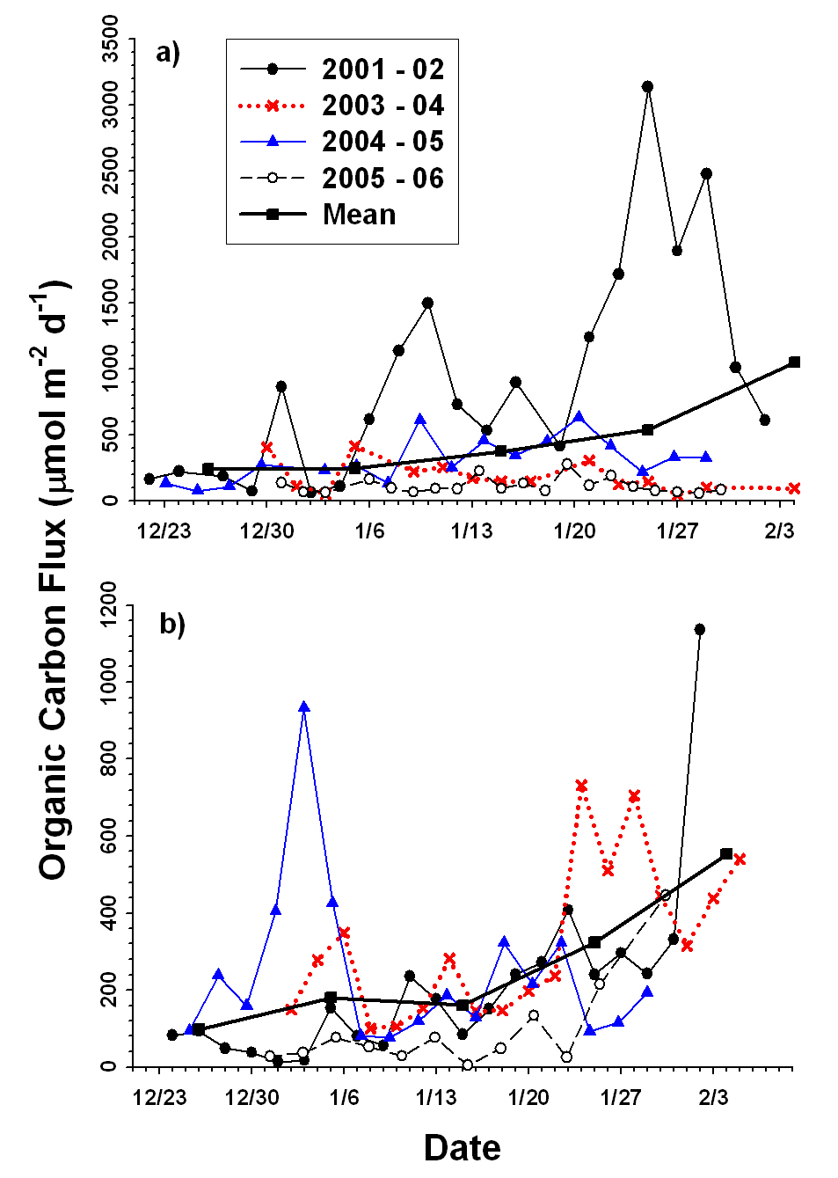
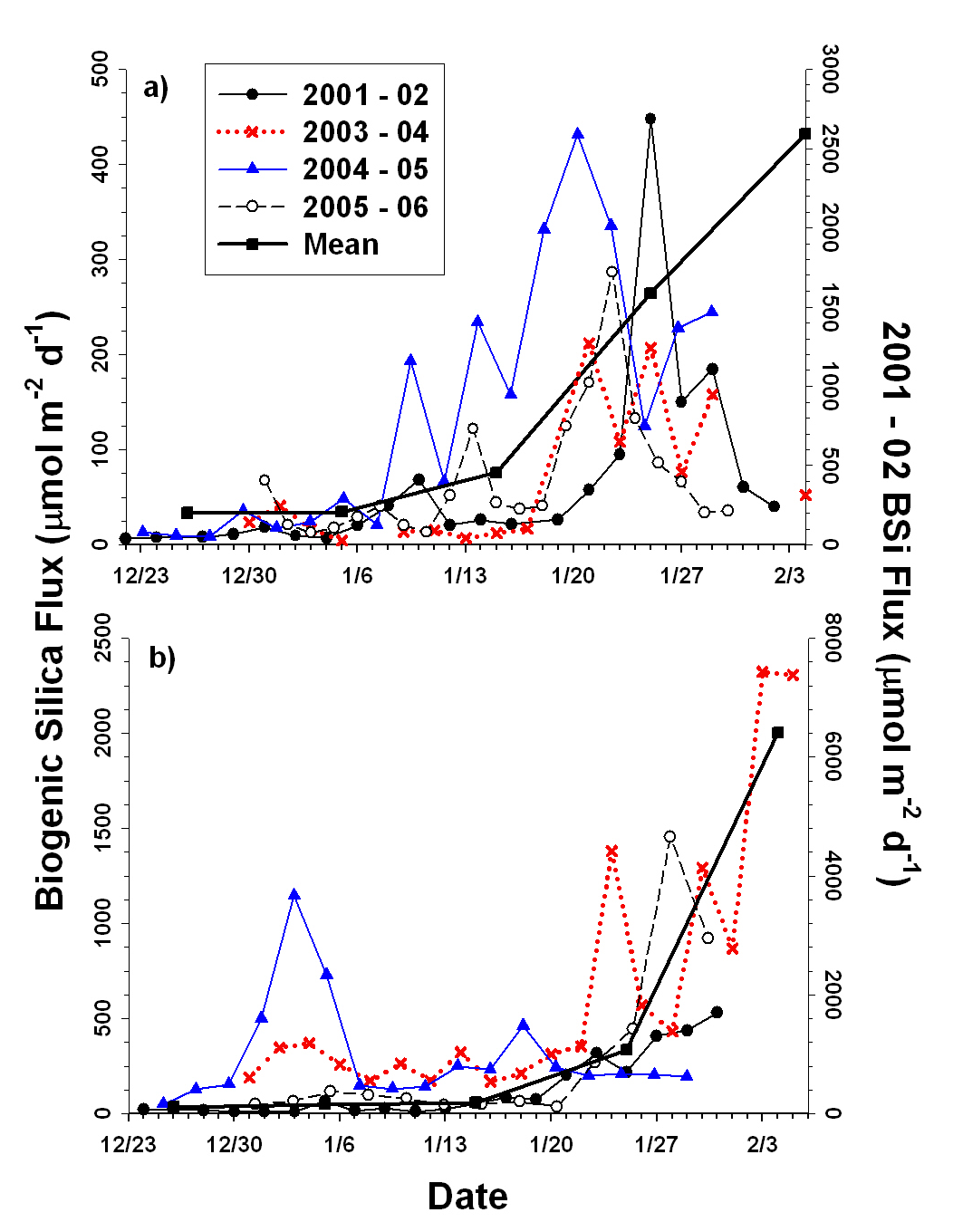
Smith et al. (2011b)

Slide 41
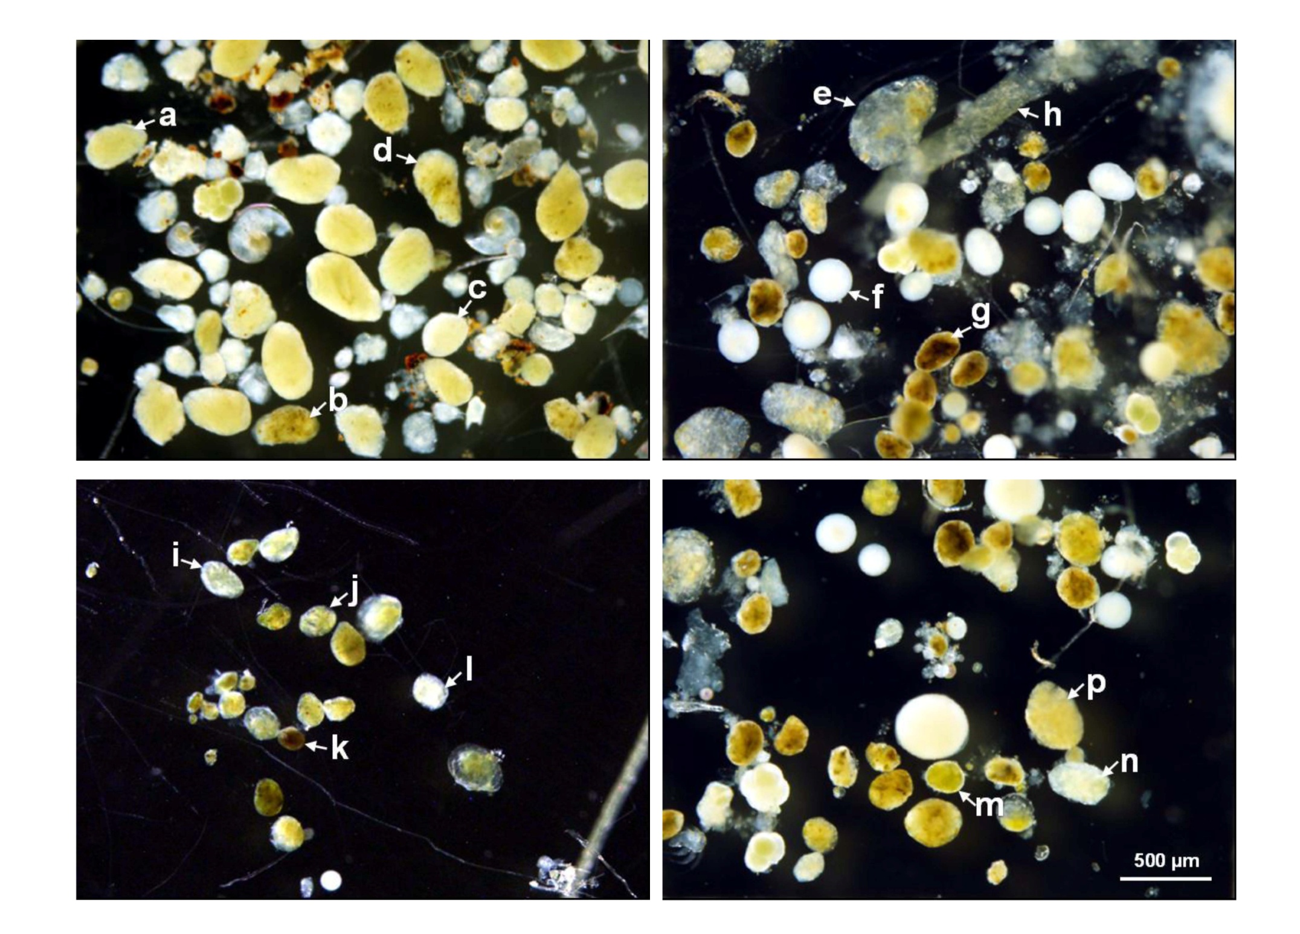
Smith et al. (2011b)

Slide 42
Sediment trap fluxes
in 2005-06 fecal pellet contributions to carbon flux were from 6 – 10% of the total flux
in 2003 – 04 and 2004 – 05 contribution ranged from 13 – 21%, but individual collections/dates had the fecal pellet contribution of 100%
Assuming that grazing pressure is related linearly to fecal pellet production, this suggests that the grazing pressure in the southern Ross Sea can vary tremendously by year and season

Slide 43
Conclusions
Variations in time and space are dramatic in the Ross Sea and are critical to assess to understand phytoplankton dynamics
Many/most of these variations are tied to physical forcing, but certain aspects are linked to biotic processes
The importance of these variations on the food webs and higher trophic levels of the Ross Sea remain at best uncertain

