Slide 1
Variation in Size and Phenology of the Ross Sea Polynya and Relationship to Primary Production
Kevin R. Arrigo
Stanford University

Slide 2
Ross Sea
Terra Nova
Bay Polynya
Ross Sea Polynya
McMurdo
Polynya

Slide 3
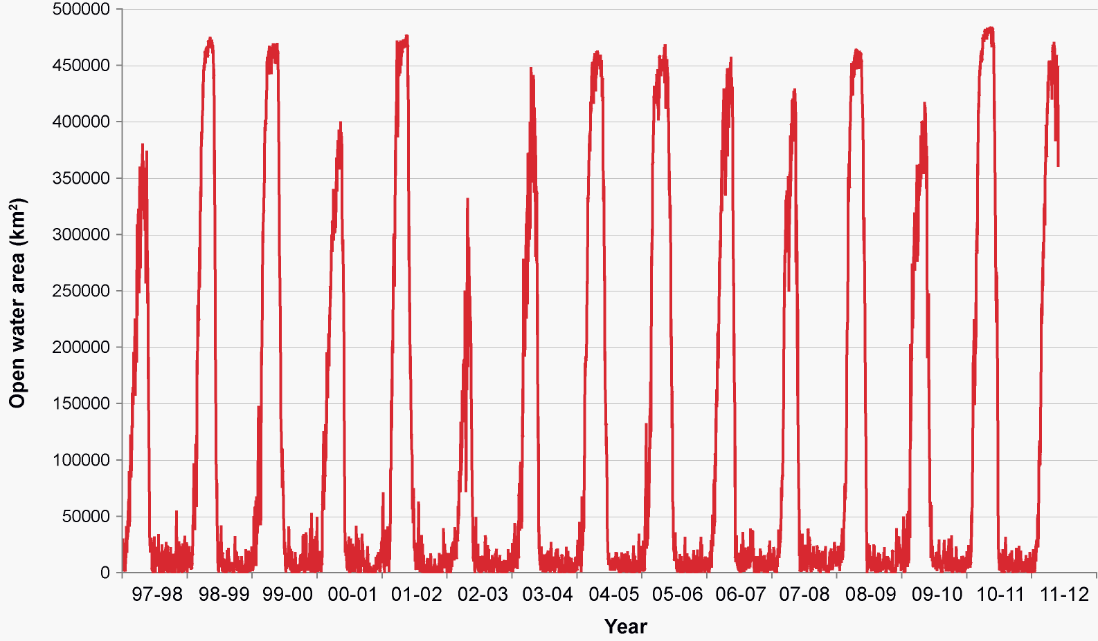
Ross Sea Polynya

Slide 5
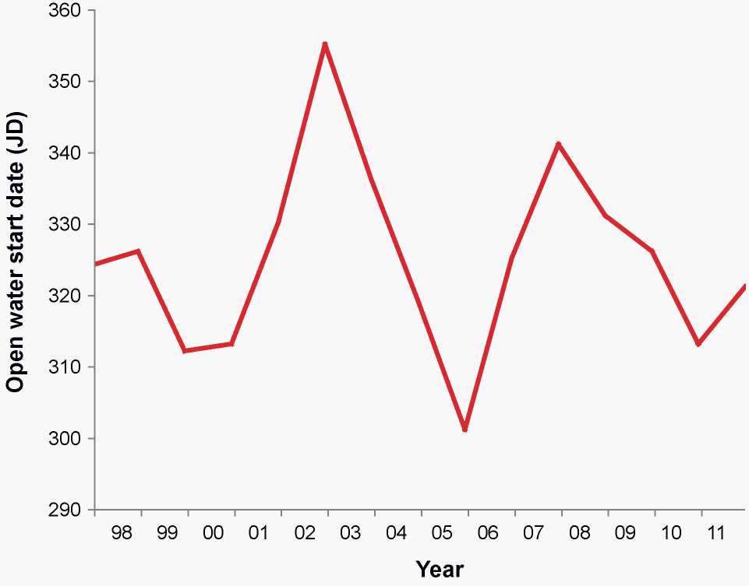
Threshold = 100,000 km²

Slide 6
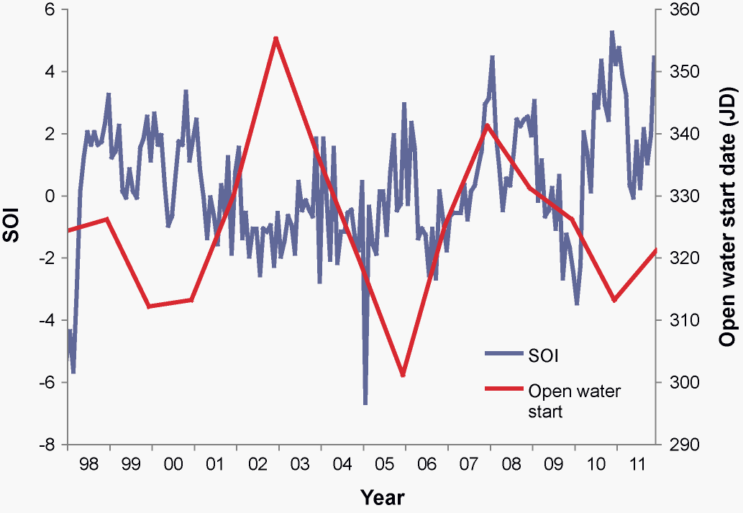
Threshold = 100,000 km²

Slide 7
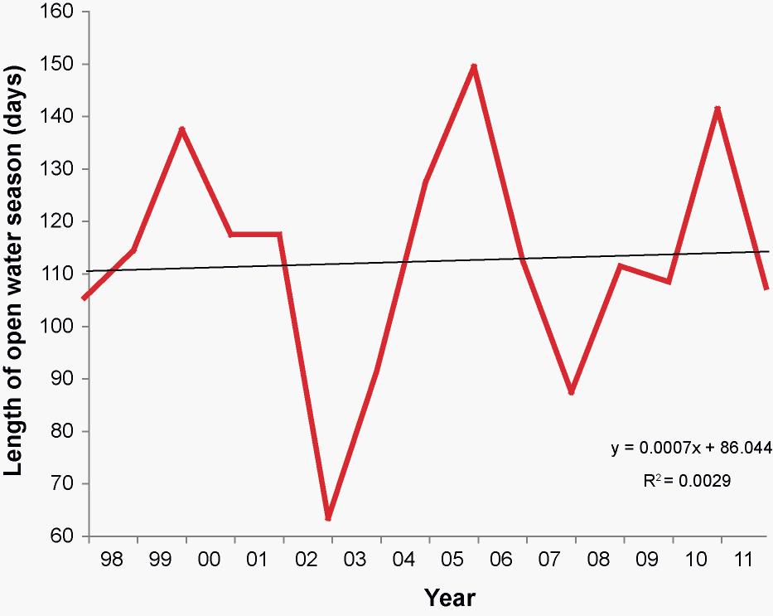
Threshold = 100,000 km²

Slide 8
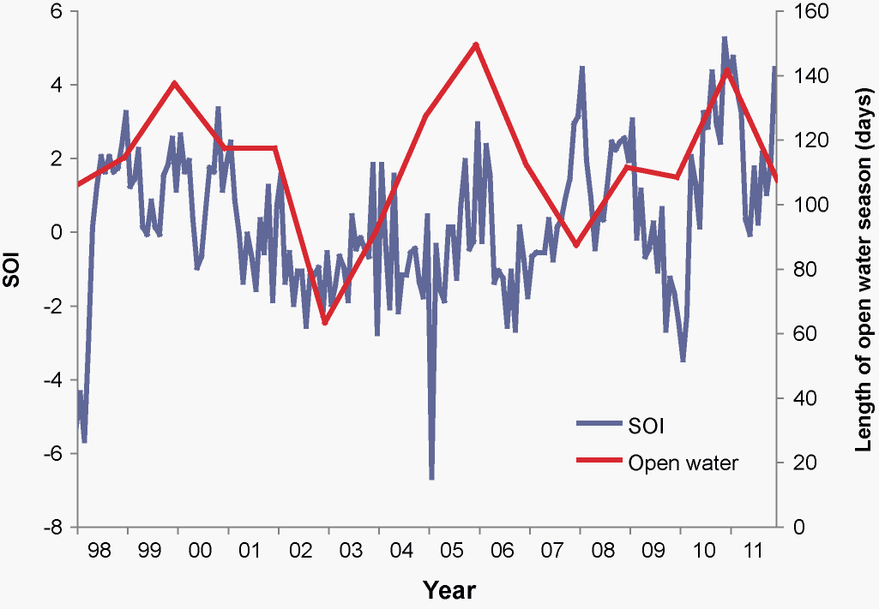
Threshold = 100,000 km²

Slide 9
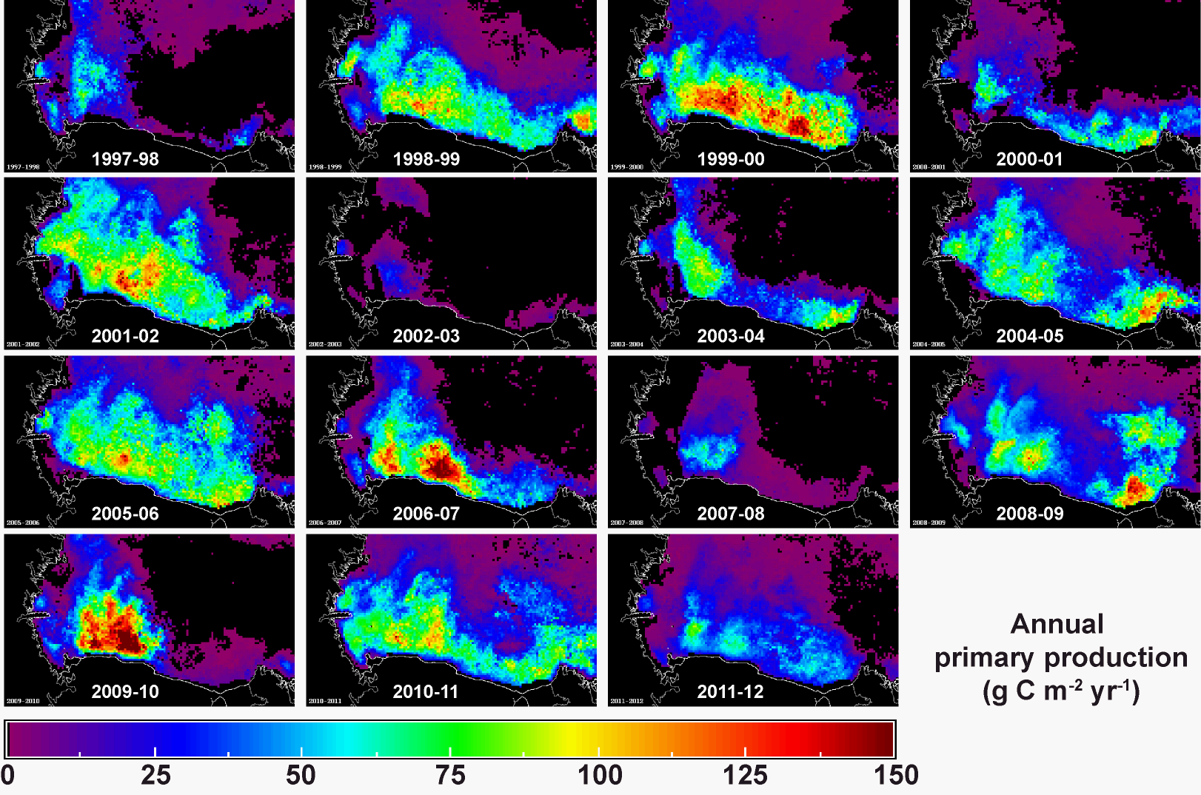

Slide 10
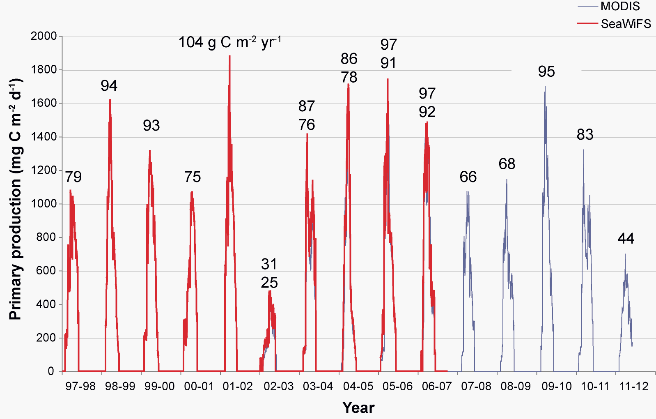
Ross Sea Polynya

Slide 11
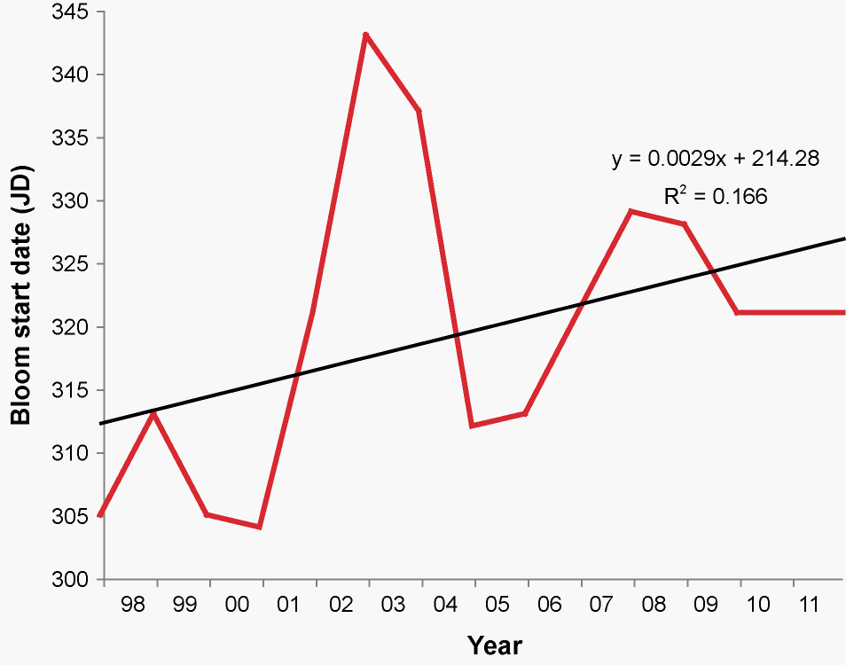
Threshold = 200 mg C m⁻² d⁻¹

Slide 12
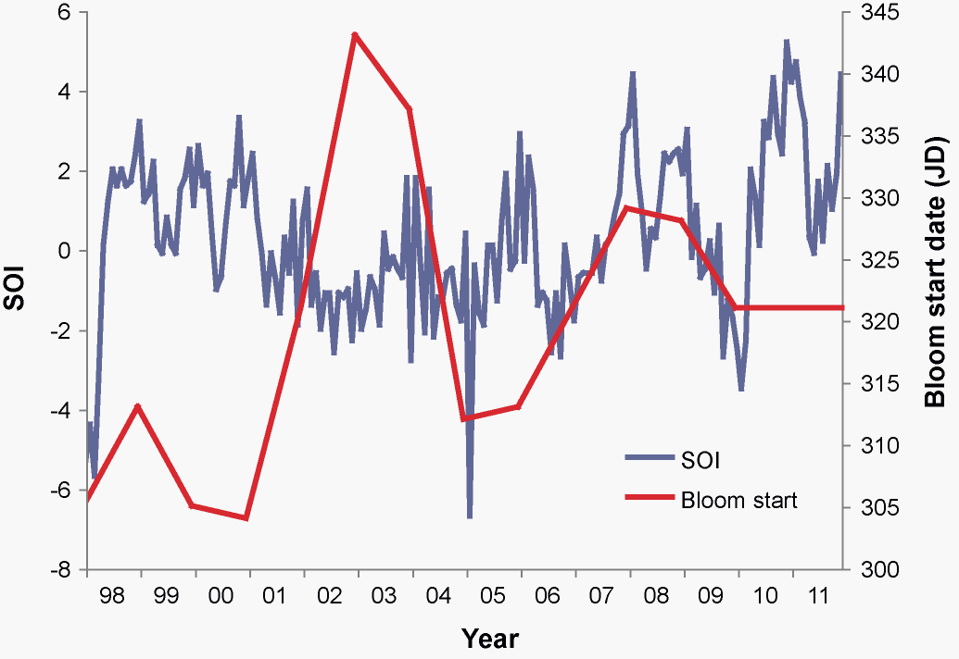
Threshold = 200 mg C m⁻² d⁻¹

Slide 13
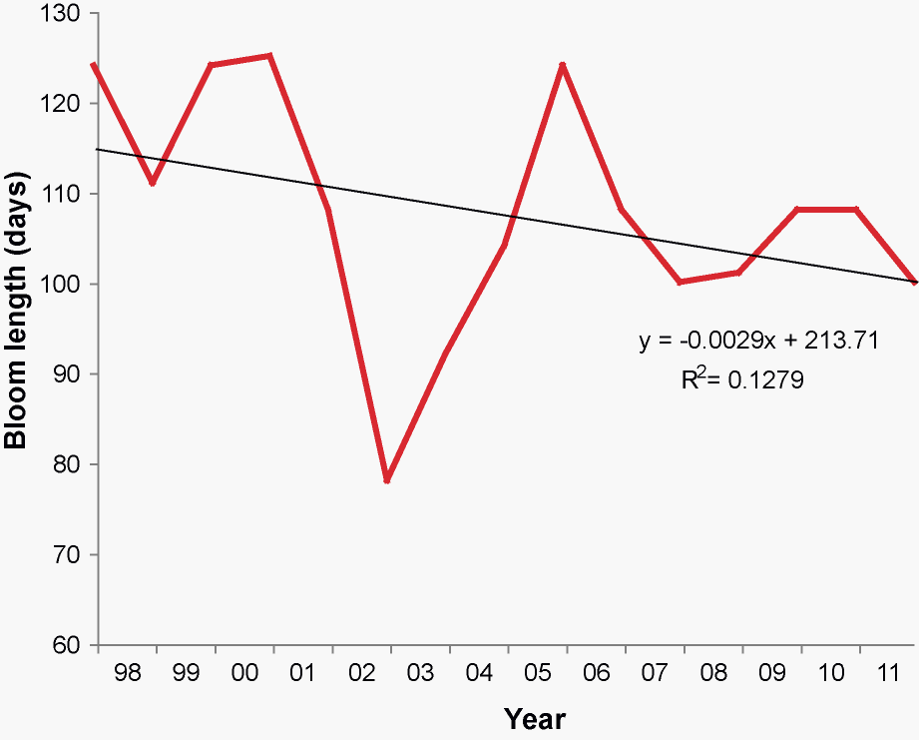
Threshold = 200 mg C m⁻² d⁻¹

Slide 14
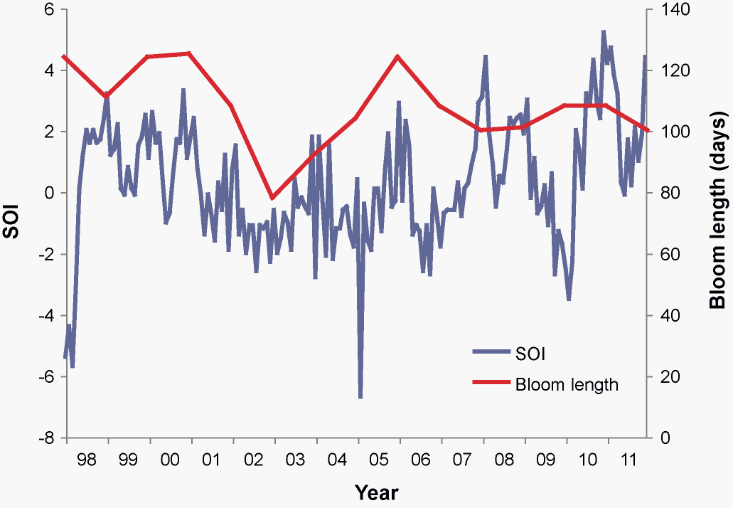
Threshold = 200 mg C m⁻² d⁻¹

Slide 15
Threshold = 200 mg C m⁻² d⁻¹

Slide 16
Threshold = 200 mg C m⁻² d⁻¹, Threshold = 100,000 km²

Slide 17
Threshold = 200 mg C m⁻² d⁻¹, Threshold = 100,000 km²

Slide 18
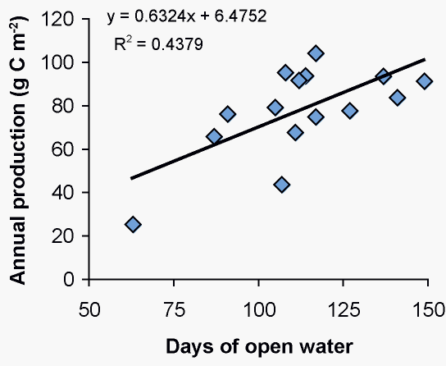

Slide 19
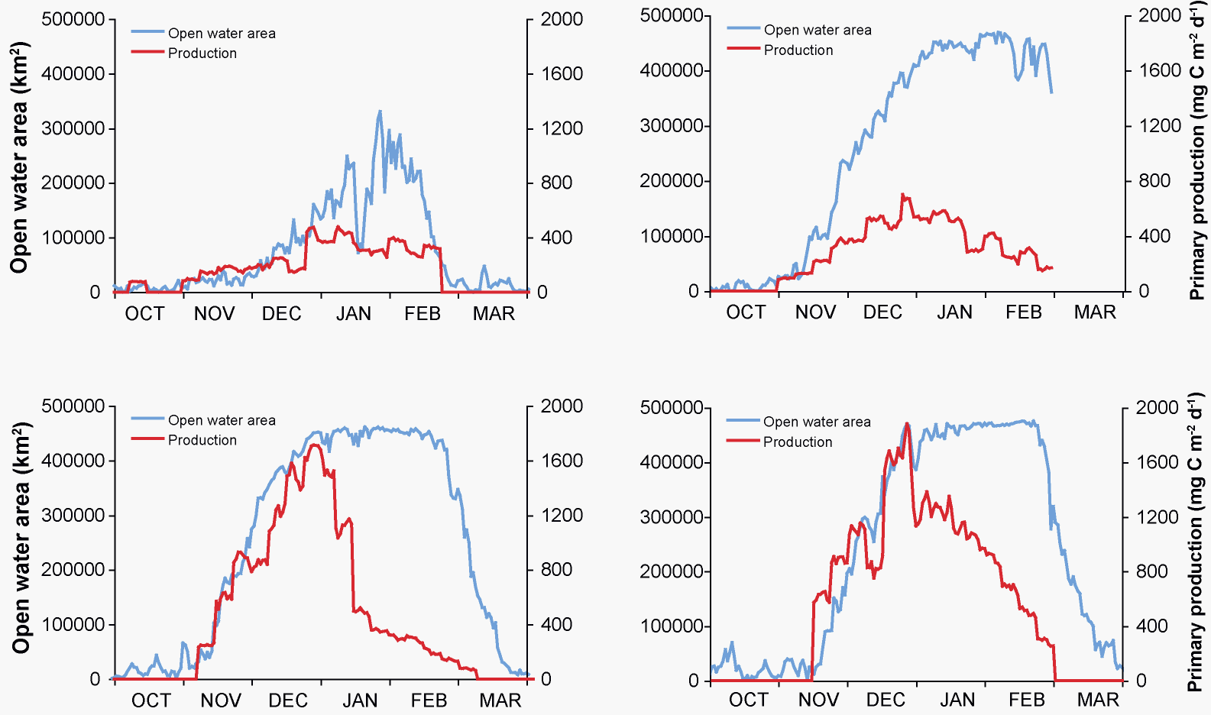
Ross Sea Polynya
2002-03 High ice/Low PP
2011-12 Normal ice/Low PP
2004-05 Normal ice/Normal PP
2001-02 Normal ice/High PP

Slide 20
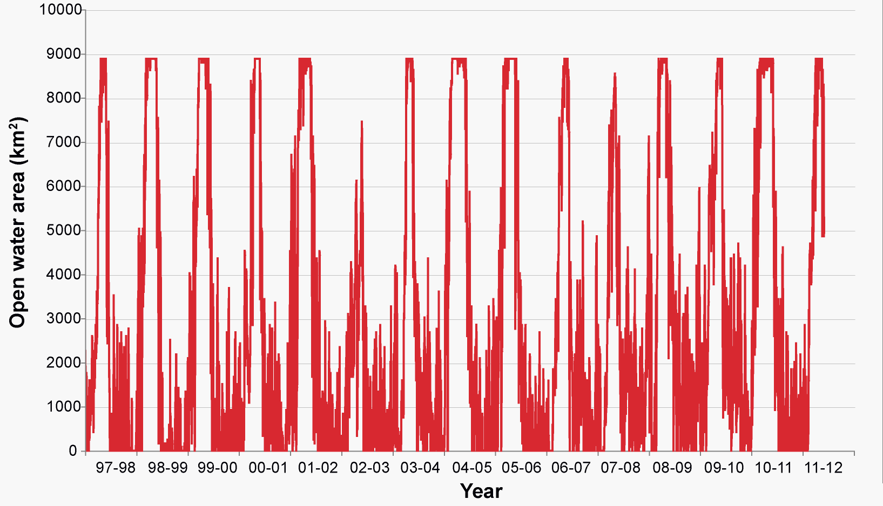
Terra Nova Bay Polynya

Slide 21
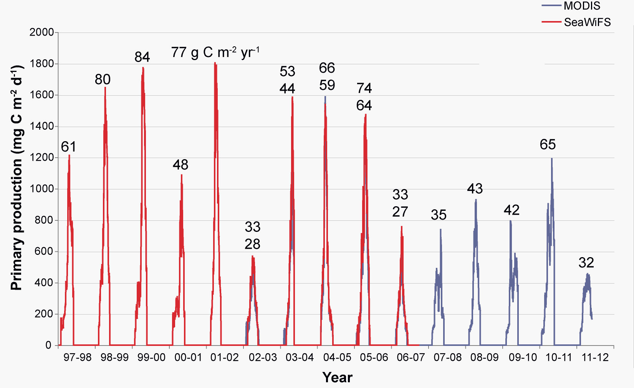
Terra Nova Bay Polynya

Slide 22
Terra Nova Bay Polynya
R² = 0.46

Slide 23
Start of Spring Bloom
(PP > 200 mg C m⁻² d⁻¹)
Ross Sea Terra Nova Bay McMurdo
Polynya Polynya Polynya
Nov 20 ± 13.2 Dec 4 ± 10.1 Dec 14 ± 18.1
Terra Nova Bay Polynya
Ross Sea Polynya
McMurdo Polynya

Slide 24
Annual Primary Production
(g C m⁻² yr⁻¹)
Ross Sea Terra Nova Bay McMurdo
Polynya Polynya Polynya
87 ± 24 53 ± 19 38 ± 21
Terra Nova Bay Polynya
Ross Sea Polynya
McMurdo Polynya

Slide 25
Conclusions
No secular trends in polynya size or date of formation
No relationship to SOI
No secular trend in the magnitude of primary production
Except for Terra Nova Bay
No relationship to SOI
High spatial and temporal variability in primary production
Phytoplankton bloom timing related to timing of polynya formation
Length of bloom related to polynya persistence
Driven mostly by timing of ice retreat

