Slide 1
RESPONSE OF ROSS SEA ORGANISMS TO INTERANNUAL AND DECADAL CLIMATE VARIATION,
AND TO OTHER FACTORS

Slide 2
INTERANNUAL/ENSO-SCALE
RESPONSES TO CLIMATE VARIATION

Slide 3
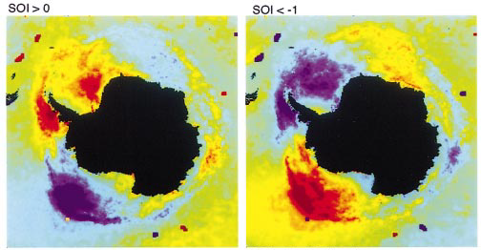
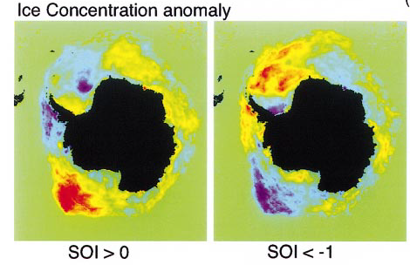
KWOK & COMISO 2002
SOI > 0 SOI < -1
ANOMALIES
SST / IST
Cold
Warm
La Nina El Nino
SIE + SIC
More
Less
NOTE STRONGEST SIGNAL IN
EASTERN ROSS SEA SECTOR

Slide 4
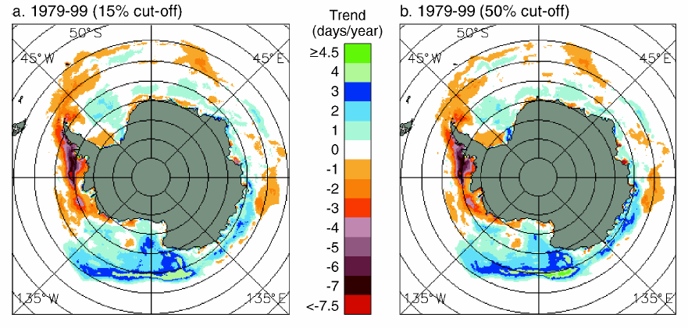
AS LARGE SCALE SEA-ICE SEASON INCREASES, THAT IN THE ROSS SEA COASTAL
POLYNAS DECREASES
PARKINSON 2002

Slide 5
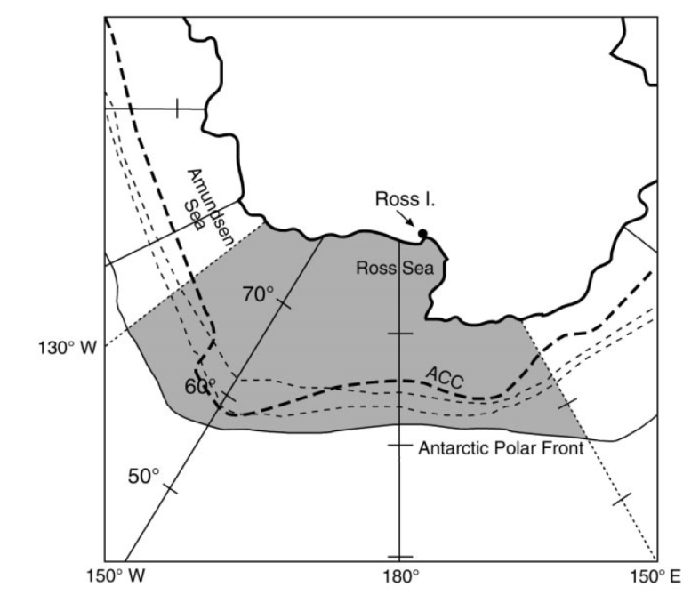
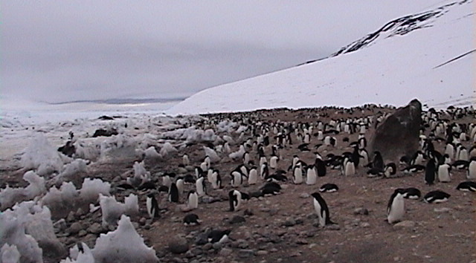
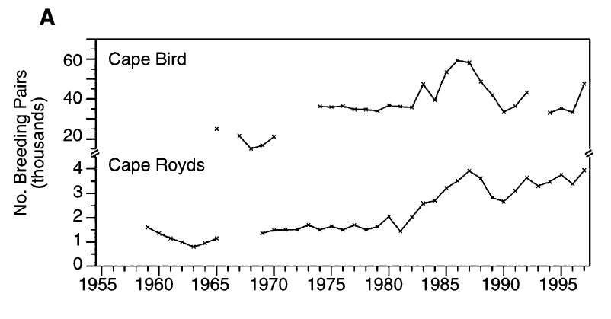
Wilson, P.R., D.G. Ainley, N. Nur, S.S. Jacobs, K.J. Barton, G. Ballard, J.C. Comiso. 2001. Adélie Penguin population change in the Pacific Sector of Antarctica: Relation to sea-ice extent and the Antarctic Circumpolar Current. Mar. Ecol. Prog. Ser. 213: 301-309.
1959-1997

Slide 6
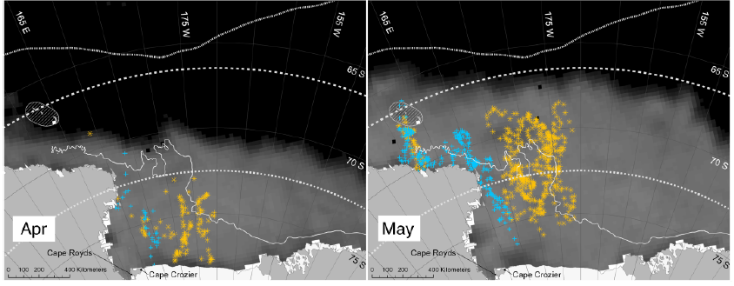
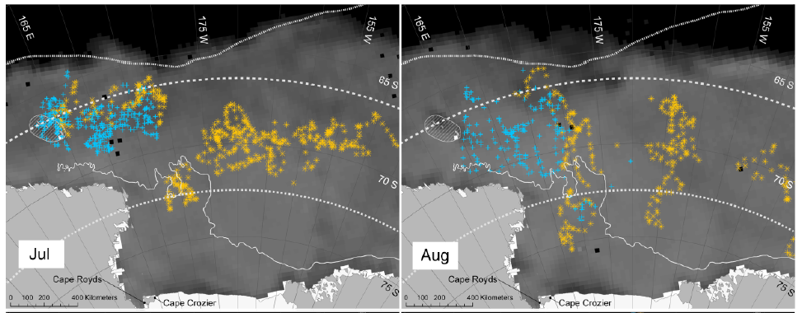

Slide 7
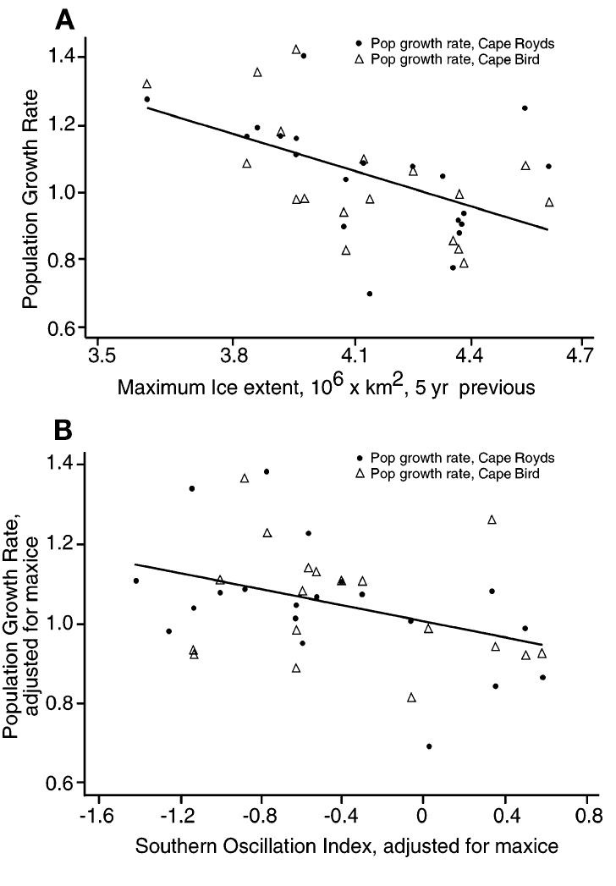
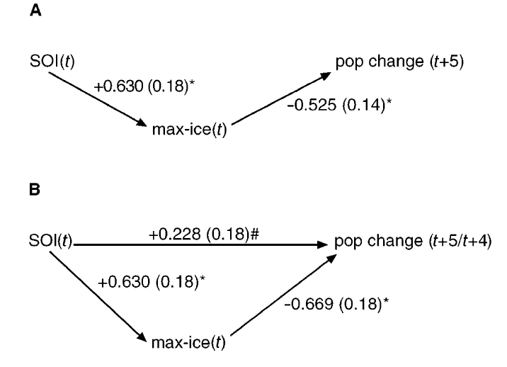
#: p > 0.2; *p < 0.001

Slide 8
Correlations significant only in eastern (175-130W); consistent with
Kowk & Comiso 2002

Slide 9
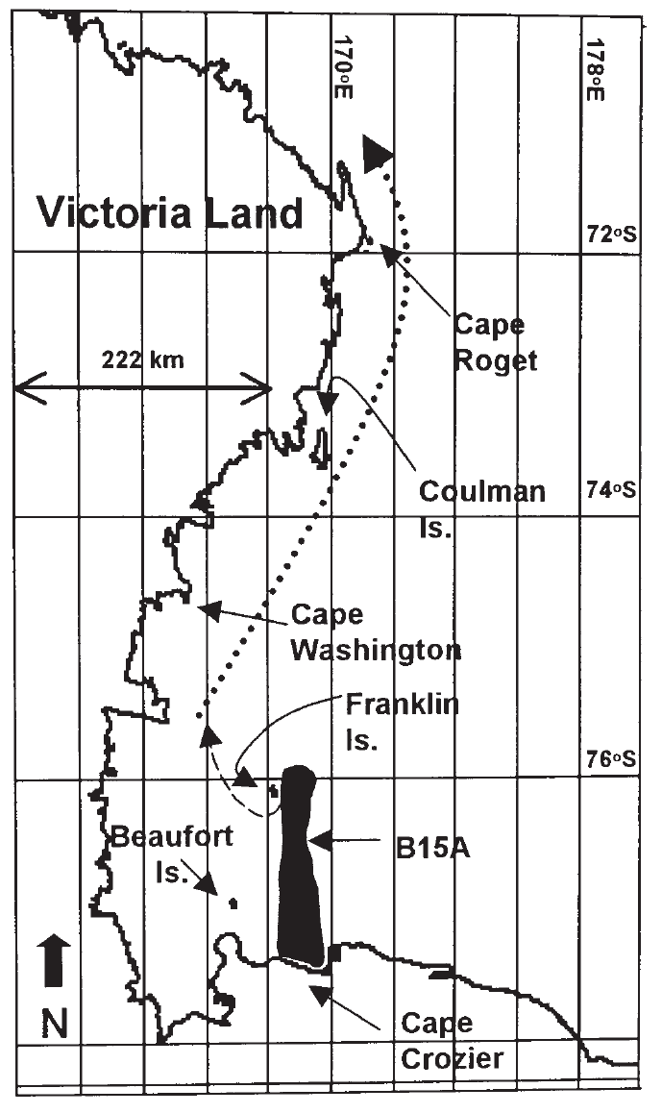
Barber-Meyer, S.M., G.L. Kooyman, P.J. Ponganis. 2008. Trends in western Ross Sea emperor penguin chick abundances and their relationships to climate. Antarctic Science 20 (1), 3–11.
1983 - 2005
SIE & SST, 160E to 130W, 50S – 78S
SOI, SAM
Crozier & Beaufort: pos SIE winter
and neg SIE winter 5YL
Interpretation: associated with +SIE is more wind
and thus more polynya for this winter-breeding
species; the lagged –SIE must have something to do
with juv survival.

Slide 10
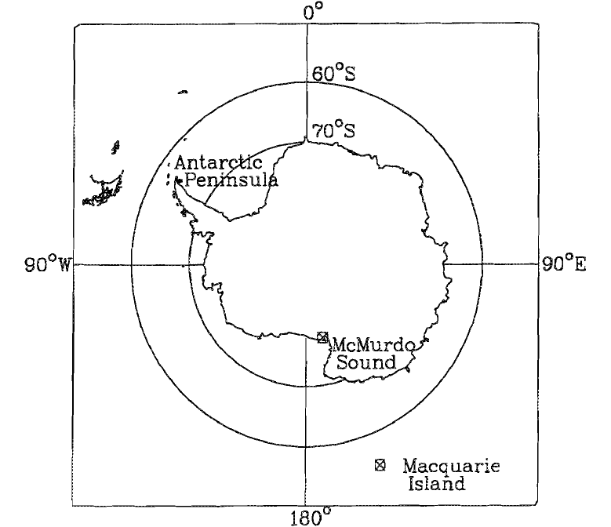
Testa, J.W., G. Oehlert, D.G. Ainley, J.L. Bengtson, D.B. Siniff, R.M. Law, D. Rounsevell. 1991. Temporal variability in Antarctic marine ecosystems: periodic fluctuations in the phocid seals. Canad. J. Fish. Aquat. Sci. 48: 631-639.
WESE pup production
LESE visitation

Slide 11
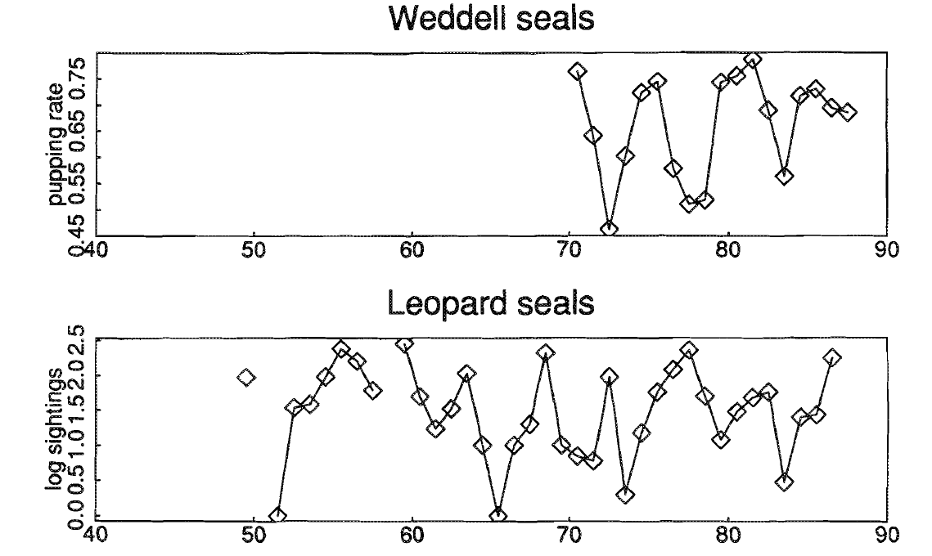
McMurdo Sound
Macquarie Island
~ 5-yr cycles
Weddell seal cycles in phase with SOI;
Leopard seal cycles in phase with SOI thru 1960s,
then SOI led by 0.25 cycles

Slide 12
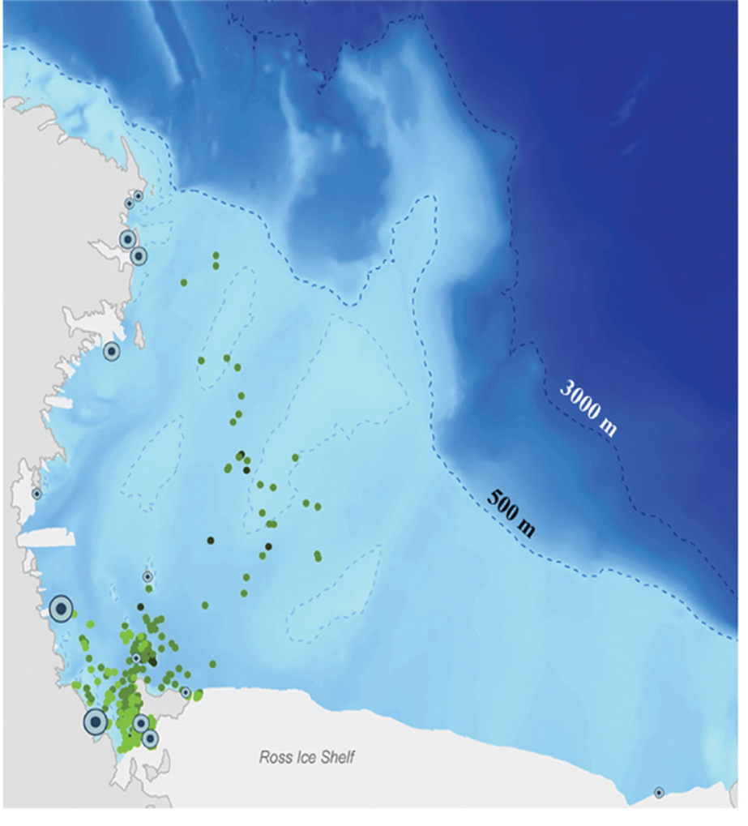
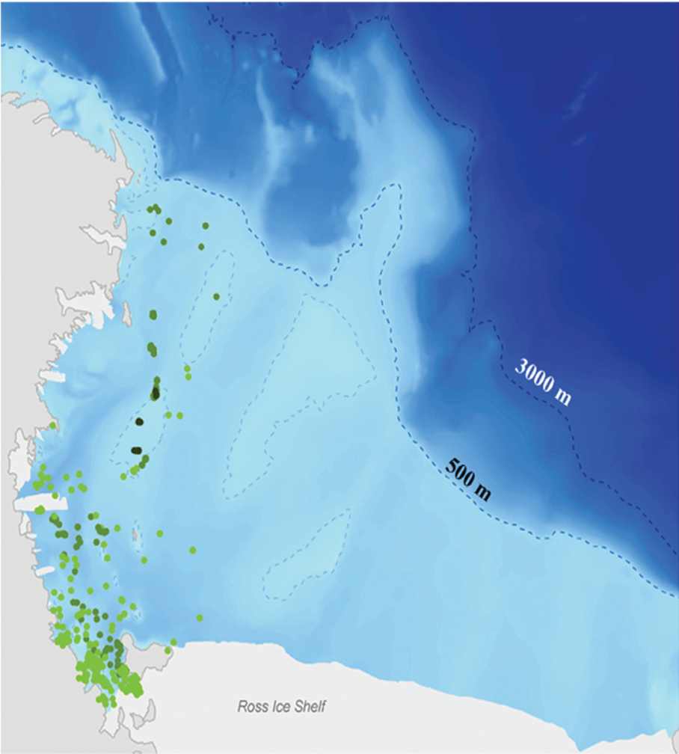
Hadley, G.L., J.J. Rotella, R.A. Garrott. 2007. Influence of maternal characteristics and oceanographic conditions on survival and recruitment probabilities of Weddell seals. Oikos 116: 601–613.
Weddell seals breed in McMurdo Sound and then disperse out into the Ross Sea during the winter.
ADULT
FEMALES
PUPS

Slide 13
Annual recruitment probability was positively related to sea-ice extent in previous winter. [>SIE also means larger polynya]
No relationship found to pup post-weaning survival
No relationship to SOI

Slide 14
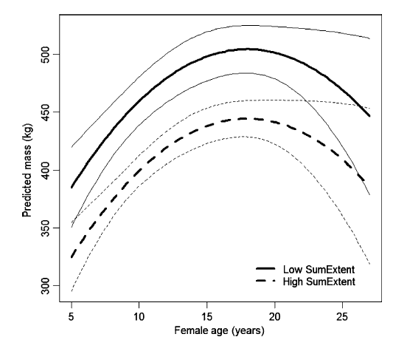
Proffitt, K.M., R.A. Garrott, J.J. Rotella, K.E. Wheatley. 2007. Environmental and senescent related variations in Weddell seal body mass: implications for age-specific reproductive performance. Oikos 116: 1683-1690
Maternal body mass
higher following summers
with low sea-ice cover and
positive phases of SOI.
Low ice
High ice
MASS
Interpretation: +SOI means +SIE and
+polynya size (K&C 2002); less sea
Ice early means higher pp?

Slide 15
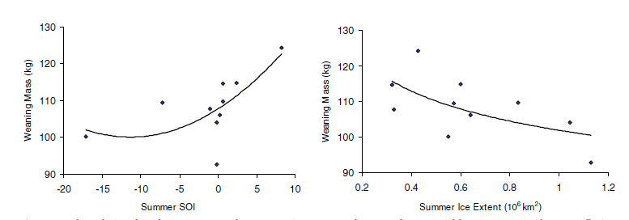
Proffitt, K.M., R.A. Garrott, J.J. Rotella, D.B. Siniff, J.W. Testa. 2007. Exploring linkages between abiotic oceanographic processes and a top-trophic predator in an Antarctic ecosystem. Ecosystems 10: 119–126.
Mass
Summer SOI Summer SIE
Pup weaning mass (measure of female foraging prior to and during pup rearing) positively correlated with SOI and sea-ice extent during previous summer (MinExtent).

Slide 16
Ainley, D.G., N. Nur, J.T. Eastman, G. Ballard, C.L. Parkinson, C.W. Evans, A.L. DeVries. 2012. Decadal trends in abundance, size and condition of Antarctic toothfish in McMurdo Sound, Antarctica, 1972-2011. Fish & Fisheries, provisionally accepted (revision in review)
5588 fish caught, 1972-2011
(KM2)
WINTER
MORE ICE ENCOURAGES MORE LARGE TOOTHFISH TO MIGRATE SOUTH?
PROTECTED FROM PREDATION? ATTRACTED TO HIGHER COASTAL PRODUCTIVITY?

Slide 17
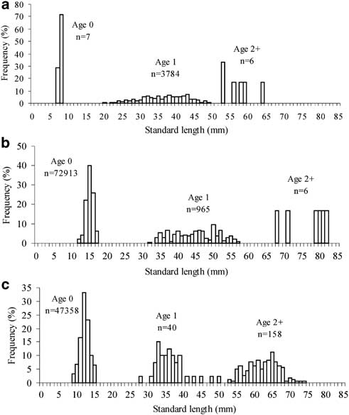
La Mesa, M. et al. 2010. Inﬂuence of environmental conditions on spatial distribution and abundance of early life stages of Antarctic silverﬁsh in the Ross Sea. Antarct. Sci. 22: 243-255.
Arrigo & Van Dijken 2004;
Cavalieri et al. 2004
1997-98
heavy sea ice, Low Prim Prod;
Early life stages practically absent
Prim Prod and ice cover
‘normal’;
Abundant early stages
Polynya delayed, reducing early
stages
1999-00
2003-04

Slide 18
SUMMARY
With greater SIE (larger polynya, too), positive SOI:
ADPE – smaller colony 5 years later (juv survival)
EMPE – fewer chicks 5 years later (juv survival)
- more chicks in present year (adult well being)
LESE – more subadult males visit Macquarie Island
WESE – more pups
Ice previous Winter (Sept)
- higher annual recruitment (more females pup)
- maternal body mass higher
- pup weaning mass higher
Toothfish – larger fish in McM Snd
Silverfish – benefit from more open water, higher PP

Slide 19
Decadal and longer term population fluctuation

Slide 20
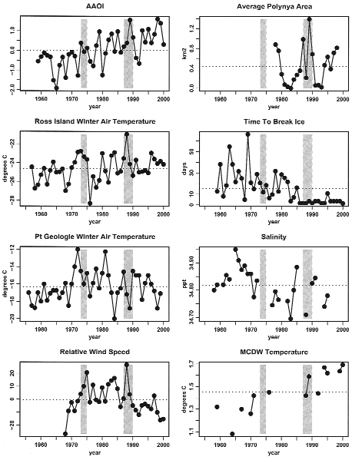
Ainley, D.G., E.D. Clarke, K. Arrigo, W.R. Fraser, A. Kato, K.J. Barton, P.R. Wilson. 2005. Decadal-scale changes in the climate and biota of the Pacific sector of the Southern Ocean, 1950s to the 1990s. Antarct. Sci. 17: 171-182.
SAM
Winter
Air Temp
Relative
Wind speed
Polynya Area
Ice thickness
Salinity
MCDW Temp
ADELIE
PENGUINS
ROSS
ISLAND

Slide 21
ICE WINTER
THICKNESS WIND TEMP SAM n p R2 R2
-
+
+
-
-
-
+
ADPE INCREASE WITH +SAM, +WINDS, THINNER ICE = MORE
OPEN COAST
EMPE DO BETTER WITH – SAM, –WIND, THICKER ICE

Slide 22
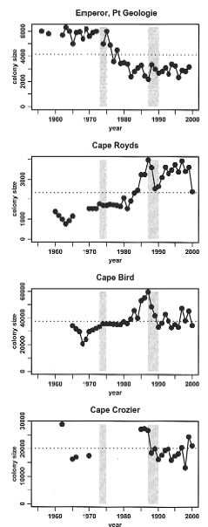
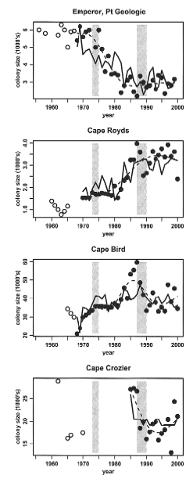
Emperor Penguin
Adelie, Royds
Adelie, Bird
Adelie, Crozier

Slide 23
Dayton, P.K. 1989. Interdecadal variation in an Antarctic sponge and its predators from oceanographic climate shifts. Science 245: 1484–1486.
Eastern McMurdo Sound
1960s: anchor ice (& platelet ice), no Homaxinella sponge
Mid-1970s: anchor ice formation reduced, invasion of Homaxinella
Early-1980s: anchor ice (& platelet ice) reappeared, Homaxinella sponge
disappear
Periods of northward flow of cold water, from beneath
Ice Shelf bring conditions for anchor and platelet ice formation

Slide 24
FINALLY, CHANGES IN POPULATIONS NOT RELATED TO
CLIMATE VARIATION

Slide 25
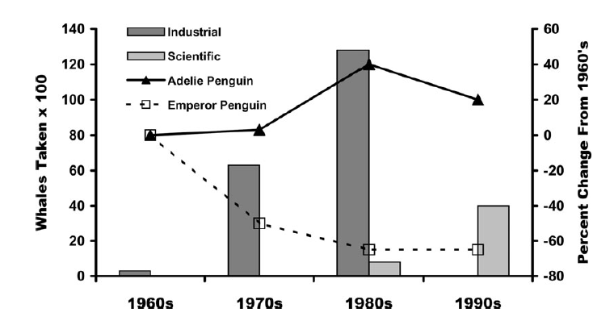
IWC AREAS V & VI
REMOVE MINKE WHALES AND ADELIE PENGUINS INCREASE (COMPETITIVE RELEASE) AND, POSSIBLY, EMPEROR PENGUINS DECREASE (KIILLER WHALE PREY SWITCHING)

Slide 26
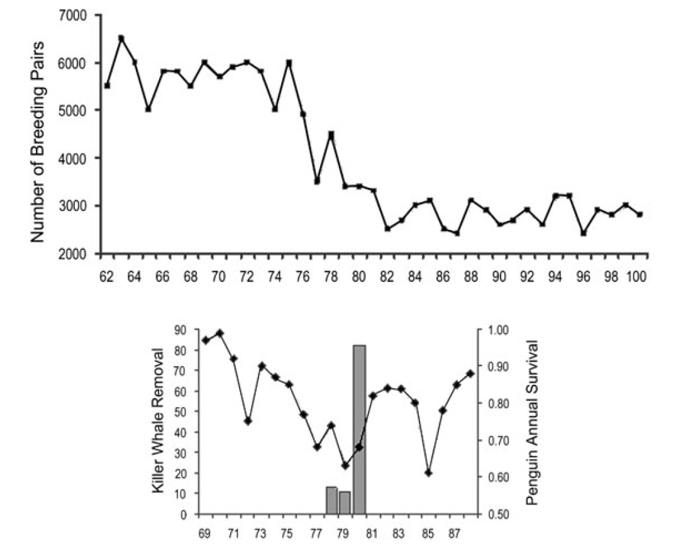
EMPE, PT GEOLOGIE

Slide 27
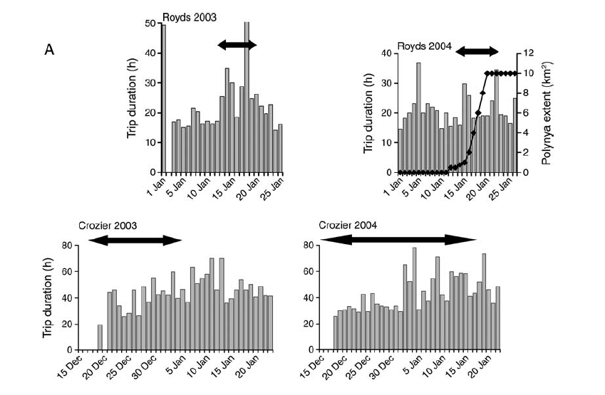
Penguin Foraging
Trip Duration (h)
Whales
present
ROSS ISLAND
ADELIE PENGUINS

Slide 28
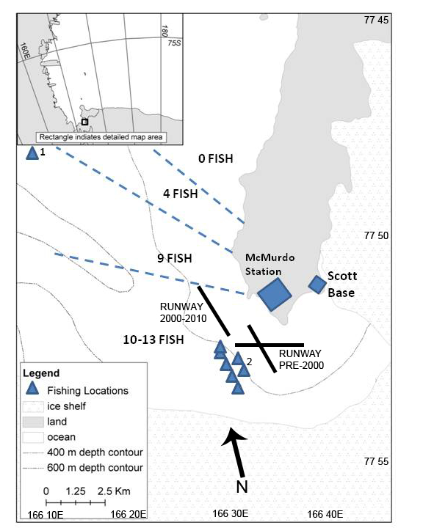
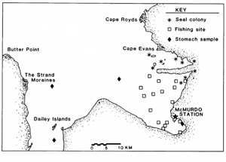
Testa, J.W., Sinniff, D.B., Ross, M.J. & Winter, J.D. 1985. Weddell seal – Antarctic cod interactions in McMurdo Sound, Antarctica. In Seigfried, W.R., Condy, P.R. & Laws, R.M., eds. Antarctic nutrient cycles and food webs. Heidelberg: Springer, 561–565.
MORE WESE, FEWER TOOTHFISH

Slide 29
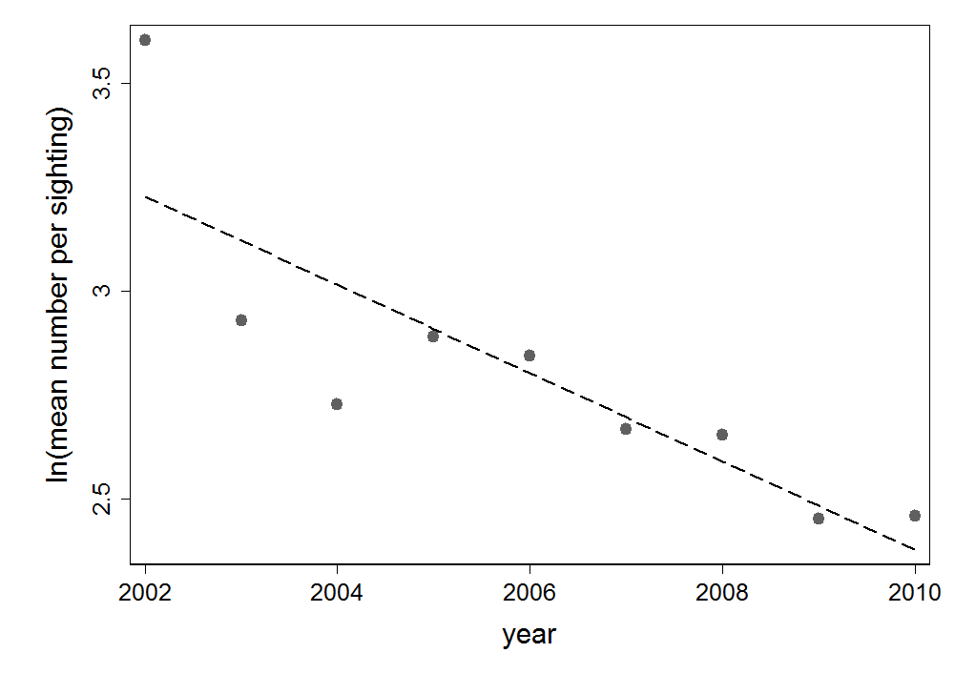
KILLER WHALES
PER SIGHTING
TOOTHFISH PREVALENCE, CPUE
INDUSTRIAL CATCH
OF TOOTHFISH

Slide 30
CONCLUSION:
ROSS SEA FOOD WEB IS EXTREMELY CLOSELY COUPLED,
AT LEAST MIDDLE TO UPPER LEVELS

