Slide 1
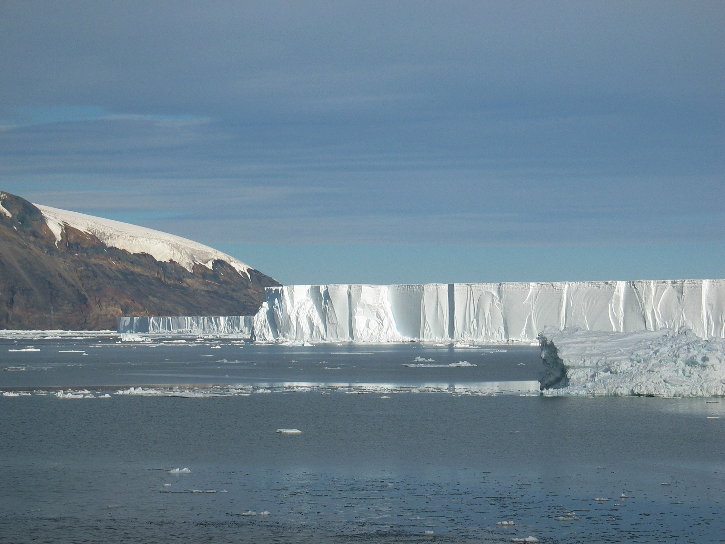

Review of ocean circulation and water masses in the Ross Sea and vicinity
Mike Dinniman
Eileen Hofmann
Center for Coastal Physical Oceanography
Old Dominion University
March 27, 2012

Slide 2
Outline of Presentation
Circulation and water masses in the Southern Ocean Ross Sea sector
Circulation and water masses in the Ross Sea
Modified Circumpolar Deep Water intrusions: What we know about location (fair amount) and timing (not much)
Circulation model particle simulations to look at Antarctic toothfish pathways
Summary

Slide 3
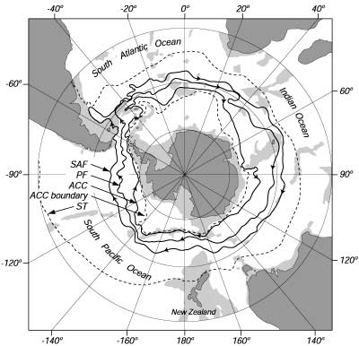
Orsi, 1995
Hanchet et al., 2008

Slide 4
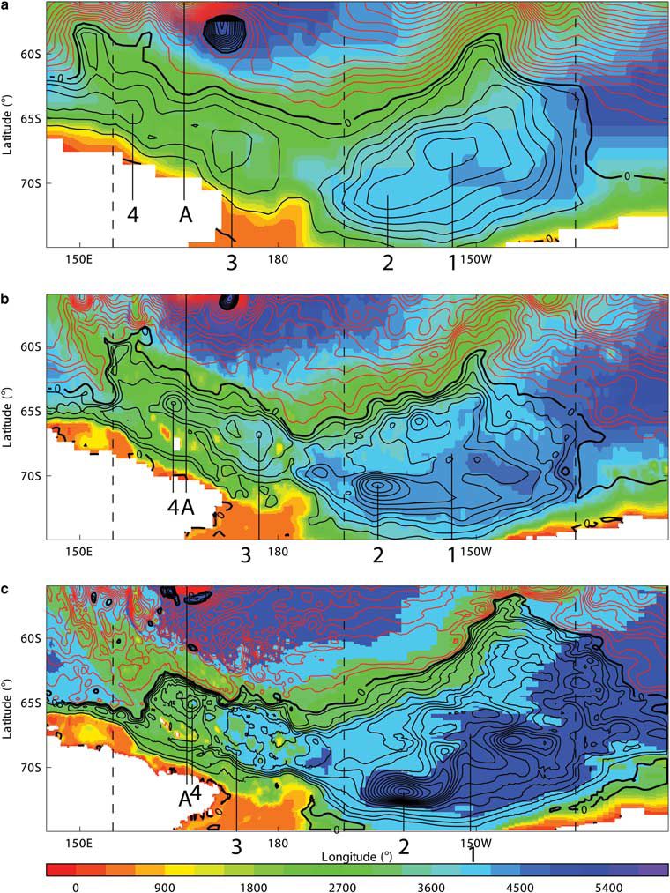
HadGEM1.1 (1° horizontal
resolution, highest ACC xport)
HiGEM1.1 (1/3° horizontal
resolution, middle ACC xport)
BRAN2.1 (1/10° horizontal
resolution, lowest ACC xport)
Rickard et al., 2010

Slide 5
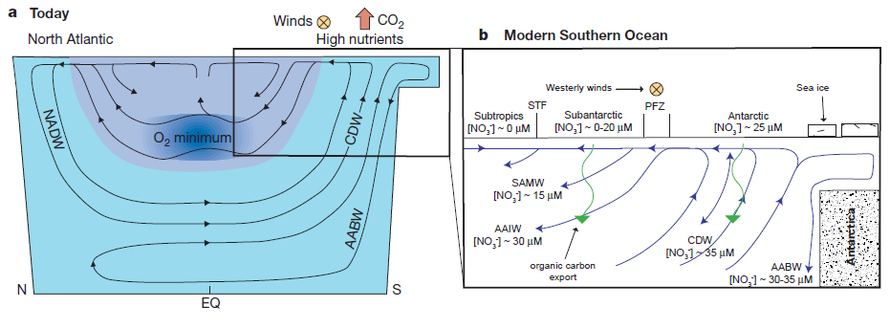
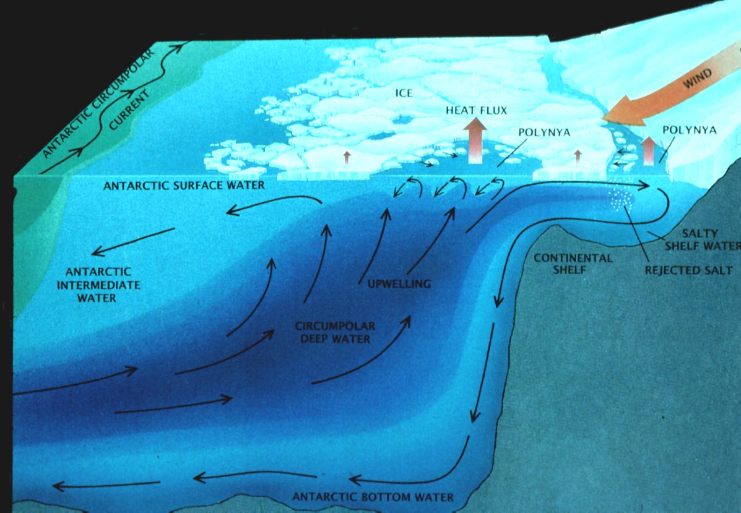
Sigman and Boyle, 2000
adapted from Gordon and Comiso, 1988

Slide 6
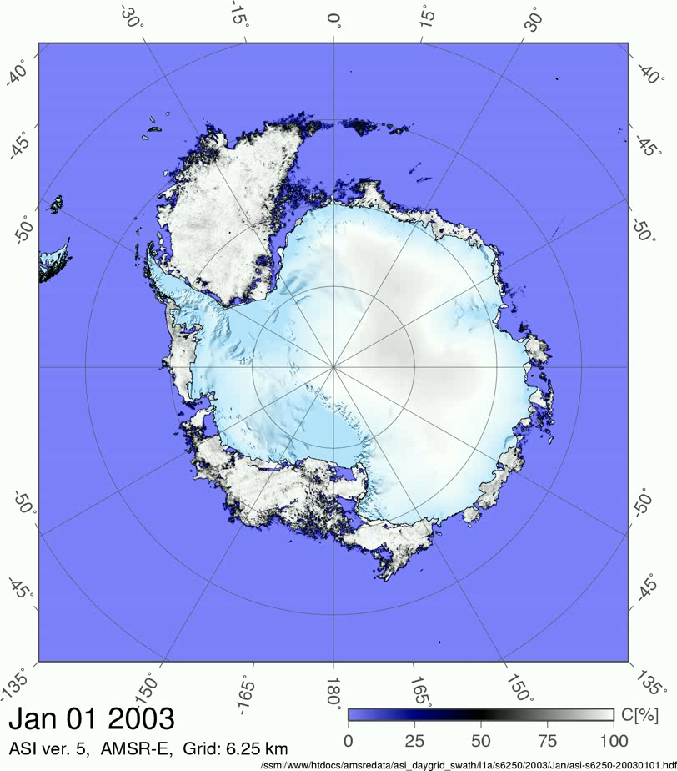
University of Bremen

Slide 7
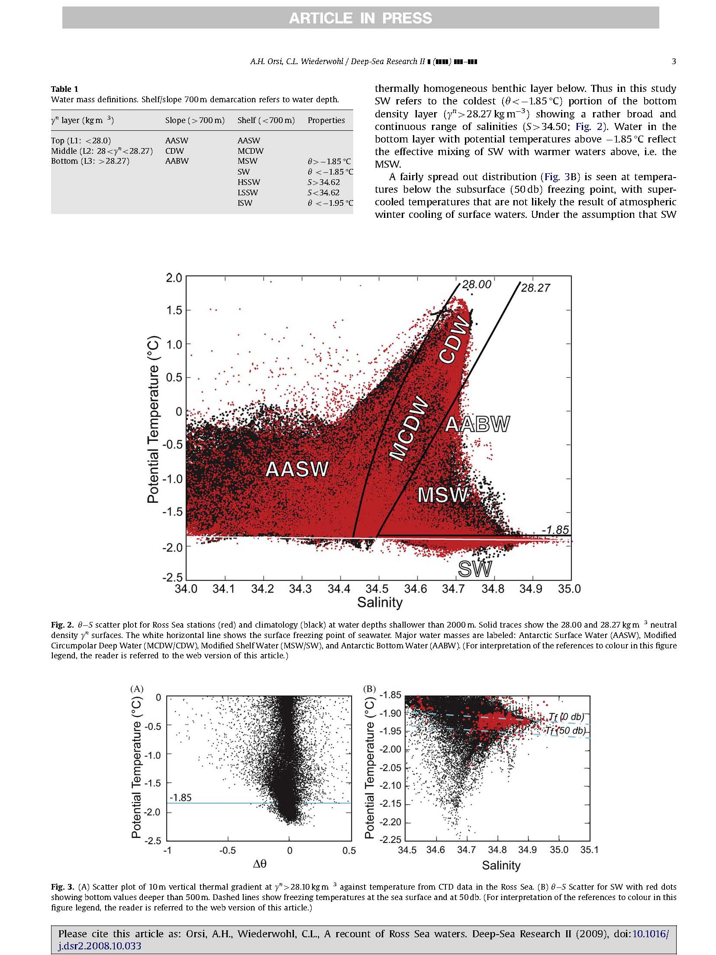
Major Water Masses
Antarctic Surface Water (AASW)
Modified Circumpolar Deep Water (MCDW)
Shelf Water
High Salinity Shelf Water (HSSW)
Low Salinity Shelf Water (LSSW)
Ice Shelf Water (ISW)
Modified Shelf Water
Volume on the shelf is distributed nearly equally among SW, AASW, MCDW and MSW
Orsi and Wiederwohl, 2009

Slide 8
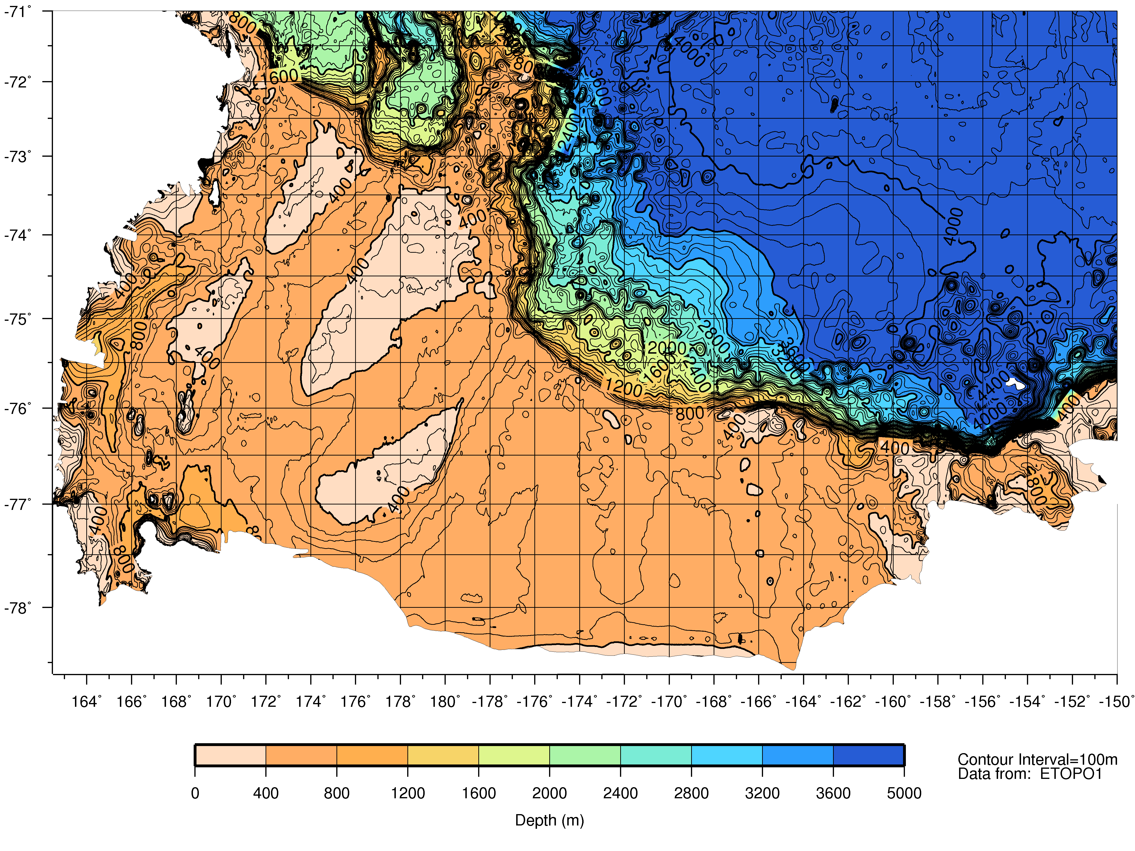
Victoria Land
Mawson Bank
Drygalski Trough
Joides Trough
Pennell Bank
Glomar Challenger Trough
Ross Bank
Ross
Island
Ross Ice Shelf
Smith et al., in press

Slide 9
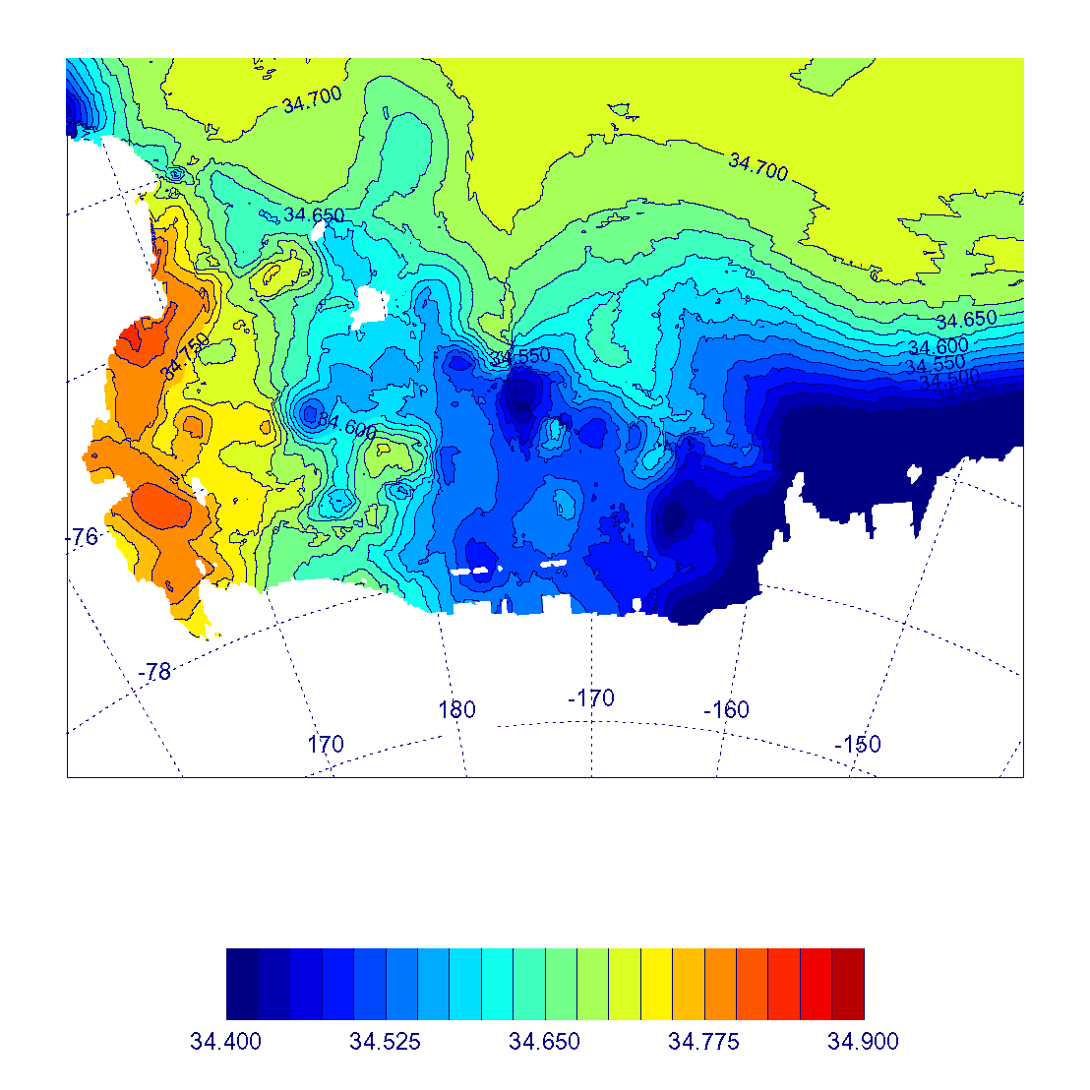
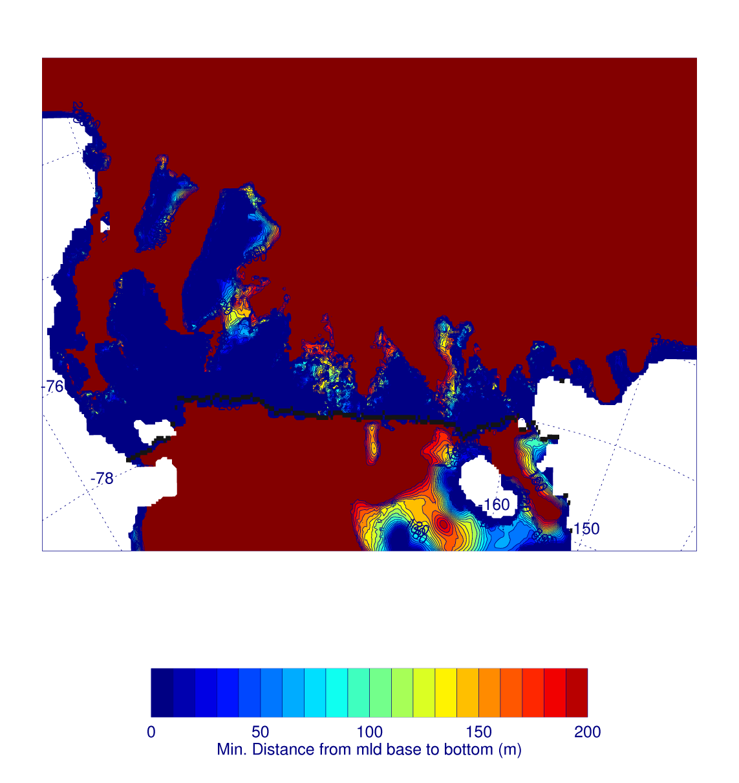
300m salinity (data from Orsi
and Wiederwohl climatology)
Closest distance between bottom
of the mixed layer and terrain at
any point in a 2-year model run

Slide 10
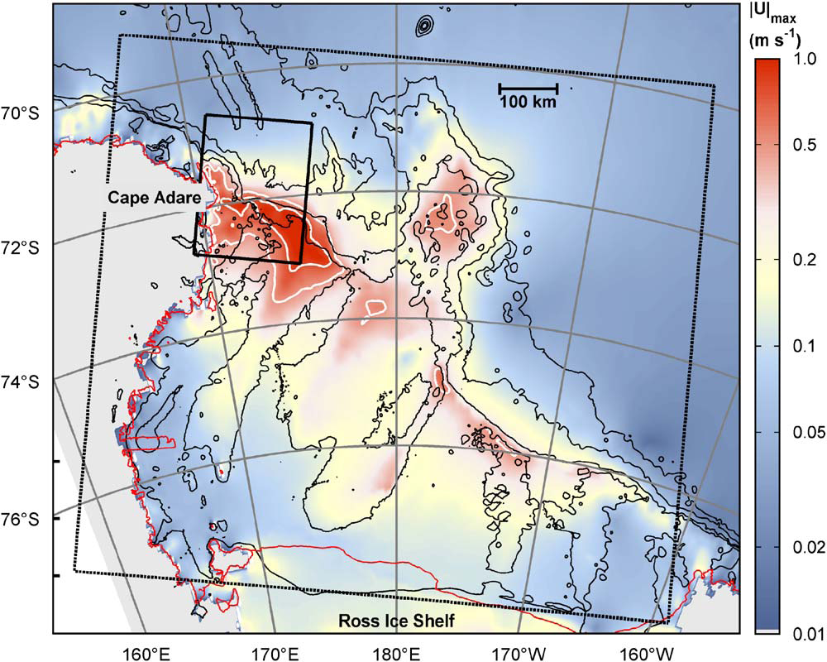
Padman et al., 2009

Slide 11
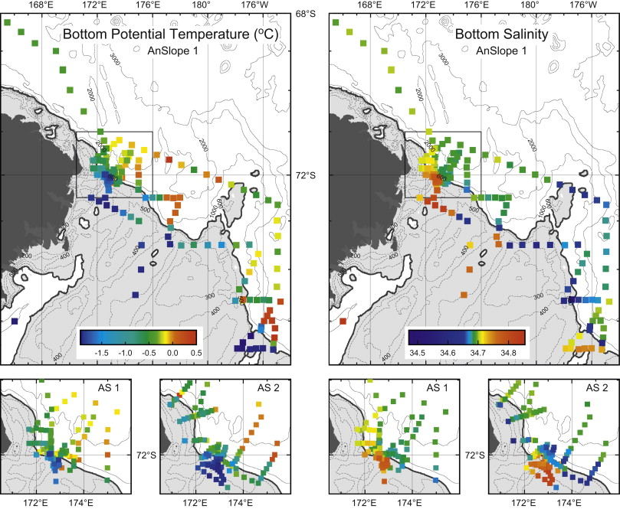
Gordon et al., 2009

Slide 12
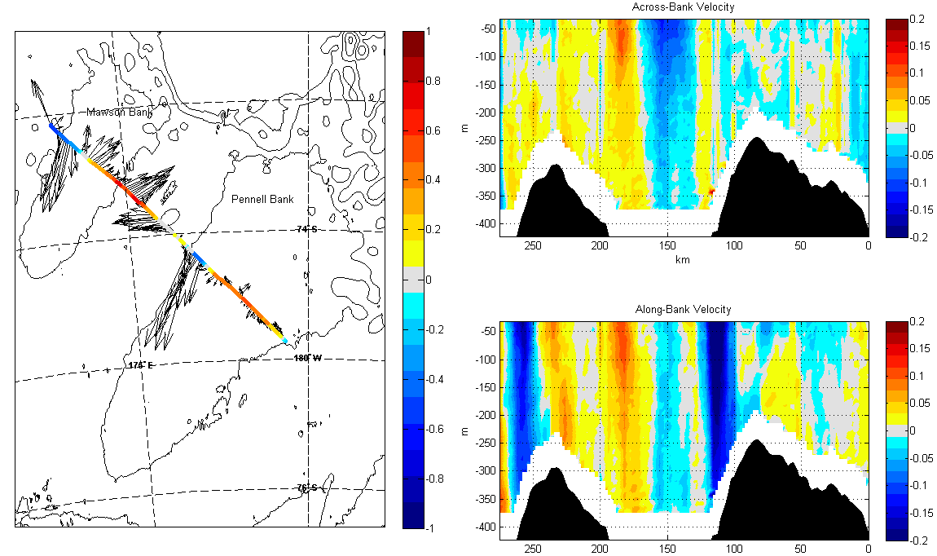
Across-Bank Sections
ADCP Velocity (m/s)
Courtesy: Josh Kohut

Slide 13
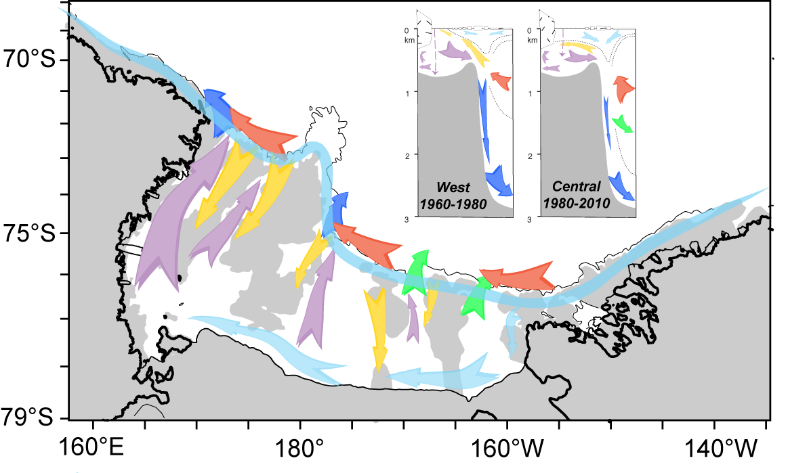
Smith et al., in press

Slide 14
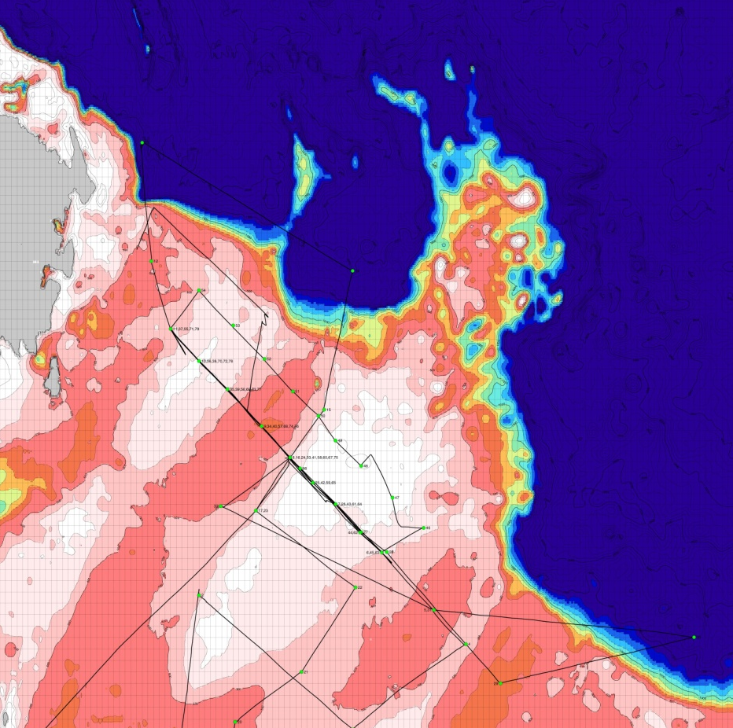
Across-Bank Sections
CTD Stations
8 Sections
Courtesy: Josh Kohut

Slide 15
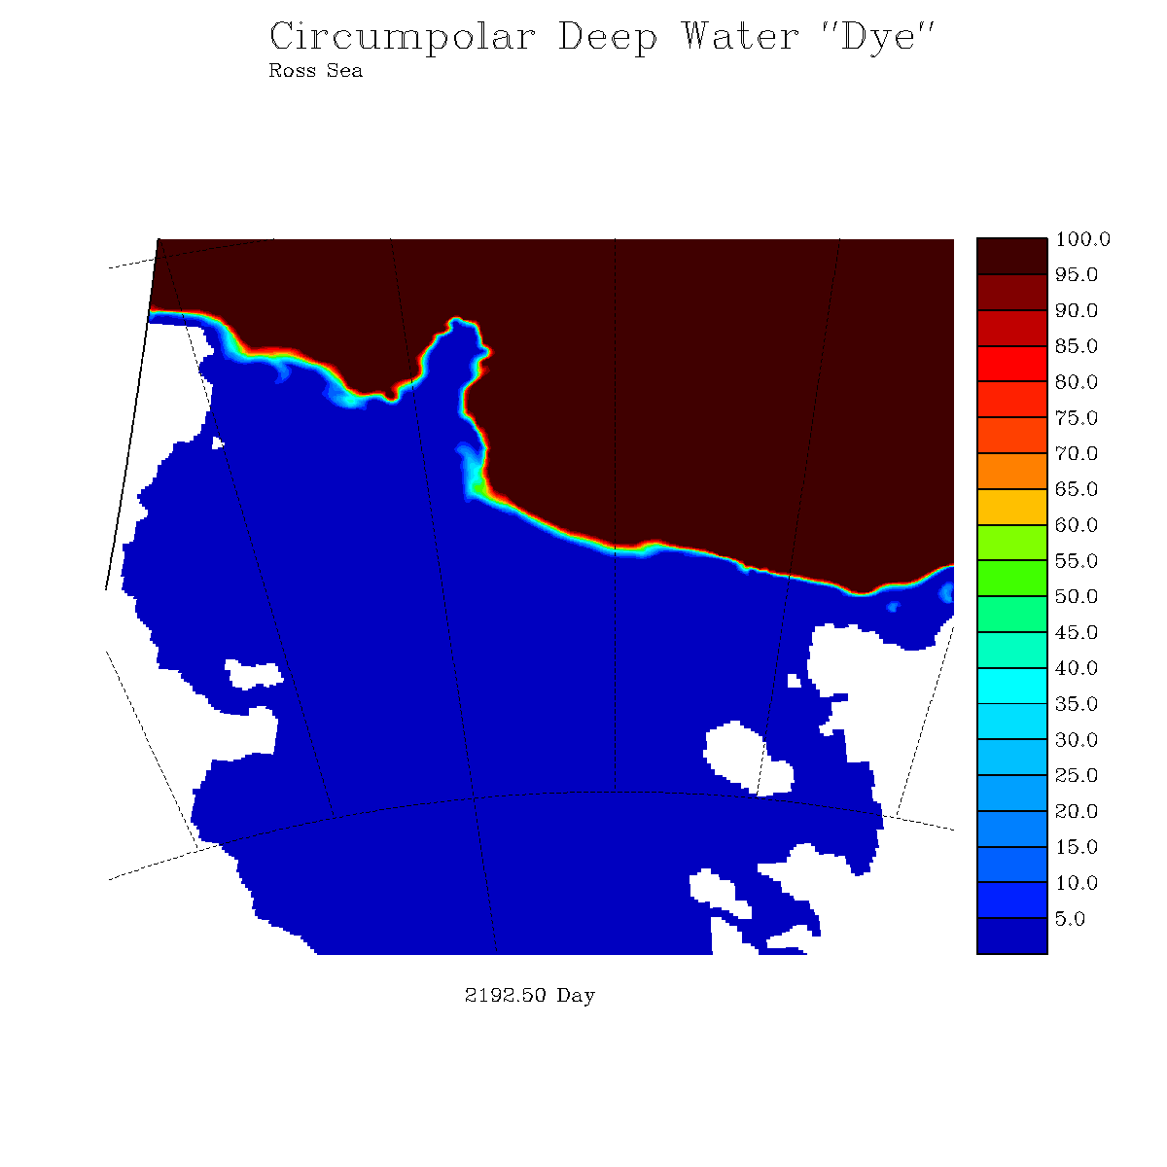
Dye concentration at depth (model level 12): 9/15/2001 – 9/15/2003

Slide 16
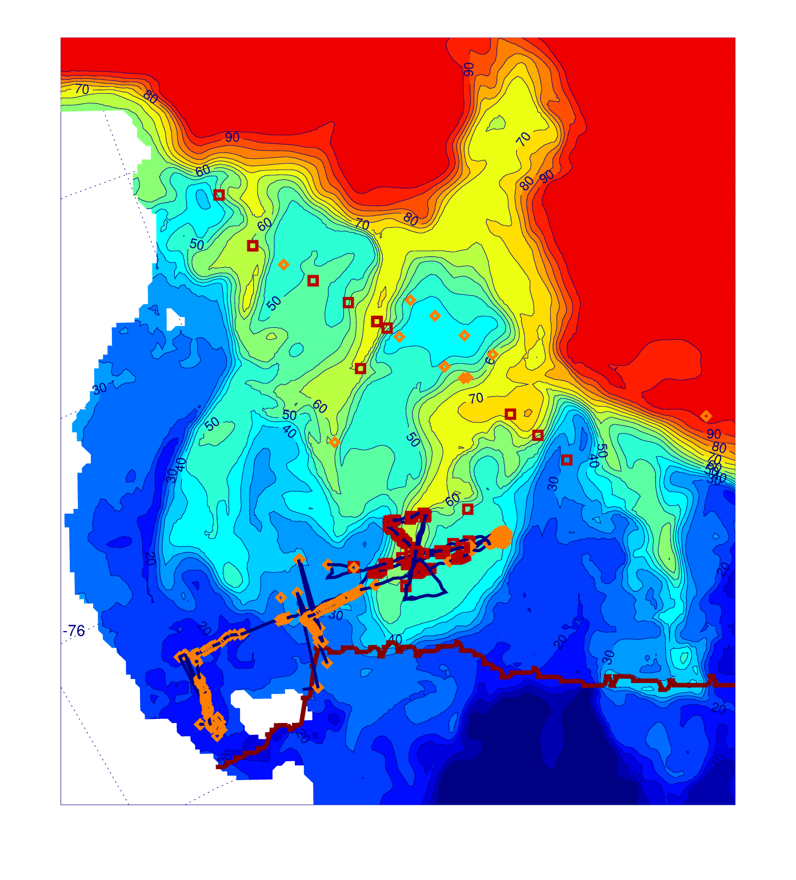
Model dye concentration (mid-depth)
vs.
observations of MCDW (red squares) or no-MCDW (orange diamonds)

Slide 17
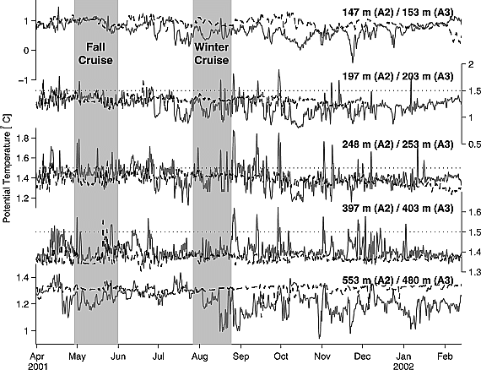
Previous view of WAP intrusion frequency: 4-6 events/year
However, this was based on broad scale hydrographic surveys
Detided, low-pass filtered time series of potential temperature at two moorings within Marguerite Trough => shows much higher intrusion frequency: 4 events/month with a 1-3 day duration
Moffat et al, 2009
Solid line: A2 – north side of MT
Dashed line: A3 – south side of MT

Slide 18
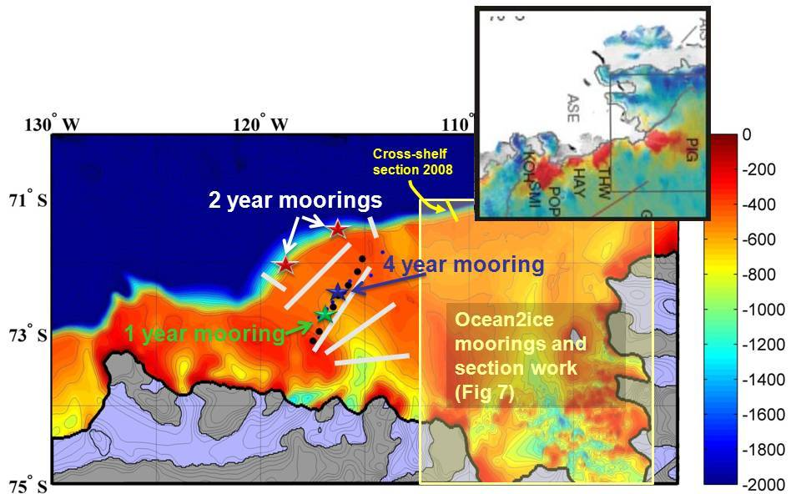
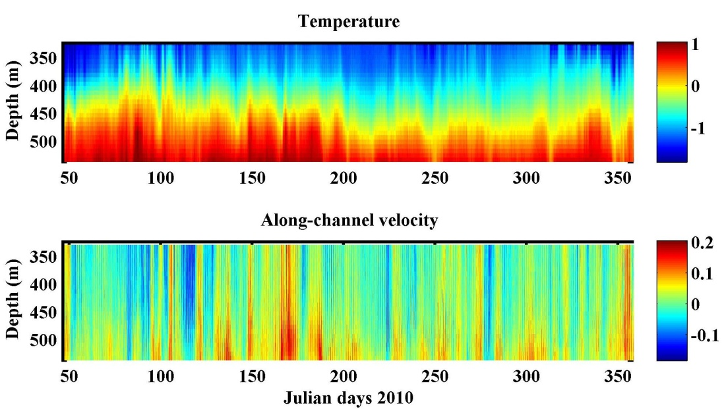
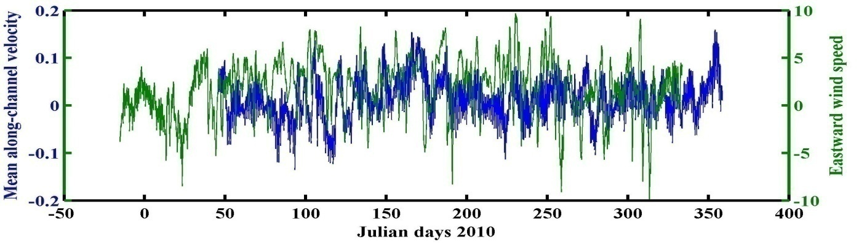
Correlation between eastward wind speed (ERA-Interim) at shelf break (green) and de-tided depth averaged along-channel velocity (blue) = 0.6
(plots courtesy of Anna Wåhlin – University of Gothenberg)

Slide 19

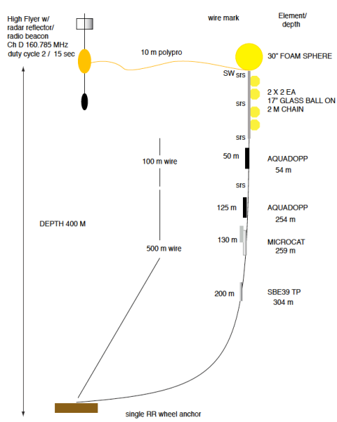
Intense Sampling
in Time
Courtesy of Bruce Huber

Slide 20
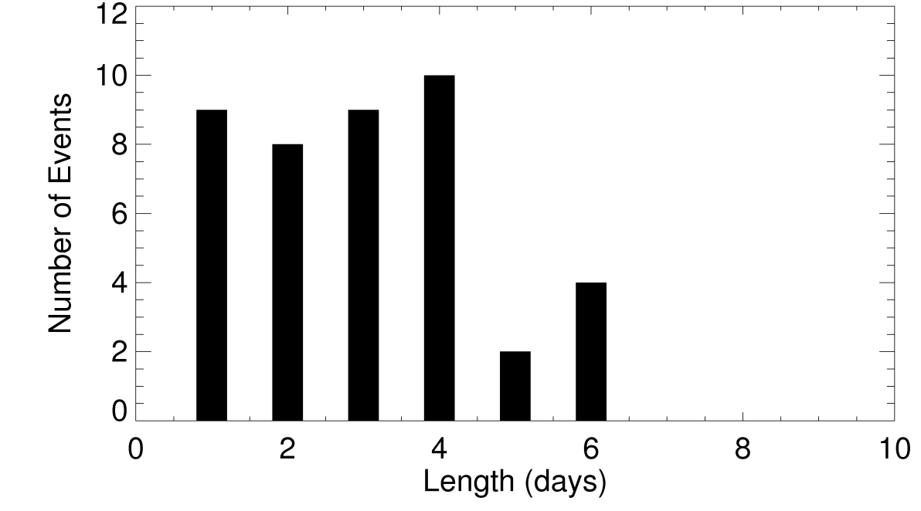
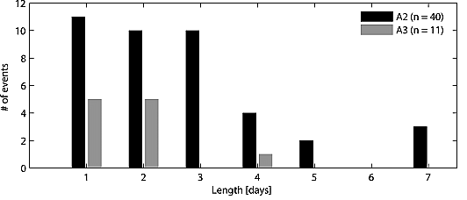
Model histogram of the intrusion duration (57 dye unit-Sv. threshold) for the entire model run
Model: 1.8 events/month
(3.0 events/month w/ 45 dye unit-Sv. threshold)
Typical duration: 1-4 d
Observed histogram of the intrusion duration
A2: 3.8 events/month
Typical duration: 1-3 d
Definition of intrusion is arbitrary, but model is much closer to mooring data than previous survey based picture of 4-6 intrusions per year

Slide 21
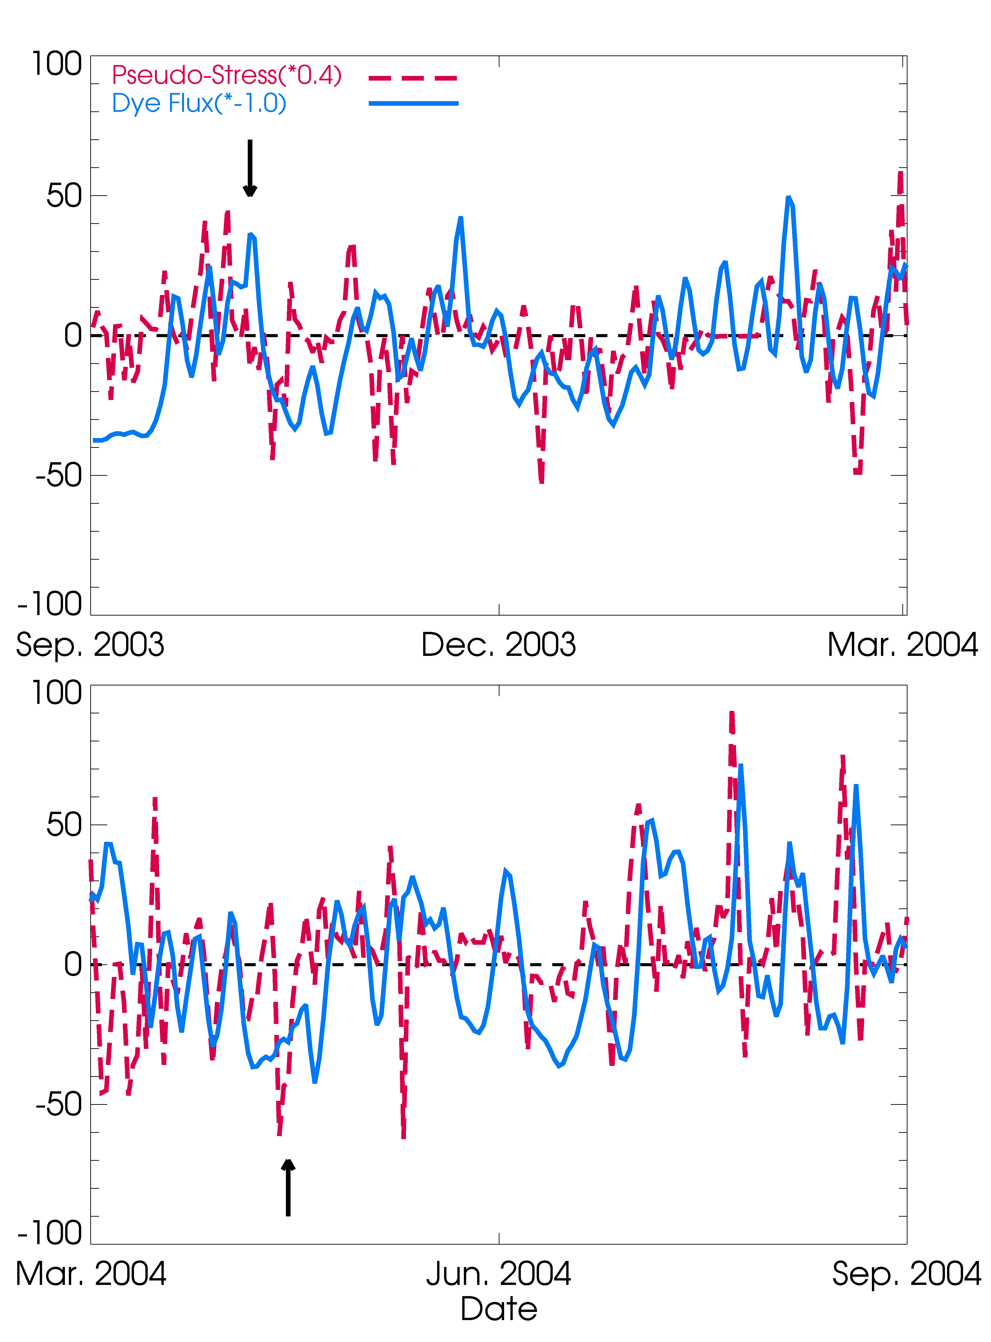
Duration of intrusions suggests wind forcing (weather band frequency: 2-8 days)
No significant correlation to wind along the trough axis, but significant lagged correlation for wind parallel to shelf-break:
r = 0.44 (wind leads dye flux by 2-3 days)
Red: Pseudo-stress (x 0.4) parallel to shelf-break
Blue: CDW-dye flux anomaly (reversed sign)

Slide 22
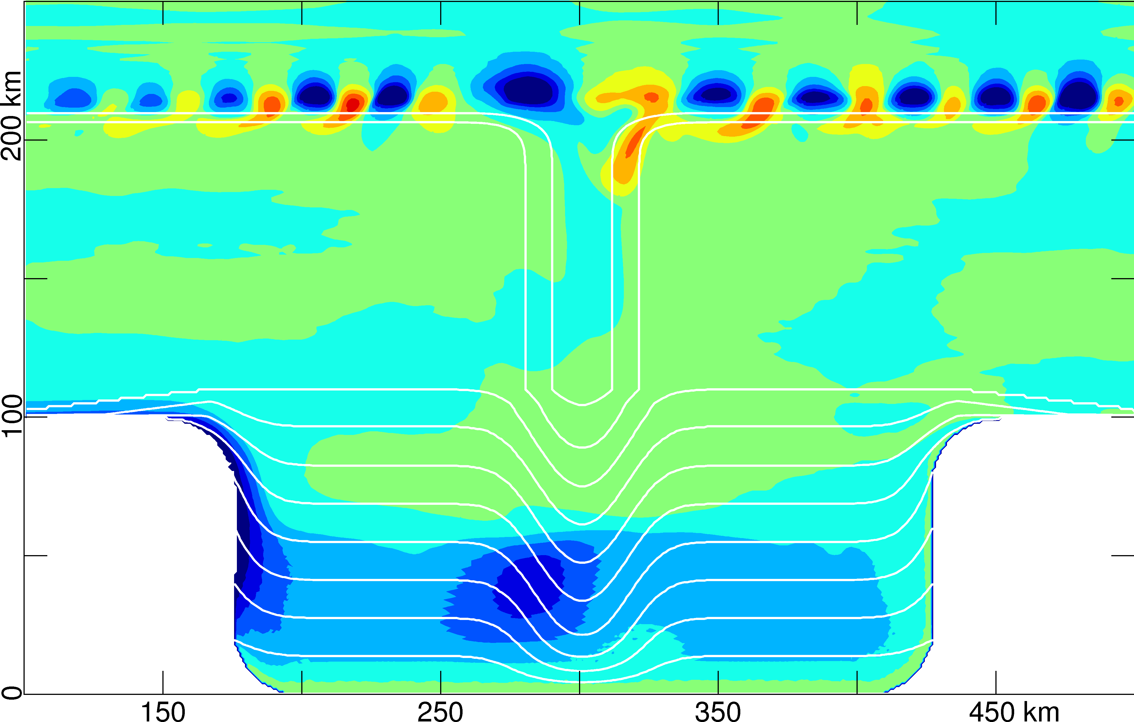
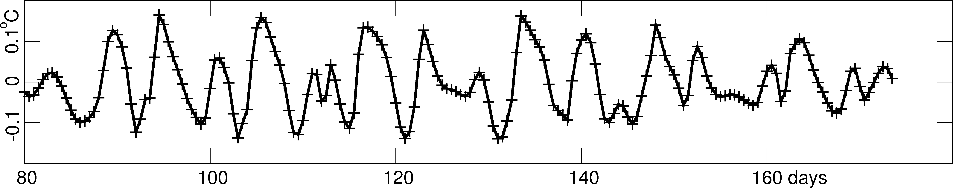
Unstable shelf break jet generates eddies within a few days.
Warm core eddies are regularly advected within the trough and (along w/ mean flow) transport heat to the ice shelf.
4-5 intrusions per month
Temperature anomaly after 10 days
Fluctuating temperature time series in trough (T ~ 6.5d)
St-Laurent et al., submitted

Slide 23
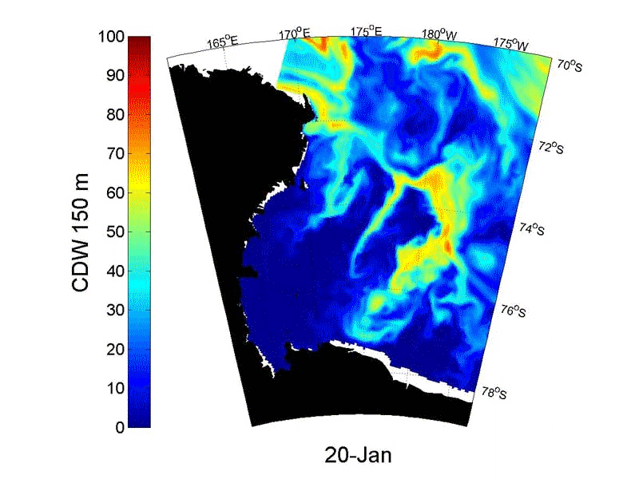
Courtesy: Kim Goetz

Slide 24
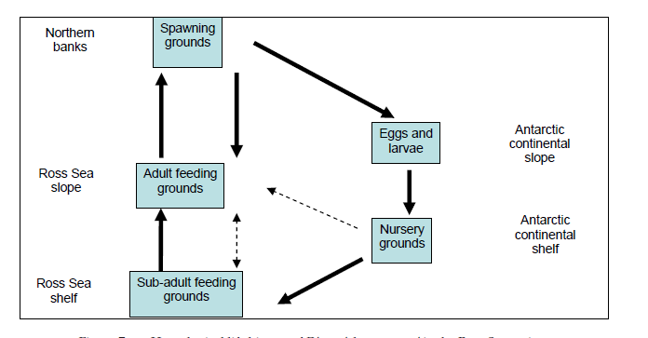
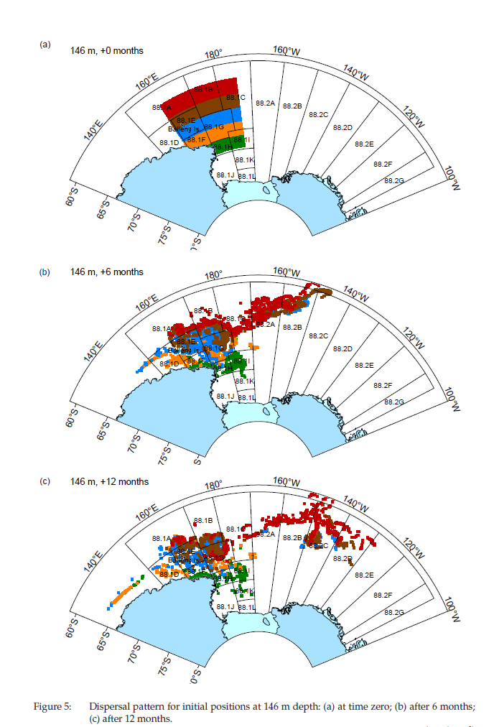
Hypothetical life cycle for Antarctic
toothfish in the Ross Sea
Hanchet et al., 2008

Slide 25
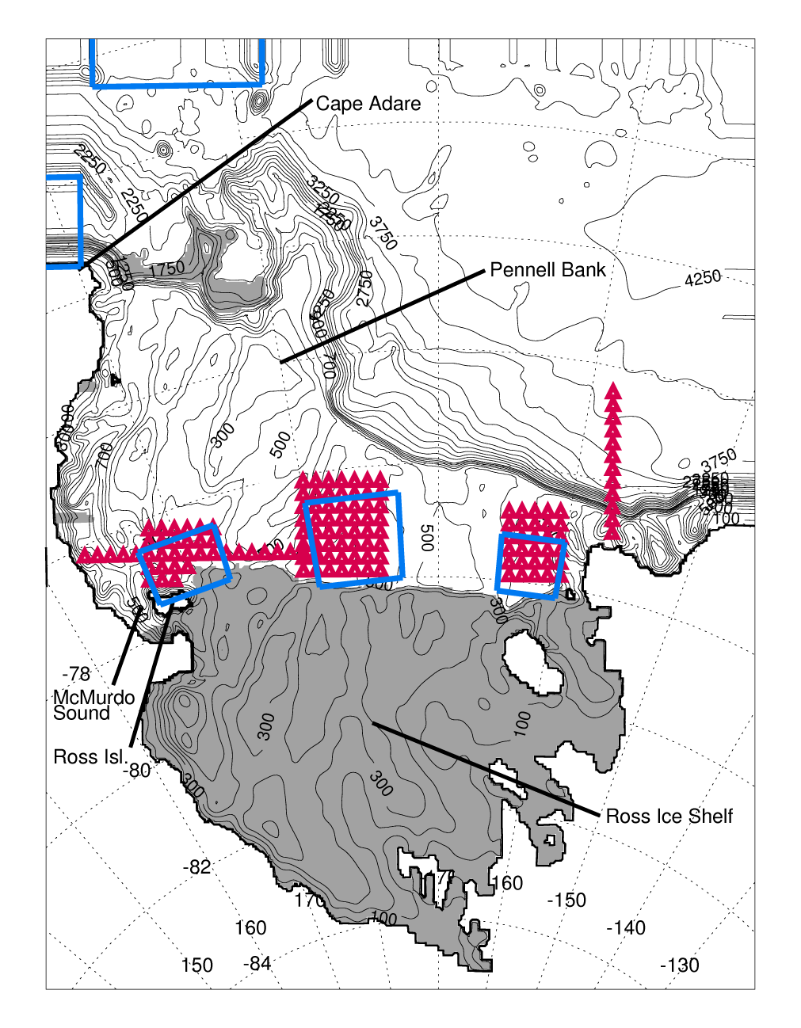
Using otolith chemistry and model particle trajectories to see how the life history of Antarctic toothfish is structured by the circulation
(Just circulation here…Cassandra to present more on this tomorrow)
5-km resolution ROMS model forced with daily winds:
9/15/2001 – 9/15/2003
Neutrally buoyant (plus vertical random walk) particles advected every model timestep
Particles released every month for the entire simulation duration
Ashford et al., submitted

Slide 26
Floats released on Nov. 1 and tracked for 400d
Eastern continental slope array (early life stages):
Surface (blue)
100m (black)
300m (yellow)
Southwestern shelf array (juvenile stages):
Bottom model layer (red)

Slide 27
Floats released on Nov. 1 and tracked for 400d
Eastern continental slope array (adults):
500m (black)
1000m (yellow)
Central shelf array (juvenile stages):
Bottom model layer (red)
Eastern shelf array (juvenile stages):
Bottom model layer (blue)

Slide 28
Proportion of drifters that reached destination boxes in 1) the western Ross Sea (WRS), 2) central Ross Sea (CRS), 3) eastern Ross Sea (ERS), 4) continental slope of the northern Ross Sea (NRS), 5) western boundary of the model domain along the northern Ross Sea continental slope (WSP), 6) northern boundary of the model domain in the western SPB (NSP).
Released from: Depth (m) No. Percentage reaching:
WRS CRS ERS NRS
Early life
Cont.Slope Surface 144 15 28 17 20
Cont.Slope 100 144 09 19 14 15
Cont.Slope 300 144 08 10 12 15
WRS CRS ERS NRS WSP NSP
Juvenile
Dryg.Basin 100 228 - 13 0 30 36 1
Dryg.Basin 400 228 - 9 0 40 45 1
Dryg.Basin Bottom 456 - 10 0 39 48 2
GC Basin Bottom 672 17 - 0 23 27 31
Eastern RS Bottom 360 7 43 - 33 32 16
WRS CRS ERS NRS WSP NSP
Adult
Cont.Slope 500 144 4 9 8 22 22 21
Cont.Slope 1000 144 3 10 10 18 16 24

Slide 29
Summary
Circulation in the Ross Sea is strongly controlled by bathymetry
Locations of MCDW intrusions are pretty well known but temporal variability is still a question
Particle simulations show that early life stages of Antarctic toothfish in the slope front current could be transported to areas in the Ross Sea where juveniles are caught; deeper flow along slope facilitates adult movement back into SPB where spawning adults are caught

