Slide 1
Next Steps in the MPA Debate
Perspectives of G. Watters

Slide 2
Background
US Delegation to CCAMLR hopes to submit and negotiate a formal proposal for an MPA in part of the Ross Sea region
It may not be possible to achieve consensus on new MPAs without 1) management plans and 2) research and monitoring plans
US Delegation is working on both, and we hope that this workshop can help flesh out #2
Agreement of new Conservation Measure (CM) in 2011 defines some requirements

Slide 3
General framework for MPAs (CM 91-04)
5. The Commission will … adopt a research and monitoring plan for an MPA.
This plan shall specify … the scientific research to be undertaken in the MPA, including …
  “research pursuant to the specific objectives of the MPA;
  other research consistent with the specific objectives of the MPA; and/or
  monitoring of the degree to which the specific objectives of the MPA are being met.”

Slide 4
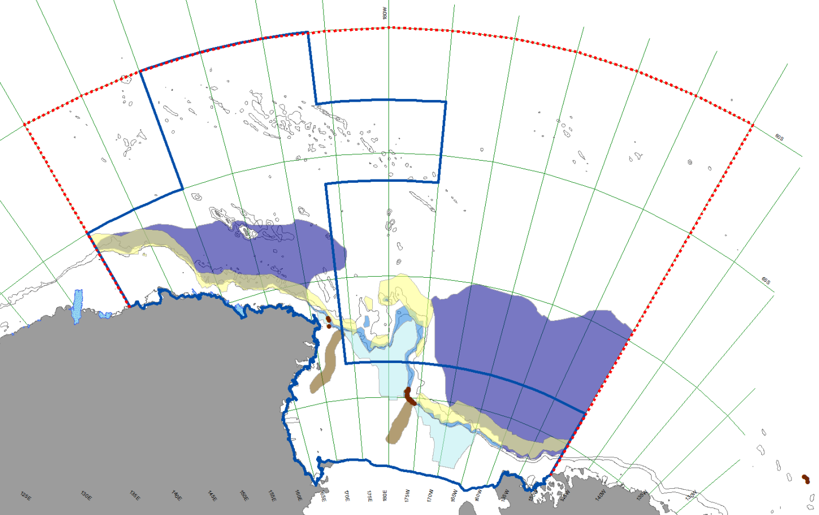
“Specific Objectives” – USA
(SC-CAMLR-XXX/9)
Conserve ecological structure and function – at all levels of biological organization – by prohibiting fishing in habitats that are important to native mammals, birds, fishes, and invertebrates throughout the Ross Sea region;
maintain a reference area in which there is no fishing to better gauge the ecosystem effects of climate change; and
promote research and other scientific activities (e.g., monitoring) focused on marine living resources.
Treatment
Control
Figure 2 – SC-CAMLR-XXX/9

Slide 5
Some questions
Is a suitably coordinated set of process studies sufficient to separate climate impacts from fishing impacts?
If so, what would such a set of process studies look like?
If not, what monitoring program would be most appropriate and useful?
Can these process studies or monitoring efforts be integrated into your research programs?

Slide 6
CM 91-04 Para. 5 Contd.
Research activities not in the research and monitoring plan shall be managed according to CM 24-01 unless otherwise decided by the Commission. [requirements for research catches of finfishes, krill, crabs, and squid]
All Members may undertake research and monitoring activities in accordance with the plan.
The data as specified in the research and monitoring plan will be submitted to the Secretariat and made available in accordance with the Rules for Access and Use of CCAMLR Data for analyses by Members pursuant to the plan.
Unless otherwise agreed, every five years Members conducting activities according or related to the research and monitoring plan will compile a report on those activities, including any preliminary results for review by the SC.

Slide 7
Additional thoughts
Consensus is not required at this workshop – if there are differences of opinion, it would be useful to understand them.
We shouldn’t need to discuss how other Members of CCAMLR (e.g., NZ, Russia, Japan) might or might not react, but if they have research expertise that can be leveraged, it would be good to know about it.
It would be nice if the product of this workshop is useful to all of us.

