Slide 1
The
Southern Ocean Observing System
Louise Newman, Mike Meredith, Oscar Schofield
On behalf of many SOOS colleagues

Slide 2
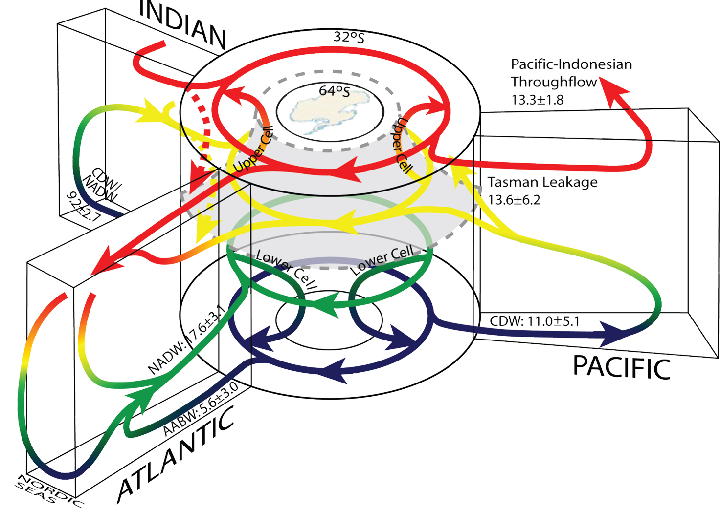
The Southern Ocean matters – for science and society
Connects all ocean basins
Site of key water mass formation
Drives global ocean circulation
Significant drawdown of CO₂
Effects global sea level
Has unique, vulnerable ecosystems
Lumpkin and Speer 2007
Notes:
- the Southern Ocean connects all other ocean basins, and is the site of formation of key water masses in the global ocean circulation, with impacts on planetary-scale climatic systems and biogeochemical cycles
overturning circulation in the Southern Ocean is a major control on carbon drawdown from the atmosphere, and hence global climate
the Southern Ocean controls the rate of deglaciation in parts of Antarctica, and hence global sea level
the Southern Ocean is home to some unique and vulnerable ecosystems, within which some species are commercially valuable

Slide 3
The Southern Ocean is changing…
Regional warming
Decreased salinity in upper and abyssal ocean
Basin-wide acidification
Regional decreases in sea ice
Shifts in ecosystems
Need to monitor and understand the changes in order to predict future changes, and mitigate impacts.
Supports the need for sustained, and internationally coordinated observations of the Southern Ocean
CSIRO
IPAB
AAD

Slide 4
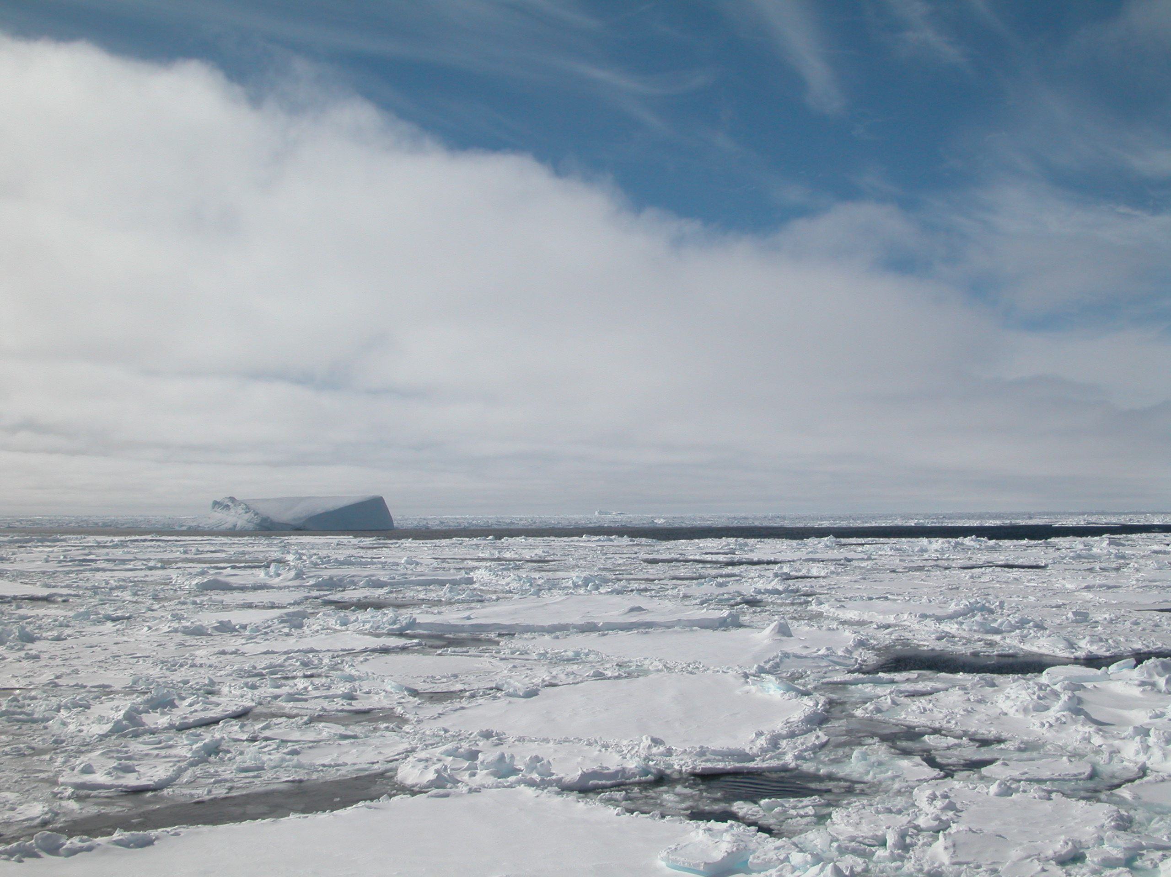
The Southern Ocean Observing System
- Many (mono-disciplinary) programmes in SO research, all with individual infrastructure, data routes etc. SOOS will connect across disciplines and programmes to ensure a coordinated approach to observing the SO.
- Sponsored by SCAR (Scientific Committee on Antarctic Research) and SCOR (Scientific Committee on Oceanic Research)
SOOS Initial Science and Implementation Strategy – developed by SCAR/SCOR Expert Group on Oceanography and the SCAR/CLIVAR/CliC Southern Ocean Panel.
International Project Office opened August 2011, hosted by the Institute for Marine and Antarctic Studies (University of Tasmania), with additional support from the Australian Antarctic Division.
Notes:
various (mostly mono-discipline) programmes have existed in the Southern Ocean for some time, each with their own infrastructures, data routes etc. Each are worthy, but the gains from genuinely cross-discipline working and shared data access have not been realised. SOOS aims to achieve these, and also chart the course for the future of sustained, strategic observations in the Southern Ocean. (Then the detail about SCAR, SCOR, IPO etc can come)

Slide 5
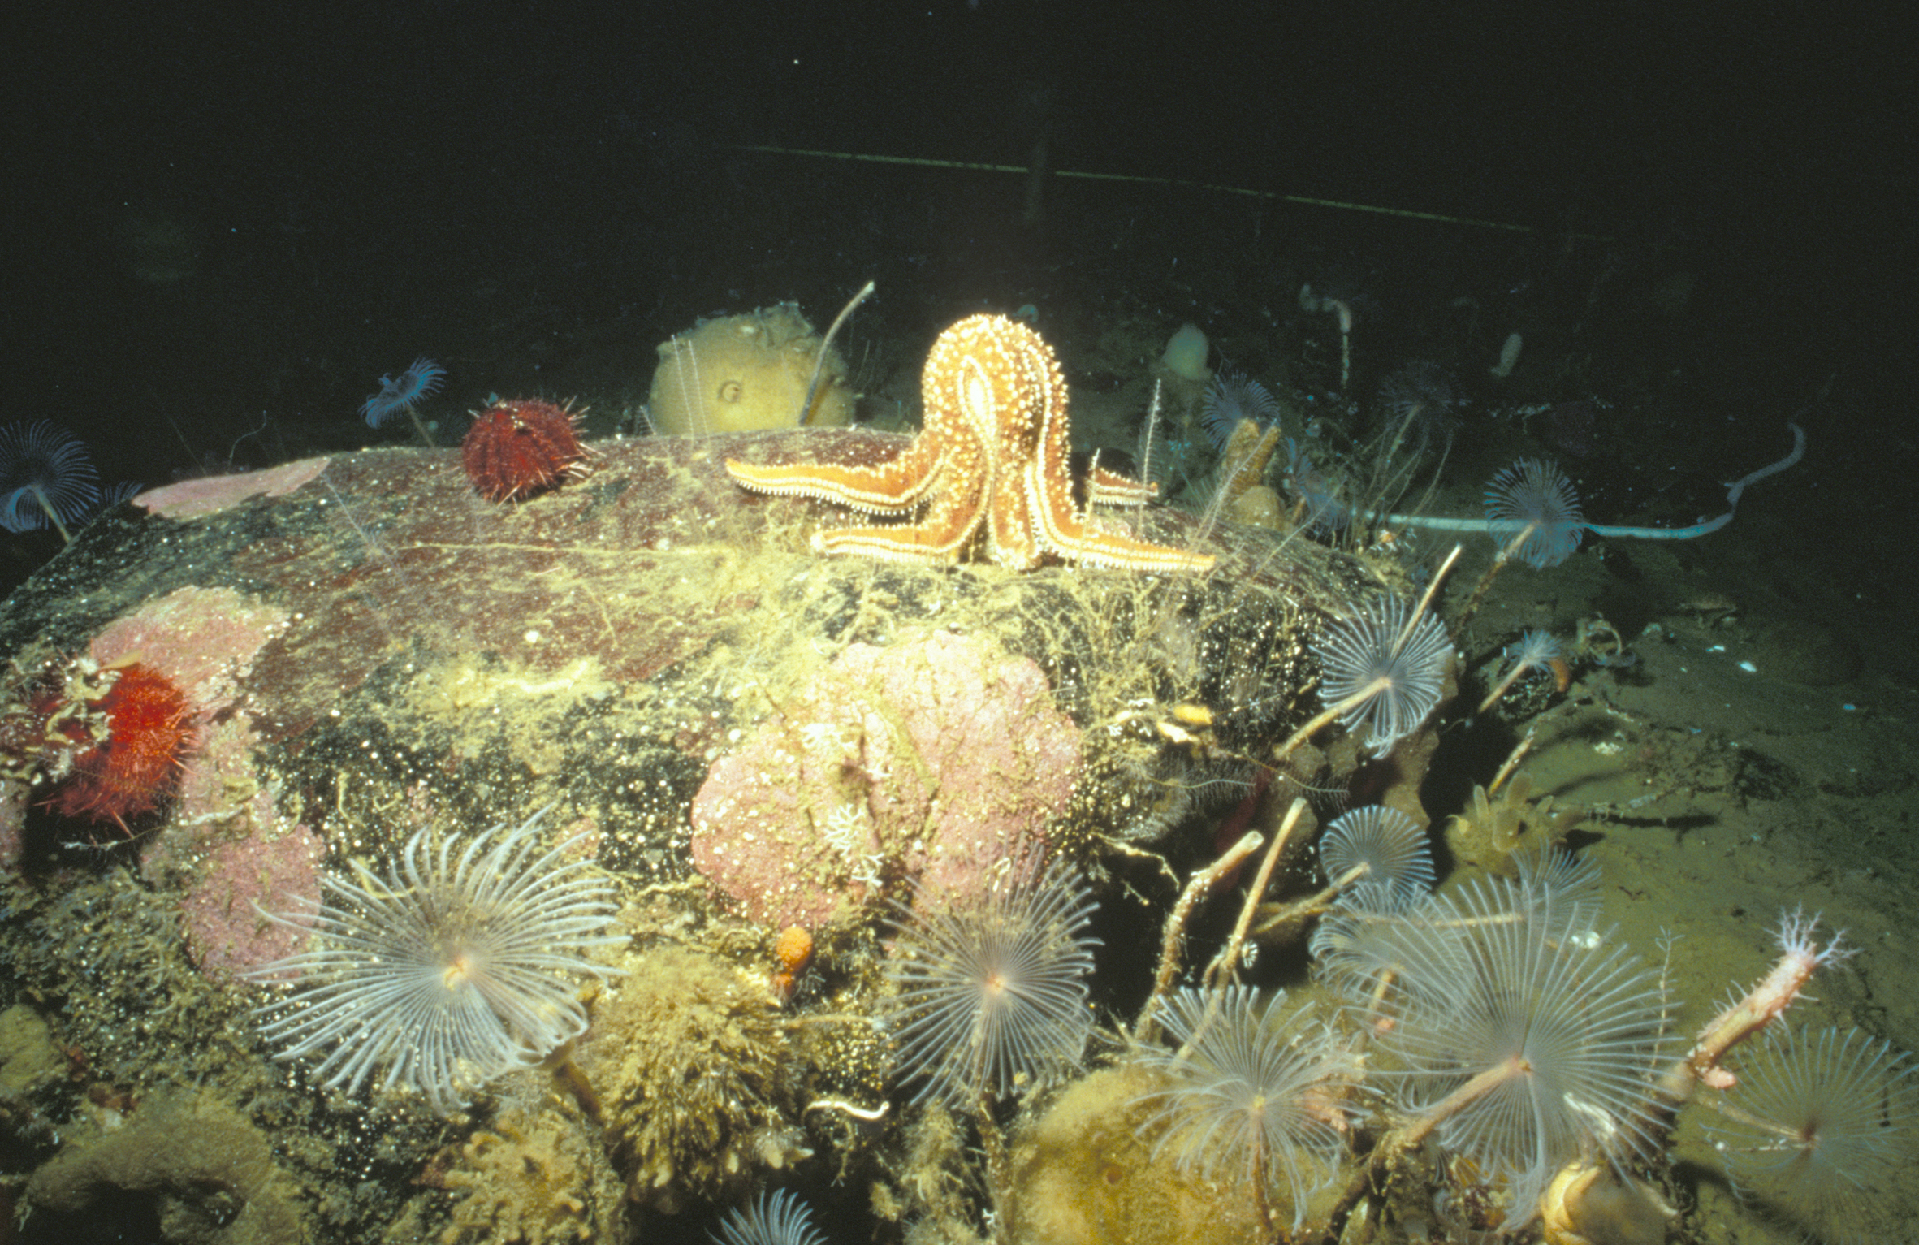
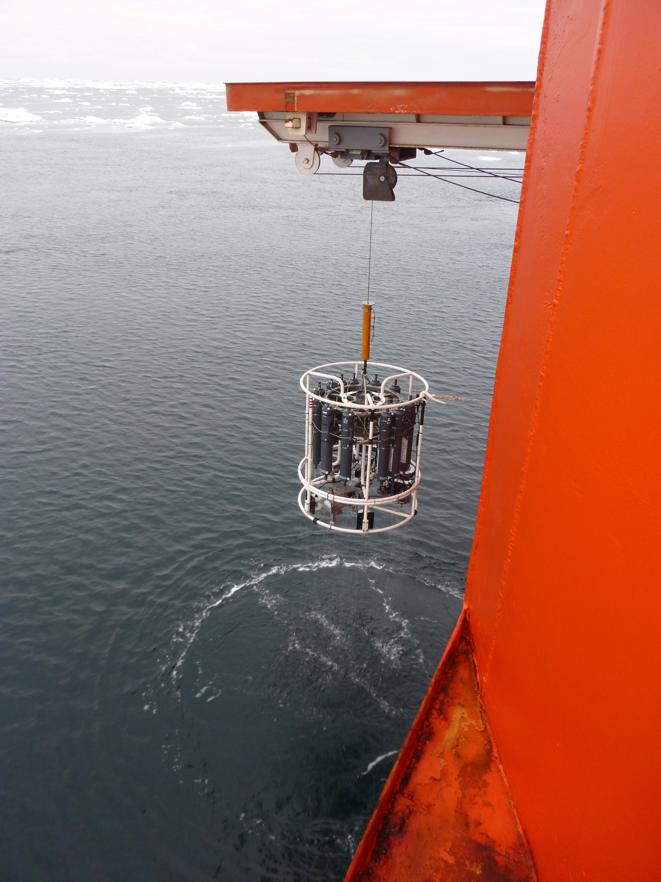
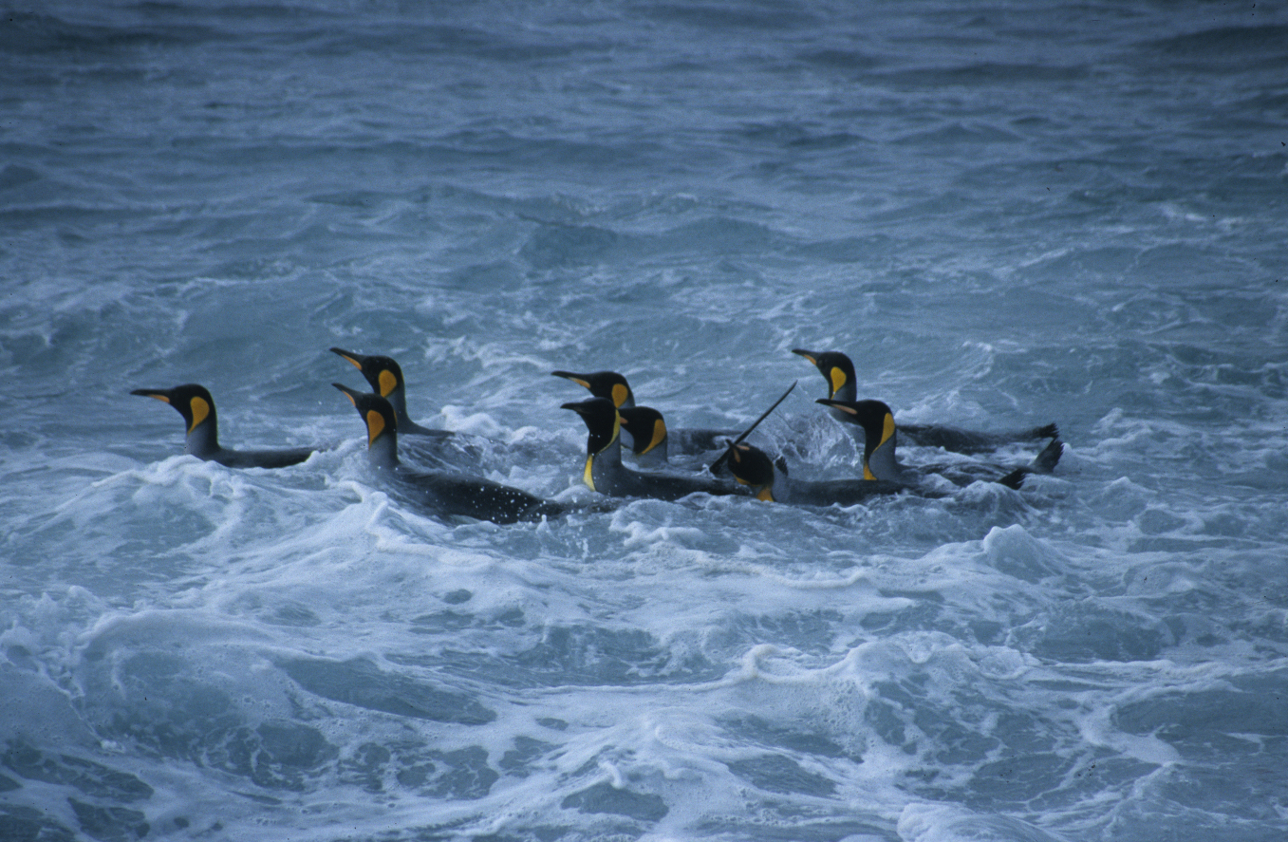
Who would use SOOS and SOOS products?
Research community
Resource managers (e.g., CCAMLR)
Policy makers (when to act? Consequences of not acting?)
IPCC
Local planners (sea-level rise)
Antarctic tourism
Shipping operators
Weather and climate forecasters
Educators
AAD
AAD
AAD

Slide 6
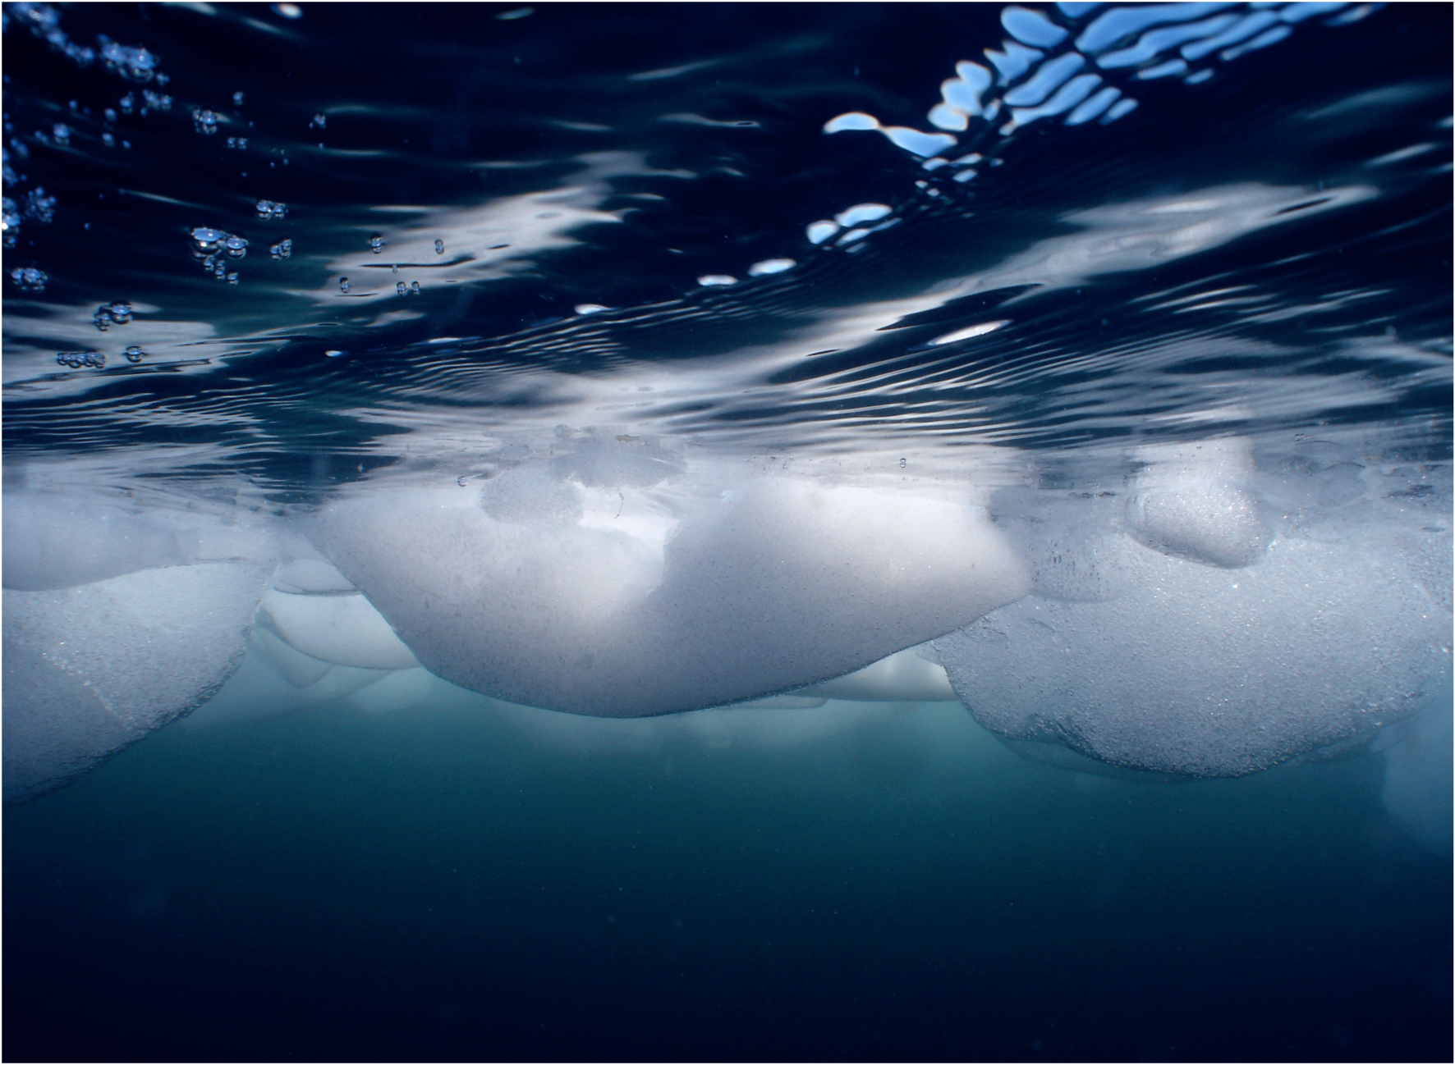
MISSION: To establish a multidisciplinary system to deliver the sustained observations of the Southern Ocean that are needed to address key challenges of scientific and societal relevance, including climate change, sea-level rise and the impacts of global change on marine ecosystems.
B. Wallis AAD

Slide 7
Scientific Steering Committee
Membership:
Expertise
Scientific standing
Programmatic connections
National representation

Slide 8
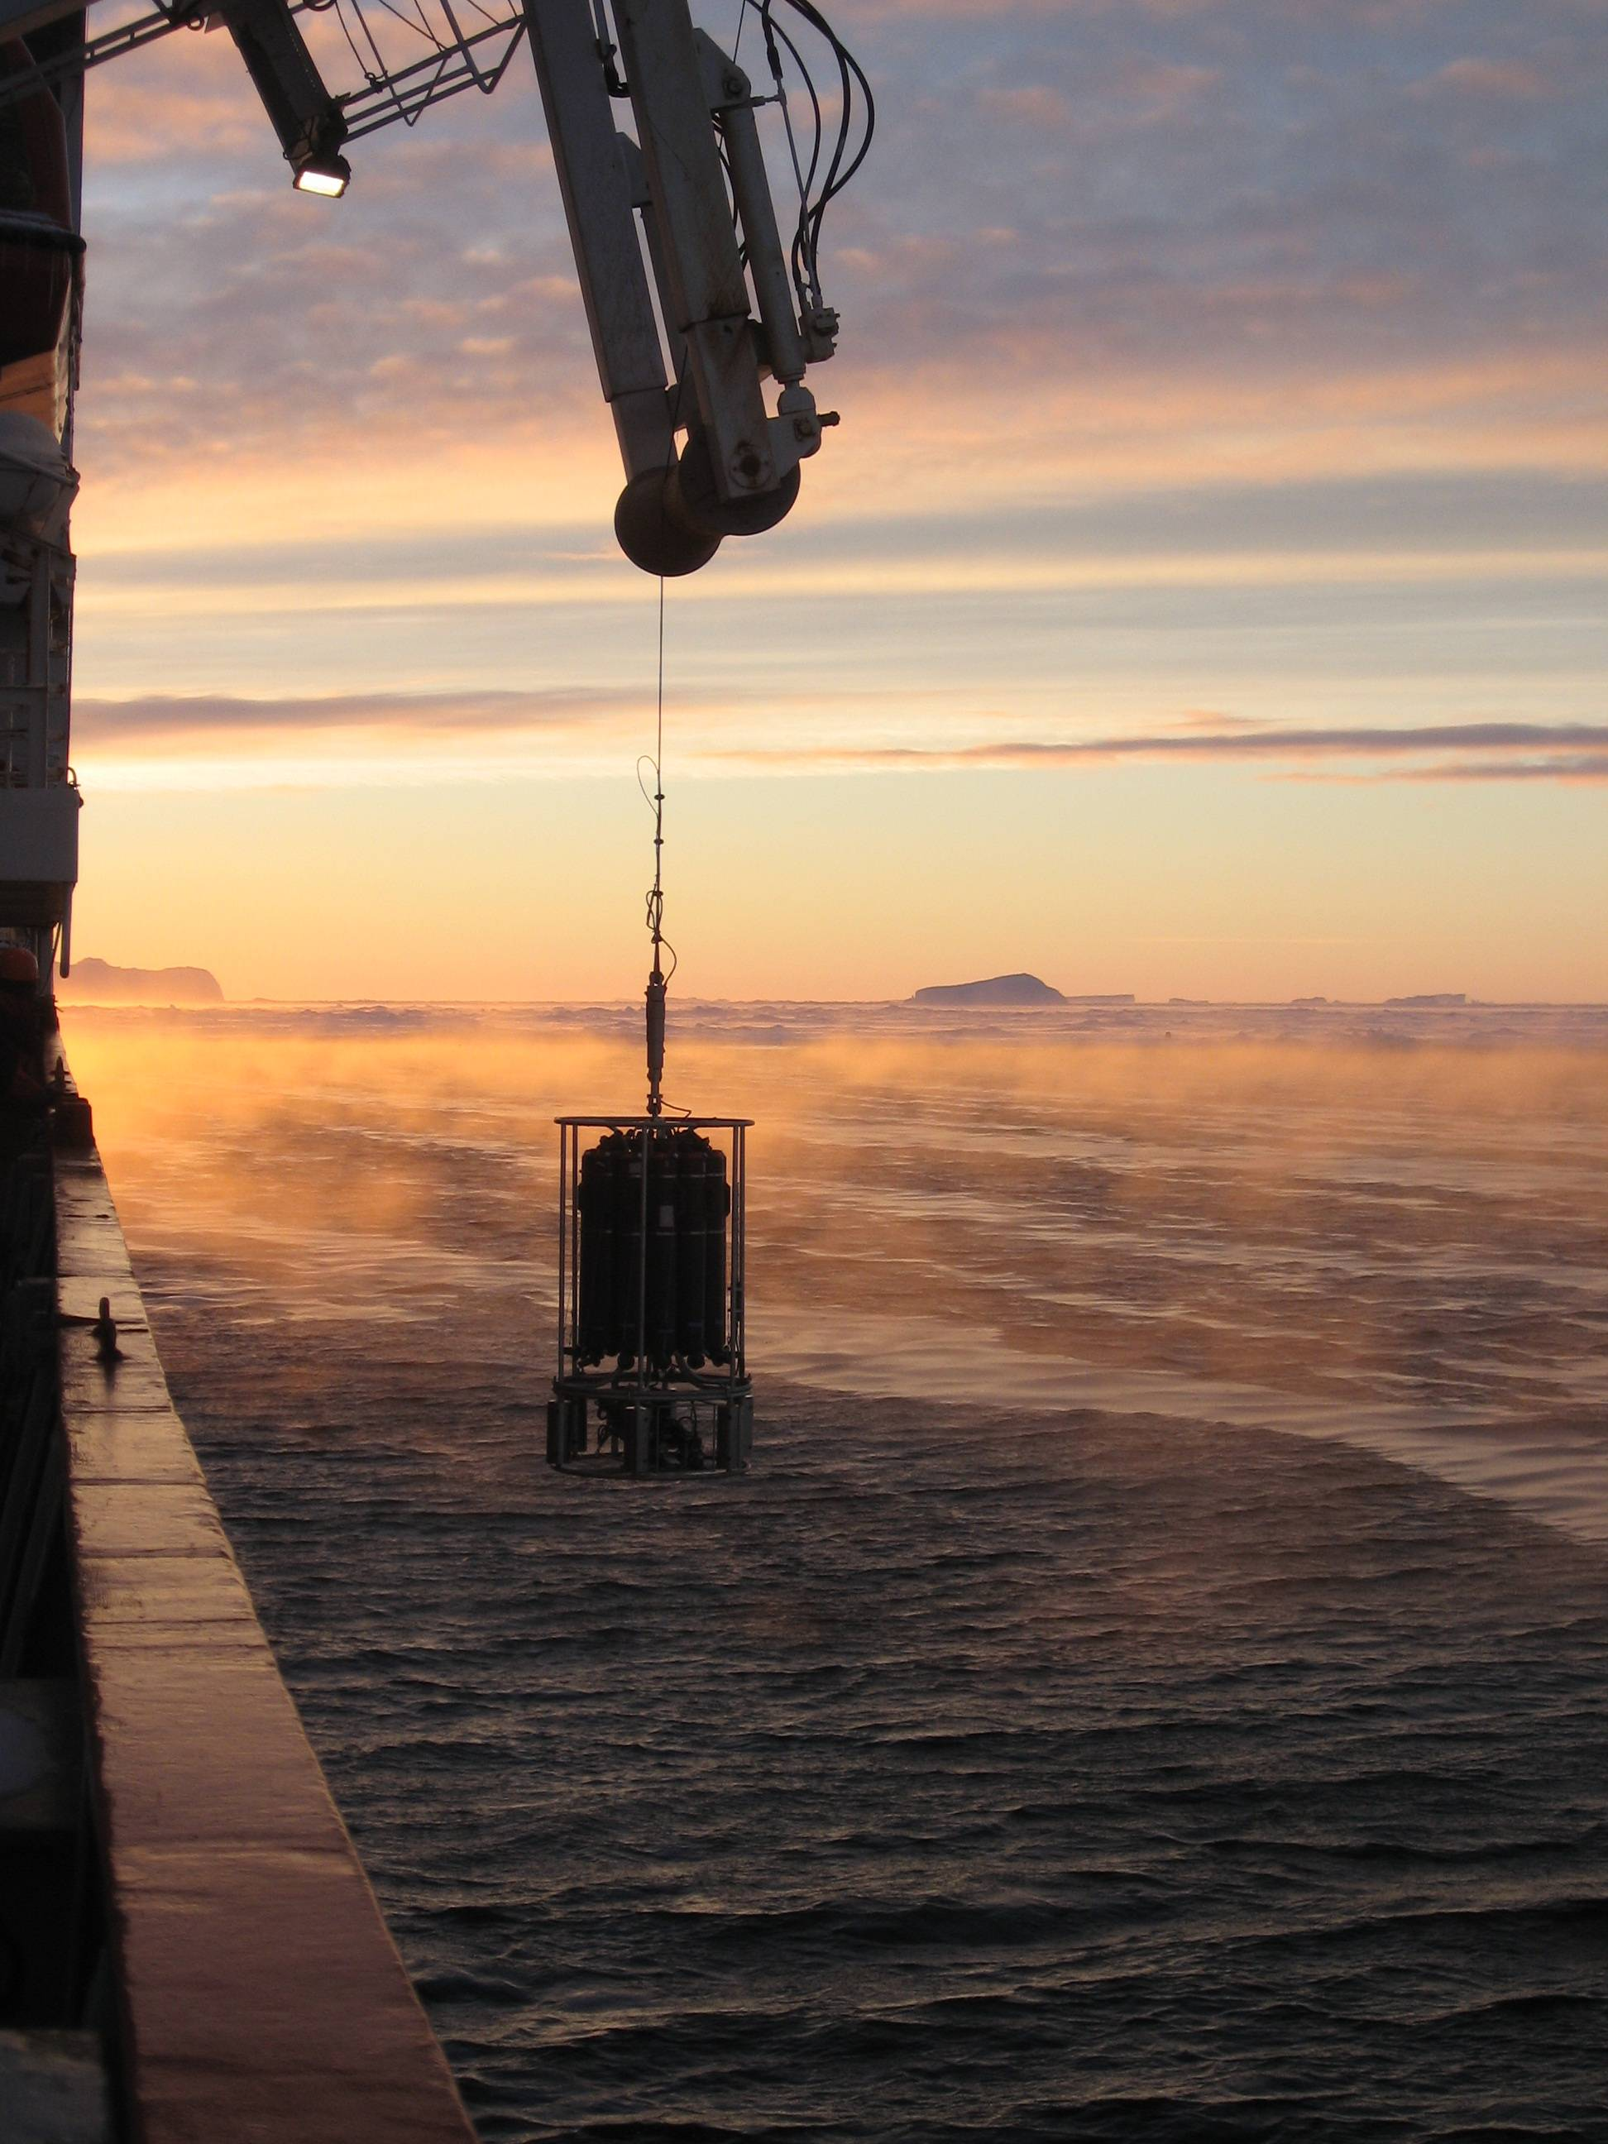
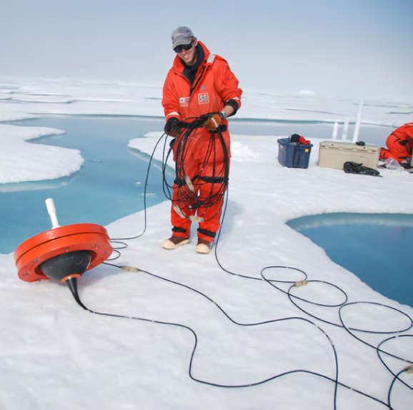
Science Themes
Key science challenges identified as most pressing issues, both scientifically and societally - to be addressed by the SOOS:
Role of Southern Ocean in global freshwater and heat balance
Stability of Southern Ocean overturning circulation
Stability of Antarctic ice sheet and future contribution to sea-level rise
Future of Southern Ocean carbon uptake
Future of Antarctic sea ice
Impacts of global change on Antarctic ecosystems
P. Holland
IPAB
Notes:
6 scientific challenges identified as being the key Southern Ocean issues that need addressing. SOOS will focus efforts along scientific themes
Outline in detail in strategy.
One important step is to articulate key questions within these themes.

Slide 9
Achieving the mission…
Many international/national programmes involved in Southern Ocean observations. SOOS will work with these to:
- Design and implement SO observing system
Advocate and guide development of new technologies
Unify current observation efforts and leverage further resources
Integrate / communicate – between nations, international and national projects, and across traditional disciplinary boundaries
Facilitate and develop a data system with seamless access to essential data and data products
Notes:
focus in on 3 of these statements with specific activities

Slide 10
SO Systems Understanding: EOVs* from Routine Observations *EOVs =Essential Ocean Variables

Slide 11
Design and implement a SO Observing System
End goal is a sustained, coherent, multidisciplinary observing system.
Design optimal sampling plans for all variables
Need quantified targets (number/frequency of required observations)
Some have already been defined, others lag behind.
- Determination of stage of readiness of EOVs* and platforms
Identification of gaps in knowledge and observations
*EOVs = Essential Ocean Variables
Notes:
The overall vision for SOOS is to design and implement a sustained, coherent, multidisciplinary observing system that provides the key data and data products required to address the key challenges identified. It will evolve over time, as new technologies develop and automated techniques mature, and will be adaptable as new challenges come to the fore
First step in implementation is to design optimal sampling plans for each variable, and integrate these plans into an overall integrated sampling scheme.
Need quantitative targets for number and frequency of observations that are required.
Already defined for some elements (eg.,, repeat hydrography, Argo). others further work is needed, and will work through Framework for Ocean Observing steps of readiness. this process clarifies what is needed to move towards a sustainable observations network at the systems level.

Slide 12
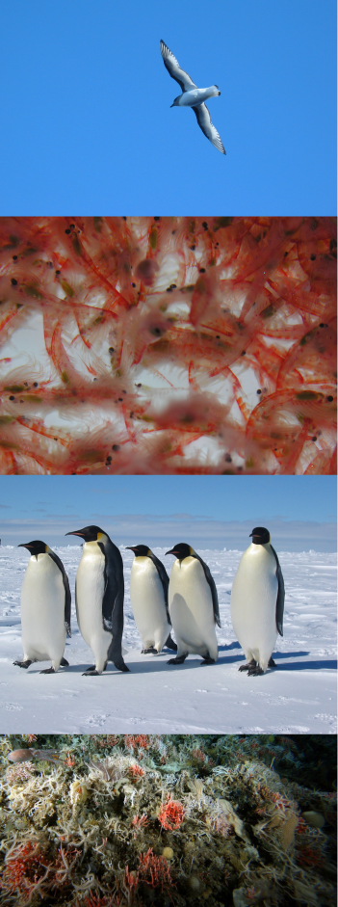
Example of SOOS development: Southern Ocean Ecosystems
Ecosystem is a challenge due to species diversity and system complexity. Work is required to identify key components of an ecosystem that must be monitored, how often, and where.
Southern Ocean Sentinel project working to address this – supported by SOOS. Sentinel will contribute to design of SOOS and is connecting physical variables with biological variables in a seamless way.
SOOS proposal for SCOR Working Group with involvement of GOOS - to identify biological parameters/variables that require monitoring on a global scale.
AAD
AAD

Slide 13
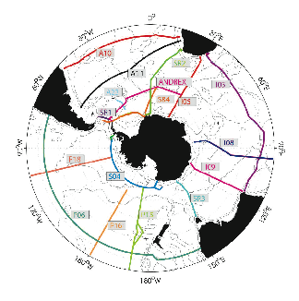
Unify current efforts and leverage resources: Examples
Hydrographic sections
Addition of biological sensors
National “ownership” of sections by countries not yet involved (Korea, China etc)
Extension of sections through the sea ice
Extension of the SOOP (Ships Of OPportunity)
Deployments from fishing vessels through collaboration with CCAMLR
Deployments from tourist vessels, through collaboration with IAATO
Notes:
Many projects and programmes, efforts are rarely coordinated = stretch the limited resources. SOOS will identify where efforts can be combined.
e.g., reoccupation of hydrographic sections will be a key component of the SOOS implementation. Advocate for the inclusion of , for example biological sensors.
Funding for some sections is not secure, countries like China and Korea with resources and interest in contributing = propose national “ownership” of sections.
Sea ice community calling for the sections to be extended into the sea ice zone where possible
SOOS will leverage additional resources through use of ships of opportunity .e.g., CCAMLR = close ties to the international southern ocean fishing community and discussions within CCAMLR for better training of fishery observers. Indications from CCAMLR that they are interested in working with the SOOS towards deployment of platforms on fishing vessels.
Additionally, SOOS will connect with the international association of Antarctic tourist operators to look at options for collaborations and use of their ships for instrument deployment.

Slide 14
Delivering the outputs
Key goal: develop a unified Southern Ocean data portal to enable easy access to relevant data and data products. This requires investment, but the scientific and societal return would be significantly greater.
Data Management Sub-Committee = representatives from international, national and programmatic data centres.
- Tasked with developing the data policy
- Identifying data products to provide and infrastructure required
- Advocate for data contributions
Notes:
A key goal of the SOOS = provision of easily accessible data. Data portal a priority
Data management sub committee composed of representatives from key international national and programmatic data centres = key goal to identify ways to provide community with information. They will develop the SOOS data policy and advocate for access to data (e.g., China).

Slide 15
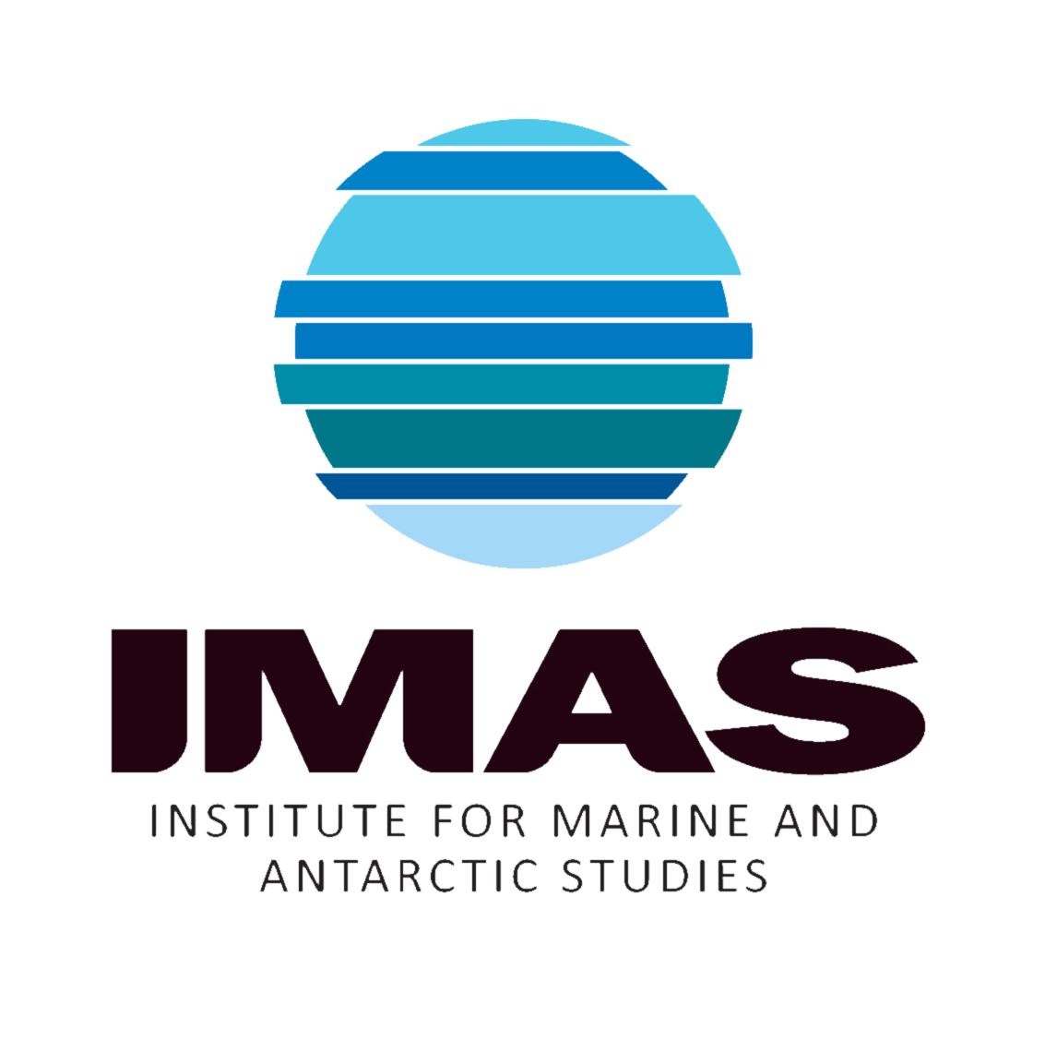
Want more information?
Contact the SOOS International Project Office:
Louise Newman (Executive Officer) newman@soos.aq
or
Check out the SOOS website at www.soos.aq
IPO hosted by:
The Australian
Antarctic Division

Slide 16
SO Systems Understanding: EOVs* from Routine Observations *EOVs =Essential Ocean Variables

Slide 17
Ecosystem Monitoring
Ship Underway measurements: Fluorescence, FRRF, Continuous Plankton Recorder along with pCO2, pH Acoustics. (Sentinel Transects in Ross Sea)
CEMP (CCAMLR Ecosystem Monitoring Program)-Establish node in the Ross Sea
Ecosystem monitoring, LTER and AMLR cited as examples. Needed in Ross Sea?
5-year Repeat Survey of Crabeater Seals-use of airborne drones.
Trackers/CTD on Seals, Penguins, GLS trackers on seabirds.

Slide 18
Marine Mammal Tracking

Slide 19
Southern Ocean Sentinel Workshop
The IMBER program, Integrating Climate and Ecosystem Dynamics of the Southern Ocean, is holding a
workshop on 7-11 May 2012 in Hobart with the following objectives:
1. Consolidation of a risk assessment of climate change impacts on Southern Ocean biota, including
how they may be represented in food web models:
a. taking account of existing works, to finalise a synthesis for publication in the primary
literature on
i. current change in Southern Ocean ecosystems
ii. prognoses for future change based on IPCC 5 scenarios
iii. key uncertainties for predicting change
b. to further develop approaches to modelling Southern Ocean foodwebs and ecosystems to
facilitate
i. assessing current and future climate change impacts
ii. management of Southern Ocean fisheries and the conservation of biodiversity
iii. designing field monitoring strategies.
2. Consider strategies for measuring change in Southern Ocean marine ecosystems, including shipbased
and land-based monitoring and integrated study areas, by
a. further developing a scoping paper, and
b. establishing a suitable implementation plan.

Slide 20
SO Heat and Freshwater Balance
Repeat Hydrography-P15(170W), P16(150W) with extension through Ross Sea to the coast.Repeat Hydrography-SO4 (zonal section 60S with Balleny Is “Hook”
Expanded ARGO Floats, SO to ARGO Standard of 4 Floats per 10x10 degree box, Ice-Capable

Slide 21
SO Heat and Freshwater Balance

Slide 22
ARGO Floats-Ice Capable and Expanded Sensors

Slide 23
Moored Arrays-Continuous Measurements

Slide 24
Future of Antarctic Sea Ice Sea Ice Thickness Fields from Ship Obs

Slide 25
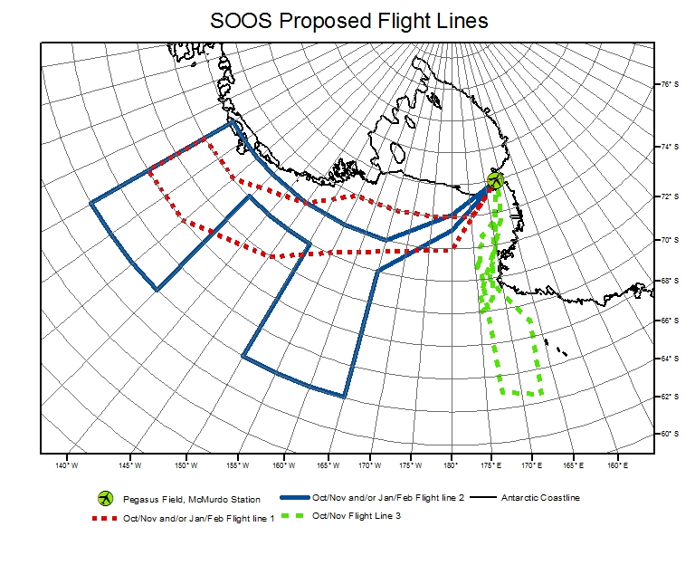
Antarctic Sea Ice Airborne Lidar And Photography

Slide 26
Digital Photos APIS 2000

Slide 27
Antarctic Sea Ice Airborne Lidar and Digital Photography

Slide 28
Gordon Research Conference on Polar Marine Science
9-10 March 2013, Gordon Research Seminar for Grad Students, PostDocs, Early Career Researchers (Travel Money available)
10-15 March 2013 GRC
Ventura CA,
www.grc.org, Future Meetings, Polar Marine Science
Chair, Christine Michel, Canada,
Vice-Chair, Paul Wassmann, Norway

