Slide 1
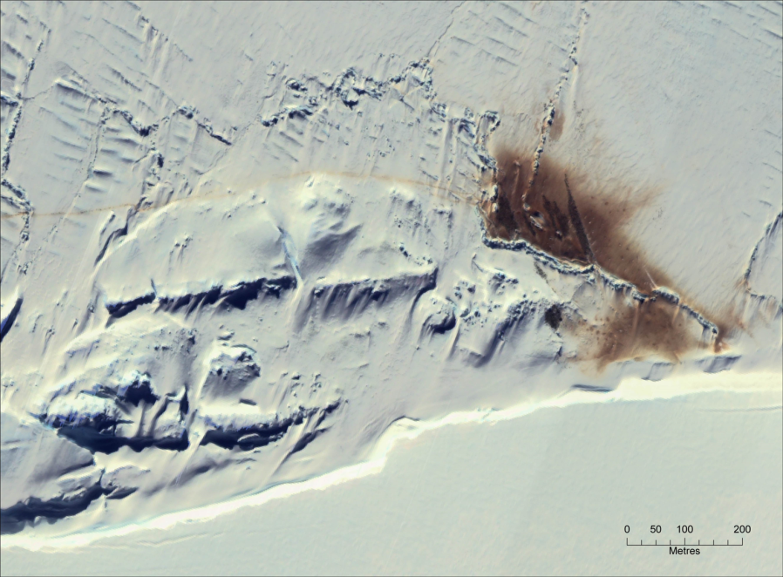
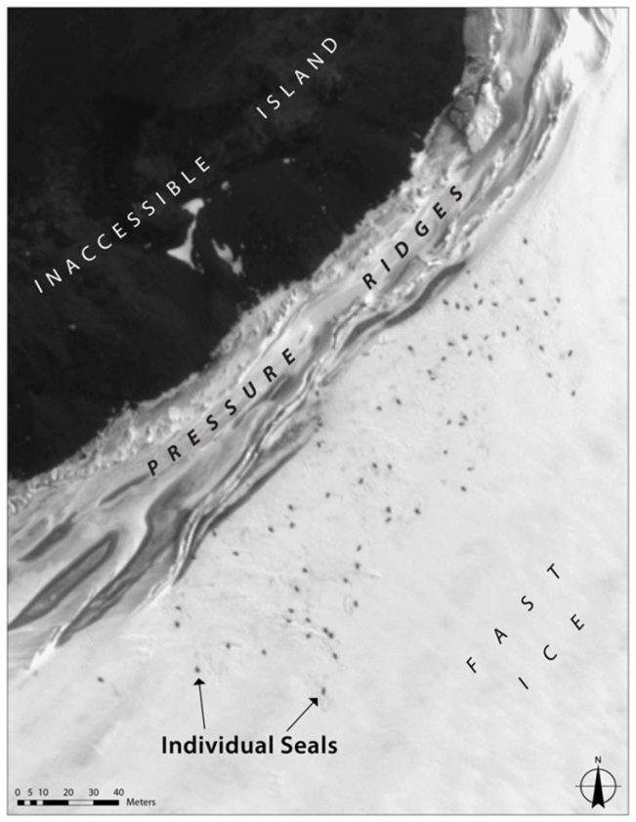
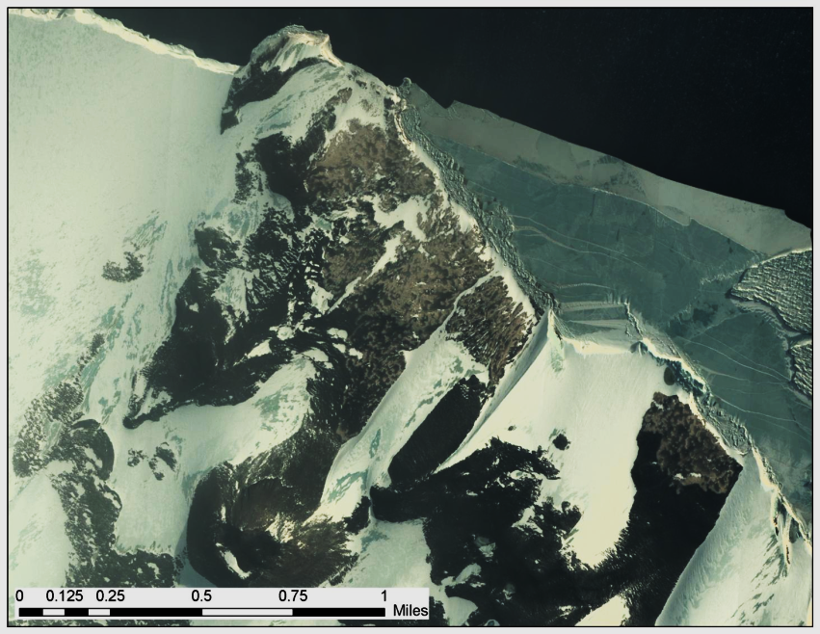
Monitoring the Ross Sea from Space: Applications of high-resolution imagery
Michelle LaRue

Slide 2
Overview
Background on high-resolution imagery
Current research
Pilot stages: emperors, Adelies, Weddells
Moving forward
Weddell seals along NVL
Capabilities
Monitor populations through time
Applications to other species
Spot fishing vessels

Slide 3
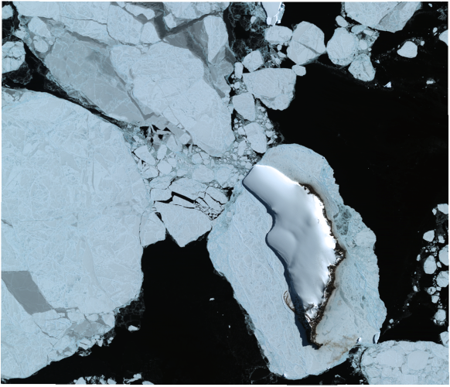
High-resolution Imagery
Digital Globe and GeoEye (<1m resolution)
5 satellites
0.6 m panchromatic (WorldView-1)
4-band ms (QuickBird-2), 8-band ms (WorldView-2)
GeoEye and IKONOS (1-5 m)
Polar revisit: 5 times/day
NGA contract
>500,000 archive

Slide 4
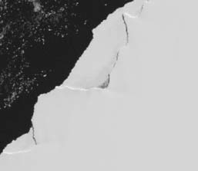
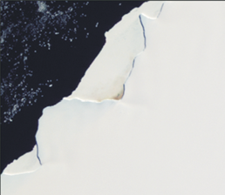
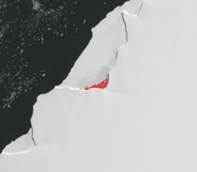
Penguin Poo from Space (Fretwell and Trathan 2009)

Slide 5
Notes:
Add more data from Peter’s first paper

Slide 6
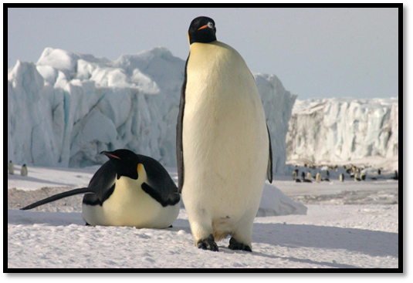
Penguin Poo from Space- Version 2

Slide 7
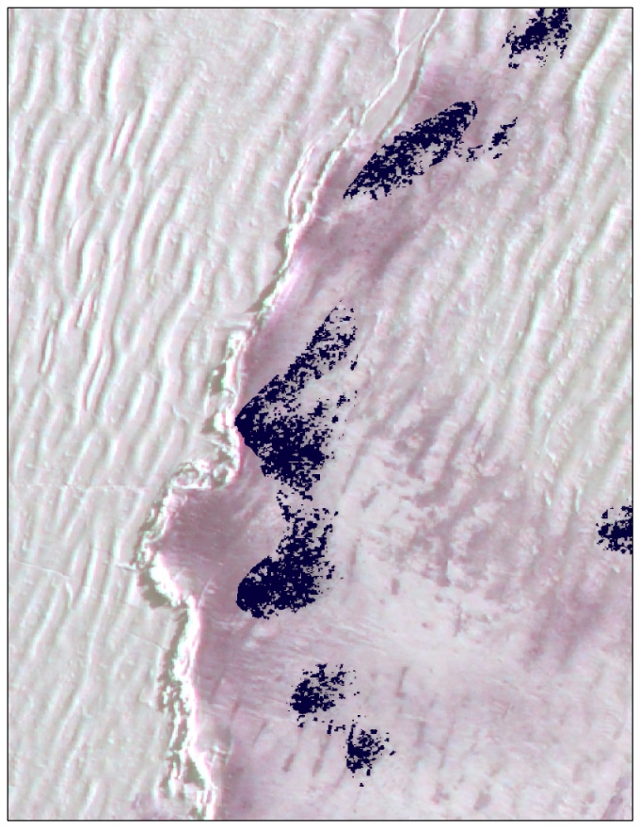
Supervised Classification
Huddles and guano
Training the computer
Penguin pixels
Notes:
Pan-sharpen the imagery, train the computer, max. likelihood calculation, penguin area, convert to # animals
238,000 breeding pairs (+/- ~20,000)

Slide 8
Ross Sea Emperors
Name | Date | Bird Estimate | PLC | Source
Cape Washington | 16-Oct-09 | 11,808 | 16,822 | Barber-Meyer et al. 2006 adults
Beaufort Island | 12-Oct-09 | 1,641 | 1,312 | Barber-Meyer et al. 2006 adults
Franklin Island | 13-Oct-09 | 7,561 | 2,460 | Barber-Meyer et al. 2006 adults
Cape Crozier | 11-Oct-09 | 303 | 437 | Barber-Meyer et al. 2006 adults
Coulman Island | 16-Oct-09 | 25,298 | 31,432 | Barber-Meyer et al 2006 adults
Cape Roget | 16-Oct-09 | 9,505 | 7,207 | Barber-Meyer 2008; chicks 1996
Total: 56, 116 pairs

Slide 9
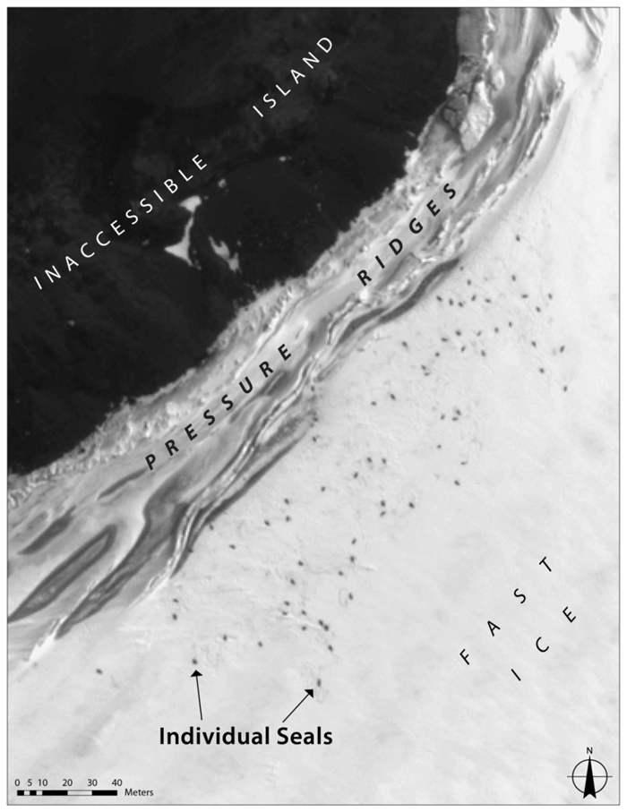
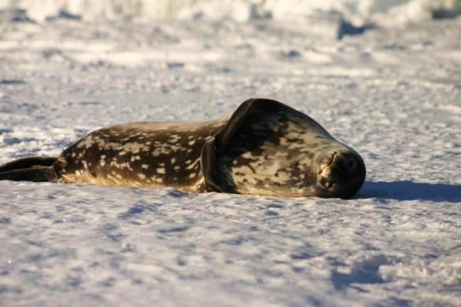

Slide 10
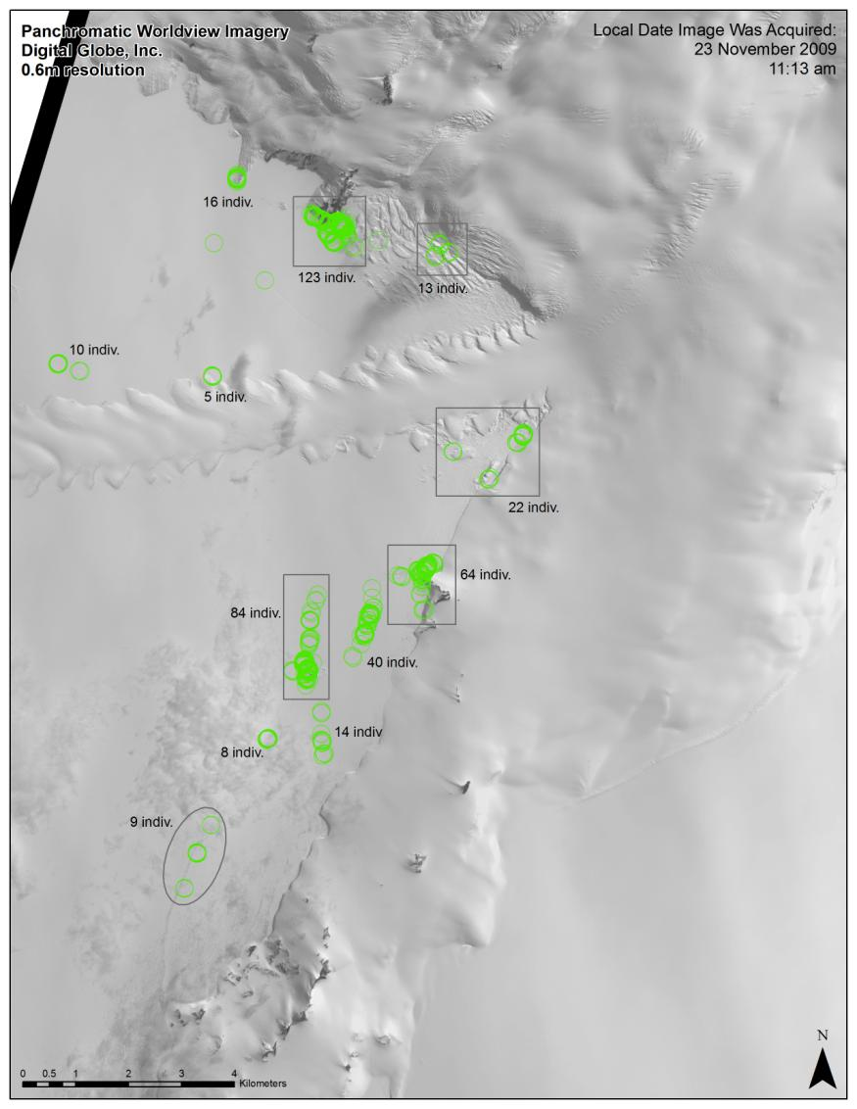
Turks Head, 21 Nov 2009
30 AF, 80 AF (w/ pup).
19 AM, 17 single pups
Tryggve Pt, 21 Nov 2009
12 AF, 1 single pup
North Base, 17 Nov 2009 (this area was difficult to reach, and this is the closest date we have.)
0 AF, 3 AF (w/ pup).
2 AM, 2 single pups
South Base, 09 Nov 2009 (this area was difficult to reach, and this is the closest date we have.)
4 AF, 16 AF (w/ pup).
5 AM, 0 single pups
Turtle Rock, 25 Nov 2009
39 AF, 46 AF (w/ pup).
14 AM, 6 single pups
Hutton Cliffs, 25 Nov 2009
21 AF, 70 AF (w/ pup).
24 AM, 9 single pups
Notes:
Compared ground counts to independent satellite counts. Calculated correlation at the haul-out level and at the study area level. Determined change in abundance through time at 3 haulouts, and for the whole study area.

Slide 12
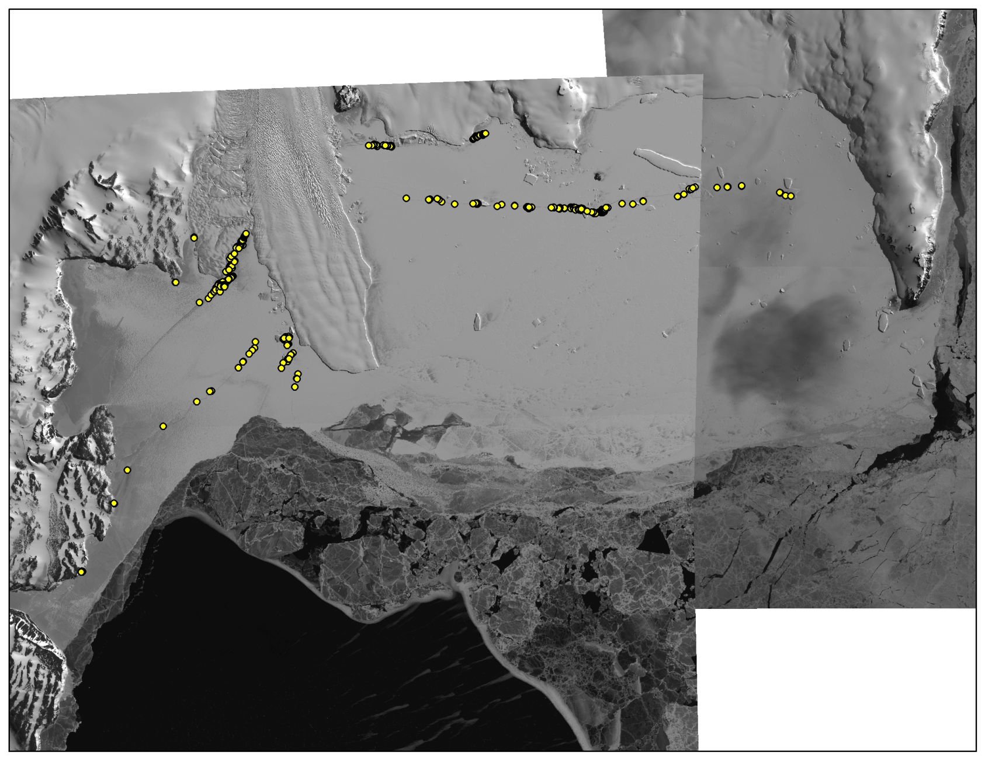
Silverfish Bay- November 2011
Notes:
335 seals near cape washington and Campbell glacier during 8 November and 18 November 2011

Slide 13
Edisto Inlet
Jan 8, 2010
10:50 am
249 seals
Notes:
Spatial overlap between Jan 8 and 9- 162 seals

Slide 14
Jan 9, 2010
10:35 am
144 seals

Slide 15
Jan 19, 2010
10:46 am
238 seals
Notes:
VERY different numbers when comparing to Stirling’s counts from 1967 (600 animals).

Slide 16
Edisto Inlet Seal Counts
Source | Date | Count | Corrected | TOD
Ian Stirling | mid-Jan 1967 | 600 | -- | --
Ian Stirling | Jan 31, 1968 | 460 | 700 | 1100
Satellite image (ML) | Jan 8, 2010 | 249 | 378 | 1050
Satellite image (ML) | Jan 19, 2010 | 238 | 362 | 1046

Slide 17
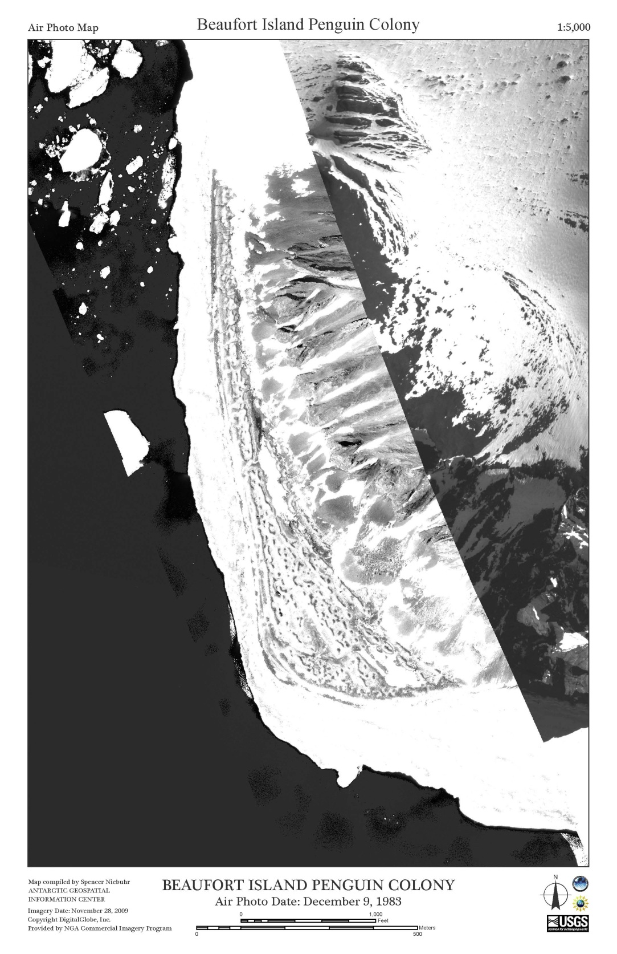
Area Increase: 21%
Notes:
21% increase; >23,000 sq. m

Slide 18
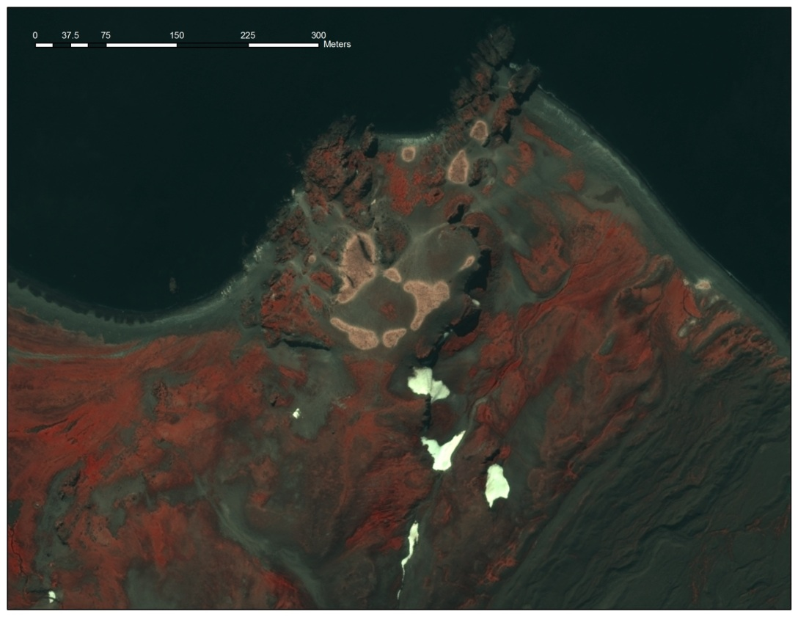

Slide 19
Notes:
Lynch et al. 2012 in press

Slide 20
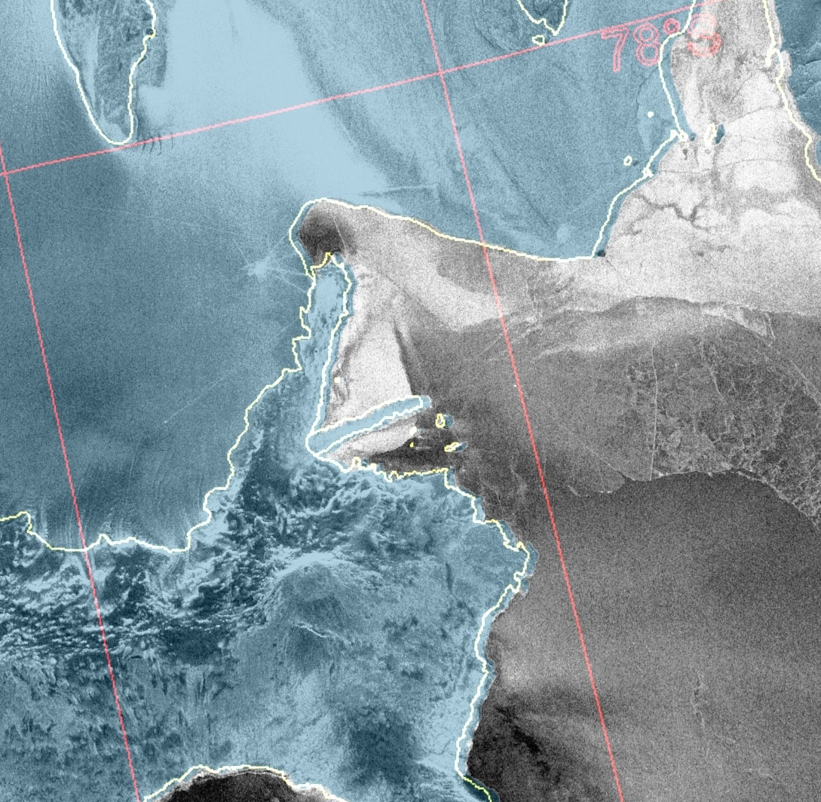

Slide 22
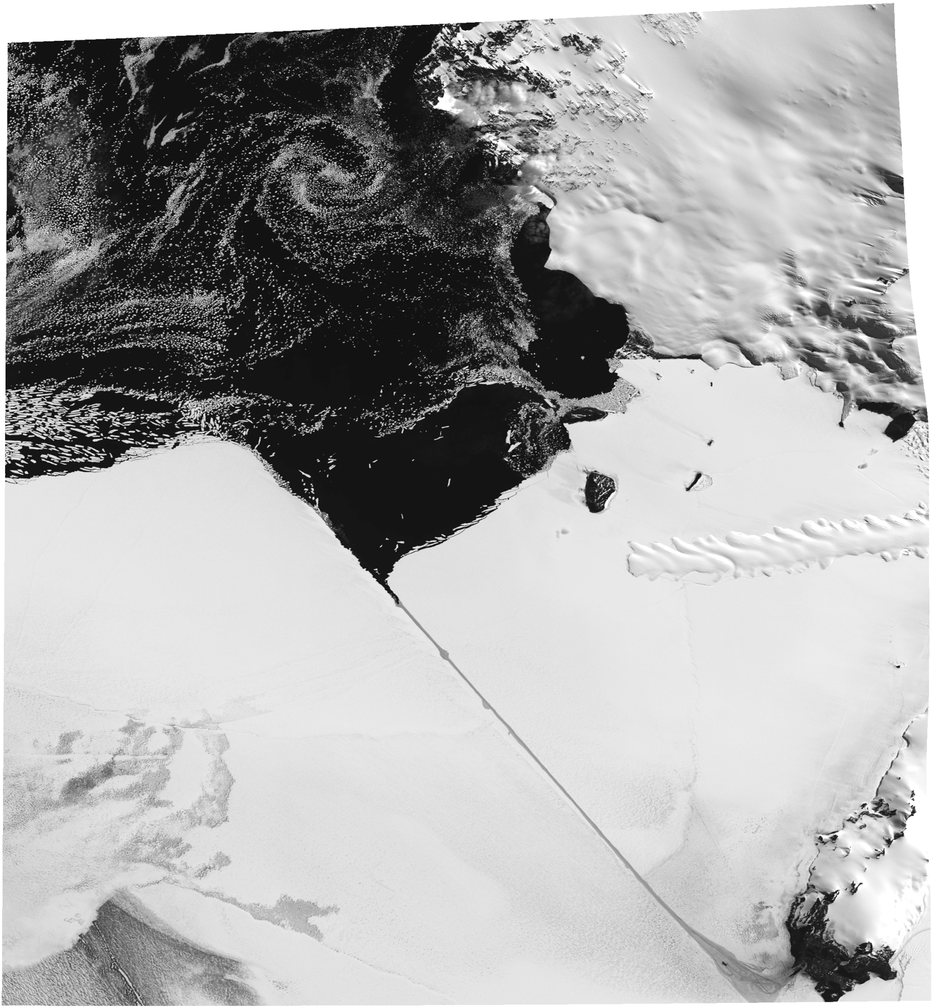

Slide 24
Monitoring the Ross Sea
Baseline population data
Emperors (continental), seals (Ross Sea 2005-2010)
Address future impacts
Capabilities
Detection, estimation, differentiation
Reliable way to remotely view the region
Efficient
Application to other species
Whales?
Crabeaters?
Ships?

Slide 26
Acknowledgements
D. Siniff, D. Ainley, R. Garrott, J. Rotella, C. Porter, G. Stauffer, P. Morin, P. Fretwell, P. Trathan, B. Wienecke, G. Kooyman, A. Fleming, N. Ratcliffe, A. Fox
Funding: NSF
Resources: DigitalGlobe

