Slide 1
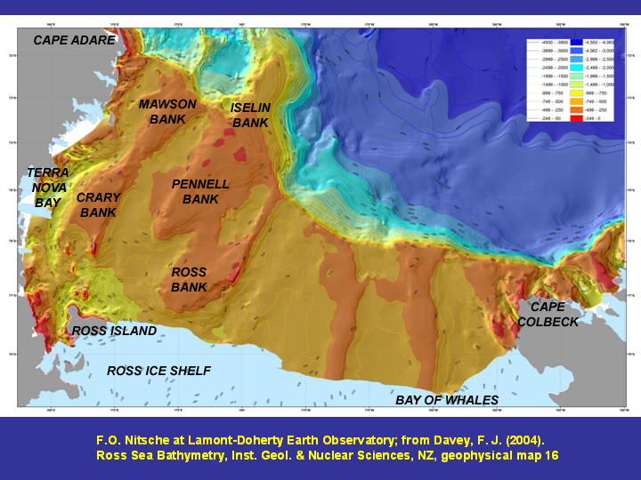
How we got here,
and where we’re going

Slide 2
CCAMLR CHARTER:
FISHING CAN PROCEED AS LONG AS:
“ARTICLE II
3(c). prevention of changes or minimisation of the risk of changes in the marine ecosystem which are not potentially reversible over two or three decades, taking into account the state of available knowledge of the direct and indirect impact of harvesting, the effect of the introduction of alien species, the effects of associated activities on the marine ecosystem and of the effects of environmental changes, with the aim of making possible the sustained conservation of Antarctic marine living resources.”

Slide 3
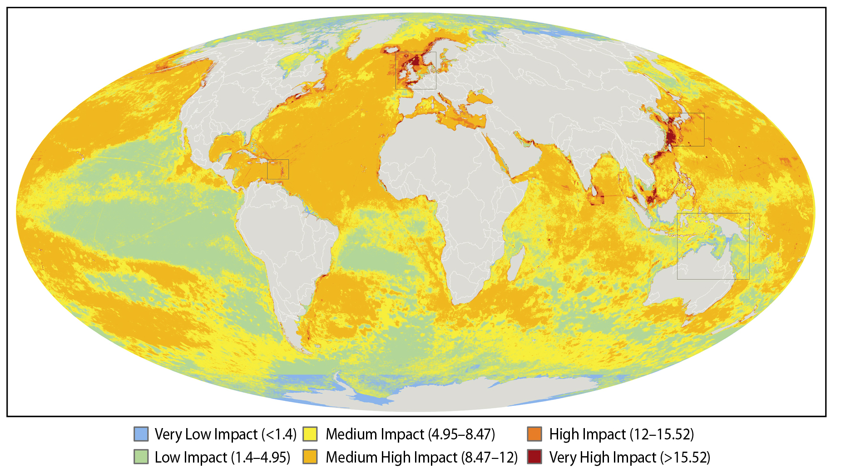
B. Halpern et al. 2008. A global map of human impact on
marine ecosystems. Science 319: 948-951.
>15
0.1
Notes:
Data from Ben Halpern’s paper from Science 2008 made world headlines

Slide 4
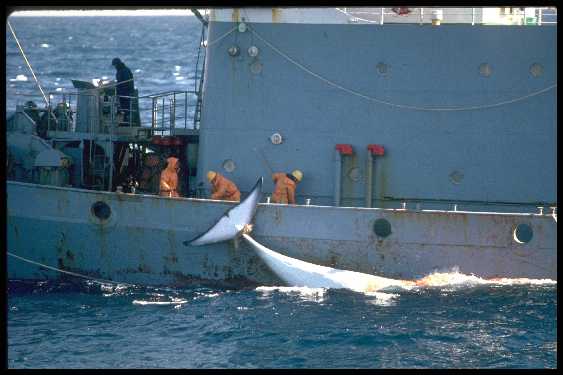
© GREENPEACE/Morgan

Slide 5
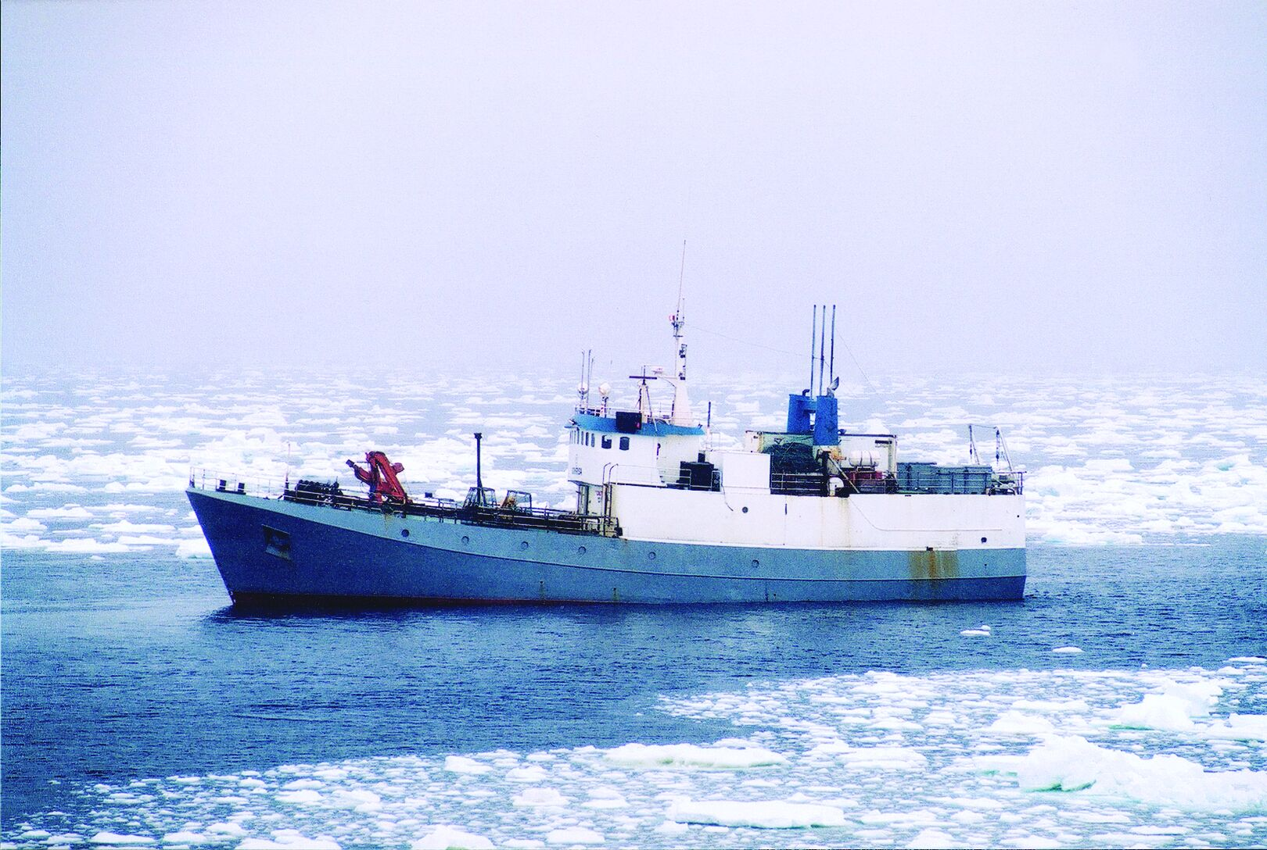
© AntarcticaNZ, pictorial collection

Slide 6
TONNES

Slide 7
TOOTHFISH FISHING AREAS

Slide 8
THIS SPAWNED…………
8 YEARS OF ‘FORSE’ PESTERING THE US DELEGATION
TO CCAMLR (HELP FROM ASOC), INCLUDING

Slide 9
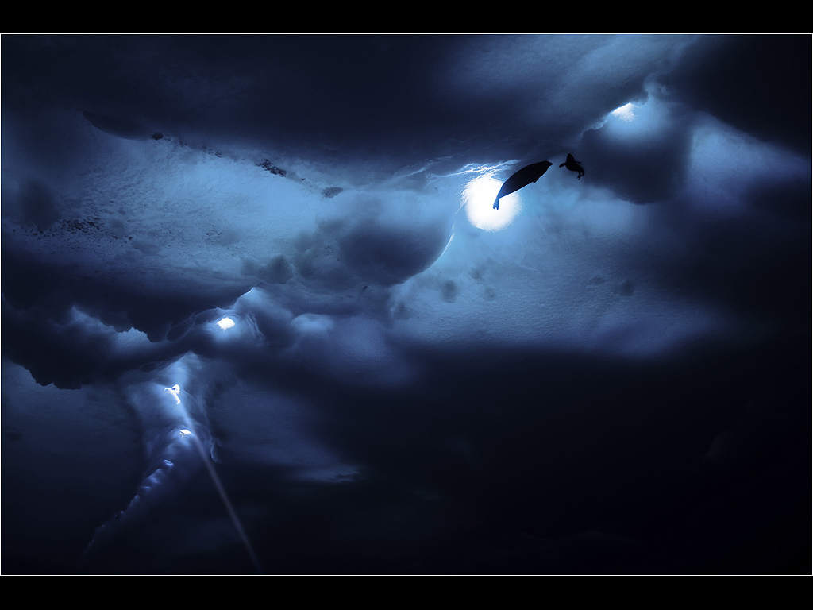
The Ross Sea, Antarctica:
Science, Policy and the Public in a Pristine Marine Ecosystem
A Workshop held at the International Marine Conservation Congress,
George Mason University, Fairfax VA USA
20-22 May 2009
PRELIMINARY REPORT
10 June 2009
FORCED NZ TO HOLD THEIR
OWN WORKSHOP

Slide 10
In April 2010,
US Delegation to CCAMLR finally agreed to take
on the Ross Sea MPA initiative.

Slide 11
CCAMLR WG-EMM-10/11
ROSS SEA BIOREGIONALIZATION Part I:
Validation of the 2007 CCAMLR Bioregionalization Workshop Results Towards Including the Ross Sea in a Representative Network of Marine Protected Areas in the Southern Ocean
David G. Ainley, Grant Ballard, John Weller
CCAMLR WG-EMM-10/12
ROSS SEA BIOREGIONALIZATION, PART II:
PATTERNS OF CO-OCCURRENCE OF MESOPREDATORS
IN AN INTACT POLAR OCEAN ECOSYSTEM
Grant Ballard, Dennis Jongsomjit, David G. Ainley
The Case for Inclusion of the Ross Sea Continental Shelf and Slope
in a Southern Ocean Network of Marine Reserves
Information Paper Submitted by ASOC to ATCM XXXIII
Agenda Item: | CEP 7e, ATCM 7
Presented By: | ASOC
Original: | English

Slide 12
At the same time, beginning about 2005,
CCAMLR finally began to consider that part of its charter which considers
marine protected areas as a tool for conservation and management
of Southern Ocean resources.
“ARTICLE IX
2. The conservation measures referred to in paragraph 1(f) above include the following:
(g) the designation of the opening and closing of areas, regions or sub-regions for purposes of scientific study or conservation, including special areas for protection and scientific study;”

Slide 13
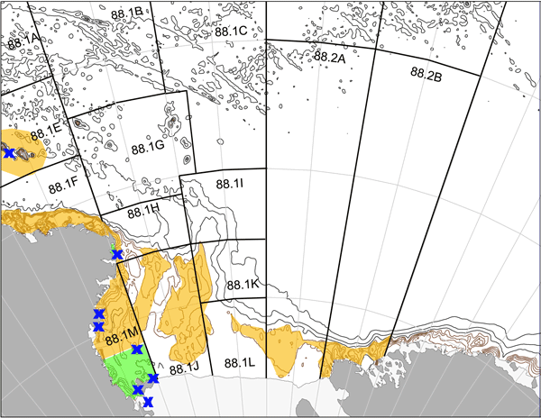
CURRENT “SPATIAL CONSERVATION MANAGEMENT”
IN THE ROSS SEA REGION
NZ
CM 41-09
CM 22-08
= ASPA

Slide 14
CCAMLR members agreed to designate
a representative network
of Marine Protected Areas
in the Southern Ocean by 2012.

Slide 15
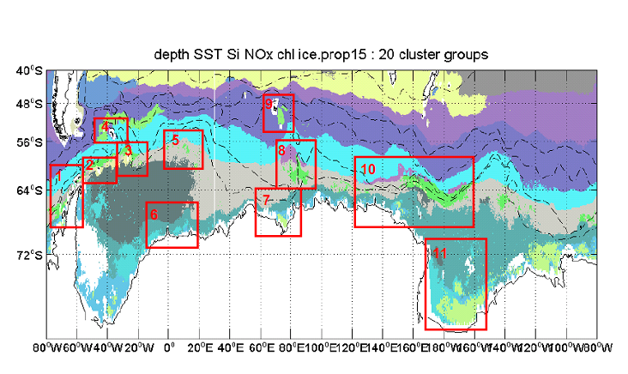
Secondary regionalisation agreed by the CCAMLR Bioregionalisation Workshop (2007) (analysis based on depth, SST, silicate concentration, nitrate concentration, surface chlorophyll-a , and ice concentration). Red boxes show areas of highest heterogeneity, which have been identified by the Working Group as priority areas for identifying MPAs as part of a representative system (numbers refer to area descriptions, and are not in any order of priority). 1 = Western Antarctic Peninsula, 2 = South Orkney Islands, 3 = South Sandwich Islands, 4 = South Georgia, 5 = Maud Rise, 6 = Eastern Weddell Sea, 7 = Prydz Bay, 8 = BANZARE Bank, 9 = Kerguelen, 10 = Northern Ross Sea / East Antarctica, 11 = Ross Sea shelf.

Slide 16
Figure 1 (f-sc-xxx-06 report, 2011): Planning Domains defined by the Workshop to provide an updated mechanism by which to plan and report on the development of MPAs across the Convention Area. (1: Western Antarctic Peninsula–South Scotia Arc; 2: North Scotia Arc; 3: Weddell Sea; 4: Bouvet–Maud; 5: del Cano-Crozet; 6: Kerguelen Plateau; 7: East Antarctica; 8: Ross Sea region; 9: Amundsen–Bellingshausen.) Planning Domain boundaries (thick lines) follow subarea boundaries (thin lines) where possible..

Slide 17
IN THE MEAN TIME………

Slide 18
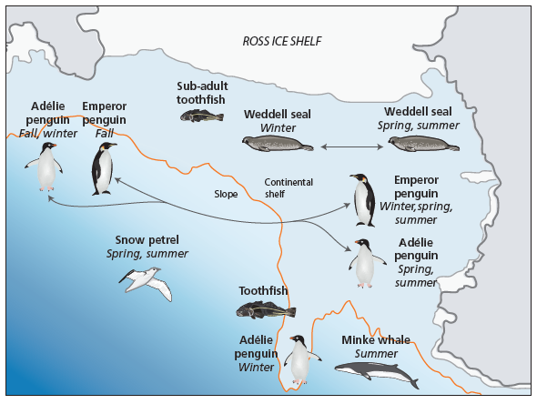
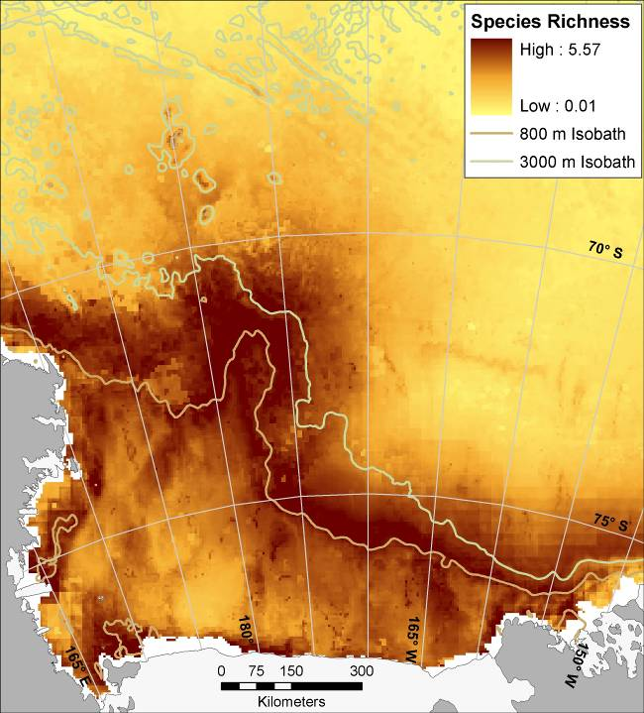
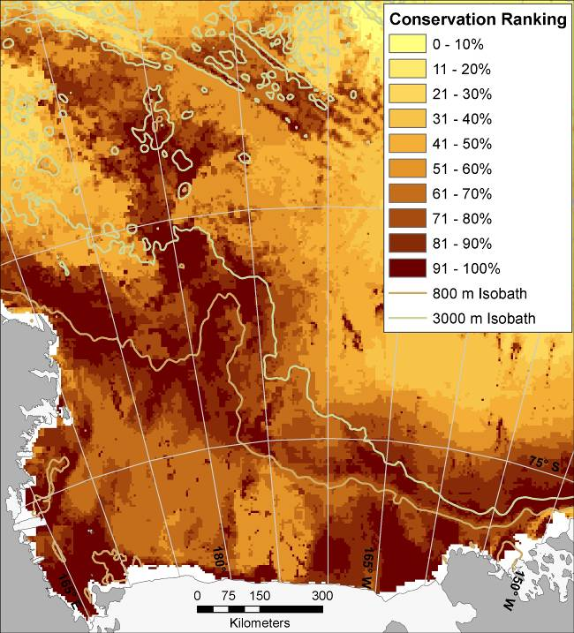
A. | B.
SPECIES RICHNESS
CONSERVATION
IMPORTANCE
SPECIES RICHNESS
5KM CELLS,
MAXENT

Slide 19
April 2011, La Jolla, NMFS offices
Spatial planning workshop to devise a
‘trial baloon’/spatial plan
that the US would float by CCAMLR at the MPA workshop
held in Brest, France, August 2011.

Slide 20
US goals for Ross Sea MPA designation :
1. conserve ecological structure and function – at all levels of biological organization – by prohibiting fishing in habitats that are important to native mammals, birds, fishes, and invertebrates throughout the Ross Sea region;
2. maintain a reference area in which there is no fishing to better gauge the ecosystem effects of climate change; and
3. promote research and other scientific activities (e.g., monitoring) focused on marine living resources.

Slide 21
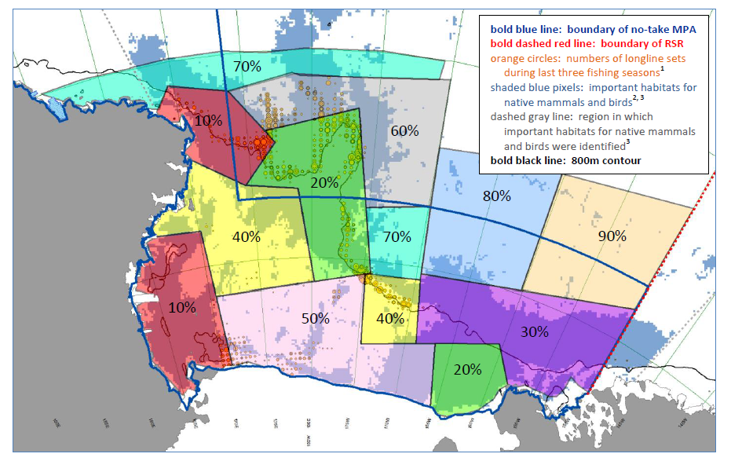
RED (10%) = PRIORITY 1: FORAGING AREAS OF BREEDING PENGUINS AND WEDDELL SEALS
GREEN (20%) = PRIORITY 2: FORAGING AREA OF RECOVERING BLUE WHALES, UNIQUE
BENTHIC COMMUNITIES ON OUTER BANKS
PURPLE (30%) = PRIORITY 3: FORAGING AREA FOR PENGUIN MOLTING
YELLOW (40%) = PRIORITY 4: BANKS OF MIDDLE SHELF HARBORING UNIQUE FAUNA
PINK (50%) = PRIORITY 5: DEEP AREAS IN INNER SHELF HARBORING UNIQUE FAUNA

Slide 22
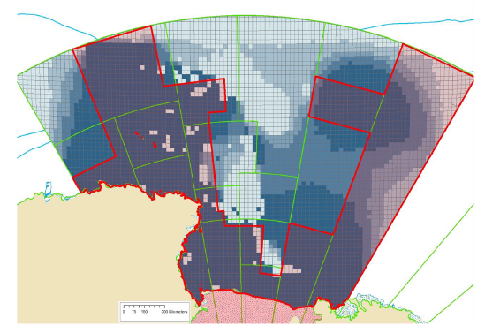
USA THEN CONSULTED WITH NZ
NZ’s proposal for spatial management of Ross Sea biotic resources
MARXAN
MAINTAIN
MAIN
FISHING
GROUNDS
REKINDLE
PREVIOUS
ATTEMPT
AT BALLENY
MPA

Slide 23
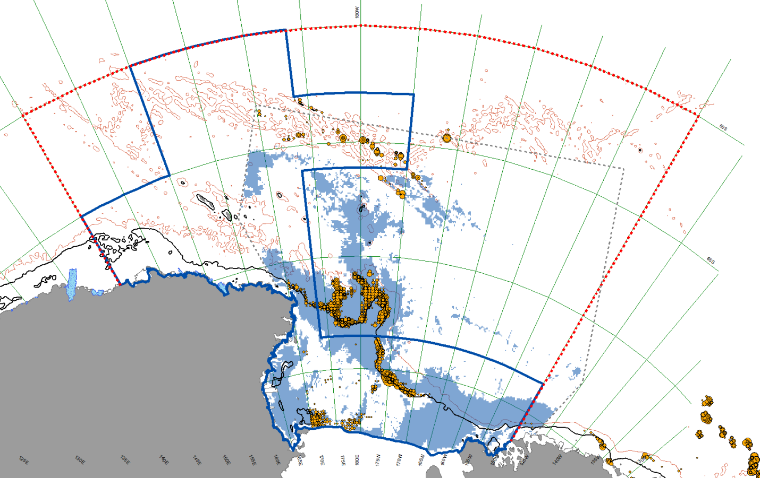
FINALLY
AN MPA SCENARIO FOR THE ROSS SEA REGION
Delegation of the USA
SC-CAMLR-XXX/9 (2012)

Slide 24
Ainley DG, CM Brooks, JT Eastman, M Massaro. 2012.
Unnatural selection of Antarctic toothfish in the Ross Sea, Antarctica. Pp 35-70 in Huettmann F (ed) (2012) Protection of the Three Poles. Springer Tokyo, Japan
REMOVING THE BIG, SPAWNING FISH HAS PROVED OVER AND OVER AND OVER AGAIN TO BE A NO-NO IN EFFICTIVE
FISHERY MANAGEMENT

Slide 25
AN MPA SCENARIO FOR THE ROSS SEA REGION
Delegation of the USA
SC-CAMLR-XXX/9 (2012)

Slide 26
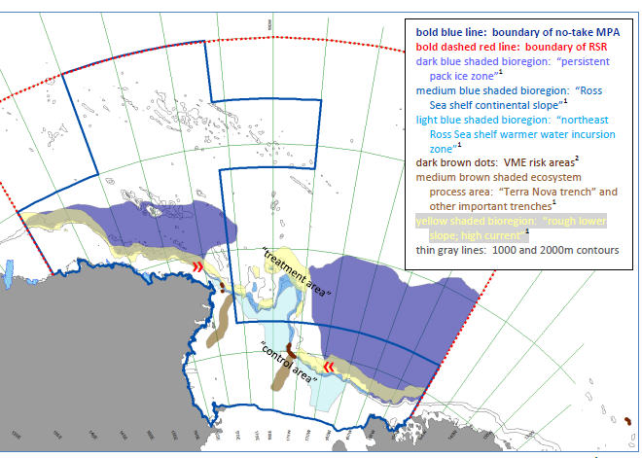

Slide 27
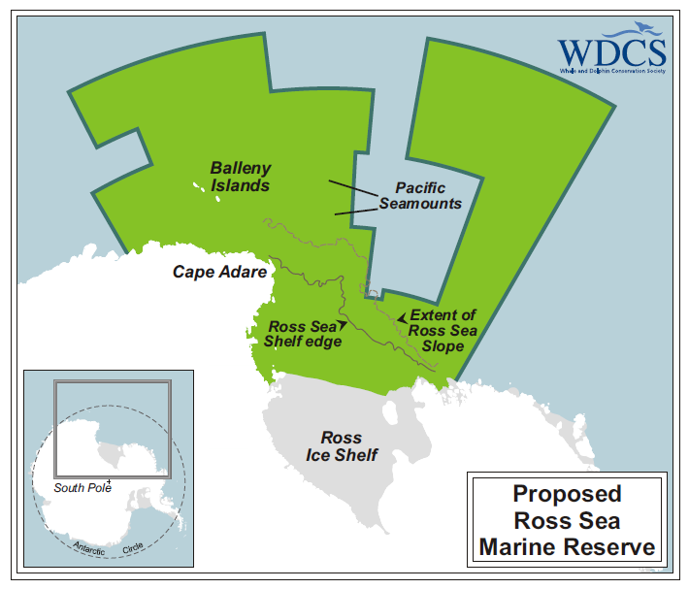
ANOTHER OPINION, AS OF A MONTH AGO:
ANTARCTIC OCEAN ALLIANCE

Slide 28
IT’S NOW 2012
AND FOR AN MPA TO HAPPEN
A MANAGEMENT PLAN NEEDS
TO BE DEVELOPED
AND AGREED TO BY CCAMLR

Slide 29
WHAT IS THE STRUCTURE AND WHAT ARE THE IMPORTANT FUNCTIONAL
PROCESSES OF THE ROSS SEA ECOSYSTEM?
IS IT ALL LINEAR?
RELATIVE IMPORTANCE OF BOTTOM UP VS TOP DOWN?
WHAT FACTORS WILL CAUSE THIS STRUCTURE TO CHANGE?
CAN WE DETECT THE CHANGE? EVEN THE SUBTLE ASPECTS?
WHAT SHOULD BE MONITORED?

