Slide 1
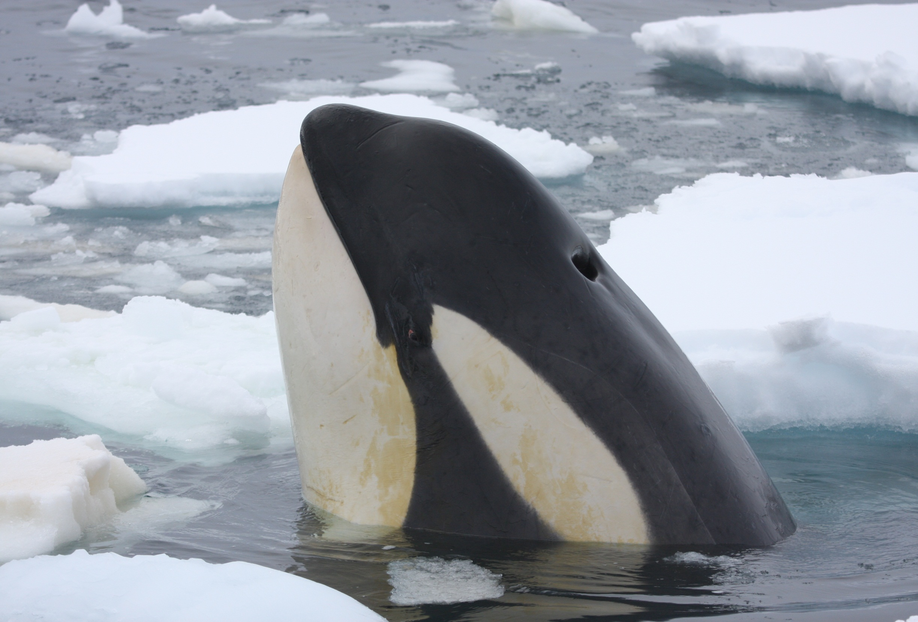
THE HUNGER GAMES:
Killer whales in the Ross Sea
Robert Pitman and John Durban
Southwest Fisheries Science Center
La Jolla, California
Notes:
Phylogenetic and ecological diversity

Slide 2
Diversity of Killer Whales (Orcinus orca) in the Southern Ocean
Soviets described two new ‘species’ of killer whales in early 1980s:
  O. nanus and O. glacialis
Pitman and Ensor 2003 described 3 different forms of killer whales from Antarctic waters based on at-sea sightings from IWC cruises and the literature:
  Types A, B and C

Slide 3
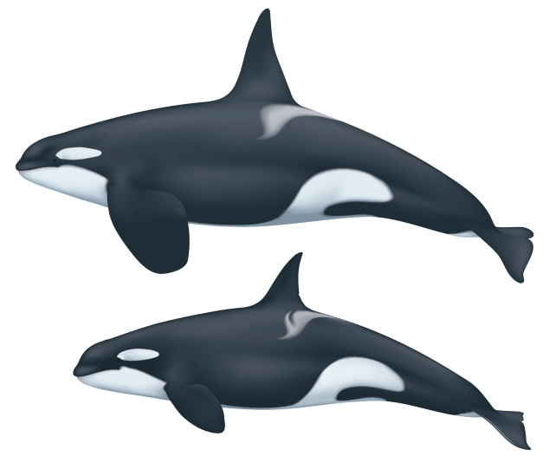
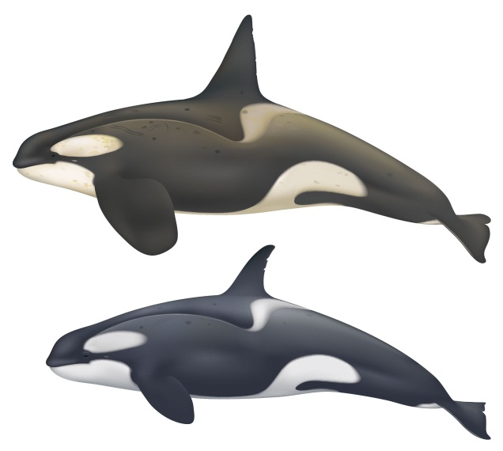
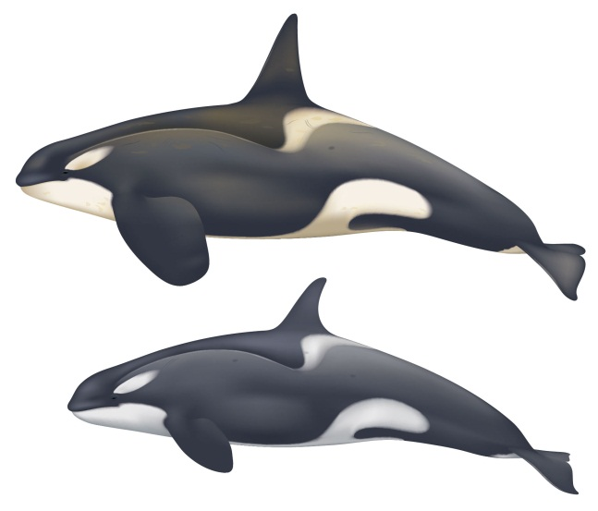
Type A:
Type B:
Type C:
Typical black and white form
Large (variable?) – 8-10 m
Eyepatch medium and horizontal
Open water
Takes mainly minke whales
Circumpolar
Two-tone gray and white,
with cape
Large – 8-9 m?
Eyepatch large and
horizontal
Loose pack ice
Mainly seals
Circumpolar
Two-tone gray and white,
with cape
Small – max. 6m
Eyepatch narrow, slanted
Fast ice leads, heavy pack
Toothfish, +?
East Antarctica
Illustrations by Uko Gorter

Slide 4
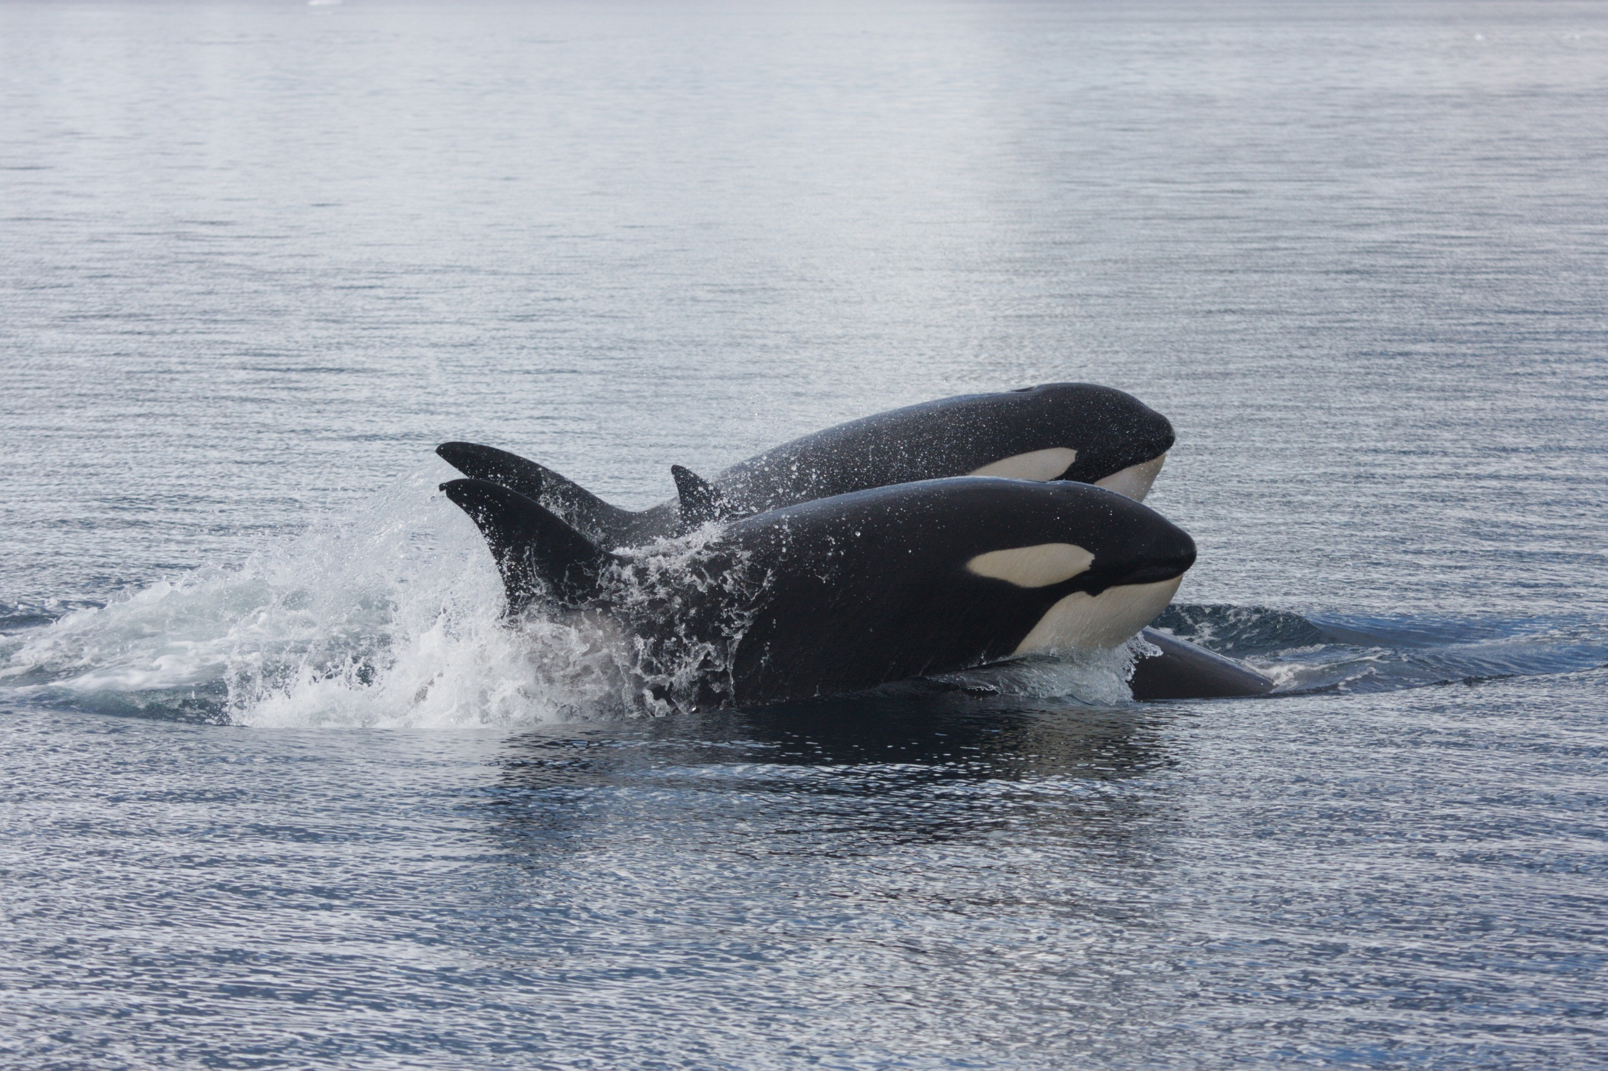
Type A

Slide 5
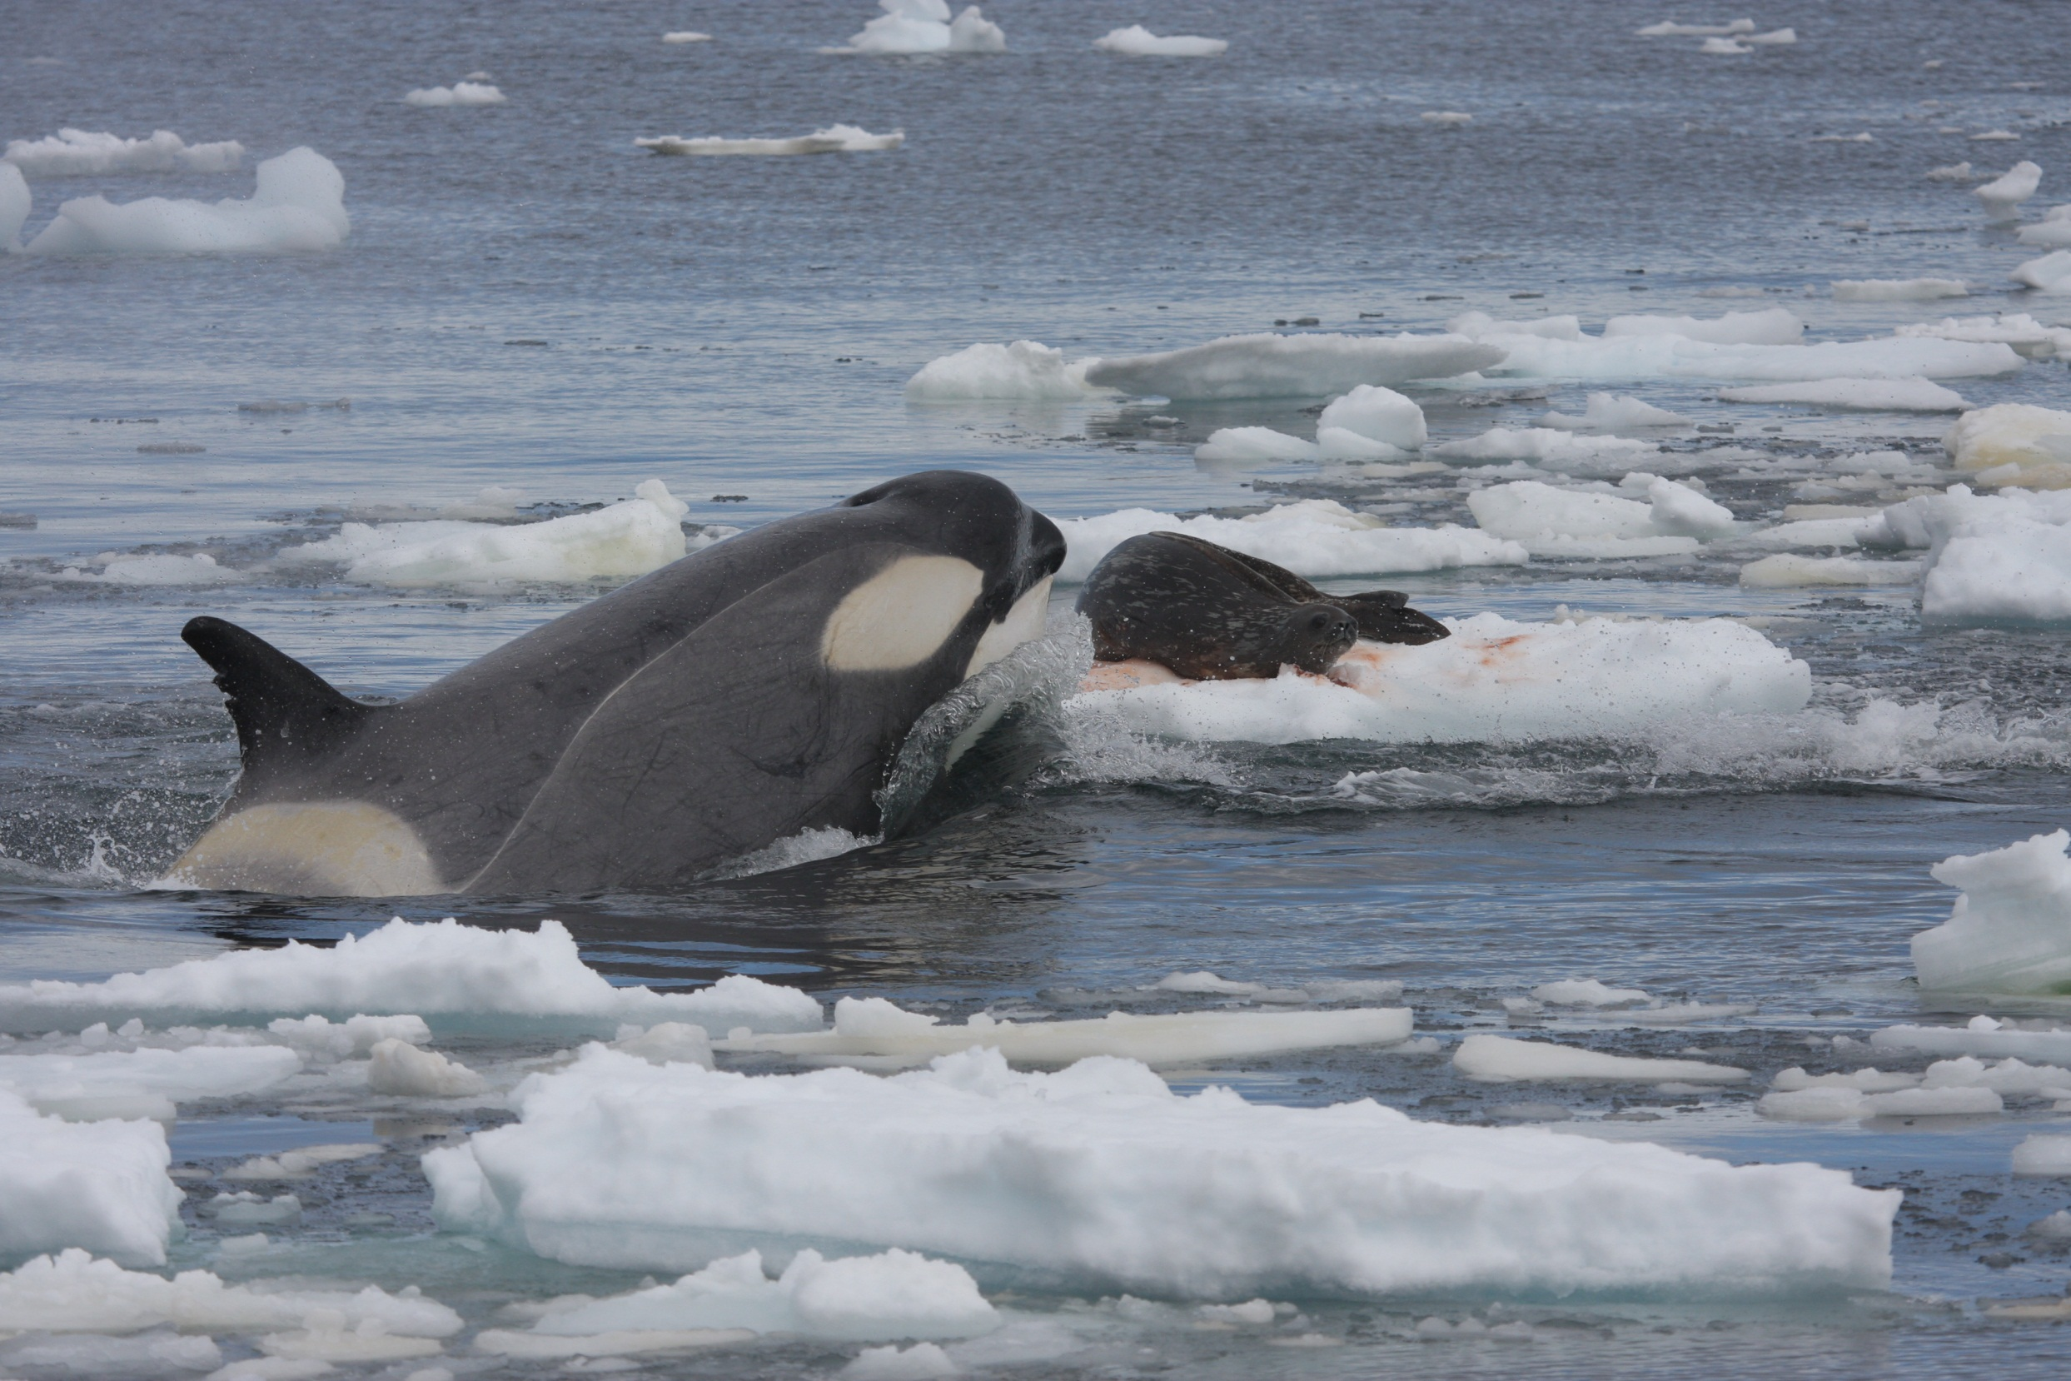
Type B

Slide 6
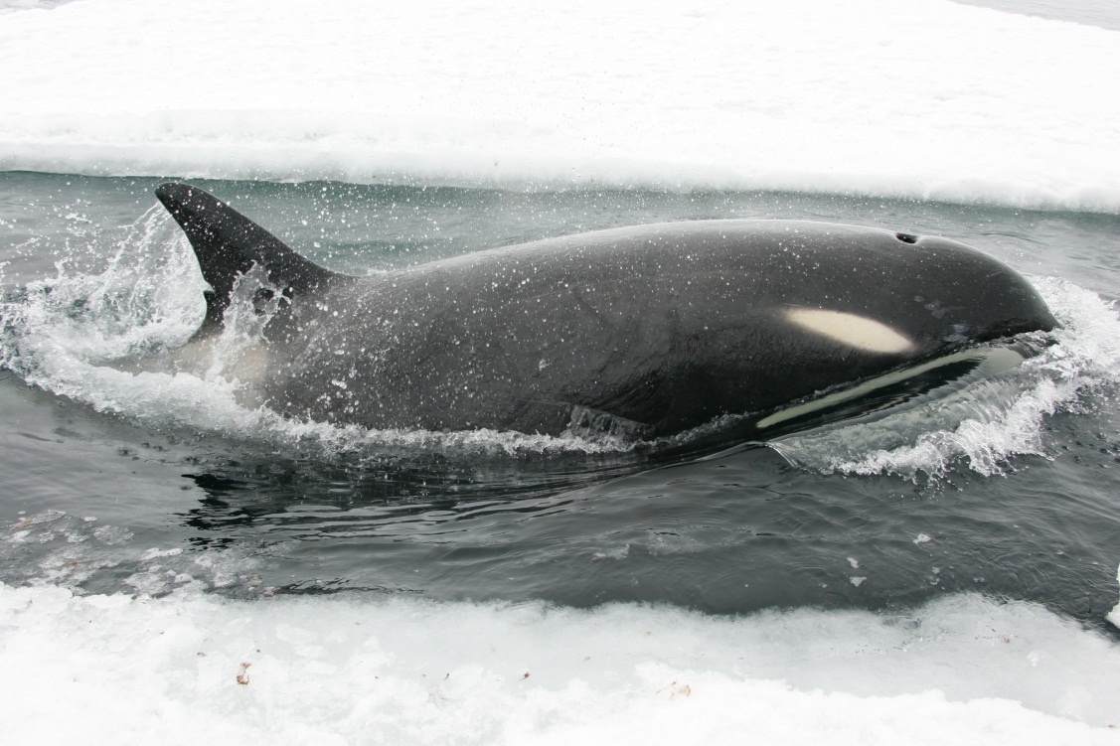
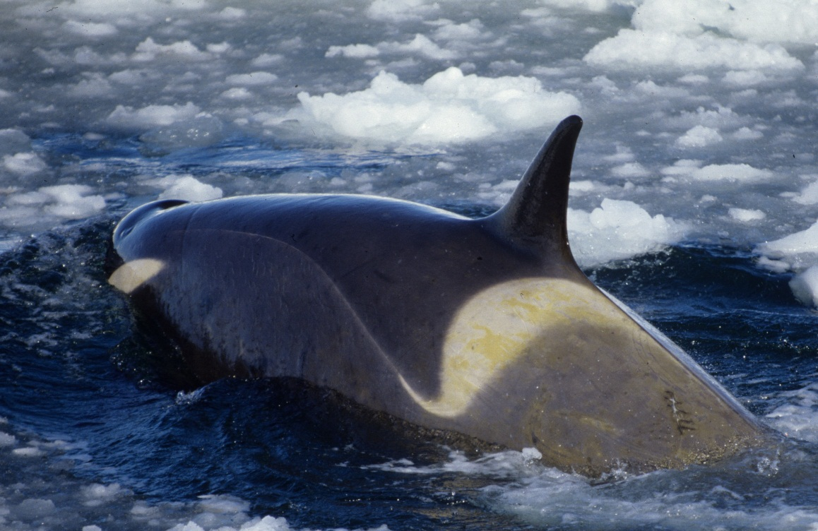
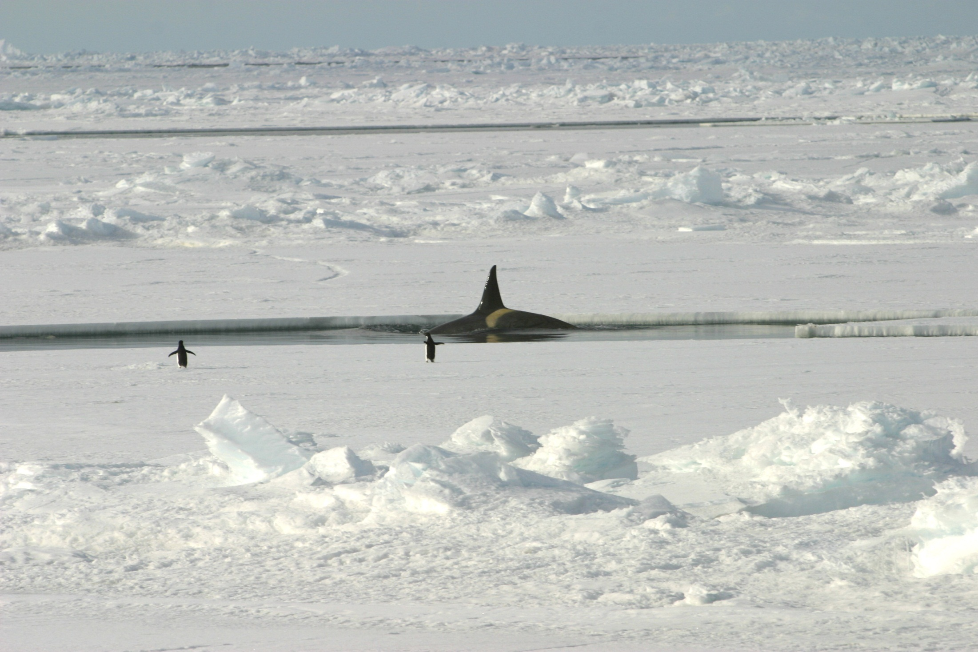
Type C
Morin, P. A., et al. 2010. Complete mitochondrial genome analysis of killer whales
(Orcinus orca) indicates multiple species. Genome Research 20:908-916.

Slide 7
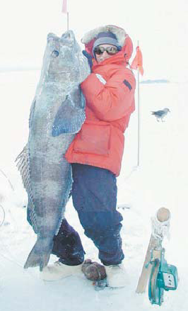
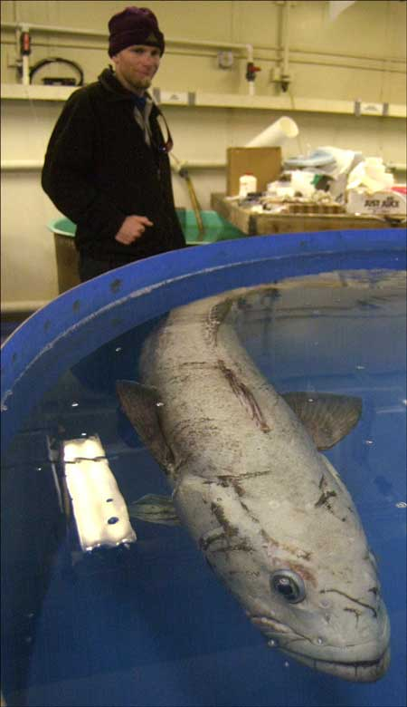
Photo: K. Hoeflin
Notes:
Photo Kevin Hoeflin

Slide 8
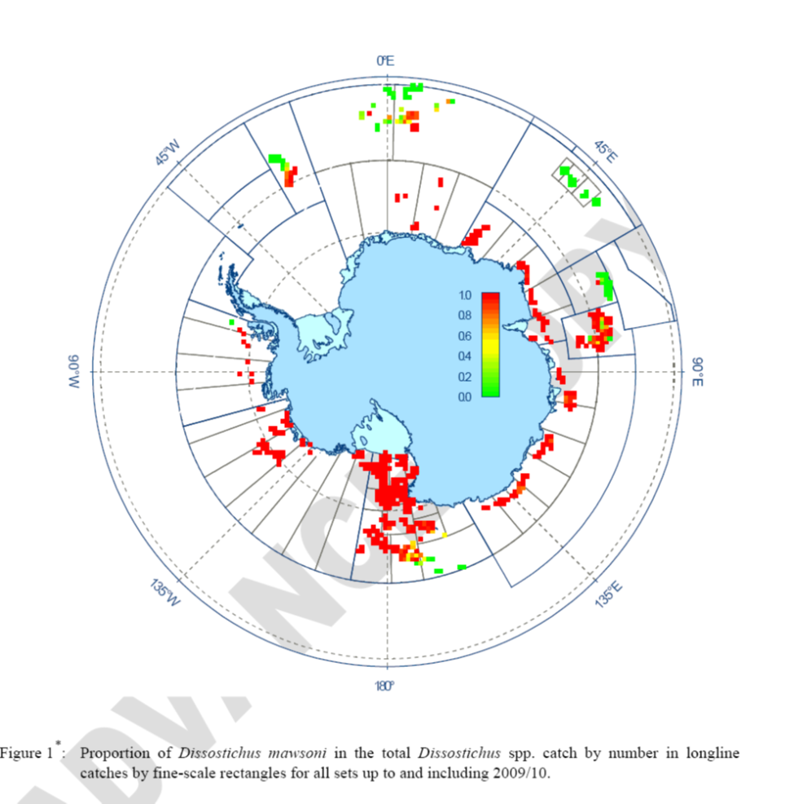
Mawsoni catches 2010

Slide 9
Type C (n=221)
Soviet Antarctic Whaling Catch (n=1239)
Pitman et al. 2007
Notes:
a) Soviet Antarctic whaling data (white, n = 1239), and Antarctica Type C killer whales (black, n = 221)

Slide 10
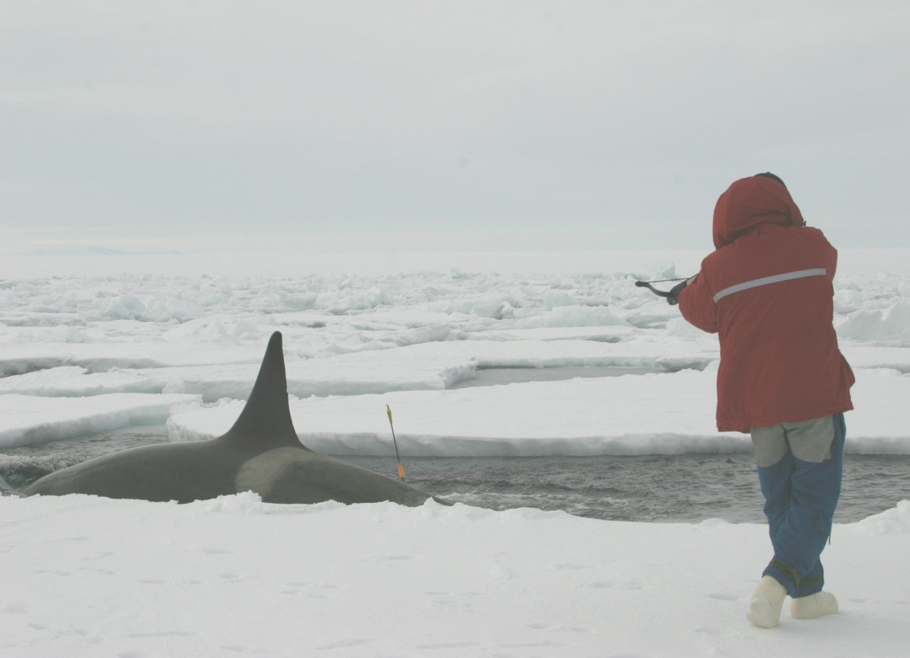
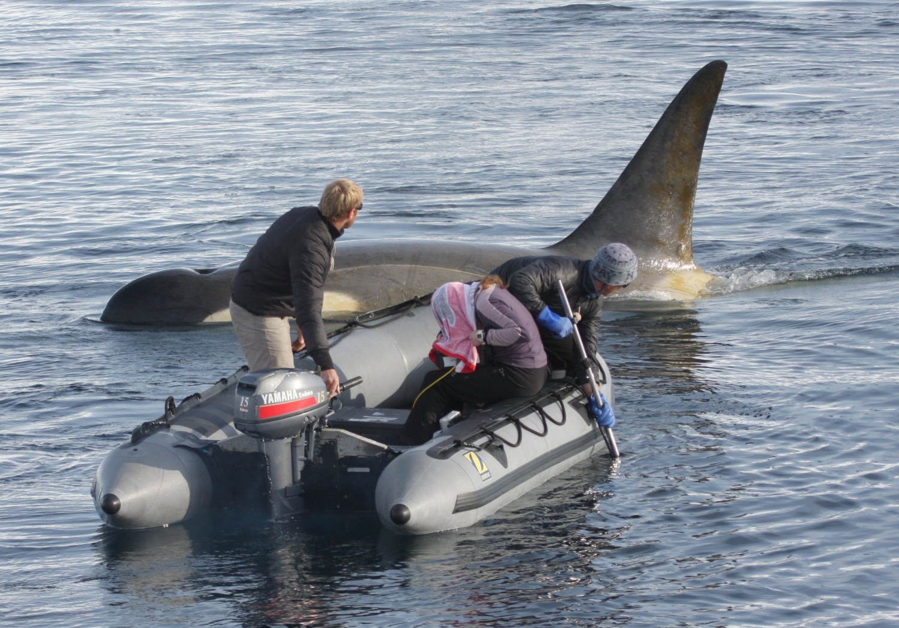
Type C adult male
Type B – large;
adult male

Slide 11
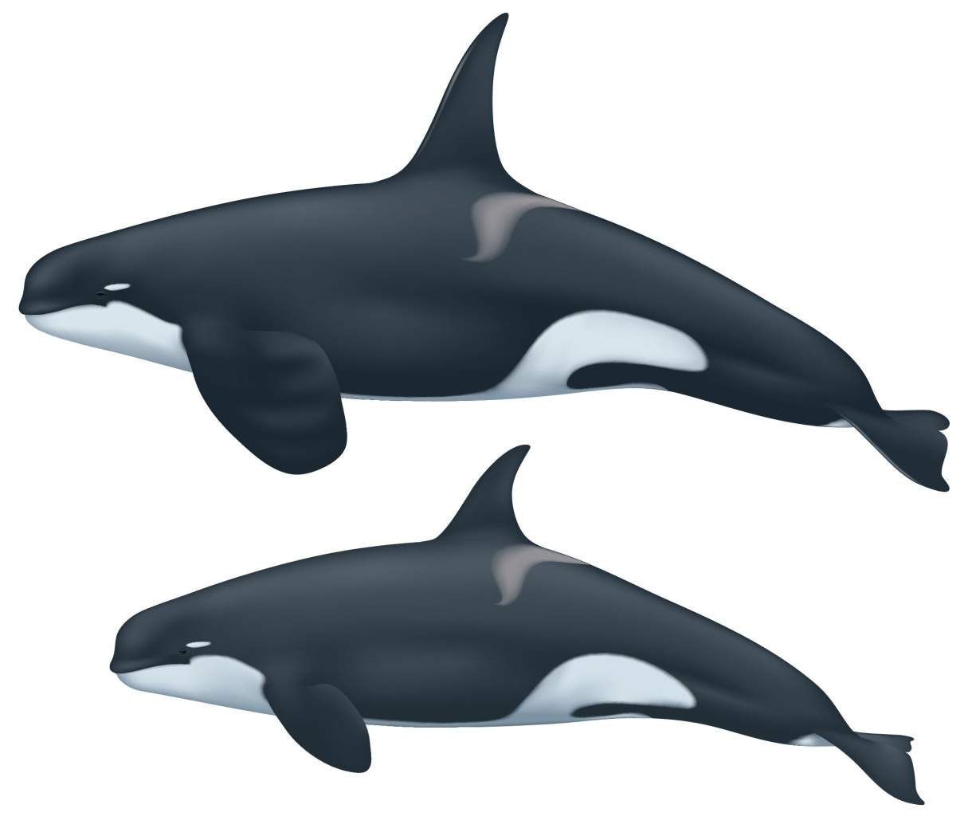
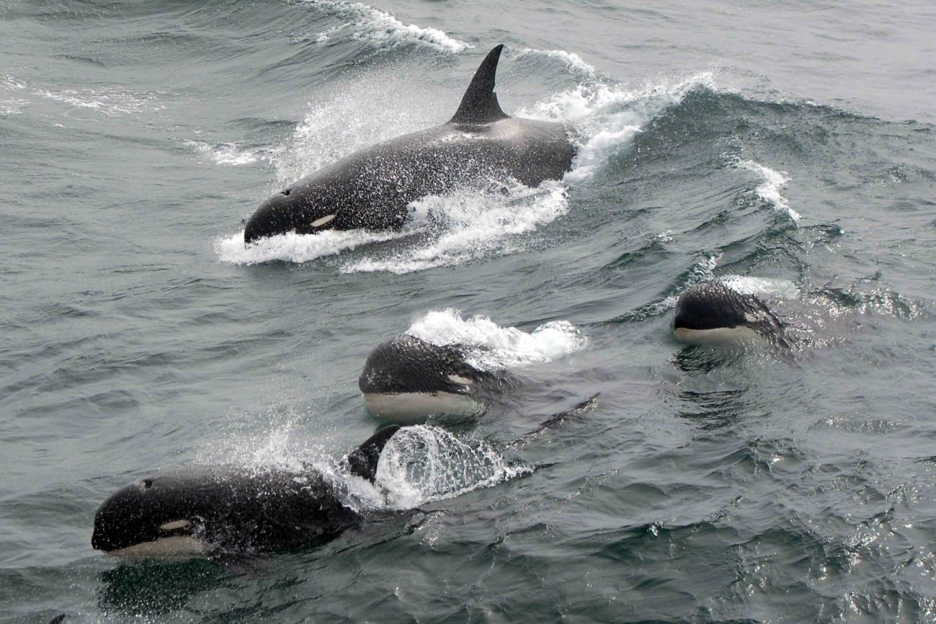
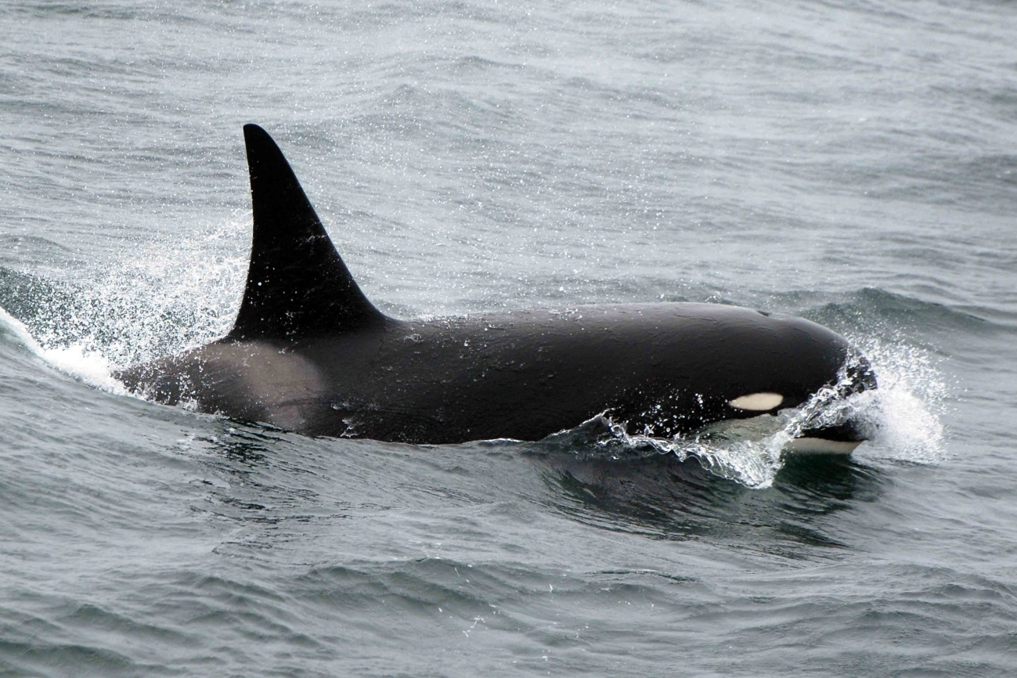
Type D

Slide 12
Insights from Antarctic Peninsula studies:
More differentiation of forms

Slide 13
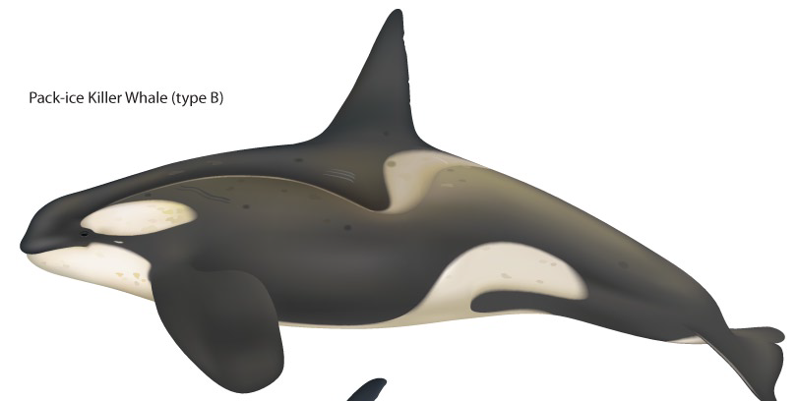
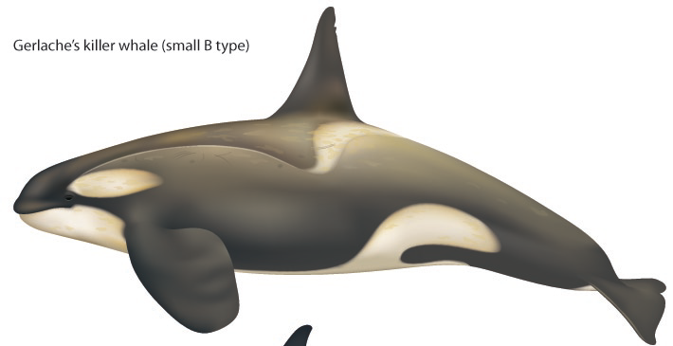
Large Type B
Pack ice killer whale
Small Type B
Gerlache killer whale
Illustrations by Uko Gorter

Slide 14
Insights from Antarctic Peninsula studies:
More differentiation of forms
Prey specialization?

Slide 15
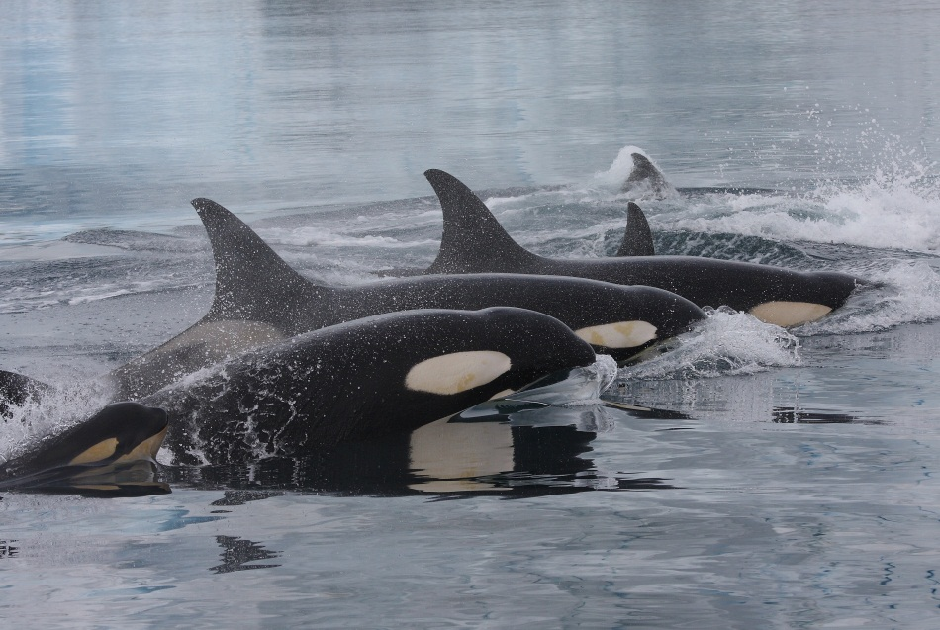
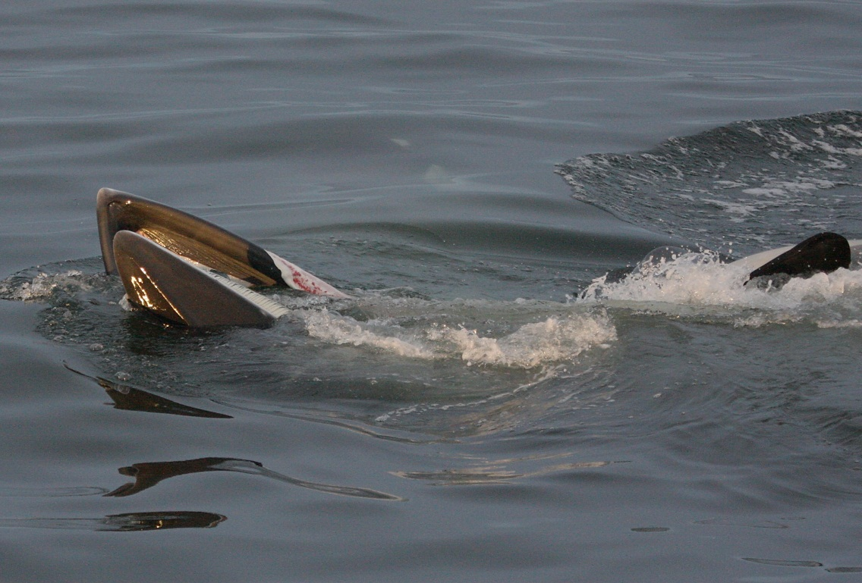
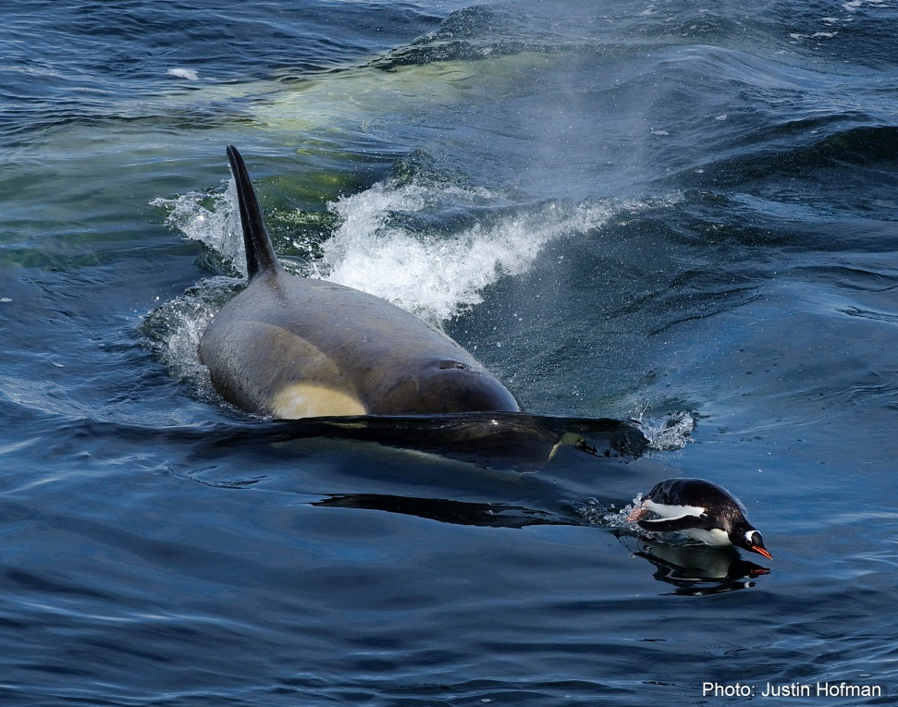
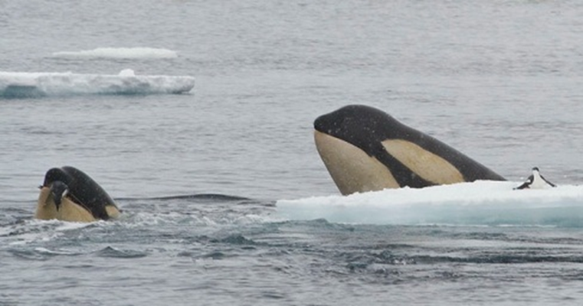
Type A
Large type B
Small type B
Small type B
Large type B
Photo: Mirek Zitek

Slide 16
Preferences within Preferences
88%
82%
15%
3%
(n = 365)
(n = 16)
Pitman and Durban 2011

Slide 17
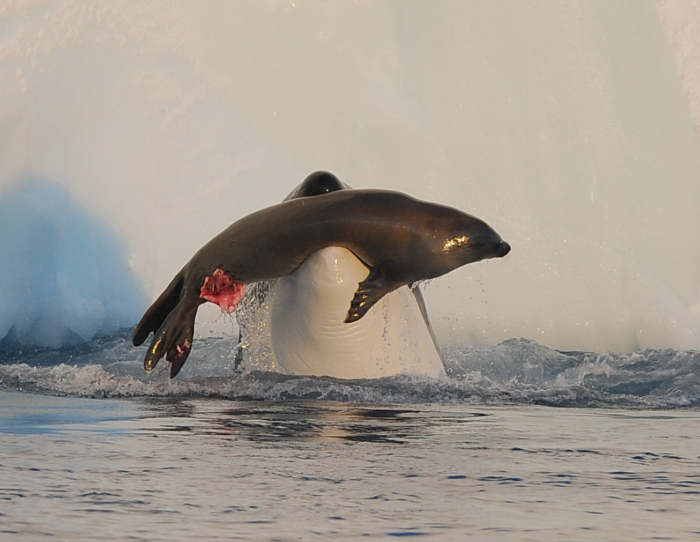
Photo: Ari Friedlaender

Slide 18
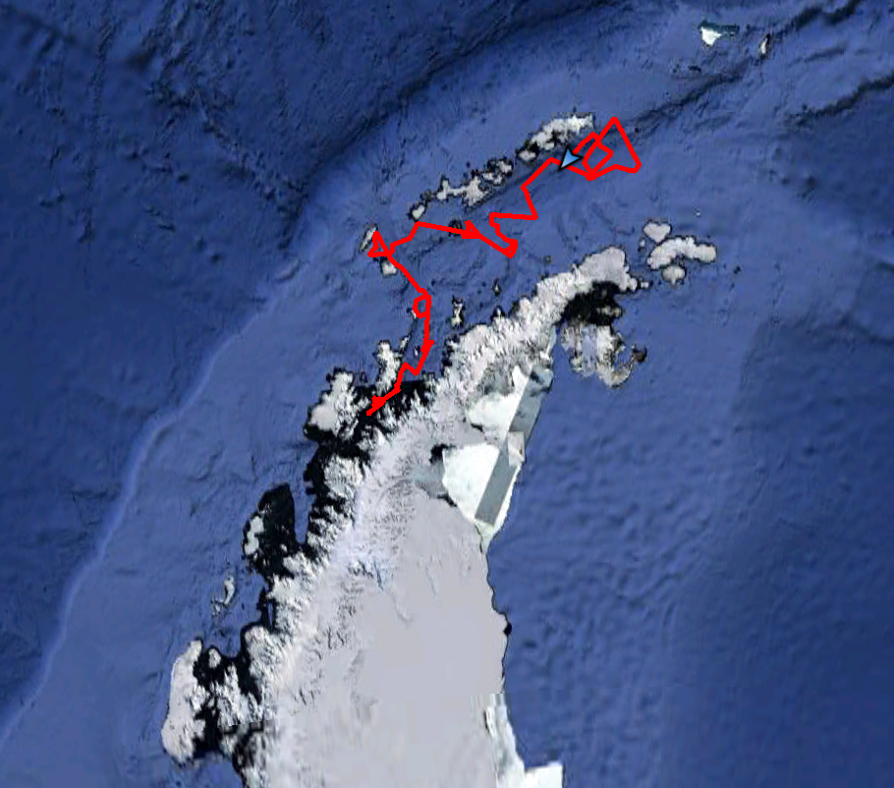
Small type B dive data –
15 days of dive data recorded every 75 seconds
Bransfield Strait
Antarctic Peninsula
Durban and Pitman, unpublished

Slide 19
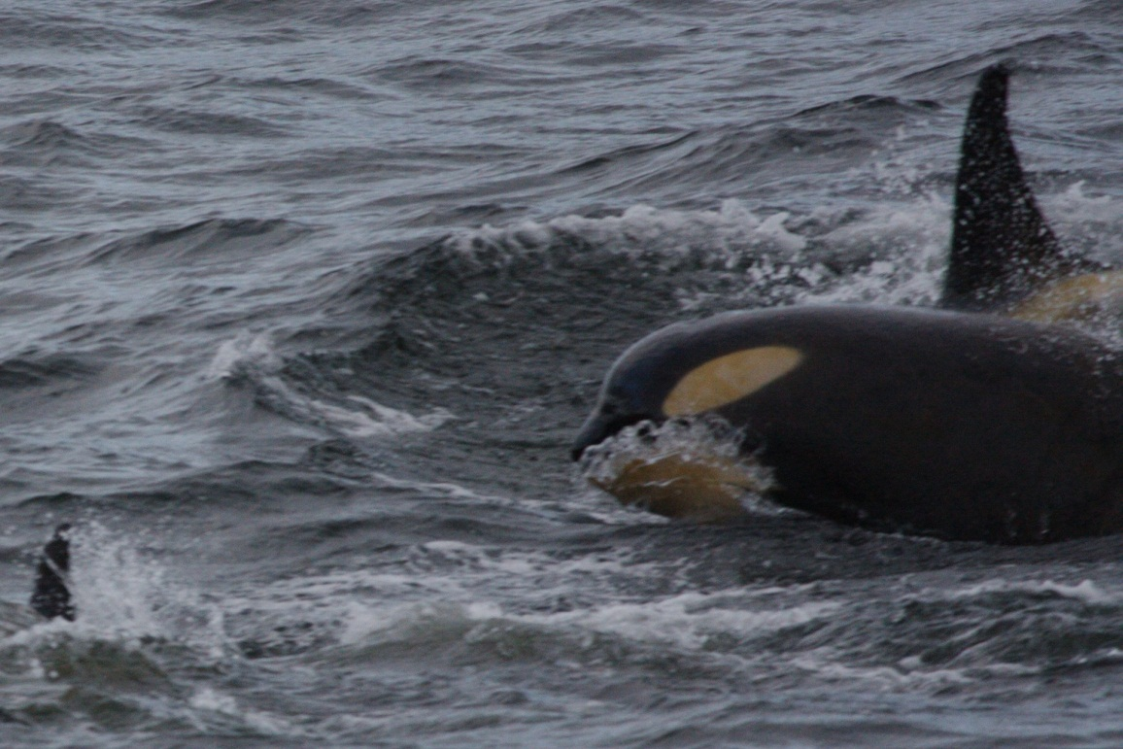
Notes:
Dive tag on a small type B KW – max dive depth 608 m; scattered randomly throughout the day and night; depth corresponds closely to bottom depth – feeding on squid or fish.

Slide 20
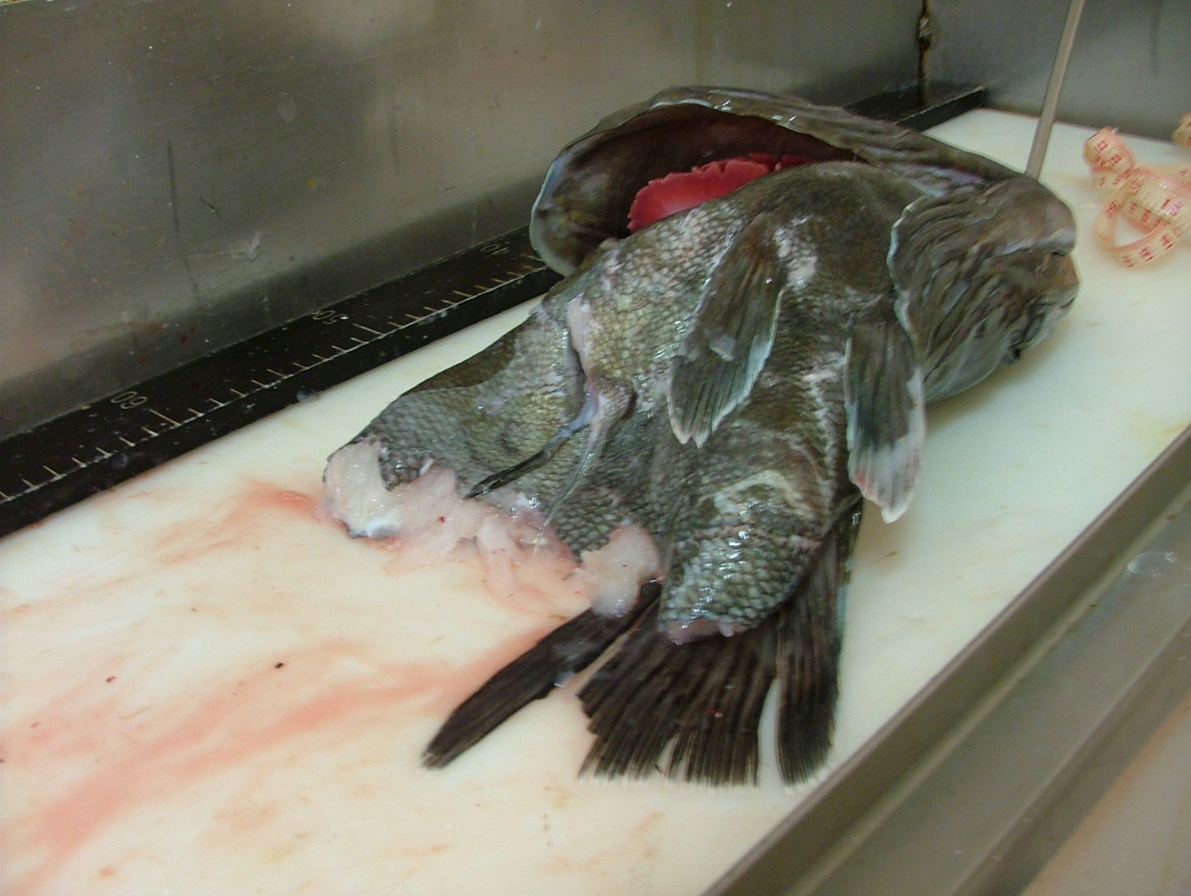
Depredating toothfish longlines:
Types A, B and D – but not C!

Slide 21
Insights from Antarctic Peninsula studies:
More differentiation of forms
Prey specialization?
Amount of individual prey taken

Slide 22
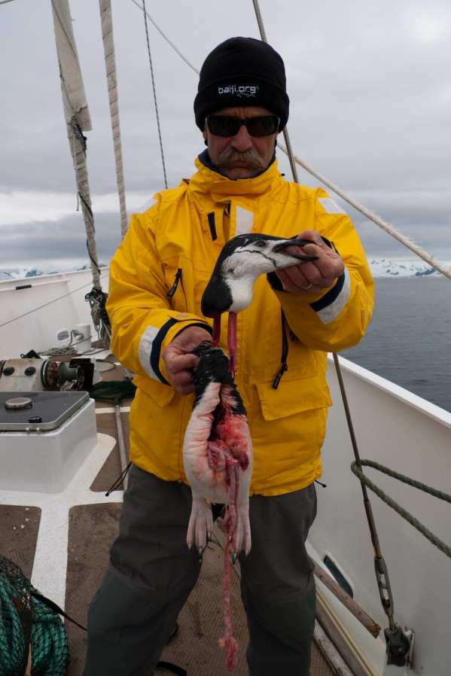
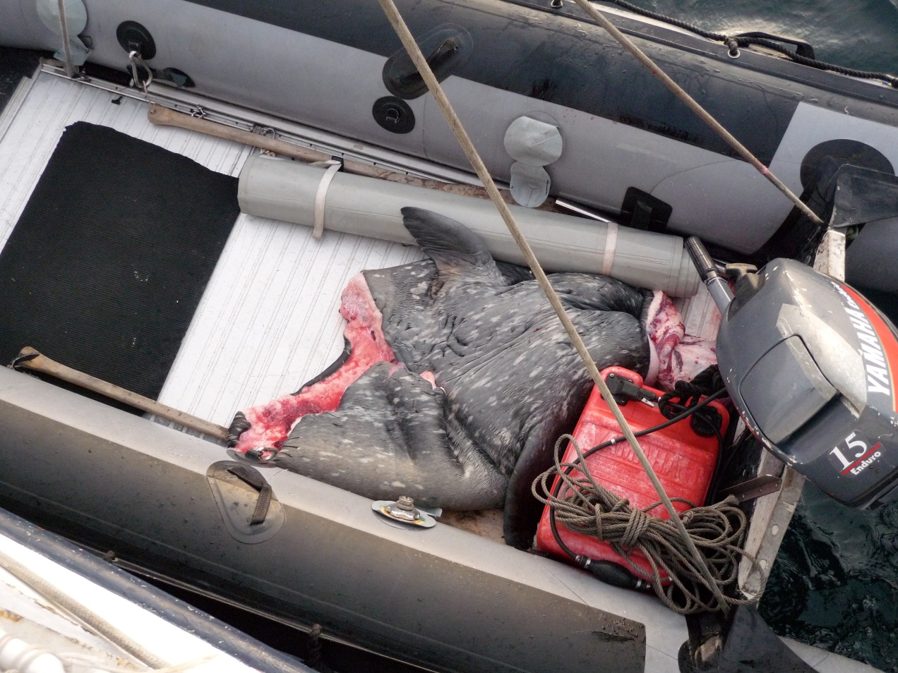
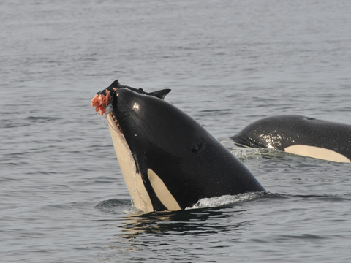
Killer whales taking
certain parts, of certain prey

Slide 23
Insights from Antarctic Peninsula studies:
More differentiation of forms
Prey specialization?
Amount of prey taken
Movement patterns

Slide 24
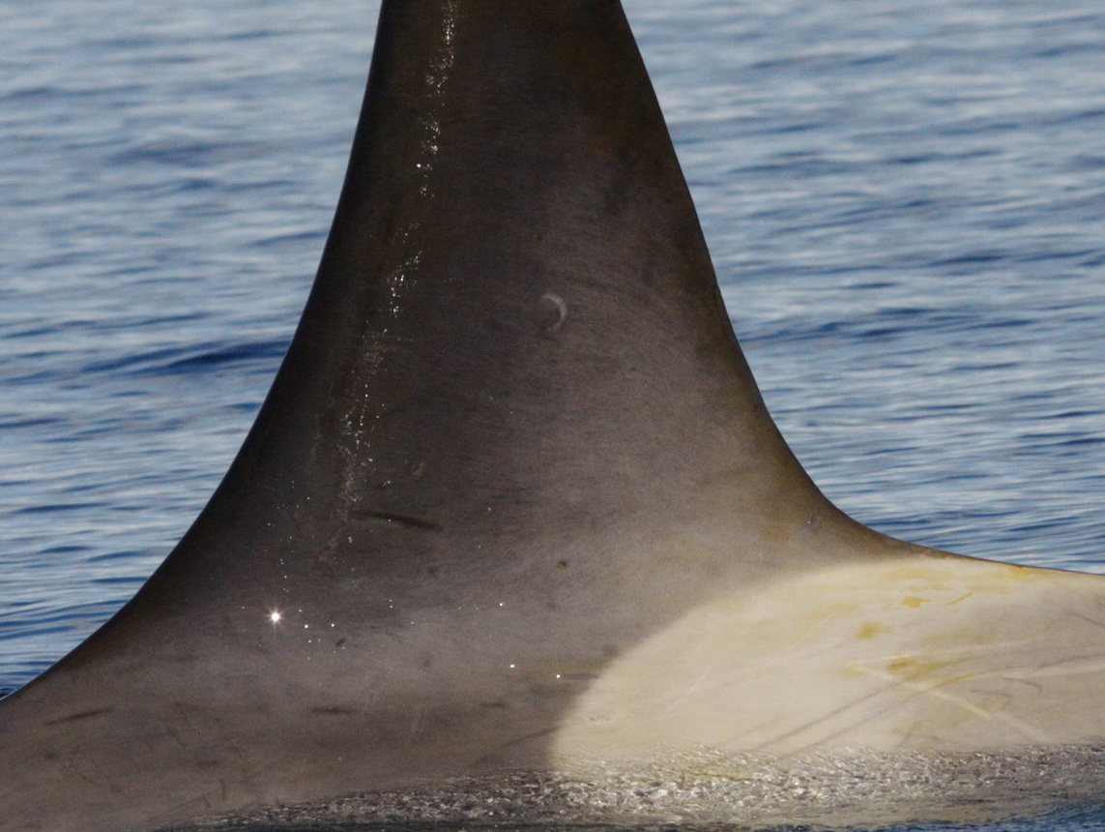
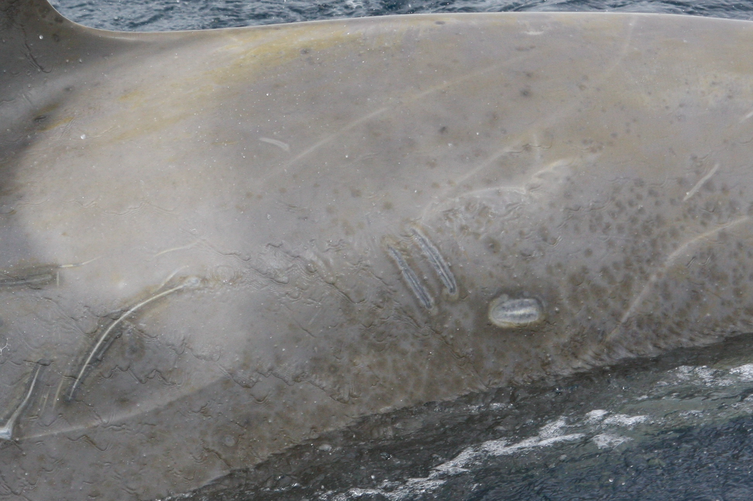
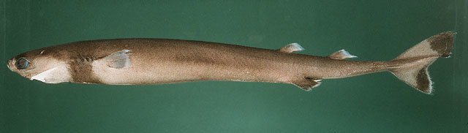

Notes:
First indication of movements – cc shark bites; 30-40 cm shark found in warmer waters. In addition, type Cs have been photographed off Australia and NZ; type B has been photographed off Falkland Islands and NZ.

Slide 25
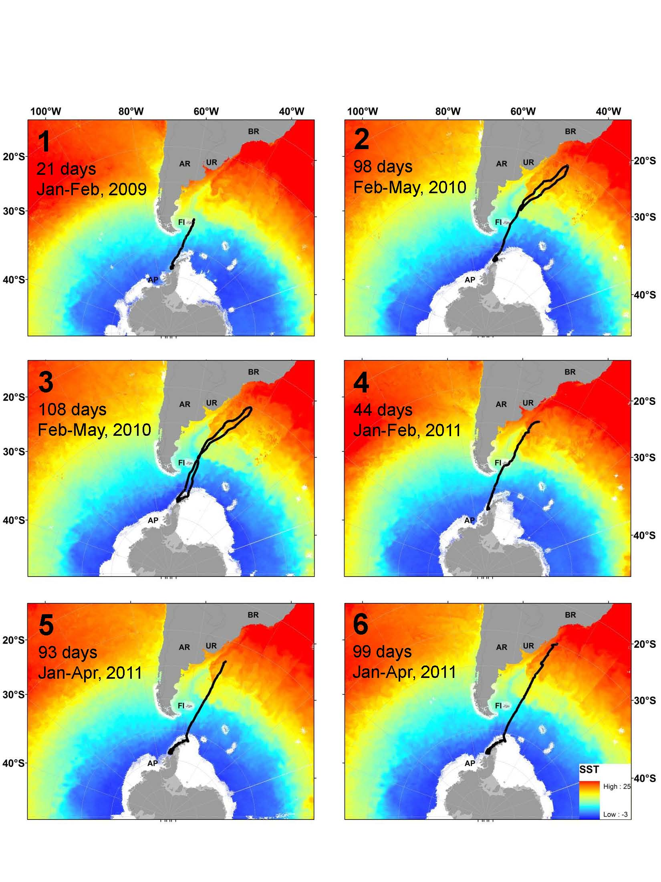
Durban and Pitman 2011
Notes:
Tracks of 6 whales from 4 different groups, over two years

Slide 26
Durban and Pitman 2011
Notes:
Longest track was 109 days, including a 9,400 km roundtrip sortee to southern Brazil and back in 42 days – returning 40 km from tagging site at the onset of winter. 6.5 kts at fasest sustained speed. SST -1.9 to 24.2C

Slide 27
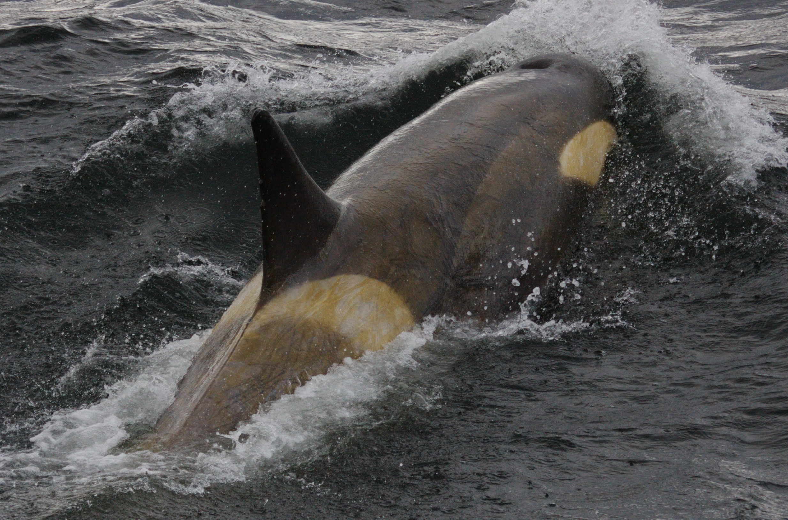

Slide 29
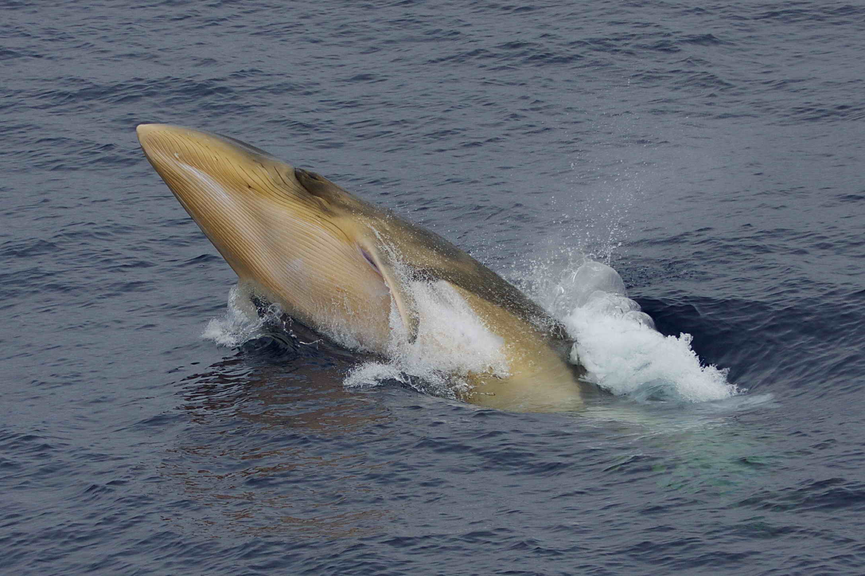

Slide 30
Determining the Ecological Role of Antarctic Killer Whales
How many species/ecotypes present?
Population sizes
Movement – within and without Ross Sea
Preferred prey species; can they switch?
Number of prey taken (depends partly on how much of each prey is eaten)
Questions?

