Slide 1
Modeling of top predators to inform conservation spatial planning in the Ross Sea, Antarctica
Grant Ballard, Dennis Jongsomjit, Sam Veloz, David Ainley

Slide 2
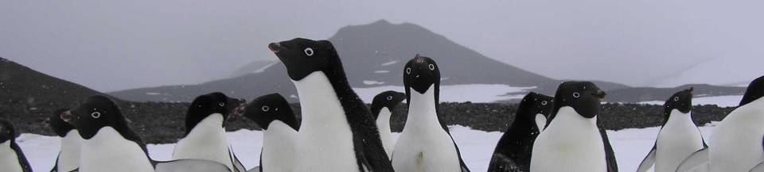
Study Context
(www.penguinscience.com)
Why do animals live where they live?
Our ability to study such fundamental questions in ecology is hampered by human activities in most places
Ross Sea provides a “base datum for normality” (Leopold 1949) – food web is still intact
We get used to what we experience
Baselines shift
Ecosystems degrade
Notes:
The context of our current study, generally speaking – why did we come to Antarctica, and the Ross Sea in particular?

Slide 3
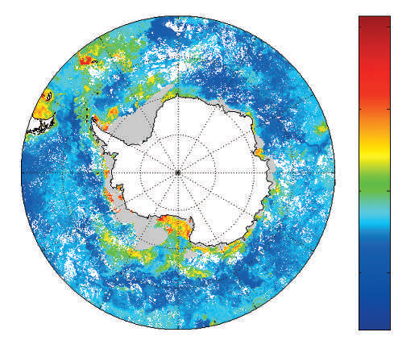
The most productive part of the southern ocean
(28% of total primary productivity)
Chlorophyll mg /m³
Arrigo et al. 1998;Smith & Comiso 2008
From Smetacek & Nicol 2005

Slide 4
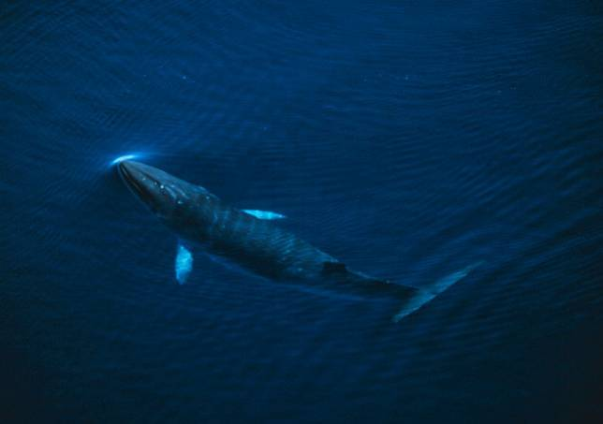
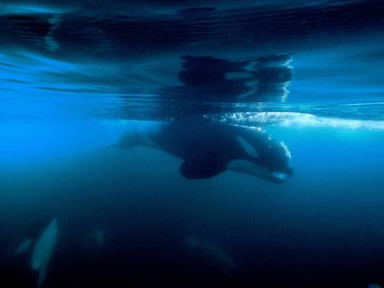
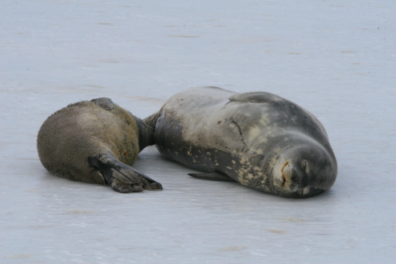
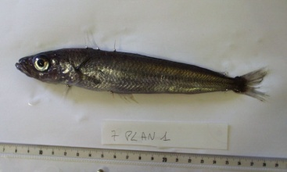
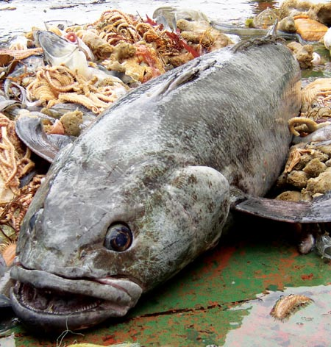
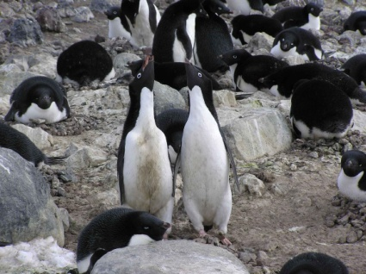
The diatoms are relatively ungrazed in the Ross Sea
Meaning krill numbers are lower than expected – why?
Fish, whales, and birds act together to keep system in balance?
Who eats who?
Minke whales
killer whales & Weddell seals
silverfish
krill
diatoms
Penguins
toothfish
Notes:
Biological paradigm – diatoms being the bottom of a food chain – could the top predators actually be acting together to reduce the amount of krill?

Slide 5
What happens if we remove pieces this web, as has been done in every other ocean?
Who eats who?
?
Minke whales
killer whales & Weddell seals
silverfish
krill
diatoms
Penguins
toothfish
?
Notes:
Biological paradigm – diatoms being the bottom of a food chain – could the top predators actually be acting together to reduce the amount of krill?

Slide 6
Ten Ross Sea Meso-predators in this study
Species | Ross Sea Pop. | Percent of global pop. | Source
1. Antarctic Minke Whale | 21,000 | 6% | Branch 2006, Ainley 2010
2. Ross Sea (Ecotype C) Killer Whale | 3350 | ~50 %? | Ainley 1985, Ainley et al. 2009a, Morin et al. 2010
3. Ecotype-A/B Killer Whale | 70 | ? | Ainley 1985, Ainley et al. 2009a
4. Weddell Seal | 30,000 - 50,000 | 50-72% | Stirling 1969, Ainley 1985, Erickson & Hanson 1990
5. Crabeater Seal | 204,000 | 17 % Pacific sector | Ainley 1985, Erickson & Hanson 1990
6. Leopard Seal | 8,000 | 12 % Pacific sector | Ainley 1985
7. Adélie Penguin | 3,000,000 | 38% | Woehler 1993
8. Emperor Penguin | 200,000 | 26% | Woehler 1993
9. Antarctic Petrel | 5,000,000 | 30% | Ainley et al. 1984, van Franeker et al. 1999
10. Snow Petrel | 1,000,000 | ? | Ainley et al. 1984

Slide 7
Species observation data sources
Taxa | Years surveyed | Source of data
Minke whales | 1976-1983, 1994, 2004 | D. Thiele, AnSlope cruises (2004); D. Ainley, RISP and NBP cruises.
Killer whales | 1976-2004 | IWC, R.L. Brownell, Jr, pers.comm.; D. Thiele, AnSlope cruises, D. Ainley, RISP and NBP cruises.
Seals & seabirds | 1976-1981, 1994 | D. Ainley, RISP and NBP cruises.
Weddell seals (winter) | 1993-1995, 1997-2000 | Pers. comm.: B. Stewart, W. Testa, J. Burns, J. Bengtson, P. Boveng

Slide 8
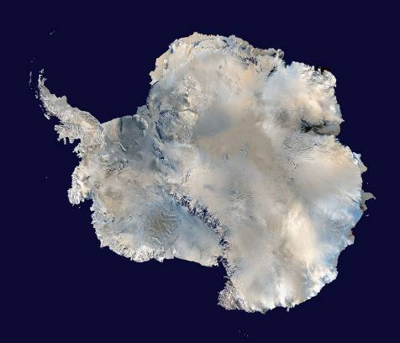
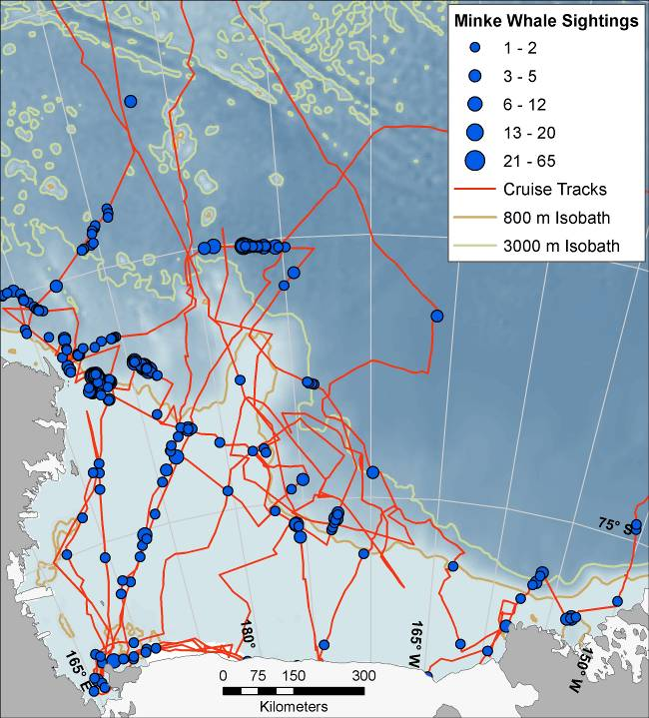
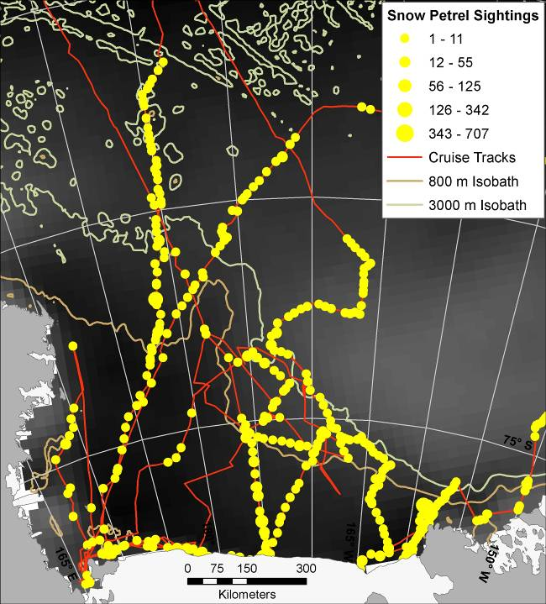
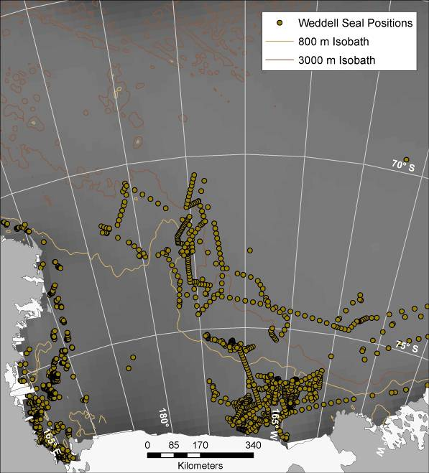
Niche occupation: geographic space
Source data (examples)
Minke Whales
Snow Petrels
Winter Weddell Seals
Notes:
Figure 2. (A): cruise tracks on which minke whales were surveyed, with bathymetry as base layer (lighter = shallower). (B): tracks on which seabirds and pinnipeds were surveyed (snow petrel sightings used for example), with typical sea-ice cover for coincident season (mean Dec-Jan ice concentration from Dec 1997 to Jan 2008; black = no ice, lighter shades of gray = more ice). (C) Positions of Weddell seals during winter (from determined satellite transmitters) and typical sea ice cover for coincident season (mean Jul - Sep ice concentration for 1997 to 2007; black = no ice, lighter shades of gray = more ice). Seals were initially tagged outside the Eastern boundary of the map and subsequently moved into the Ross Sea over the next several months.

Slide 9
Six Environmental Variables considered
 | Definition | Years collected | Scale | Source
Variable
1. Bathymetry | Depth (m) |  | 5km | ADD 2000
2. Circumpolar Deep Water | Temperature and salinity defined water mass |  | 5km | Orsi & Wiederwohl 2009; http://wocesoatlas.tamu.edu. Also, Dinniman et al. 2003, M. Dinniman, pers. comm.
3a. Summer Sea Ice | Mean % cover (Dec - Jan) | 1998-2008 | 25km | SSM/I - Cavalieri et al. 2008.
3b. Winter Sea Ice (Weddell Seal only) | Mean % cover (Jul – Sep) | 1998-2007 | 25km | SSM/I - Cavalieri et al. 2008.
4. Chlorophyll | Mean Mg x m⁻³ (Nov – Jan) | 1997-2006 | 12.5km | NASA, J. Comiso, pers. comm.
5. Distance to Shelf Break | Euclidean distance (m) to the 800-m isobath |  |  | Derived from ADD 2000
6. Bathymetric gradient | The angle of maximum change between cells in bathymetry grid (degrees) |  | 5km | Derived from ADD 2000

Slide 10
Ross Sea Niche occupation: diet
(from literature review)
Substantial overlap
Notes:
Prevalence of Antarctic silverfish and krill (all species) in the diet of (air breathing) top-predators over the Ross Sea shelf and slope, thus indexing degree of diet overlap. Data from Ainley et al. 1984, 2003; Burns et al. 1998, Cherel & Kooyman 1998, Green & Burton 1987, Pitman & Ensor 2003, and Ichii et al. 1998. Values shown for minke whales are a large underestimate for silverfish, as Ichii et al. only presented the proportion of samples in which silverfish was the dominant prey, not the proportion of samples in which silverfish occurred; values for killer whales are a guess (the only fish available to them in any quantity would be silverfish and toothfish; see Ainley et al. 2009a).

Slide 11
Niche Occupation: foraging depth
(from literature review)
Broadly distributed
Notes:
Percent overlap in maximum diving depth among Ross Sea top mesopredators.

Slide 12
Low spatial overlap, but high env. niche overlap
Notes:
Index of spatial overlap (%; left side), and environmental niche similarity index (I; right side) for species in the Ross Sea region during summer, except for Weddell seal (winter only, in italics). Spatial overlap values >13% (the median for summer species co-occurrence) are shown in bold font, as are significant values of I as determined from randomization tests.

Slide 13
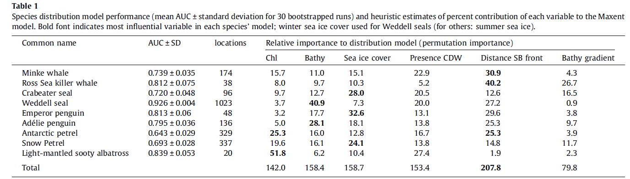
Explanatory variable contributions to habitat suitability models: Distance to shelf is most important
Notes:
Species distribution model performance (mean AUC ± standard deviation for 30 bootstrapped runs) and heuristic estimates of percent contribution of each variable to the Maxent model. Bold font indicates most influential variable in each species’ model; winter sea ice cover used for Weddell seals (for others: summer sea ice).

Slide 14
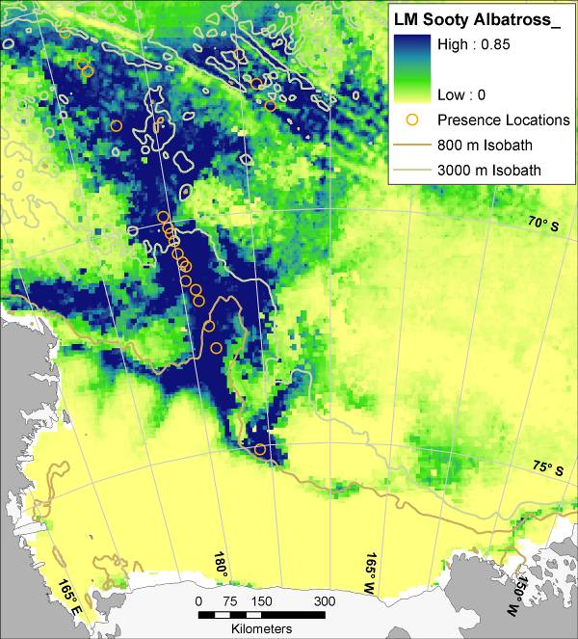
Three patterns of habitat suitability:
1. Shelf Break Slope
Light Mantled Sooty Albatross
Notes:
Mean (from 30 bootstrapped runs) modeled environmental suitability for predators in the Ross Sea; results of maximum entropy modeling. Presence locations are displayed as orange circles.

Slide 15
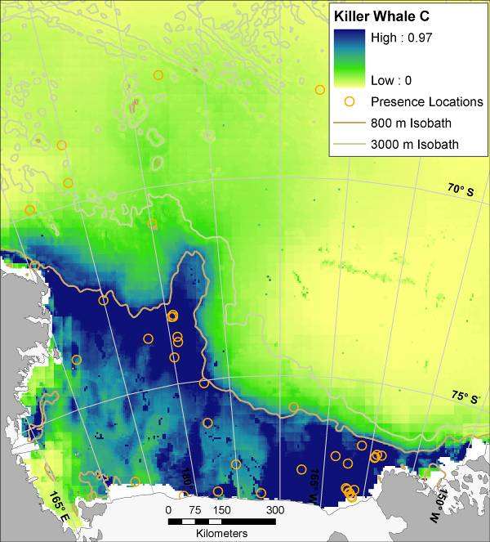
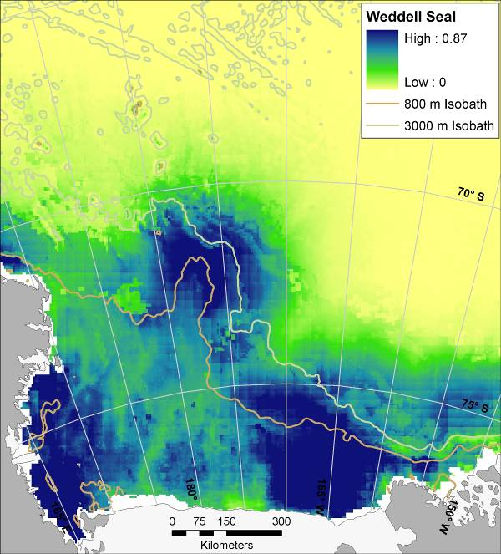
Three patterns of habitat suitability:
2. Shelf + Shelf Break Slope
Type C Killer Whale
Weddell Seal (winter)
Notes:
Mean (from 30 bootstrapped runs) modeled environmental suitability for predators in the Ross Sea; results of maximum entropy modeling. Presence locations are displayed as orange circles (see Figure 1 for Weddell seal presence locations, and for full survey effort). Map for Weddell seal is for winter distribution (all others are summer), when no longer confined mostly to haul outs along coastal tide cracks in fast ice not adequately sampled by ship-based surveys.

Slide 16
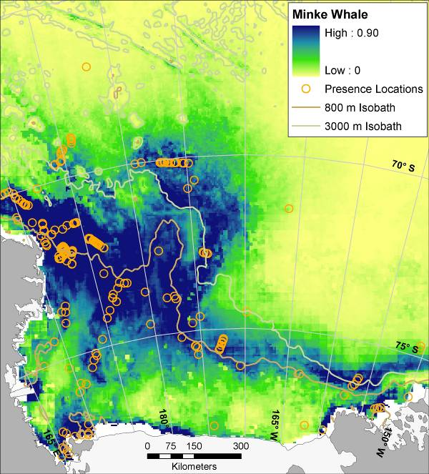
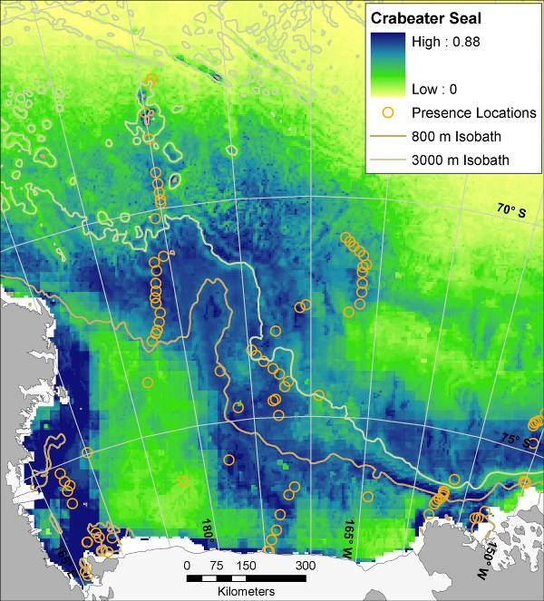
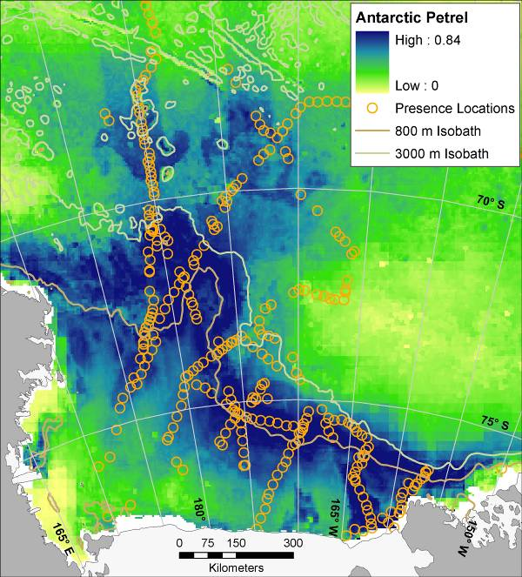
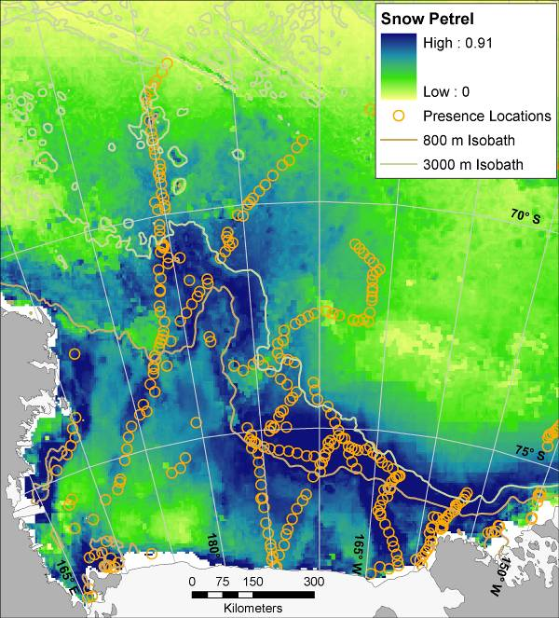
Three patterns of habitat suitability:
3. Marginal Ice Zone
Minke Whale
Crabeater Seal
Antarctic Petrel
Snow Petrel
Notes:
Mean (from 30 bootstrapped runs) modeled environmental suitability for predators in the Ross Sea; results of maximum entropy modeling. Presence locations are displayed as orange circles.

Slide 17
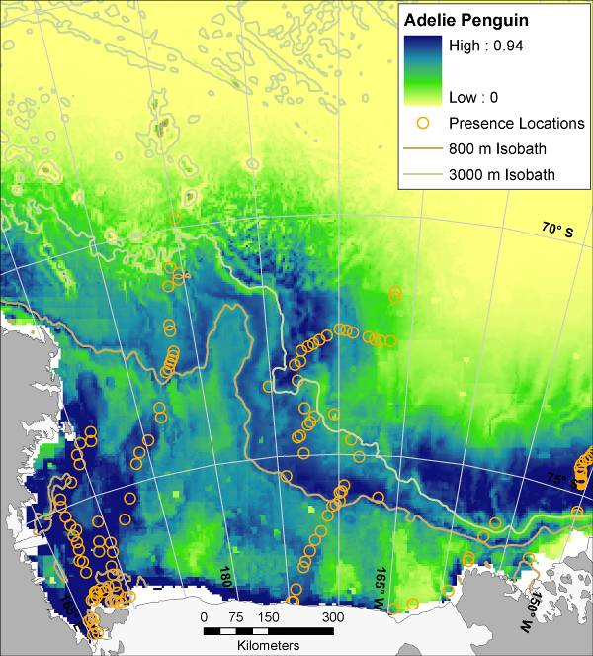
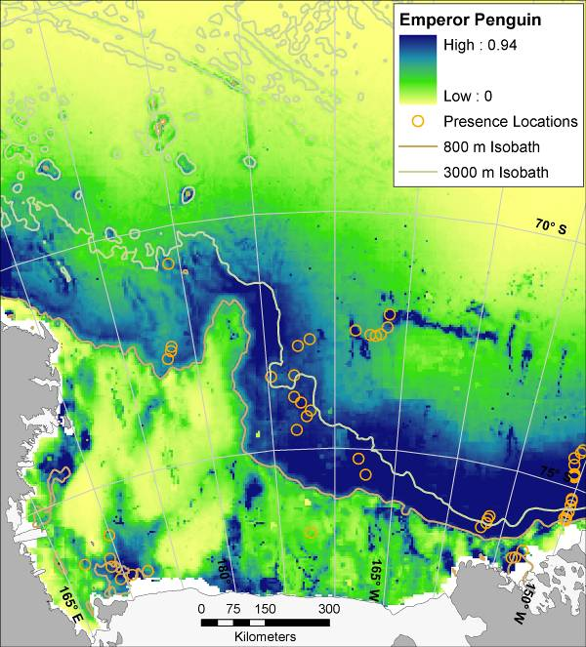
Three patterns of habitat suitability:
3 (cont’). Marginal Ice Zone (penguins!)
Adélie Penguin
Emperor Penguin
Notes:
Mean (from 30 bootstrapped runs) modeled environmental suitability for predators in the Ross Sea; results of maximum entropy modeling. Presence locations are displayed as orange circles.

Slide 18
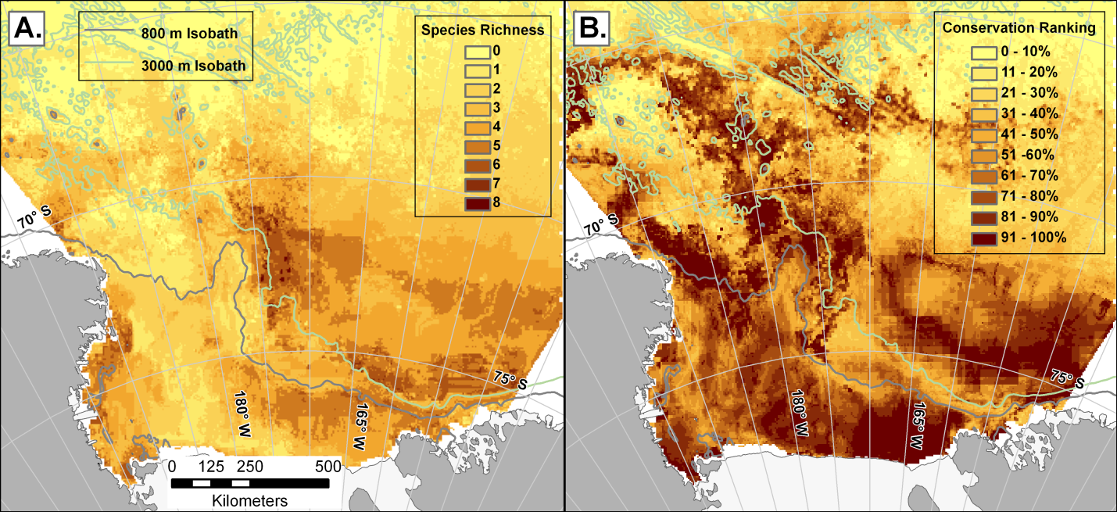
Species Richness (from Maxent) and
Conservation Rank (from Zonation)
Species Richness
Conservation Ranking
Notes:
(A) Modeled species richness (sum of individual species’ Maxent-modeled probabilities of occurrence) of mesopredators of the Ross Sea: Ross Sea Killer Whale (ecotype C), Minke Whale, Crabeater Seal, Weddell Seal, Emperor Penguin, Adélie Penguin, Antarctic Petrel, Snow Petrel, and Light-mantled Sooty Albatross. (B) Relative conservation importance for same species; results from Zonation core area analysis with all species given equal conservation priority (darker colors represent higher conservation ranking).

Slide 19
Conclusions
Three patterns of spatial use of the Ross Sea:
  1) Shelf Break Slope
  2) Shelf + Shelf Break Slope
  3) Marginal Ice Zone
Almost all study taxa had higher environmental suitability scores nearer to shelf break
Diet composition and environmental niche indices overlapped extensively, but use of foraging space was well partitioned by depth of diving
Species have low overlap in horizontal space - they used the entire shelf and slope, not necessarily during the same season
Outer shelf and slope, as well as deeper troughs in the Ross Sea Shelf and Ross Island vicinity are of particularly high importance

