Slide 1
Toothfish Stock Assessment (88.1, 88.2A, 88.2B)
2011 Report(s) of WG-FSA
WG-FSA-11/42
2009 Report of WG-EMM

Slide 2
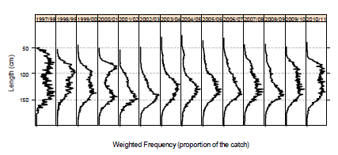
Basics as of 2011
“exploratory” status of fishery is now a (useful and important) policy decision
one area (88.2E assessed separately)
three “fisheries” (shelf, slope, north)
sex- and age-structured (1-50+)

Slide 3
Data, penalties, and priors
Fixed and estimated params.
Sex-specific catches at age (annual age-length keys plus size composition of the catches)
Marks and length-specific recaptures
IUU catch and “unaccounted” mortality
Exploitation rate ≤ 0.999
N ≥ release of tagged fish
prior on initial biomass
prior on selectivity params.
Natural mortality (2)
Growth (12)
Maturity schedule (4)
Tag-detection rate (1)
Tag-loss rates (2)
Initial tagging mortality (1)
Tagging effect on growth (1)
Recruitment (20)
Initial biomass (1)
Selectivity (35)
Process errors/weights for each type of data (2)

Slide 4
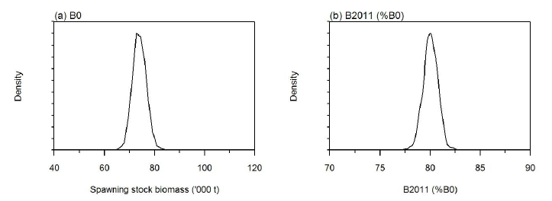
Initial Biomass and Status in 2011

Slide 5
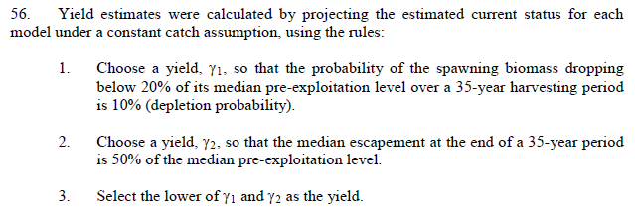
Forward Projections → Yield

Slide 6
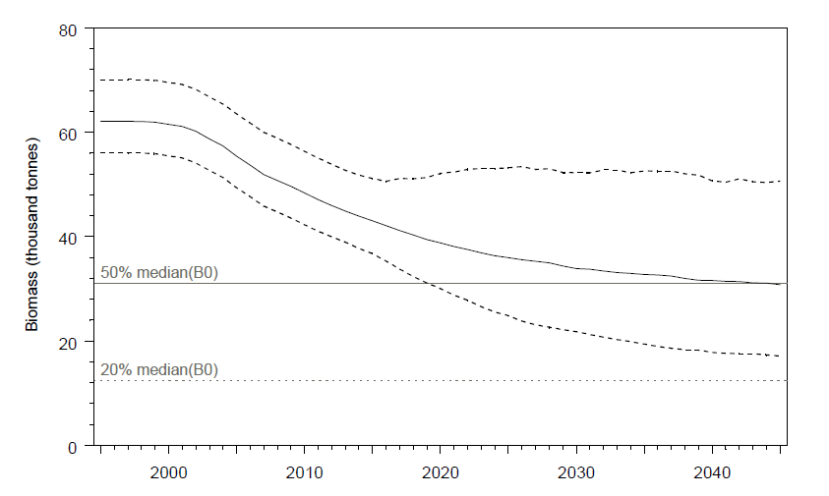
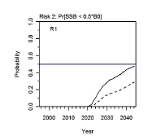
Recent Projections
2009-2010 Assessment
2011-2012 Assessment
assess
project (2850 t)
Pr(SSB < 0.5*B0)
3282 t
2850 t

Slide 7
Bycatch Limits
Grenadiers: based on extrapolation of trawl-survey results to estimate initial biomass and subsequent application of GYM and decision rules (430 t + “move-on rules”)
Skates: set as a fraction of the toothfish catch (but ongoing mark-recapture may eventually allow independent estimation of yield)

Slide 8
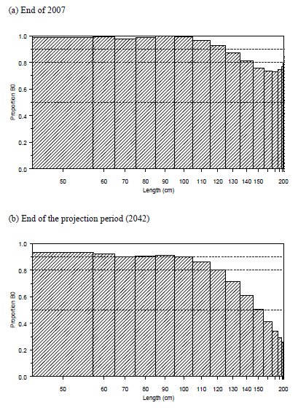
Toothfish as Prey (old)

Slide 9
What could change over time
Data, penalties, and priors
Fixed and estimated params.
Sex-specific catches at age (annual age-length keys plus size composition of the catches)
Marks and length-specific recaptures
IUU catch and “unaccounted” mortality
Exploitation rate ≤ 0.999
N ≥ release of tagged fish
prior on initial biomass
prior on selectivity params.
Natural mortality (2)
Growth (12)
Maturity schedule (4)
Tag-detection rate (1)
Tag-loss rates (2)
Initial tagging mortality (1)
Tagging effect on growth (1)
Recruitment (20)
Initial biomass (1)
Selectivity (35)
Process errors/weights for each type of data (2)
+ Model Structure!

