Slide 1
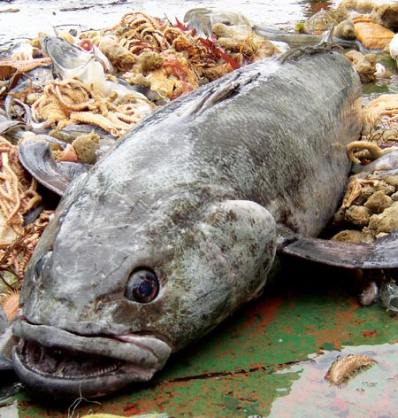
Ainley, DG, N Nur, JT Eastman, G Ballard, CL Parkinson, CW Evans, AL DeVries. 2012.
Decadal trends in abundance, size and condition of Antarctic toothfish in McMurdo Sound, Antarctica, 1972-2011.
Fish & Fisheries in review
AND COMPARISON TO INDUSTRIAL CATCH

Slide 2
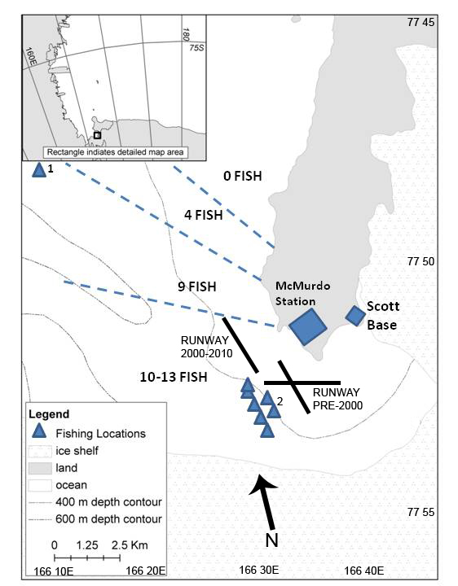
Seal
colony
38 Years

Slide 3
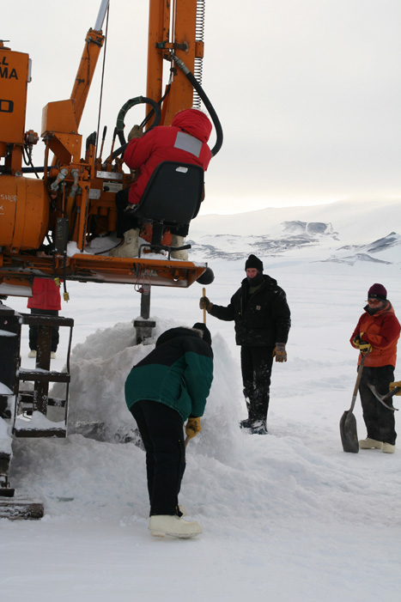
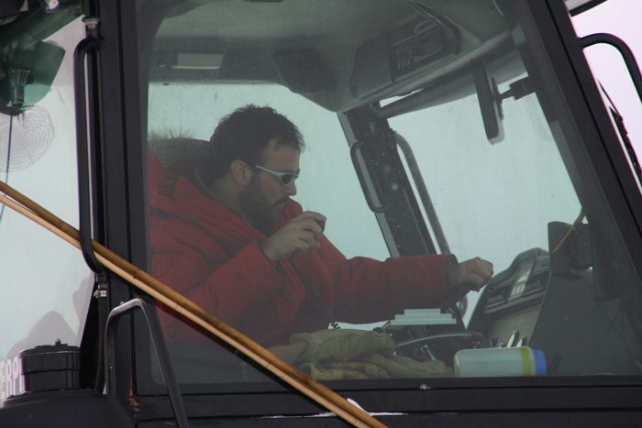
Tom Holford (LT)

Slide 4
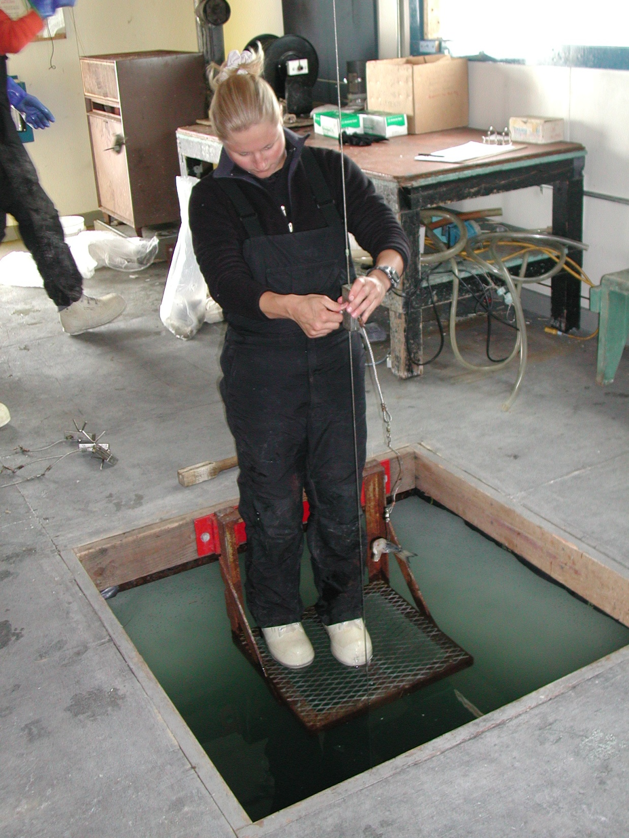
Vertical setline with
15-20, baited hooks
Spaced 3-5m apart;
no hooks
within 10-20m of bottom
to avoid scavenging of
fish by amphipods
Bottom depth varied
415-495m deep
depending on
location
Long liner
Mackenzie Zippay

Slide 5
Comparison of the catch for D. mawsoni
5588 fish caught, measured, tagged, most
released, 1972-2011,
THANKS TO ART
DEVRIES

Slide 6
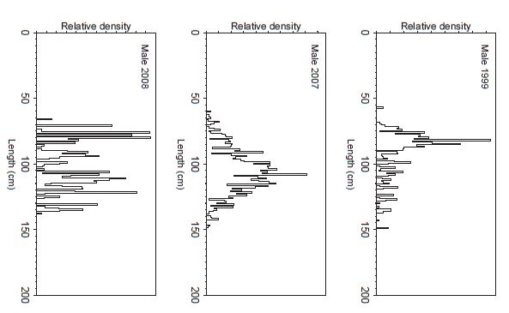
75%tile length
BODY LENGTH
OF FISH
CAUGHT
McMurdo Sound
Vertical setline
BOUYANCY ACHIEVED
AT ~100cm
Hanchet et al.
2010,
Benthic longline
vicinity of
Ross Island

Slide 7
Hanchet et al. 2008: fish length in the entire fishery,
including slope and sea mounts to the north.

Slide 8
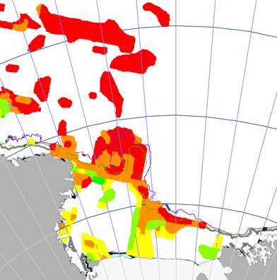
From Hanchet et al.
2008
AS DETERMINED BY BENTHIC LONGLINE CATCH: distribution of Antarctic toothfish, by size class (TL), as taken in the CCAMLR Area 88.1 fishery: green 40-80 cm, yellow 80-100 cm, orange 100-120 cm, red >120 cm).

Slide 9
QUESTIONS: VERTICAL LINE FISHING METHOD
IS PROVIDING A BIASED VIEW OF THE LENGTH-FREQUENCY
OF TOOTHFISH OVER THE ROSS SEA SHELF. SEEMS THAT THIS
IS THE CASE, TOO, FOR BENTHIC LONGLINE?
IS IT JUST UNDER HEAVY ICE COVER, OR WHERE THERE ARE SILVERFISH TO EAT, THAT TOOTHFISH RISE IN THE WATER COLUMN?

Slide 10
CHANGE IN FISH LENGTH BY YEAR,
1972-2004
N <17 fish/yr after 2004 so not included in model

Slide 11
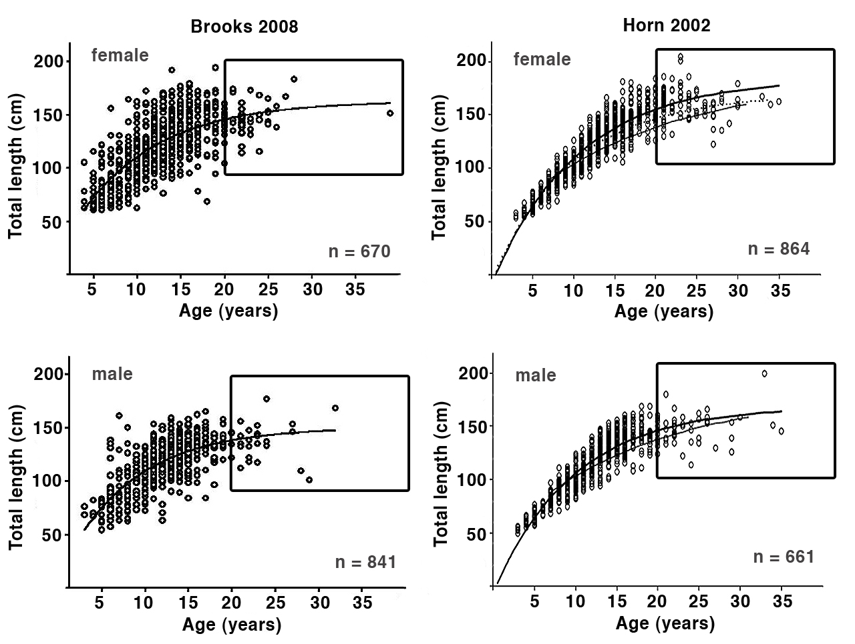
100cm
2004 season 1996-1999 Seasons

Slide 12
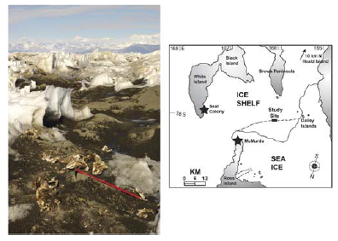
KIM SZ, DG AINLEY, J PENNYCOOK & JT EASTMAN. 2011.
Antarctic toothfish heads found along tide cracks of the McMurdo Ice Shelf. Antarctic Science 23, doi:10.1017/S095410201100040X
Weddell seals also used to take bigger toothfish

Slide 13
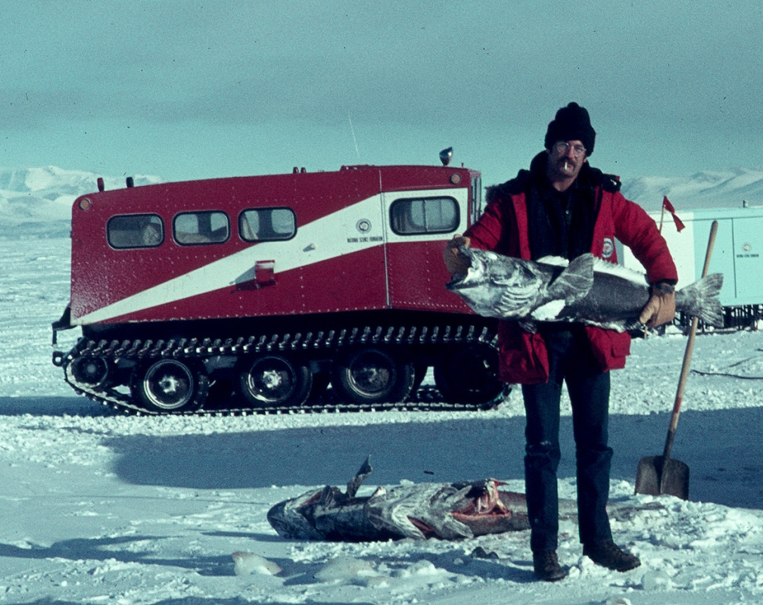
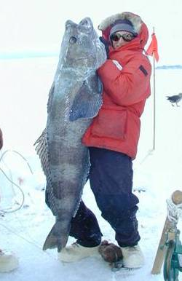
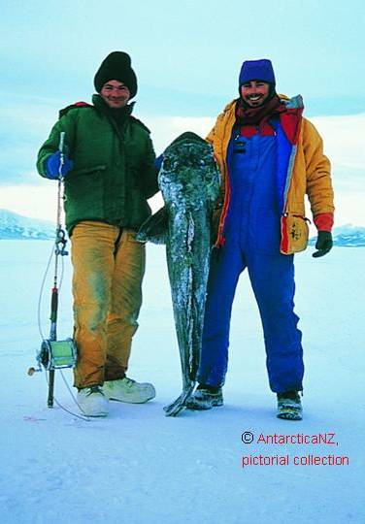
LARGE FISH NOW GONE
FROM MCMURDO SOUND
THUS CHANGING ECOSYSTEM
STRUCTURE AND PROCESSES.

Slide 14
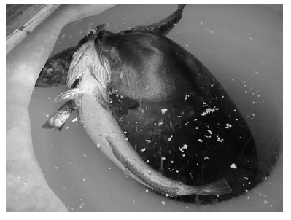
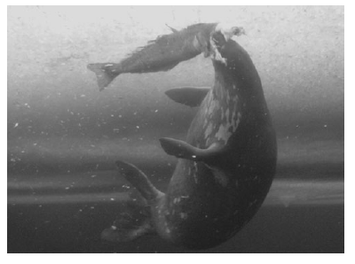
PLENTY OF SMALL TOOTHFISH STILL PRESENT,
AVAILABLE TO DEEP-DIVING WEDDELL SEALS
P.J. Ponganis & T.K. Stockard. 2007. The Antarctic toothfish: how common a prey for Weddell seals? Antarctic Science 19: 441-442

Slide 15
THE LOSS OF LARGE FISH FROM THE STOCK, THIS APPARENTLY HAPPENED VERY RAPIDLY. COULD THE ONTOGENETIC AGE DISTRIBUTION SHOWN BY HANCHET ET AL. (2008) BE PARTLY REFLECT A FISHERY EFFECT?

Slide 16
Catch by month

Slide 17
IS POOR FISHING SUCCESS IN EARLY SPRING DUE TO THE FISH NOT YET
BEING THERE? OR, GIVEN THAT THE WATER COLUMN IS DEVOID OF
LIFE (PHYTOPLANKTON ETC), THE TOOTHFISH ARE ON THE BOTTOM?

Slide 18
CATCH PER UNIT EFFORT OF TOOTHFISH
IN MCMURDO SOUND,
1972-2012

Slide 19
McMurdo Sound
Ross Sea industrial
catch
Tonnes

Slide 20
PRESUMABLY (ANOTHER) FISHERY INDUCED EFFECT?

Slide 21
K = (W/L ) x 10
3 5
CHANGE IN CONDITION OF FISH IN MCMURDO SOUND, 1972-2004

Slide 22
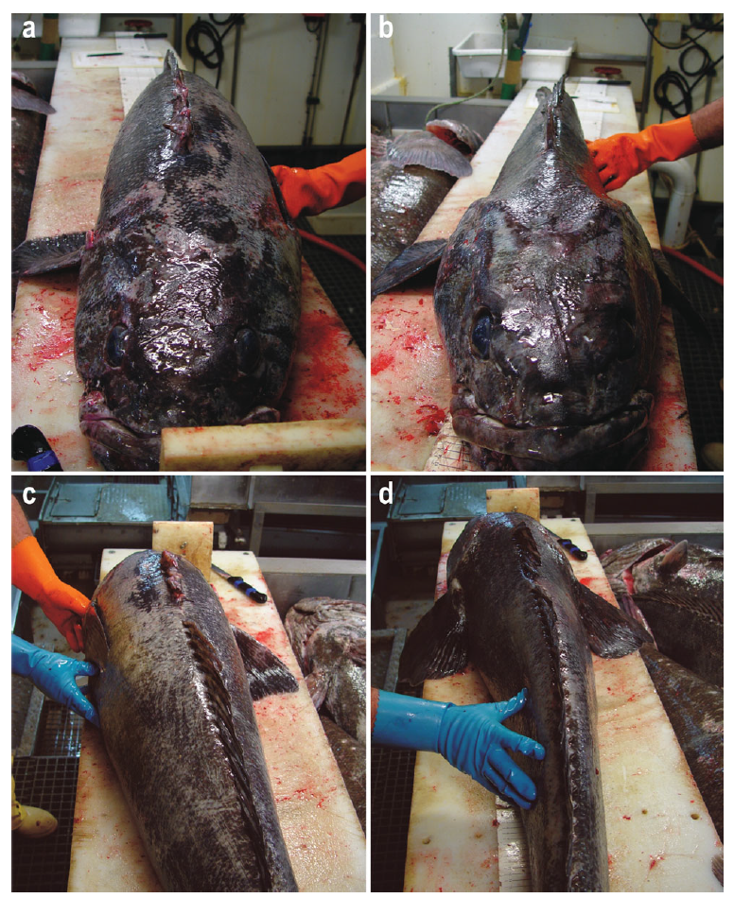
Fenaughty, Eastman & Sidell.
2008. Biological implications of low condition factor “axe handle” specimens of the Antarctic toothfish, Dissostichus mawsoni, from the Ross Sea. Antarctic Science 20: 537-551
GOOD CONDITION “AXE-HANDLE”
FAT-DEPLETED FISH
Mean K = 1.265 sd 0.149
K(AH) = <1.0125 (= LOWER
QUARTILE OF FISH)

Slide 23
PROPORTION OF AXE-HANDLE FISH IN MCMURDO SOUND, 1972-2004

Slide 24
LONGLINES ARE REKNOWN FOR TAKING THE HIGH QUALITY FISH. THESE FISH ARE THE MOST
VORACIOUS FORAGERS, AND ALSO THE PRIME BREEDERS.
UN-NATURAL SELECTION AT WORK?

Slide 25
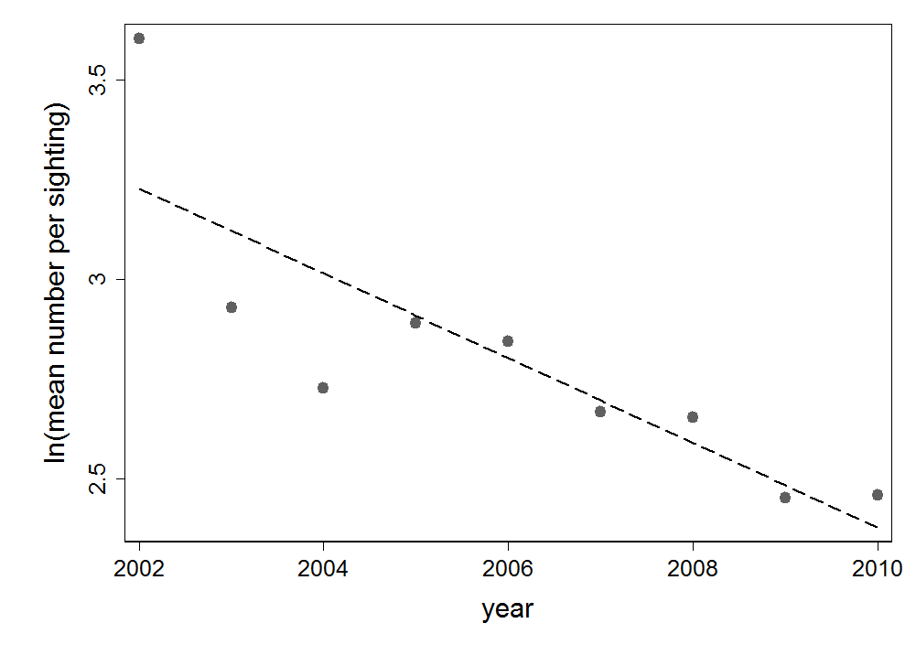
KILLER WHALES
PER SIGHTING
TOOTHFISH PREVALENCE, CPUE
INDUSTRIAL CATCH
OF TOOTHFISH

Slide 26
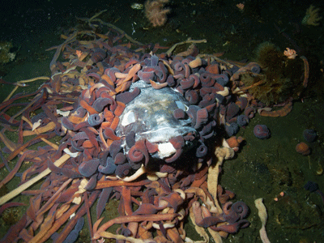
CCAMLR AIMS TO DEPLETE PRE-FISHED TOOTHFISH SPAWNING BIOMASS BY 50% BY 2030.
IS THIS “PRECAUTIONARY, ECOSYSTEM-BASED MANAGEMENT?”
STEVE RUPP
RIGHT NOW THEY THINK THE STOCK IS AT ~80%

