Slide 1
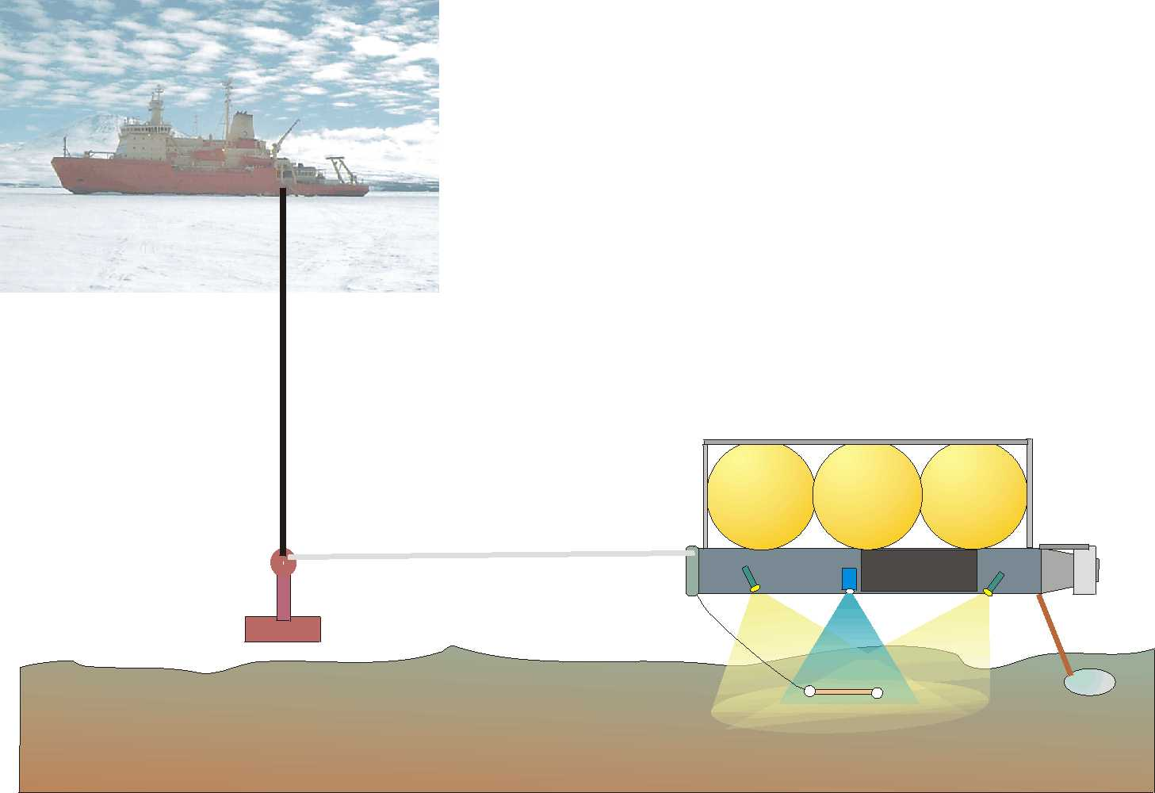
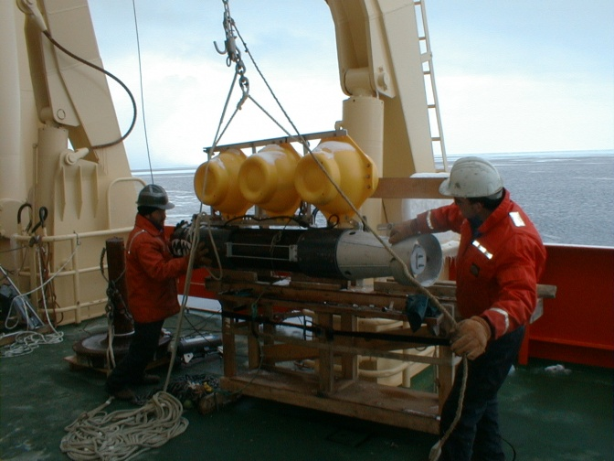
Benthic Video Transects
Megafaunal Abundance / Distribution
Benthic Boundary Layer Current Speed

Slide 2
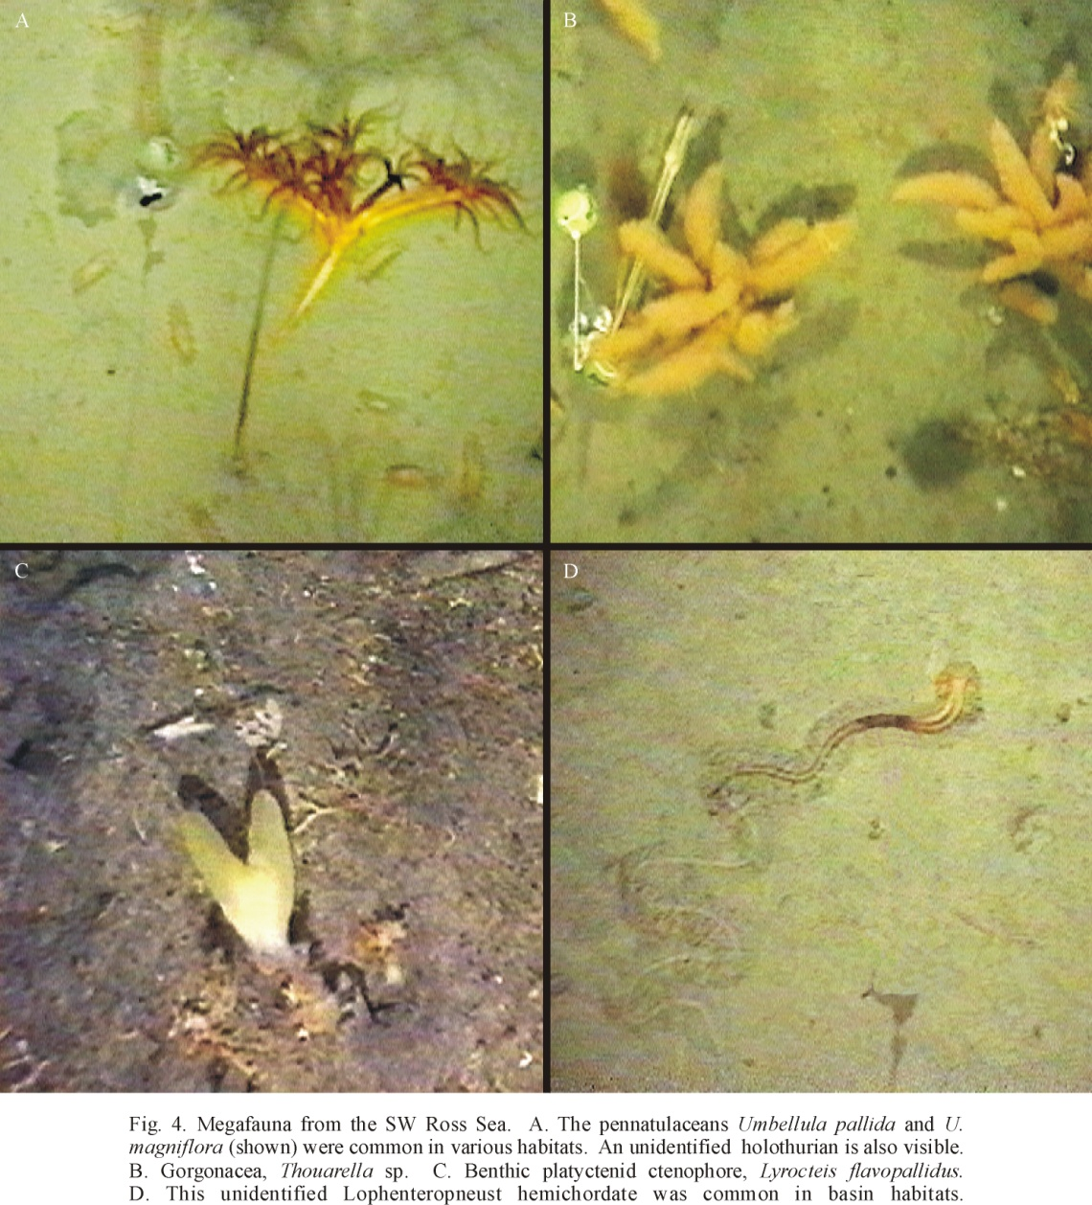
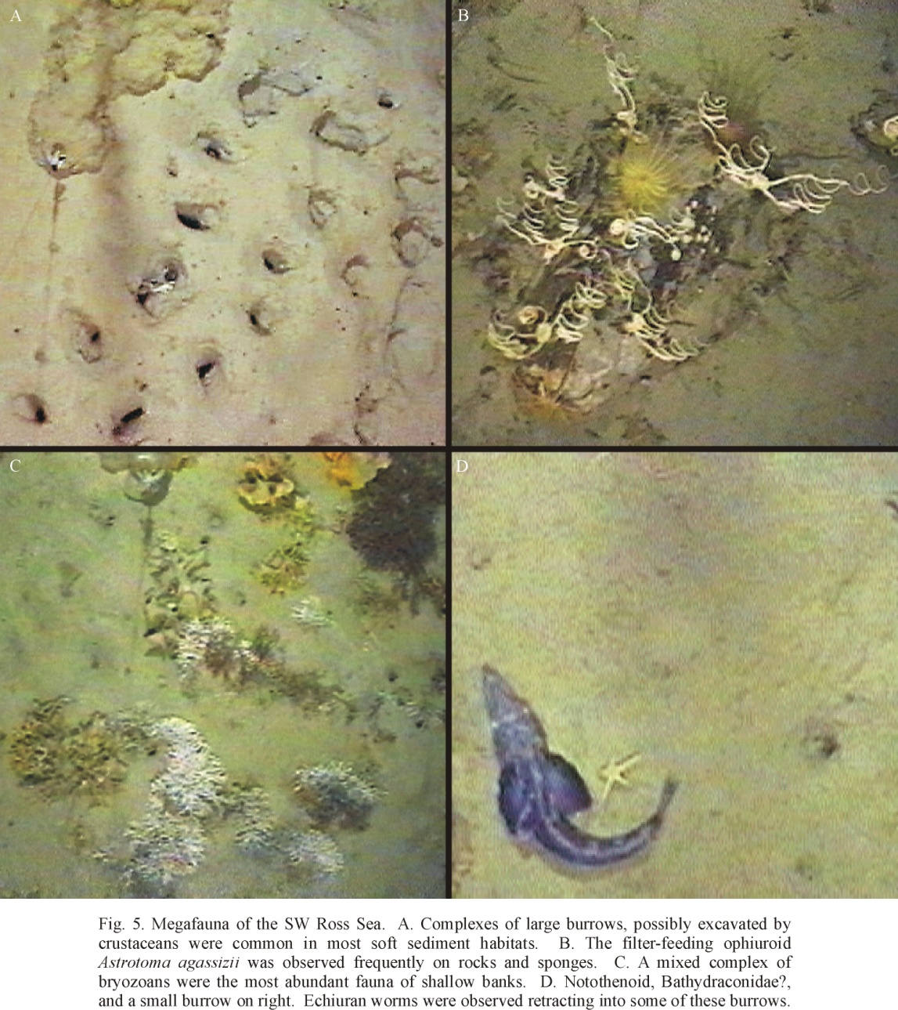
Ross Sea Benthos

Slide 3
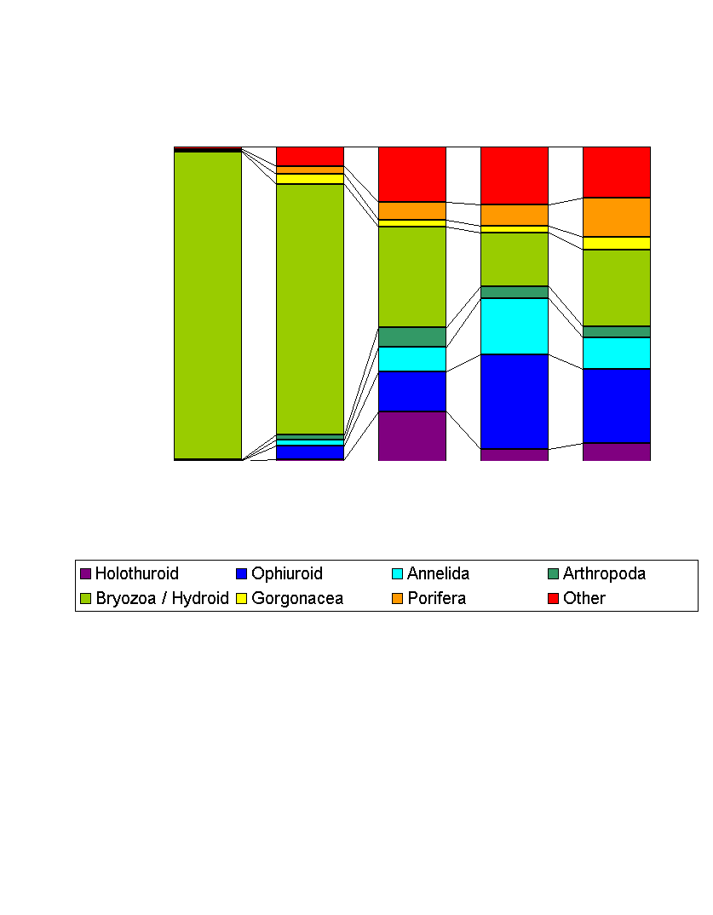
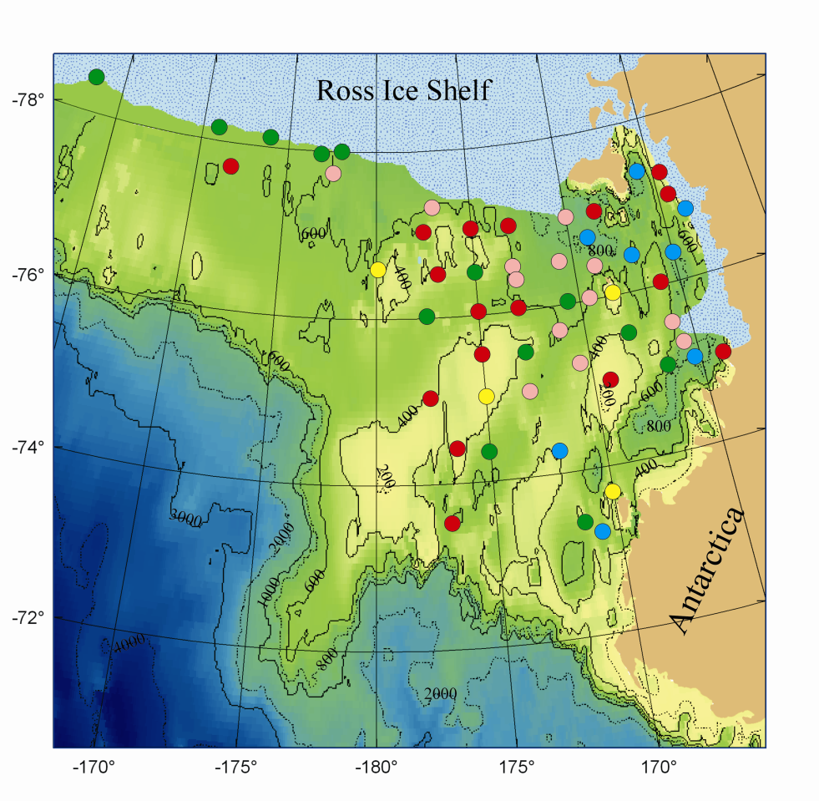
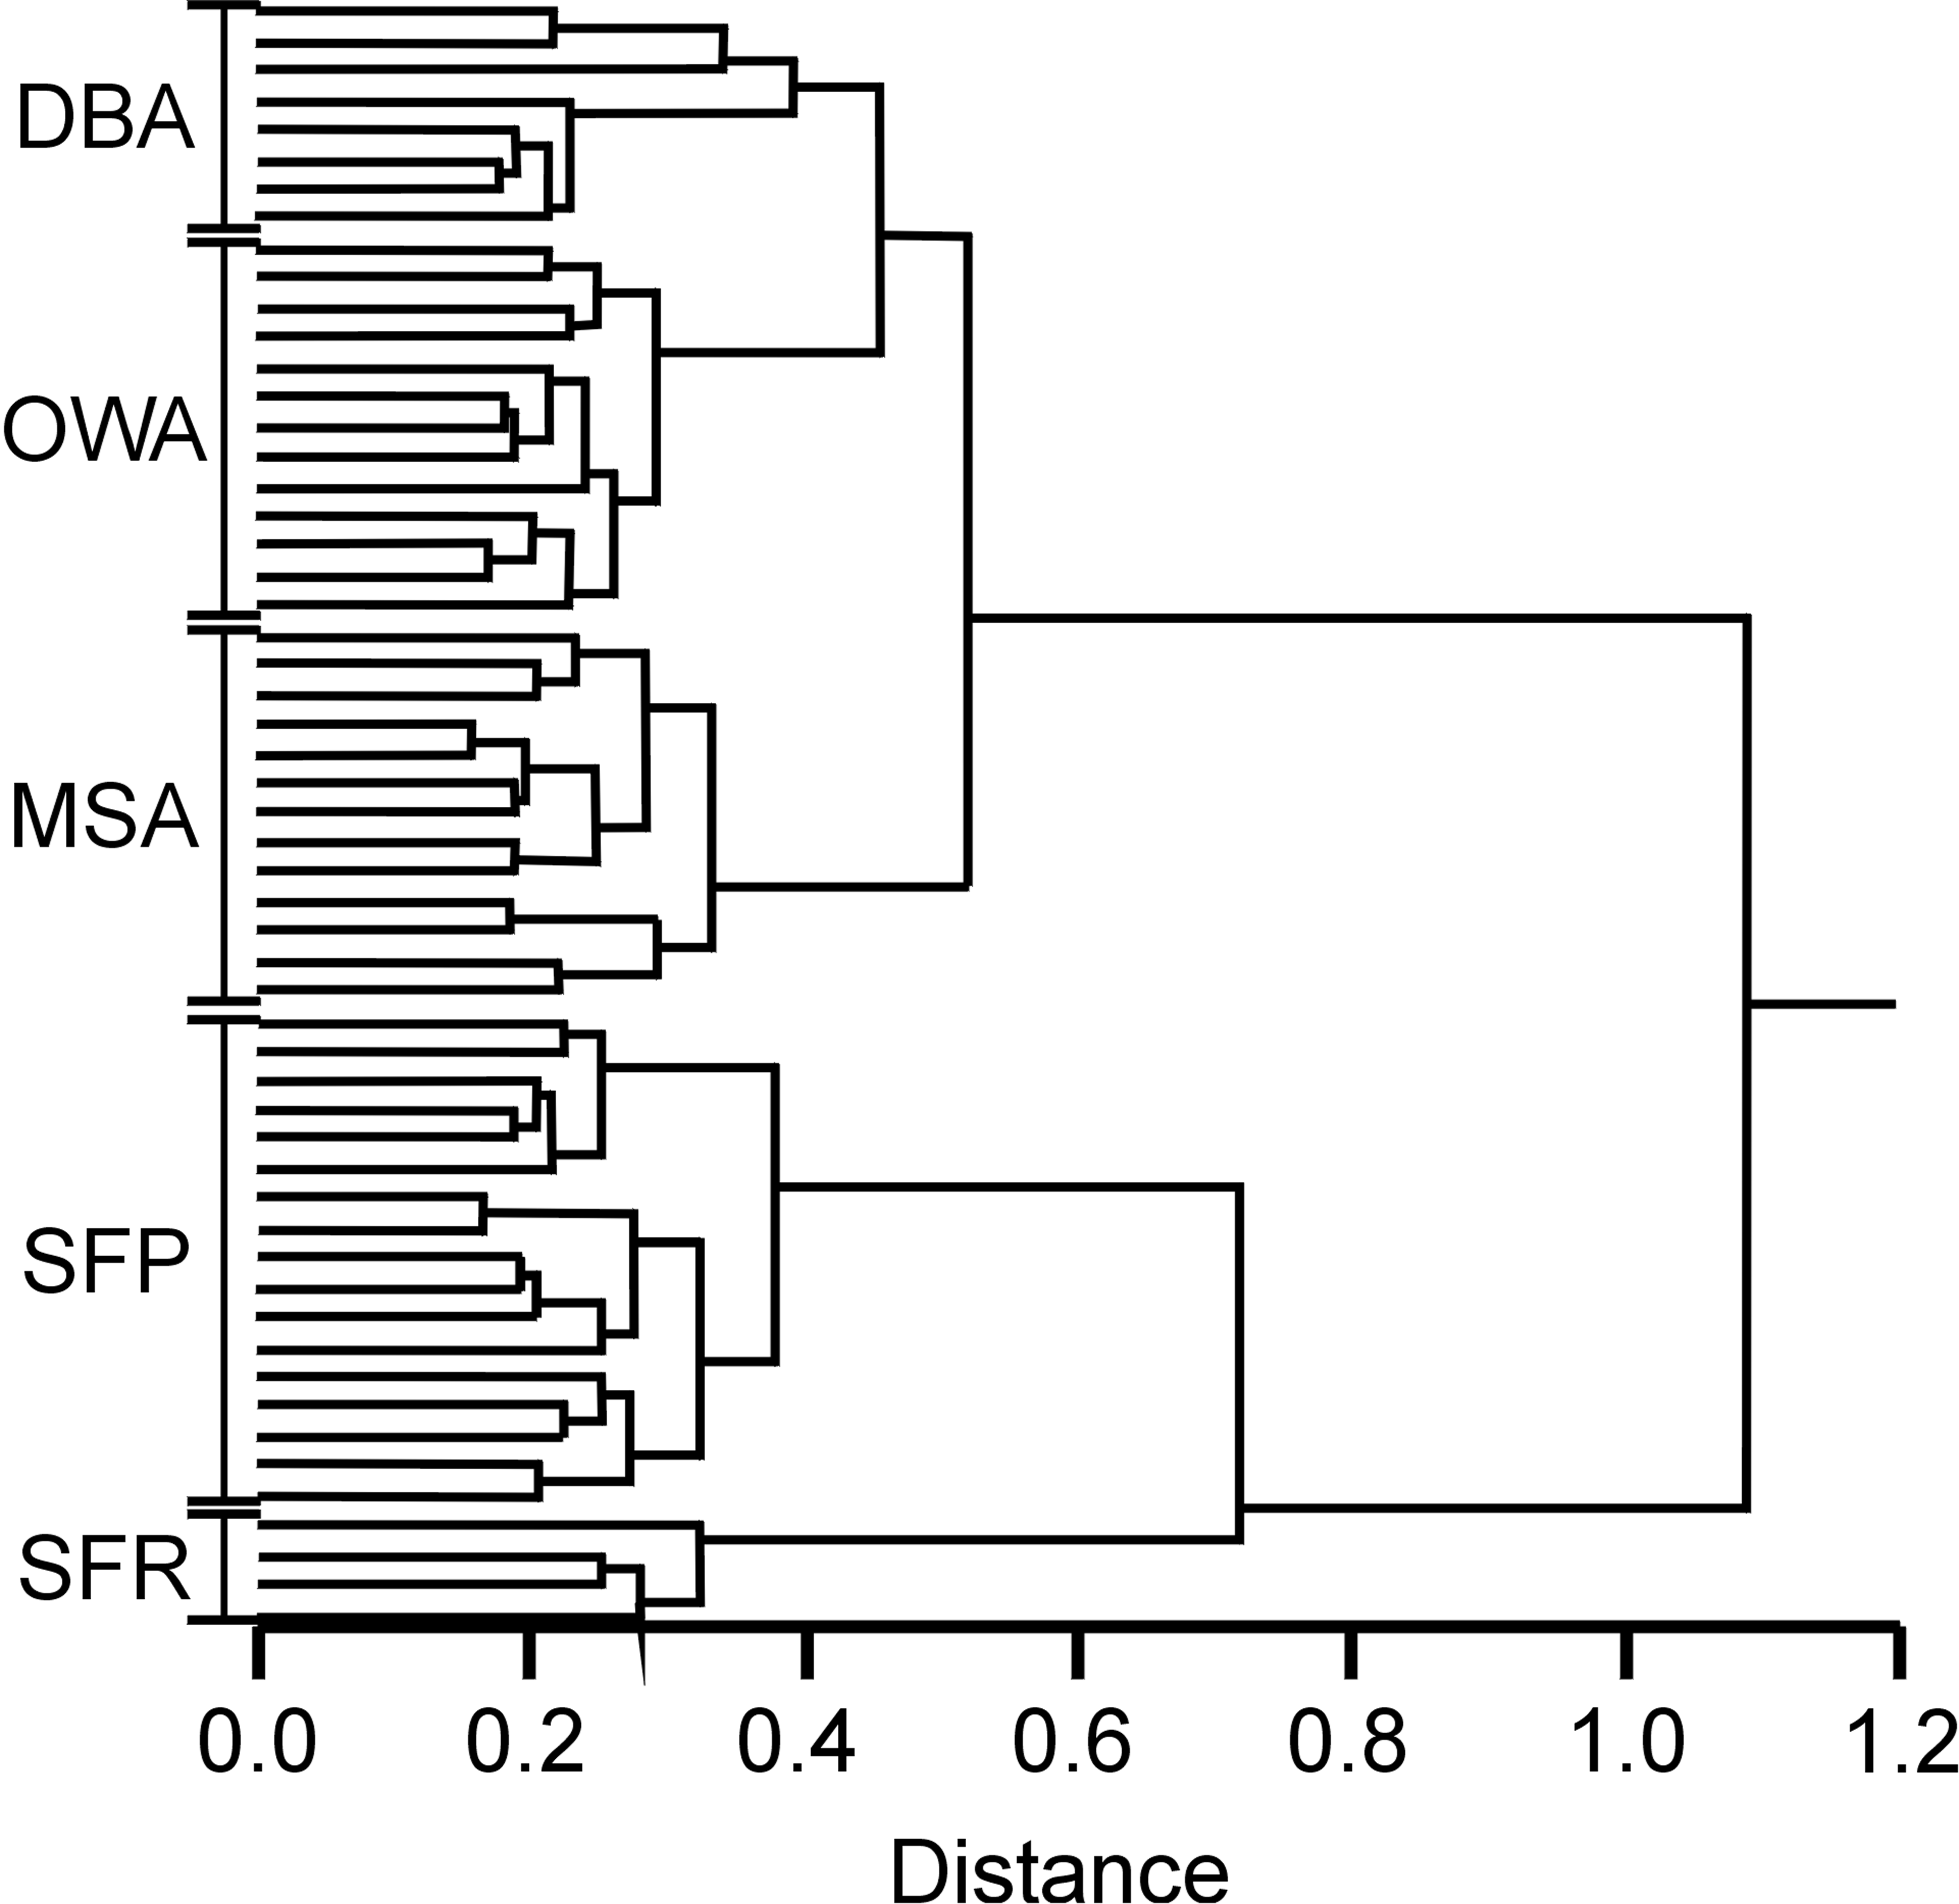
Benthic Megafaunal Assemblages
SFP – Suspension Feeder Rich
SFP – Suspension Feeder Poor
MSA – Mixed Slope Assemblage
OWA – Ophiuroid / Worm Assemblage
DBA – Deep Basin Assemblage
Barry et al. 2003

Slide 4
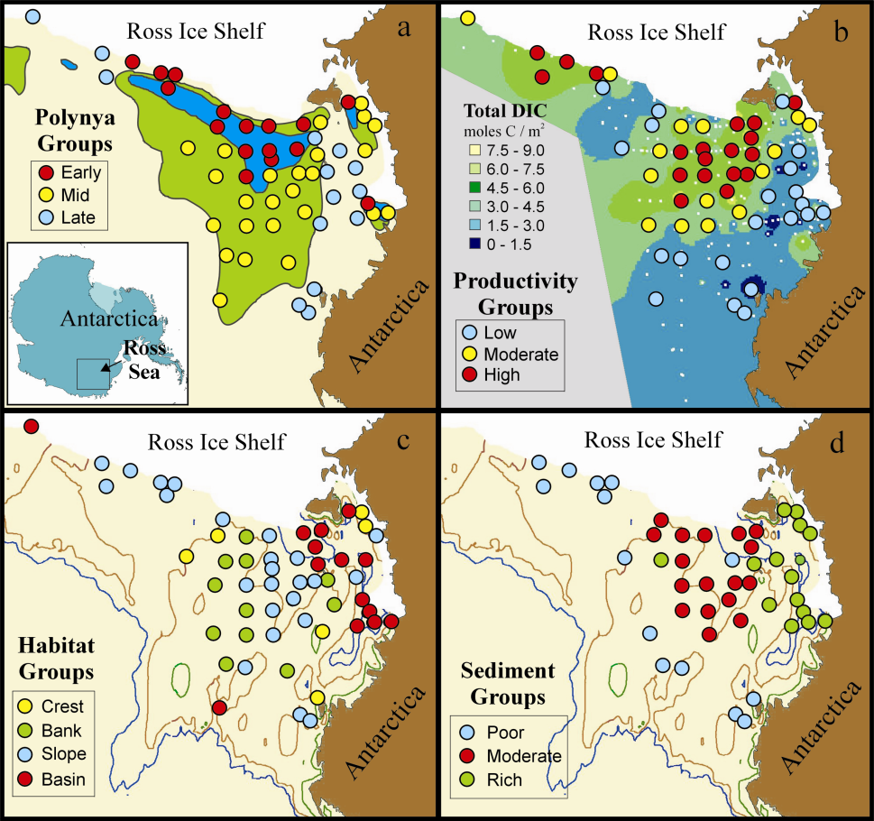
Factors Influencing Benthic Ecosystem Structure
Station Associations
Polynya Groups
Formation and persistence of open water
Early spring
Mid-season opening
Late / never open
Productivity Groups
Primary productivity of overlying water column
High water column PP
Moderate PP
Low PP
Habitat Groups
Grouped by depth, slope, bottom current speed
Crest – edge of ridge, rapid flow
Bank – shallow, flat, moderate flow
Slope – mid-depth, moderate flow
Basin – deep, flat, low flow
Sediment Groups
Grouped by sediment organics (%C, C/N, δ¹³C)
Poor – low %C (0.4)
Moderate – %C (0.8), δ¹³C~ -24
Rich – high %C(1.0), δ ¹³C~-27.

Slide 5
Correspondence of Faunal and Environmental Groups
Factor | Polynya | Productivity | Habitat | Sediment | Faunal
Faunal Abundance
Total % Cover
Total Density
All Species
All Phyla
Cnidarian Classes
Anthozoan Orders
Echinoderm Classes
Trophic Groups
Faunal Richness
Total # species
All Phyla
Cnidarian Classes
Anthozoan Orders
Echinoderm Classes
Trophic Groups
* ANOVA
n.s. ANOVA
Weak coupling of benthic fauna to spatial
pattern of sea ice or productivity
Strong coupling of fauna with seabed
habitat characteristics
Barry et al. 2003
Notes:
We selected three sites in the SW Ross Sea to compare from year to year. Productivity during our cruise in 1996 was high (the beginning of the flux that accounted for the high integrated flux in 1997). During 1997, productivity was considerably lower, due mainly to the higher ice cover (see slides above). We compared the blue circled area, which went from low to low productivity, Red circled area, which went from high to high (1996 to 1997), and Purple, which went from high to low.

Slide 6
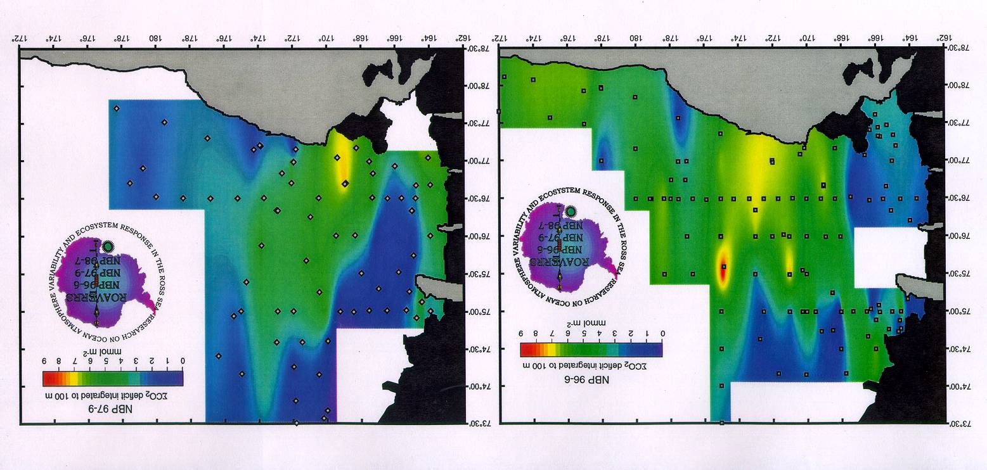
Macrofaunal response to interannual shift in surface production
CO2 Deficit (surface water)
1996 - 1997
1997 - 1998
Notes:
We selected three sites in the SW Ross Sea to compare from year to year. Productivity during our cruise in 1996 was high (the beginning of the flux that accounted for the high integrated flux in 1997). During 1997, productivity was considerably lower, due mainly to the higher ice cover (see slides above). We compared the blue circled area, which went from low to low productivity, Red circled area, which went from high to high (1996 to 1997), and Purple, which went from high to low.

Slide 7
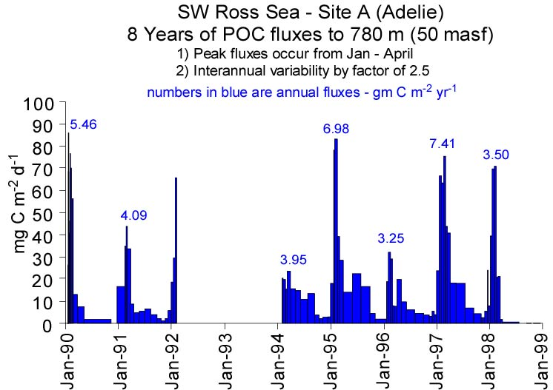
Sinking Flux of Organic Carbon
Notes:
The relevant data are circled in red. Our cruises are shown as green bars on the time axis.
For the data on the next couple slides, The cruises in late 1996 to early 1997 (1996 cruise) and late 1997 to early 1998 (1997 cruise) are most relevant. Note the low integrated carbon flux in 1996 and roughly 2X flux through 1997.

Slide 8
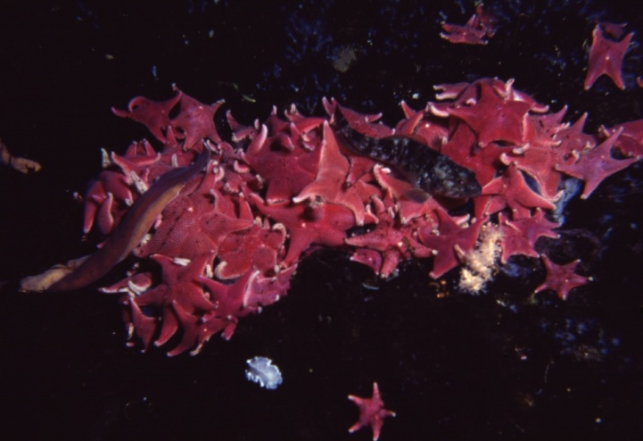
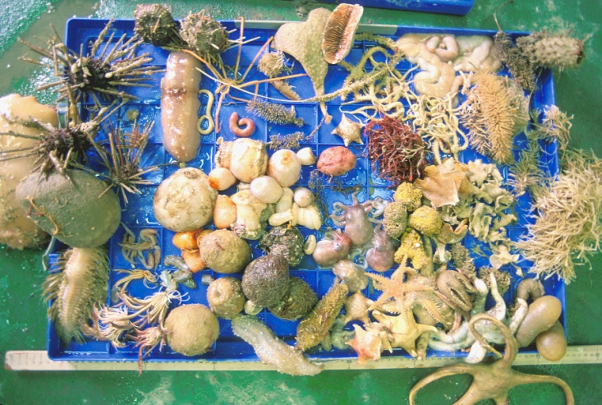
Benthic Ecosystem Response
Benthic Studies Stations

Slide 9
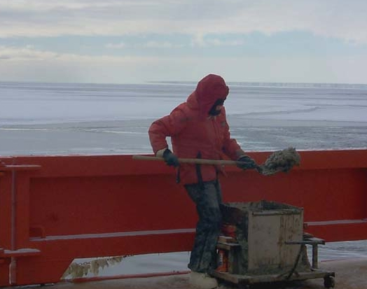
Abundance and Biomass by Phylum
30
25
n = 19
20
Biomass (g/m²)
15
10
5
0
700
600
500
Density (individuals/m²)
n = 19
400
300
200
100
0
Porifera
Annelida
Echiura
Mollusca
Cnidaria
Sipuncula
Nemertea
Arthropoda
Nematoda
Ectoprocta
Unknown
Brachiopoda
Urochordata
Echinodermata

Slide 10
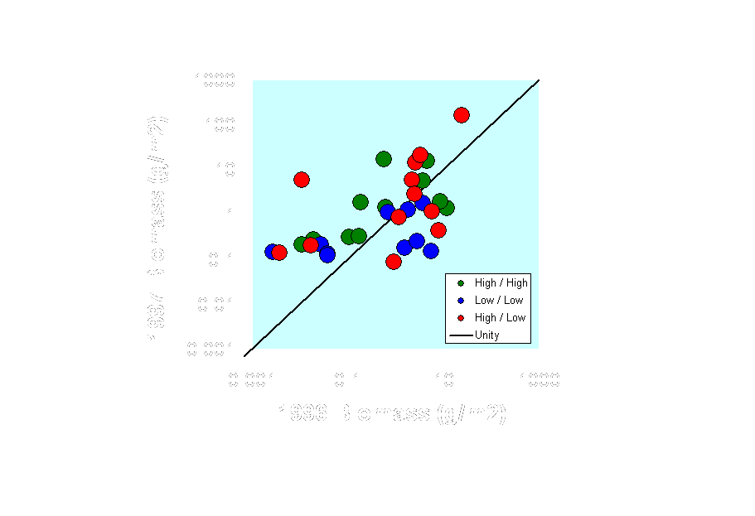
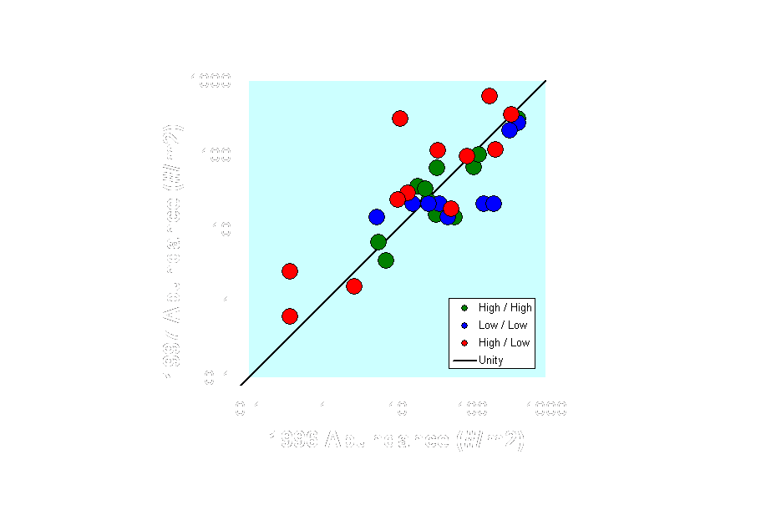
Benthic Response to Productivity Regime
All Phyla (1996 – 1997)
Notes:
Polychaetes are the numerically dominant component of the macrofauna – in biomass the box core samples were dominated by bryozoans, which were huge at a few stations, and echinoderms. Both of those groups have relatively high turnover rates, so the polychaetes, which at least some can respond rapidly (i.e. yearly) to changes in flux, are interesting in the context of pelagic benthic coupling. Here you can see that where the flux remained steady from year to year (LL, HH), there was little change in polychates, but for the area which went from high flux to low flux (the green circle on the carbon drawdown map), there was a 60% increase in polychaete density. Puzzling perhaps? Well first, remember that the total flux in 1996 was low – we sampled at the end of 1996 – at that time, productivity in the water column was very high and bacterial productivity on the bottom was high, based on bacterial abundance – Through 1997 there was high flux, especially very early in the year – this very likely led to the increased density of polychates we detected during late 1997. Of question is the pattern of productivity during 1995-96 – was the pattern of ice cover similar (i.e. high ice years have higher ice cover, especially in the eastern part of the Ross Sea? The answer to this is yes – ice cover in the eastern and northeastern RS during late 1995 and early 1996 was more similar to the late 1997 / early 1998 pattern than to the intervening year. Bottom line, it looks like sea ice controls primary productivity, so it is expected that the eastern area (our green circle) was low in productivity in 1995 and 1997, but high in 1996. In view of this, it appears that the increase in polychaete abundance in that area is linked directly to sea ice => phytoplankton productivity => flux.

Slide 11
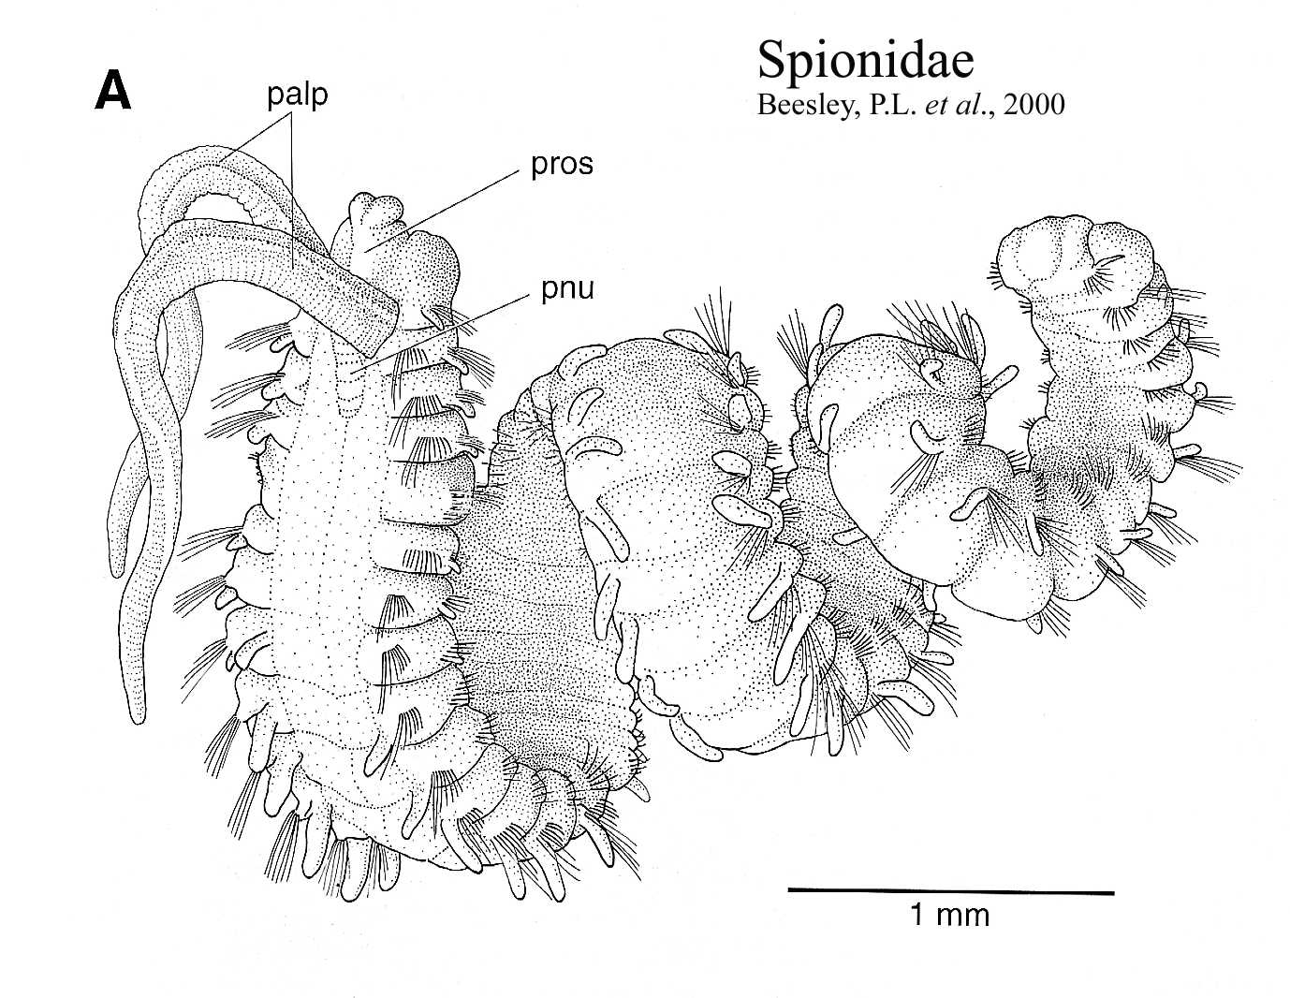
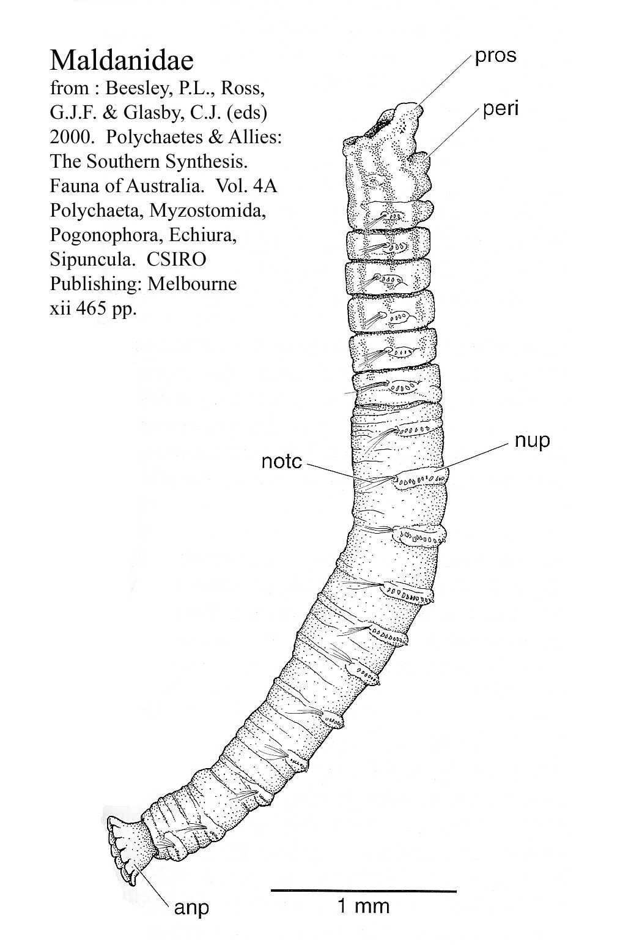
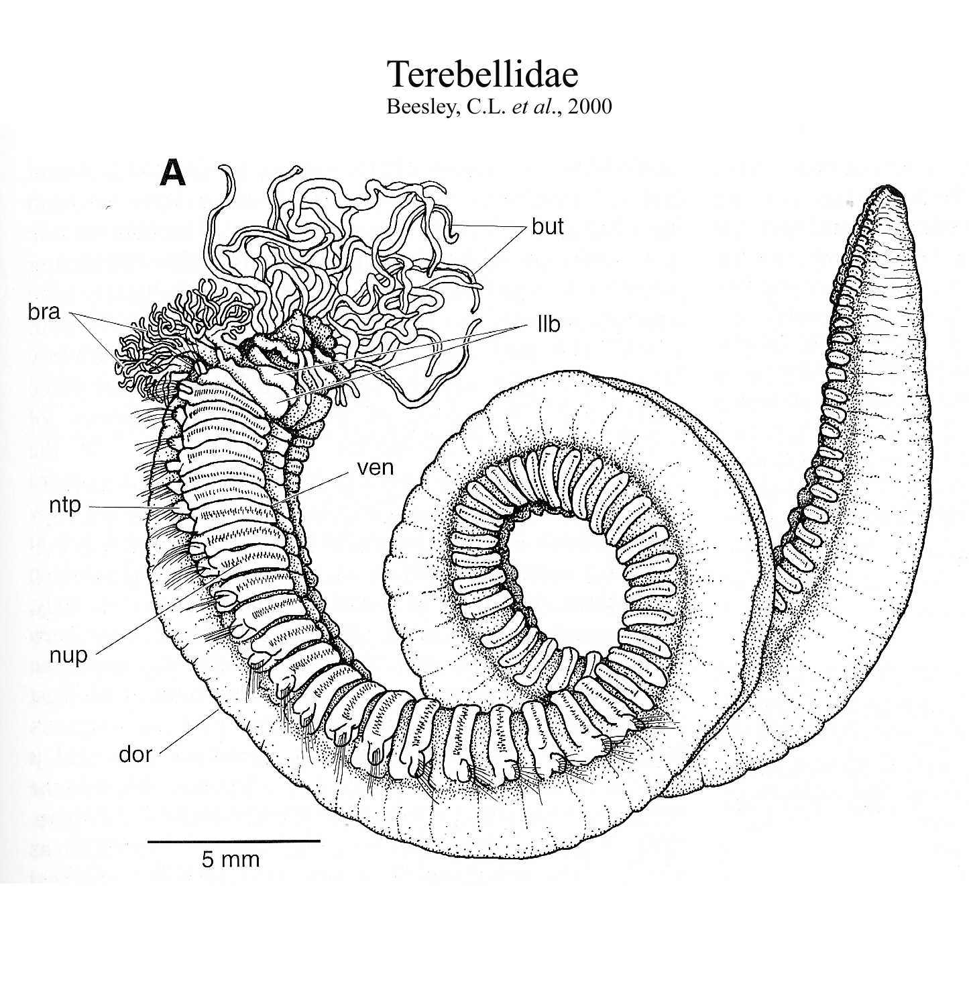
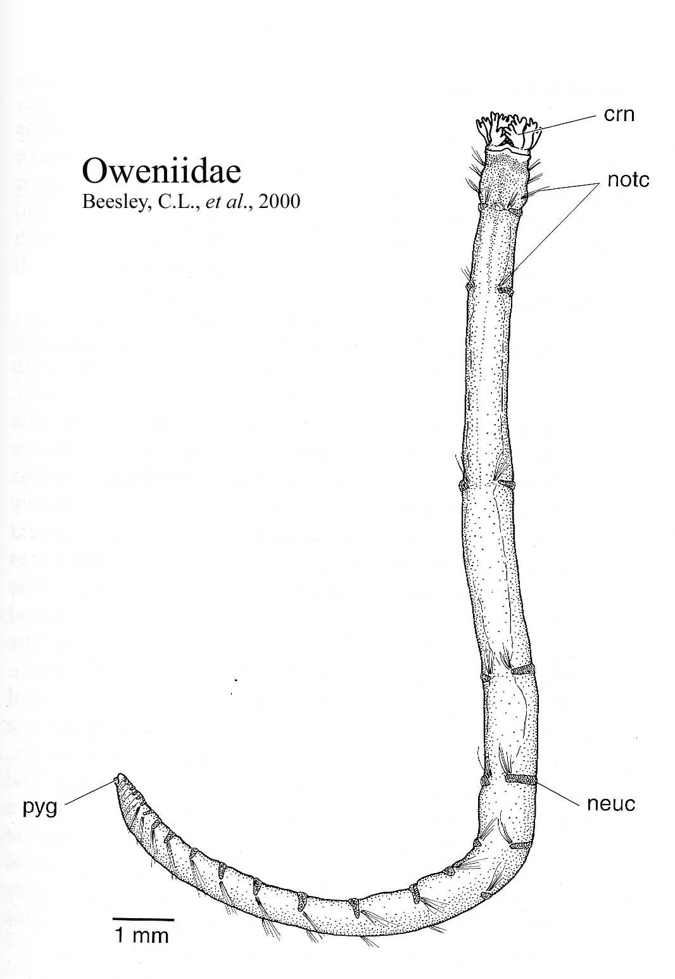
Polychaete Abundance
5
n = 19
4
Biomass (g/m²)
3
2
1
0
120
100
n = 19
80
Density (individuals/m²)
60
40
20
0
Syllidae
Orbiniidae
Spionidae
Nereidae
Oweniidae
Sabellidae
Unknown
Opheliidae
Polynoidae
Glyceridae
Serpulidae
Paraonidae
Cirratulidae
Maldanidae
Nephtyidae
Capitellidae
Acrocirridae
Terebellidae
Oligochaeta
Phyllodocidae
Lumbrineridae
Ampharetidae
Chaetopteridae
Scalibregmidae
Spaerodoridae
Fauveliopsidae
Trichobranchida

Slide 12
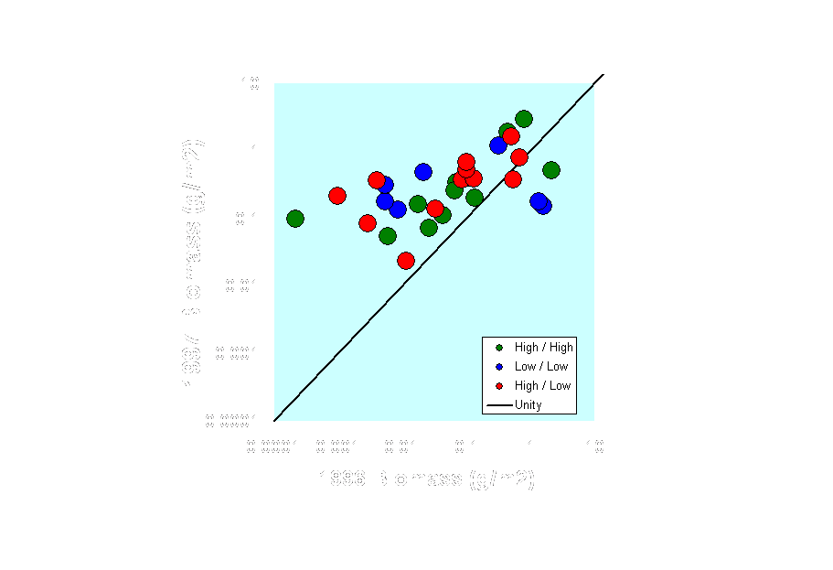
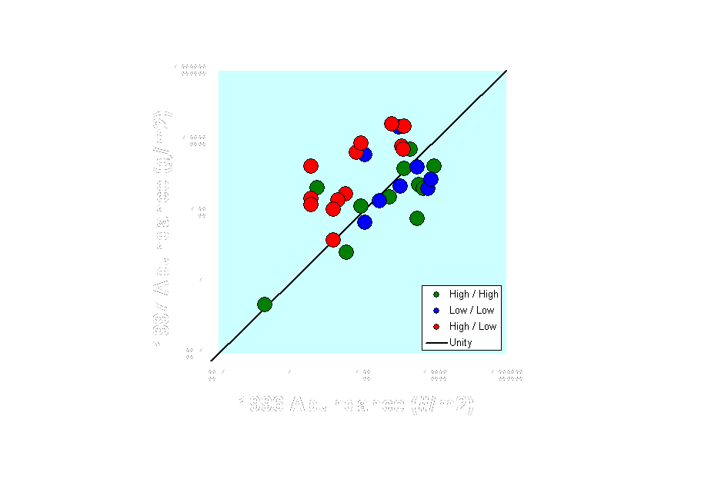
Benthic Response to Productivity Regime
Polychaete Families (1996 – 1997)
Notes:
Polychaetes are the numerically dominant component of the macrofauna – in biomass the box core samples were dominated by bryozoans, which were huge at a few stations, and echinoderms. Both of those groups have relatively high turnover rates, so the polychaetes, which at least some can respond rapidly (i.e. yearly) to changes in flux, are interesting in the context of pelagic benthic coupling. Here you can see that where the flux remained steady from year to year (LL, HH), there was little change in polychates, but for the area which went from high flux to low flux (the green circle on the carbon drawdown map), there was a 60% increase in polychaete density. Puzzling perhaps? Well first, remember that the total flux in 1996 was low – we sampled at the end of 1996 – at that time, productivity in the water column was very high and bacterial productivity on the bottom was high, based on bacterial abundance – Through 1997 there was high flux, especially very early in the year – this very likely led to the increased density of polychates we detected during late 1997. Of question is the pattern of productivity during 1995-96 – was the pattern of ice cover similar (i.e. high ice years have higher ice cover, especially in the eastern part of the Ross Sea? The answer to this is yes – ice cover in the eastern and northeastern RS during late 1995 and early 1996 was more similar to the late 1997 / early 1998 pattern than to the intervening year. Bottom line, it looks like sea ice controls primary productivity, so it is expected that the eastern area (our green circle) was low in productivity in 1995 and 1997, but high in 1996. In view of this, it appears that the increase in polychaete abundance in that area is linked directly to sea ice => phytoplankton productivity => flux.

Slide 13
Benthic Community Patterns and Dynamics in the Ross Sea
High seabed habitat heterogeneity in the Ross Sea very likely
enhances biodiversity and ecosystem complexity
  Shallow Banks
  Deep basins
Pelagic – Benthic Coupling
  Weak coupling in space – surface pattern not reflected on bottom
  Strong temporal coupling

