Slide 1

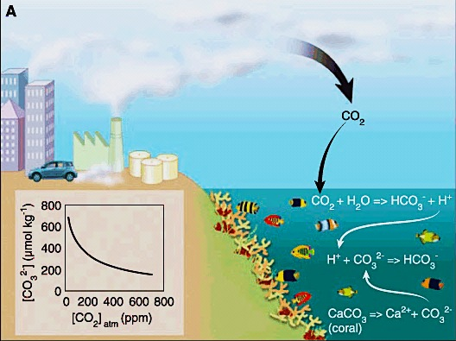
Ocean Acidification and polar ecosystems
Jim Barry, Monterey Bay Aquarium Research Institute, Moss Landing, CA
Ross Sea Meeting, La Jolla, 2012
OA can affect physiology, performance, and population dynamics
Changes in community interactions and ecosystem function
Hough-Guldberg et al. 2007

Slide 2
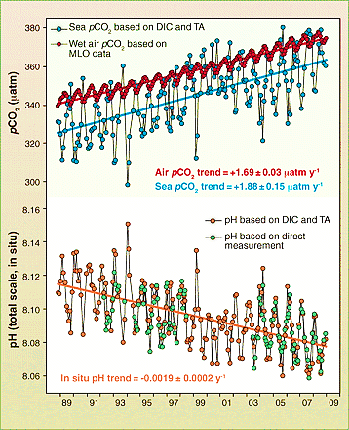
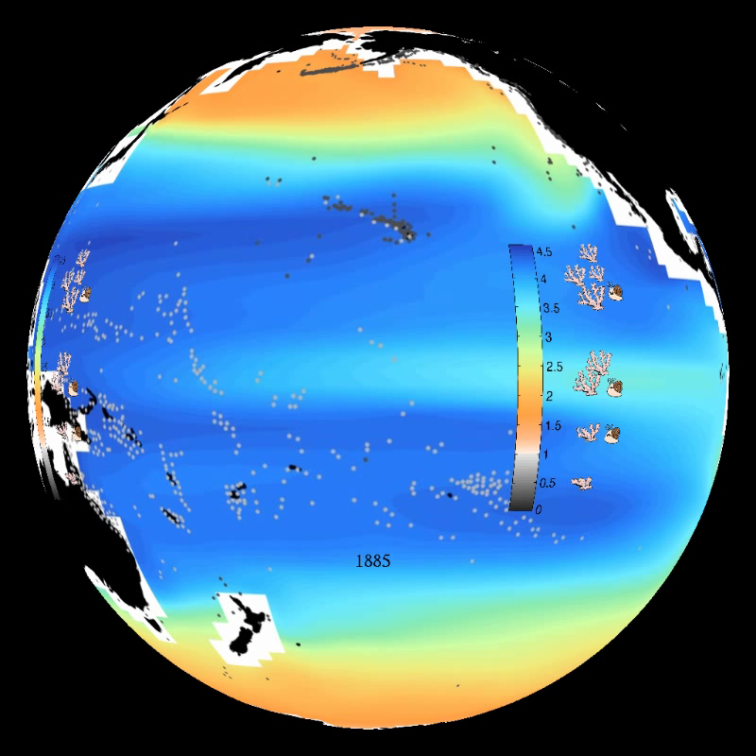
Fossil fuel CO₂ emissions are causing Ocean Acidification on global scale
Ocean CO₂ is ‘tracking’ atmospheric CO₂
Oceans becoming more acidic & mineral-poor (shell-forming minerals)
Shell-forming minerals – 1885 to ~2100
Blue – high (good for shell growth)
Orange/grey – low (bad)
NOAA - Feely
Doney 2010
Notes:
Ocean chemistry is very well understood and the amount of carbon dioxide emissions now in the oceans, as well as their effects on ocean chemistry, are highly measurable.
CO2 levels in the atmosphere are rising rapidly
CO2 in the ocean surface waters are ‘tracking ‘ atmospheric CO2
Ocean pH (Acidity) is mirroring ocean / atmospheric CO2
Levels of minerals used for shell formation are falling rapidly through this century and will be very low by ~2100
Blue indicates high levels of minerals in 1885
By ~2100, levels are low (orange), or even corrosive (exposed shells will dissolve) – even harder to make or maintain shells
Could have very imortant impacts on organimss
This is a massive and rapid change in ocean chemistry different than known on Earth for 25+ million years.

Slide 3
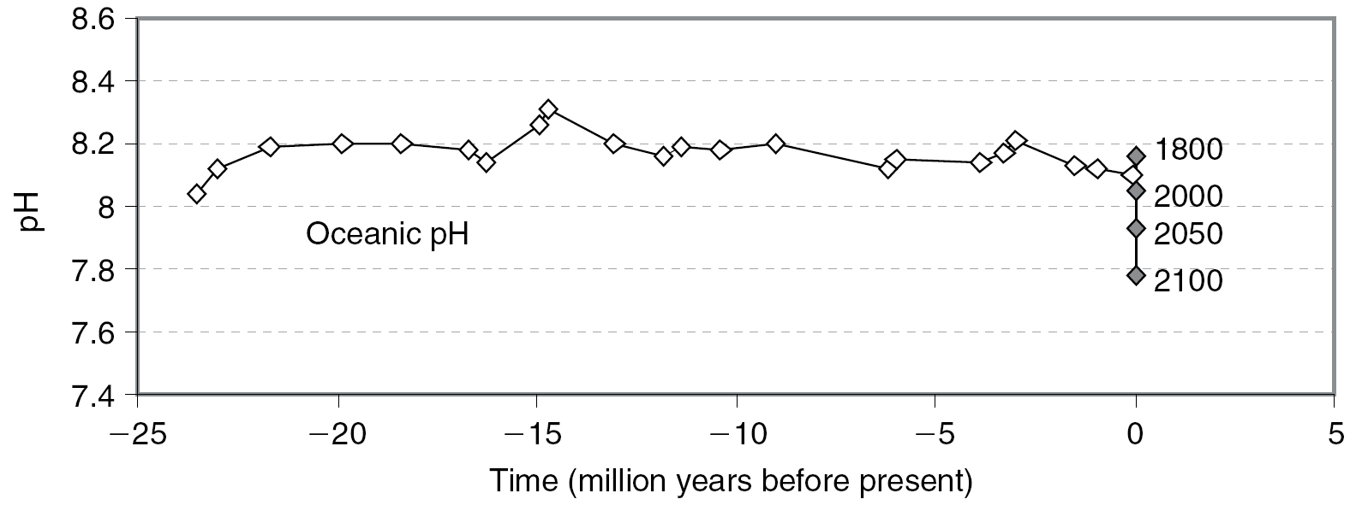
Massive and rapid change in ocean chemistry
Ice Ages
Effect of fossil fuel emissions
Turley et al 2005
Estimated from boron isotopes in seabed foraminifera
Note speed and size of current pH change

Slide 4
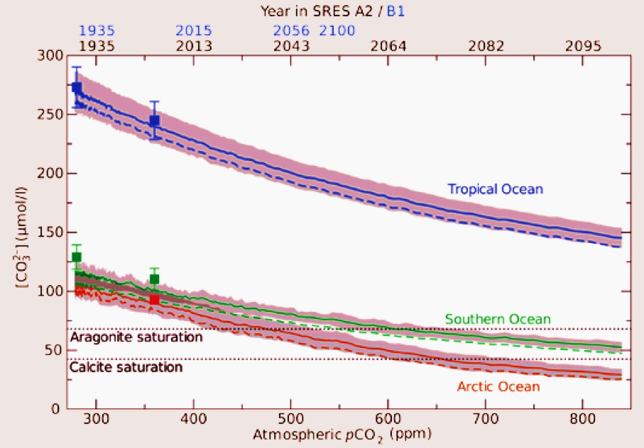
Decline in carbonate saturation:
High latitude surface waters: closer to the edge
Steinacher et al. 2009

Slide 5
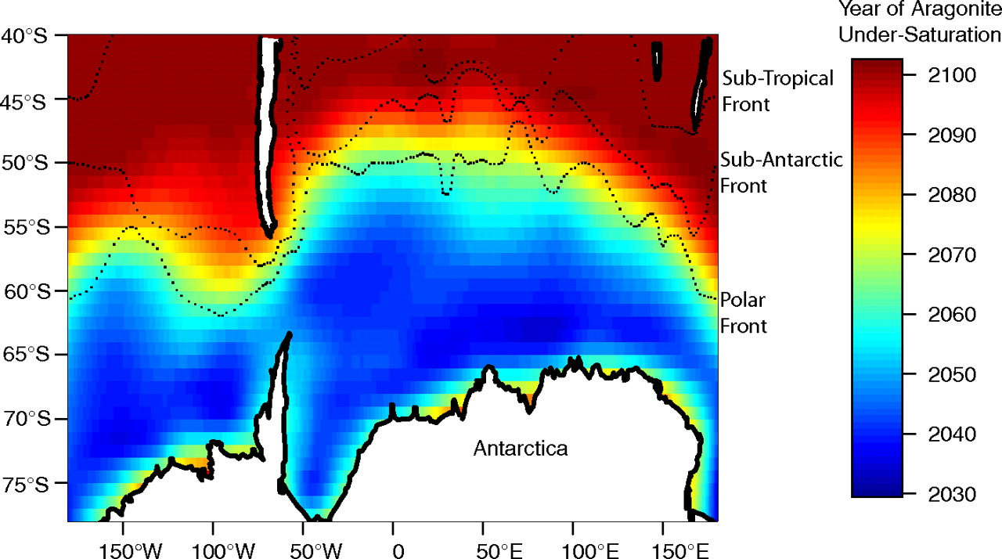
Contour plot of the year in which the onset of wintertime undersaturation occurs under equilibrium conditions.
McNeil B I , Matear R J PNAS 2008;105:18860-18864
©2008 by National Academy of Sciences
Notes:
Contour plot of the year in which the onset of wintertime undersaturation occurs under equilibrium conditions. Shown are the average location of Southern Ocean fronts (38).

Slide 6
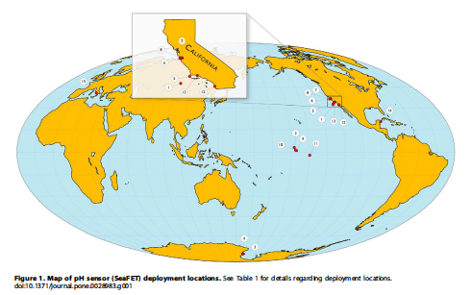
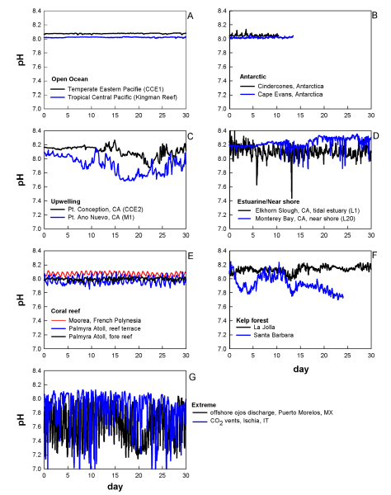
pH variation is variable, but larger in coastal areas
Hofmann et al. 2011

Slide 7
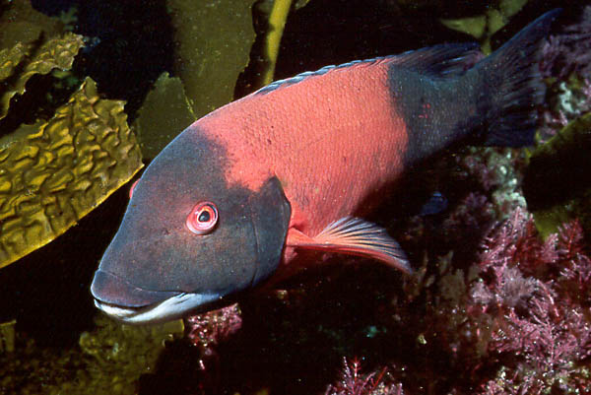
How do animals cope with ocean acidification and other environmental changes?
What to
do..?
Migration
Acclimation
Adaptation
Extinction
Notes:
Organisms and populations can respond to ocean acidification in several ways

Slide 8
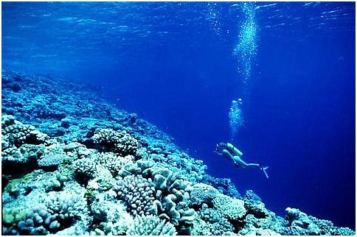
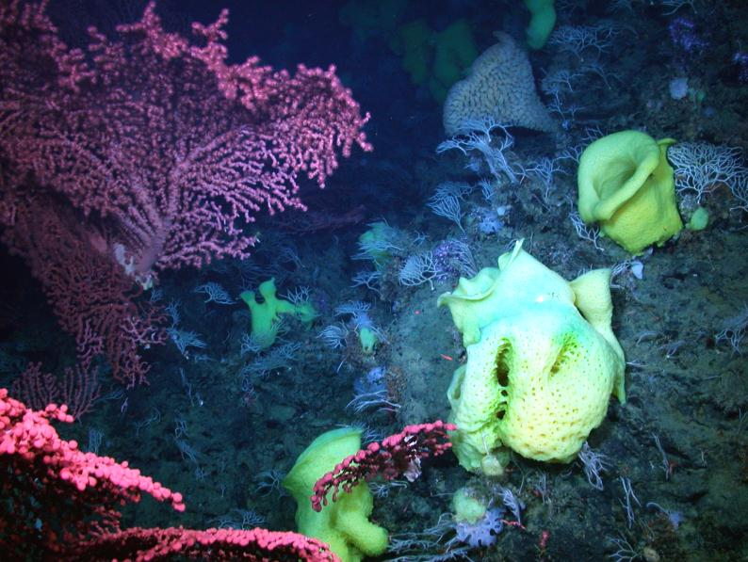
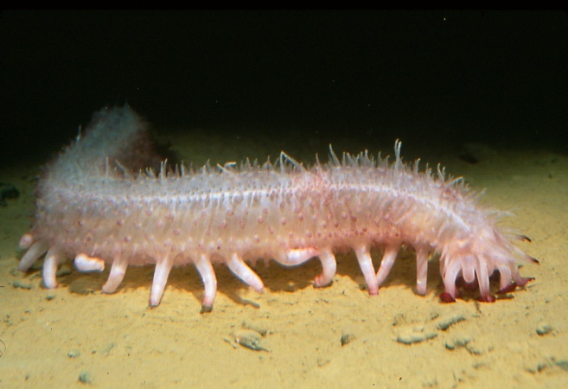
OA can affect organisms and ecosystem function
Organism Level
Physiological response
Multiple environmental changes?
Performance?
  Behavior
  Growth
  Reproduction
Sensitivity of life stages?
Demographic rates?
Acclimatization?
Adaptation?
Community Level
Functional role of species
  Key community interactions
  Ecosystem engineers

Slide 9
Ocean Acidification acts on the physiology of individual organisms, but has consequences for ecosystems & society
Environmental
Change
Physiology
Growth
Survival
Reproduction
Community Interactions
Ecosystem Services
Less difficult
More difficult
Scientific study
Notes:
The front line of coping is always coupled to the physiology of individual organisms –
Our physiology is the ‘window to the world” for all organisms. No matter what the environmental change is, organisms can only react based on physiological adaptations shaped during their evolutionary history.
Changes in physiology due to the environment lead to changes in growht, repdocution, and survival, which in turn, affect the function of food webs, and eventually the natural benefits we receive from the oceans.

Slide 10
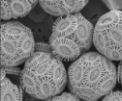
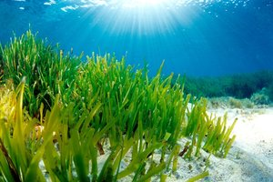
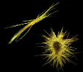
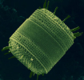
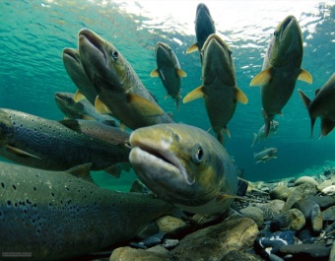
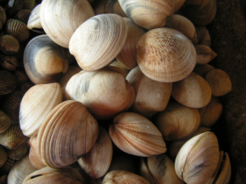
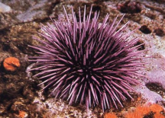
Stress increases the ‘cost of living’
Normal
Stressed
Cost of
Living
Growth
Cost of
Living
Growth
Reproduction
Energy
Budget
Reproduction
Physiological processes affected by Ocean Acidification
Photosynthesis
Calcification*
Respiration
Acid-base balance
Metabolism
Barry et al. 2011
Notes:
Stress increases “cost of living” , with less energy for growth and reproduction.
Individuals = reduced 1) survival, 2) size, 3) reproductive output.
Populations = Reduced abundance, productivity, resilience, and greater likelihood of extinction.

Slide 11
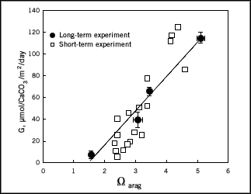
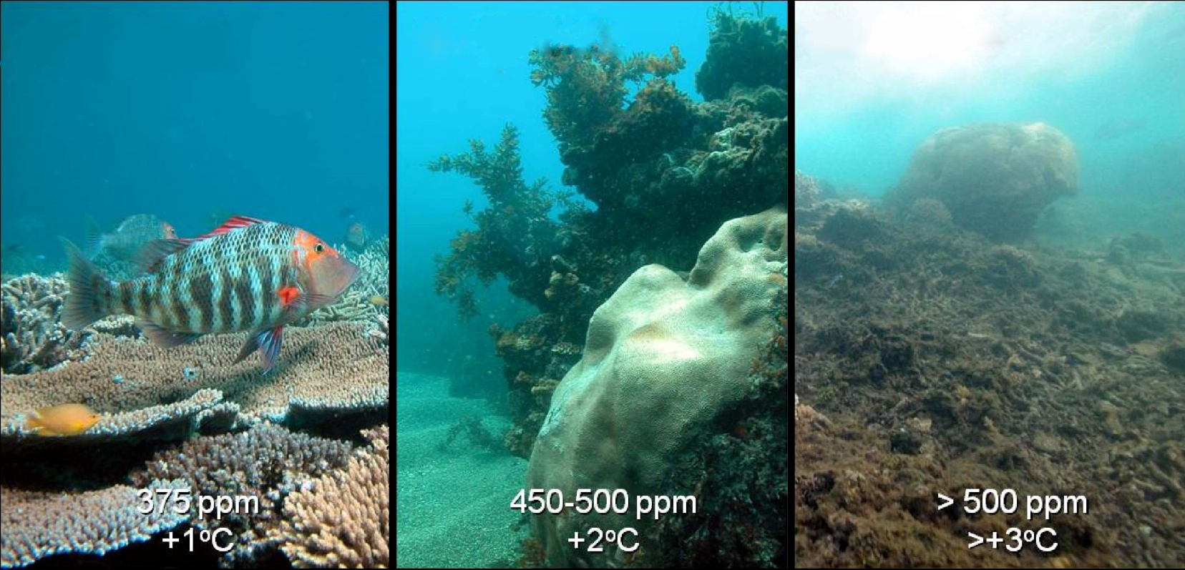
Ecosystem
Function
Calcification and Coral Ecosystem Tipping Points
Low carbonate saturation associated with low calcification rate
Loss of ecosystem engineers
Calcification Rate
Corals
Aragonite Saturation State
Hoegh-Guldberg et al. 2007

Slide 12
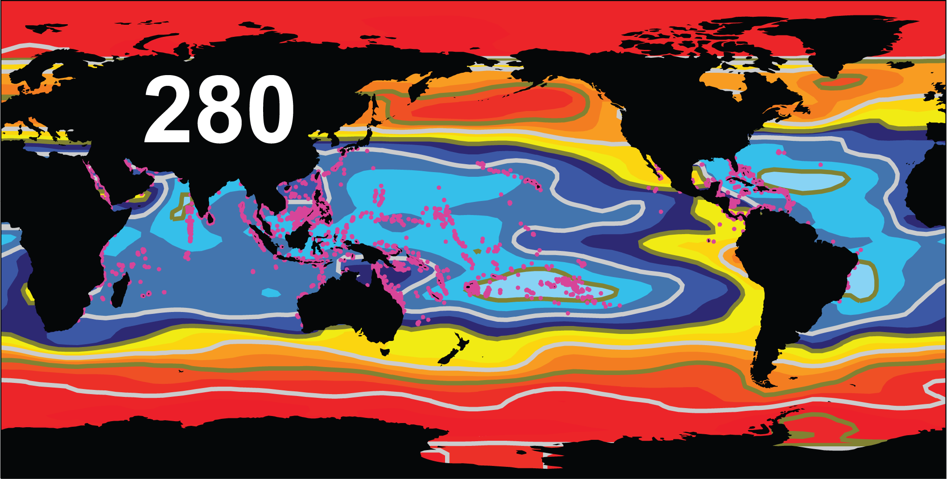
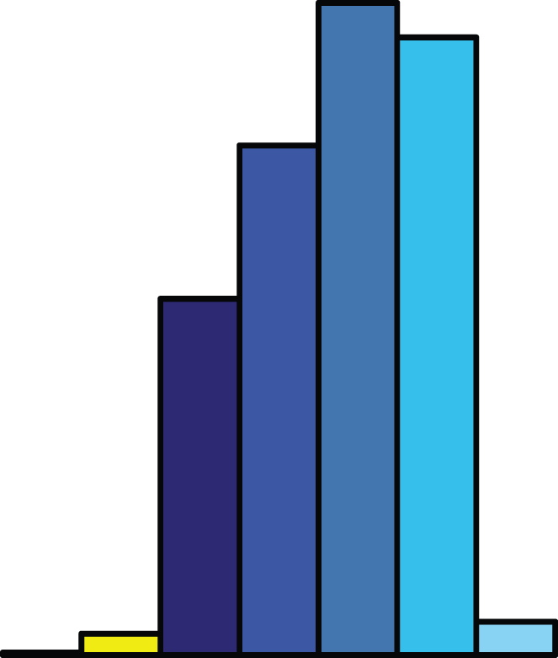
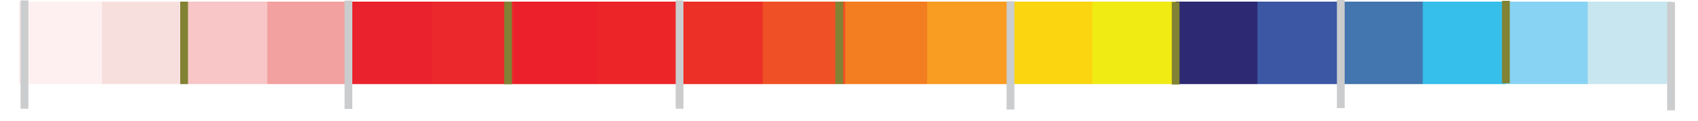
Carbon dioxide level,
Coral reef distribution,
and chemical conditions helping drive reef formation
0
1
2
3
4
5
Corrosive
Ω_{Aragonite}
Optimal
Cao and Caldeira, 2008

Slide 13
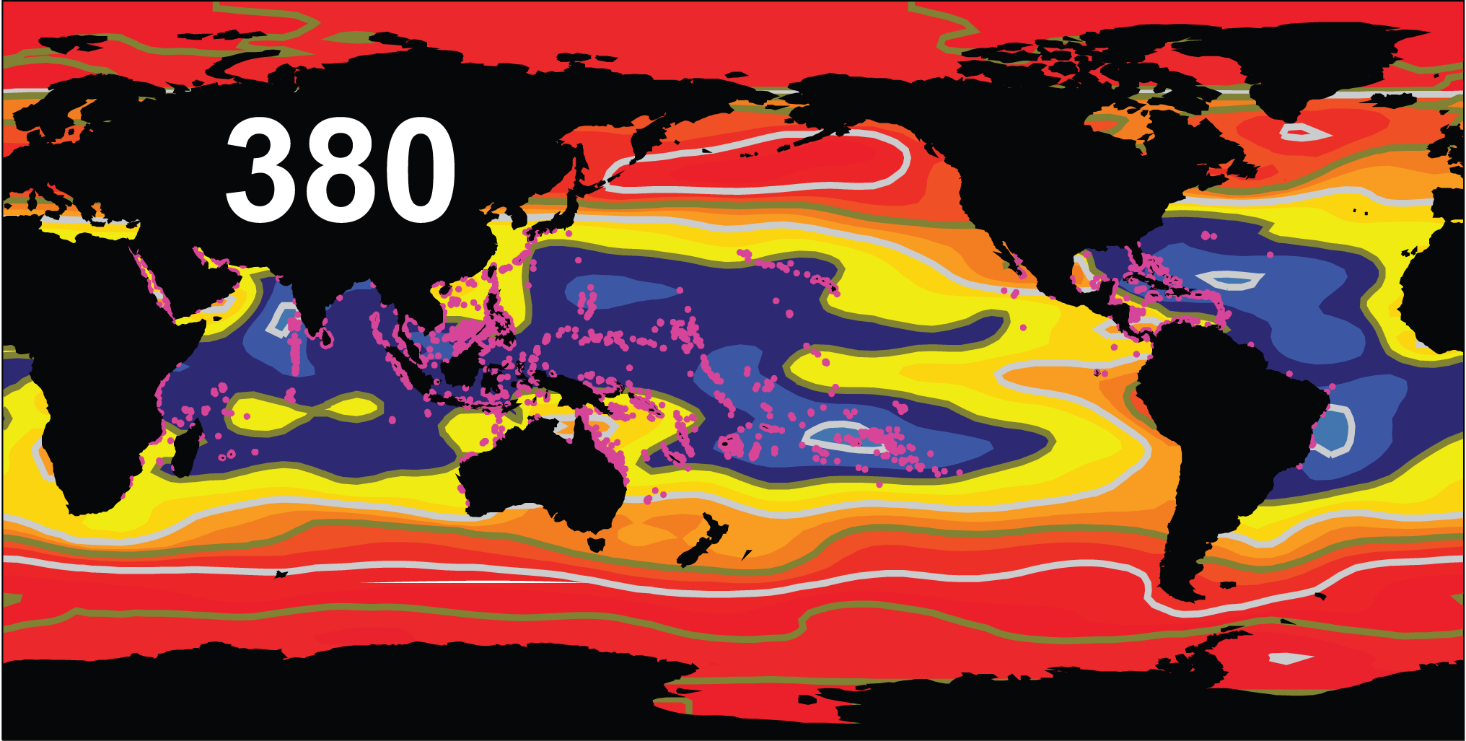
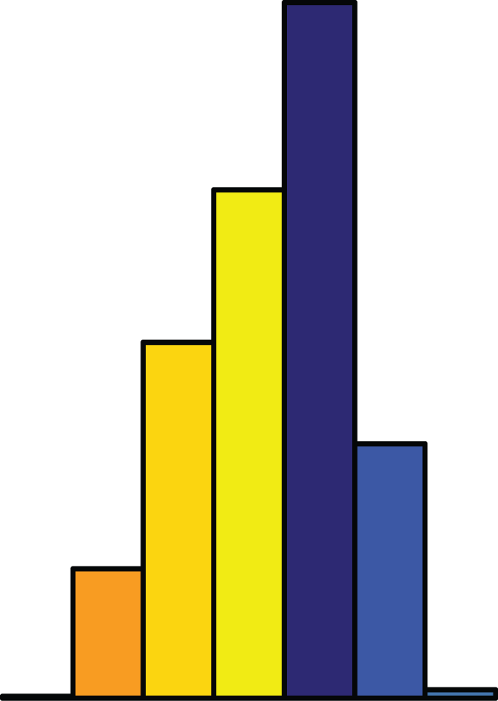
Carbon dioxide level,
Coral reef distribution,
and chemical conditions helping drive reef formation
0
1
2
3
4
5
Corrosive
Ω_{Aragonite}
Optimal
Cao and Caldeira, 2008

Slide 14
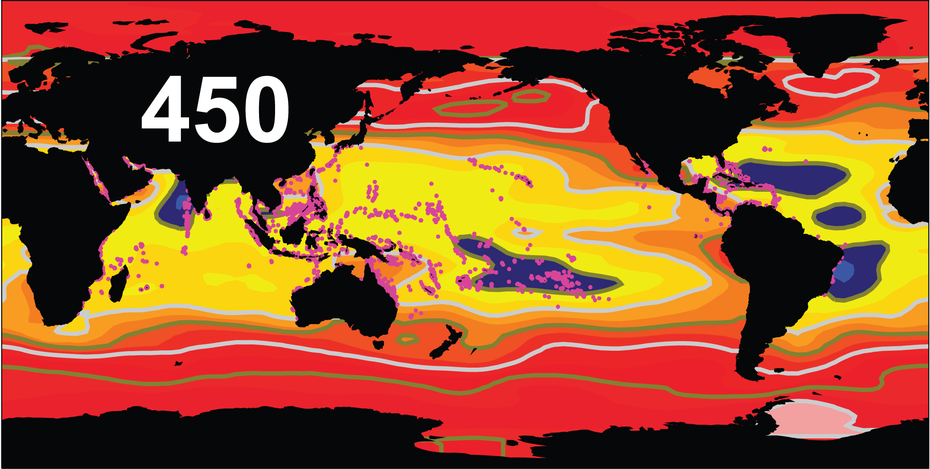
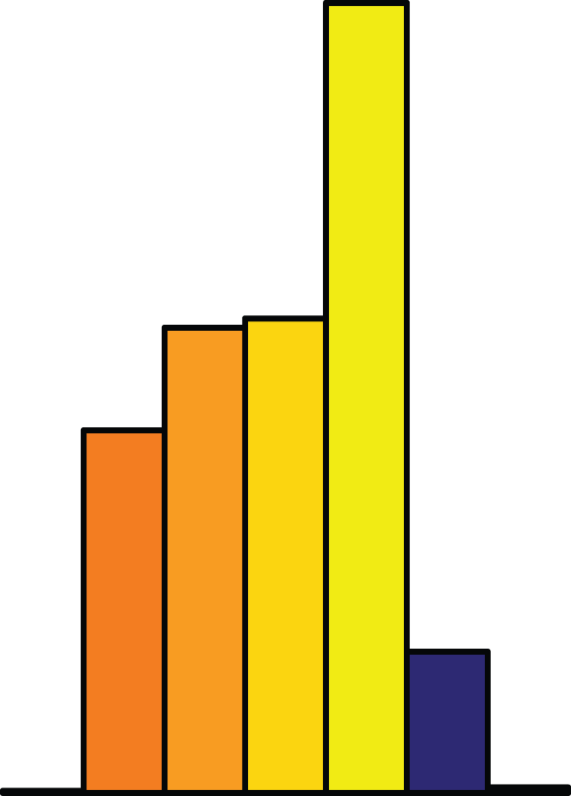
Carbon dioxide level,
Coral reef distribution,
and chemical conditions helping drive reef formation
0
1
2
3
4
5
Corrosive
Ω_{Aragonite}
Optimal
Cao and Caldeira, 2008

Slide 15
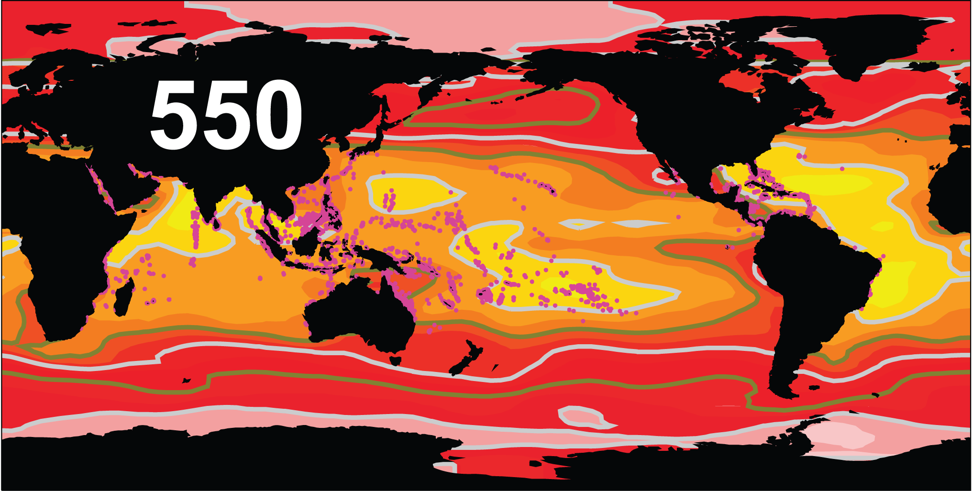
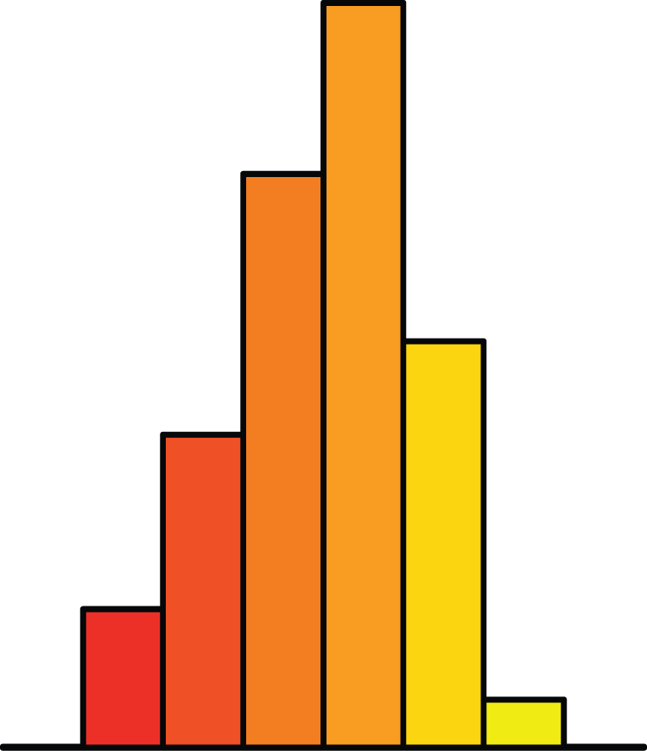
Carbon dioxide level,
Coral reef distribution,
and chemical conditions helping drive reef formation
0
1
2
3
4
5
Corrosive
Ω_{Aragonite}
Optimal
Cao and Caldeira, 2008

Slide 16
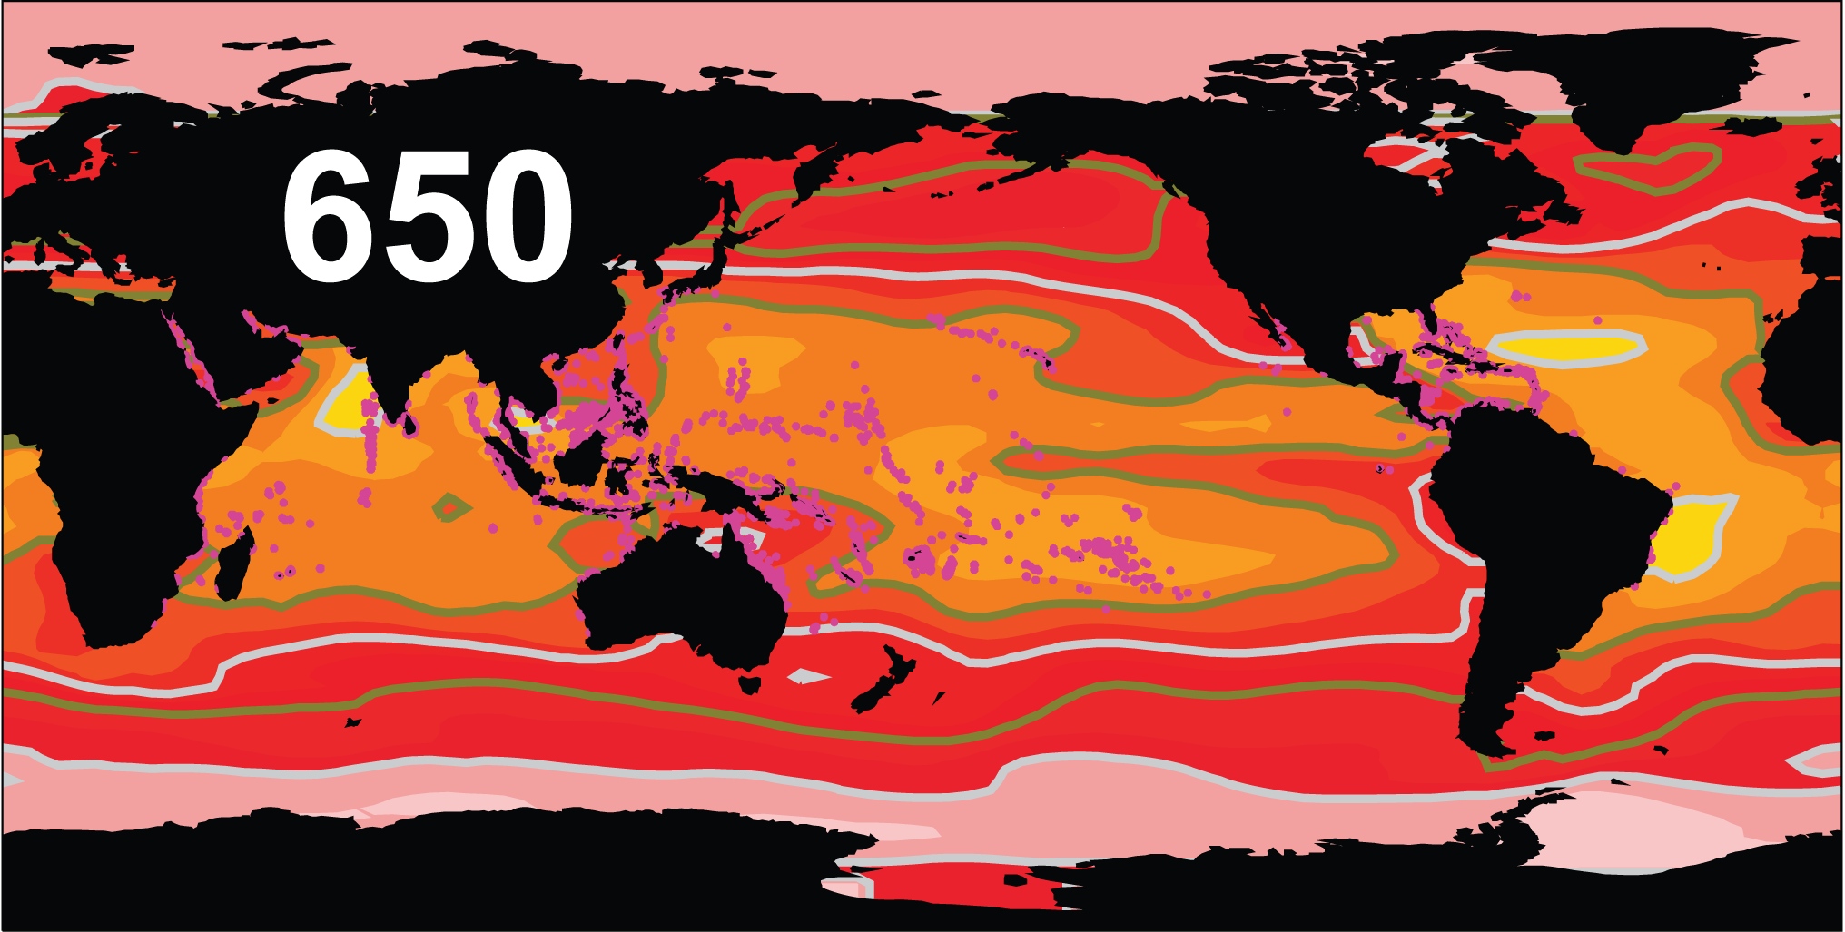
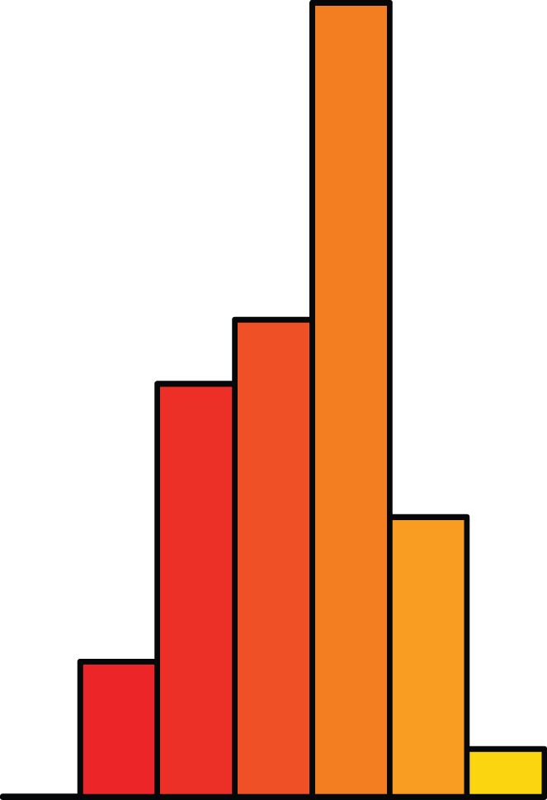
Carbon dioxide level,
Coral reef distribution,
and chemical conditions helping drive reef formation
0
1
2
3
4
5
Corrosive
Ω_{Aragonite}
Optimal
Cao and Caldeira, 2008

Slide 17
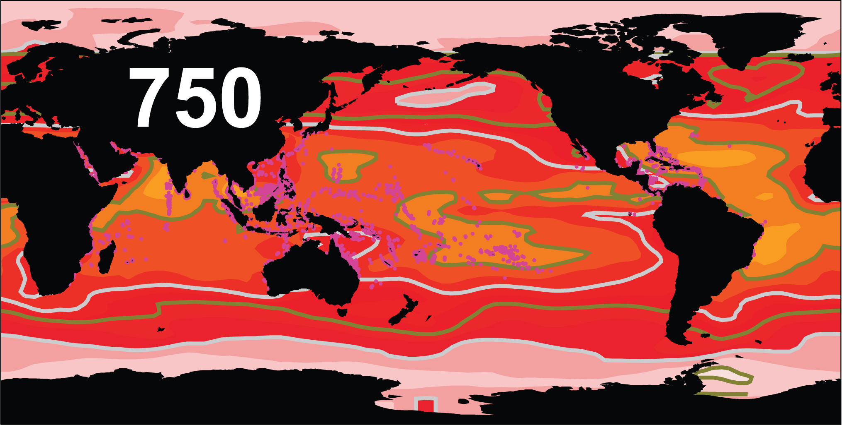
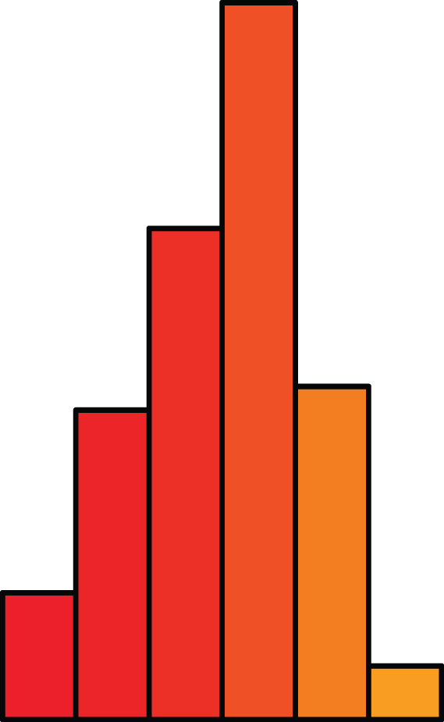
Carbon dioxide level,
Coral reef distribution,
and chemical conditions helping drive reef formation
0
1
2
3
4
5
Corrosive
Ω_{Aragonite}
Optimal
Cao and Caldeira, 2008

Slide 18
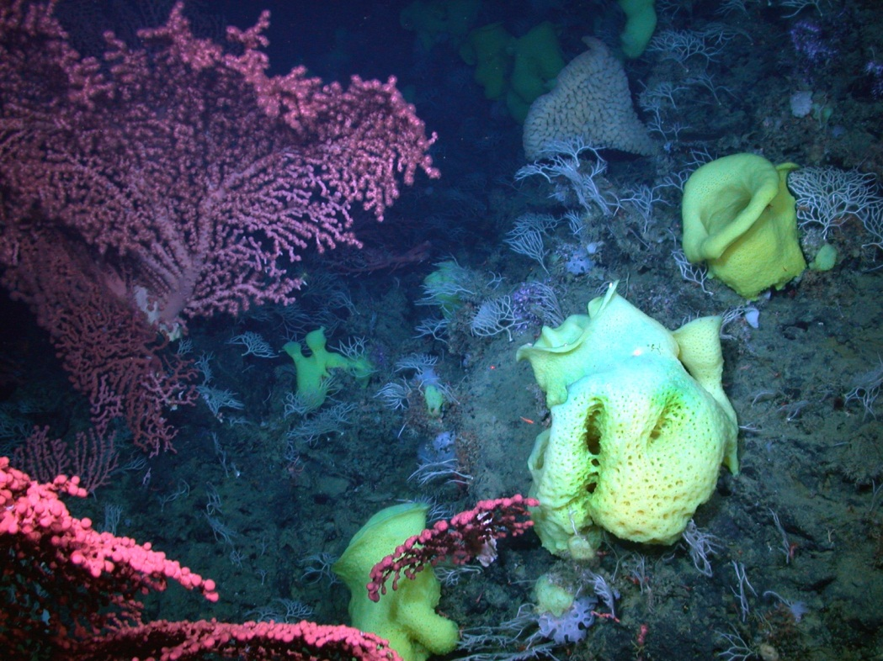
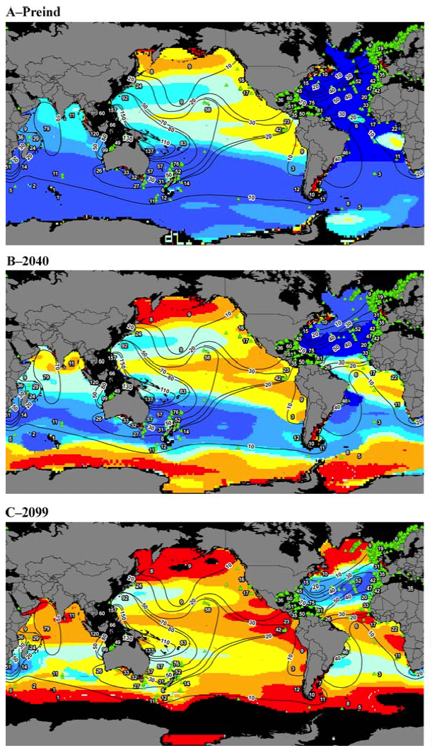
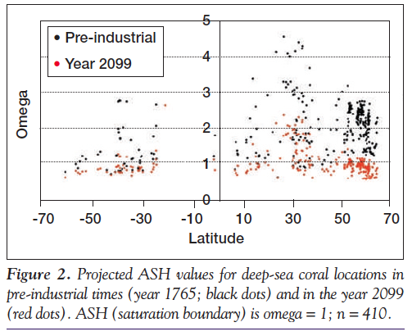
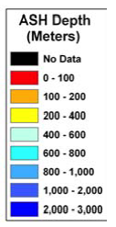
Ecosystem
Function
Reduced carbonate saturation limits deep-sea corals
Preindustrial
2040
2099
Guinotte et al. 2006
Guinotte and Fabry 2008

Slide 19
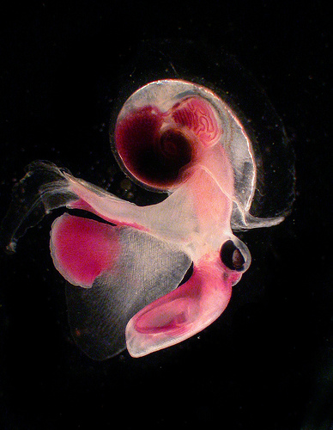
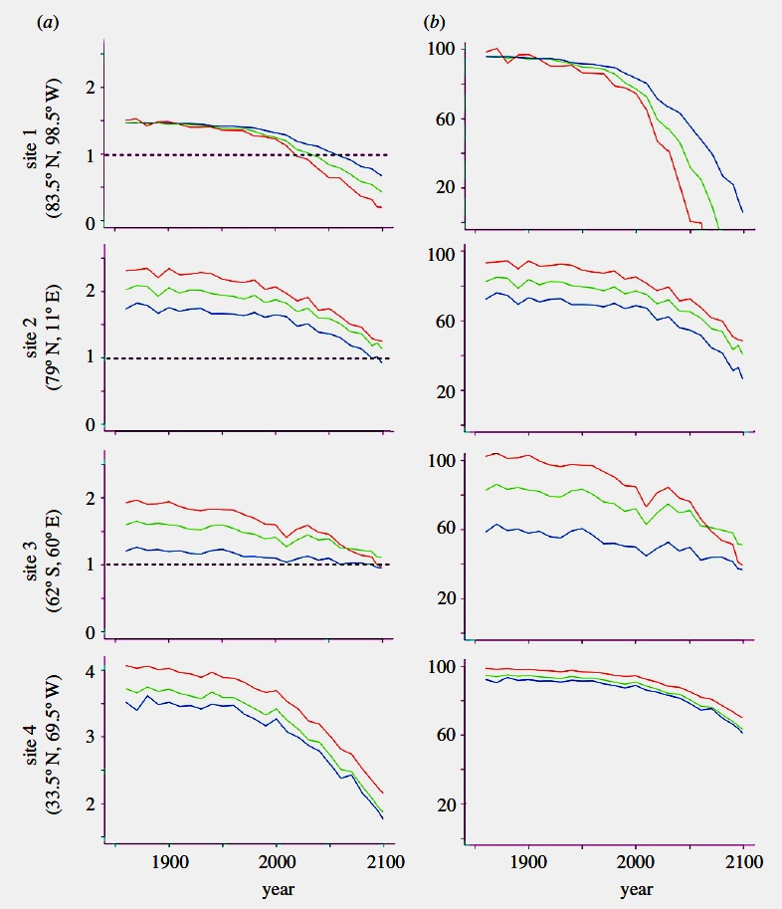
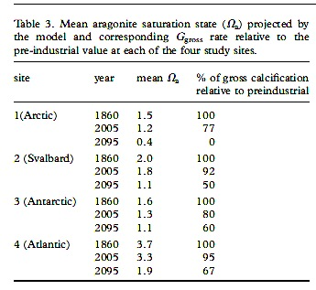
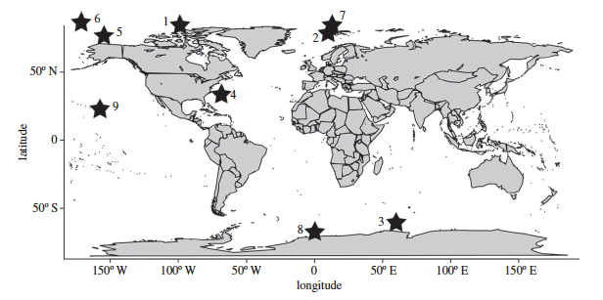
Reduced aragonite saturation will impact pteropods
Aragonite Sat. State
% Initial Calcification
Comeau et al. 2011

Slide 20
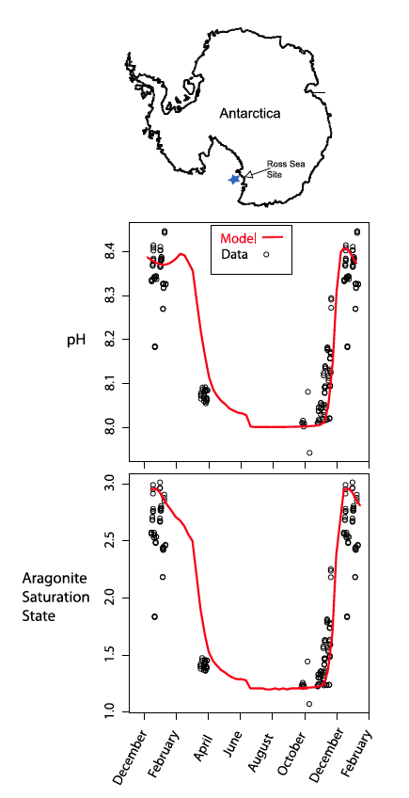
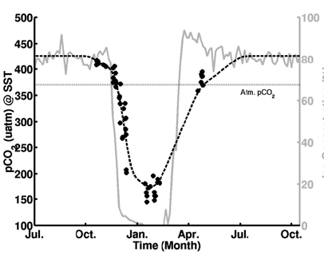
High Latitude: Antarctic marginal seas
Strong seasonal variation in carbonate chemistry
Sweeney,2004
McNeil et al. 2010. GRL

Slide 21
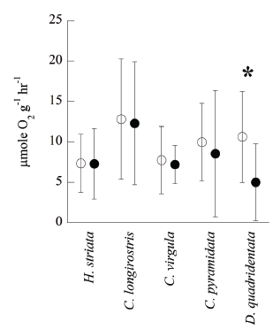
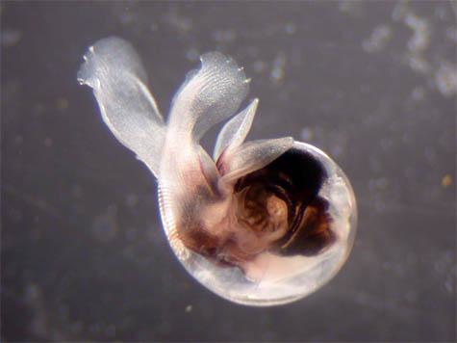
Vertically migrating pteropods are more tolerant of high CO₂
Migrator spp.
Normal CO2
High CO2
Maas et al. 2011

Slide 22
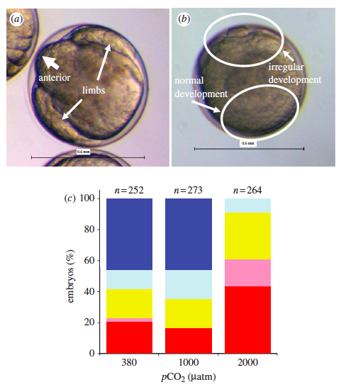
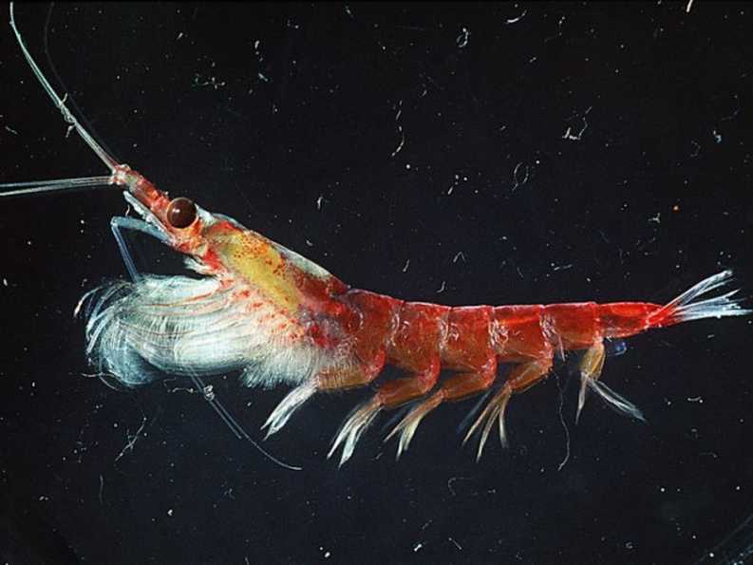
Will krill fare well under Southern Ocean acidification?
Maybe not…
1000 µatm pCO₂ – normal
2000 – abnormal development
Kawaguchi et al. 2010

Slide 23
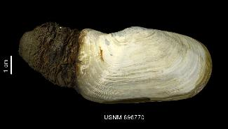
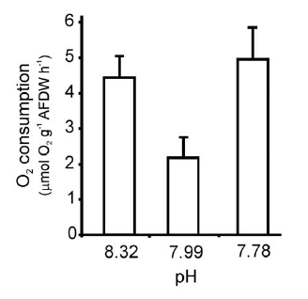

Benthic bivalves are stressed by ocean acidification
Laturnula elliptica
Laturnula metabolic rate
High pH
Control
Low pH
Cummings et al. 2011
Increased basal metabolism suggests higher maintenance cost

Slide 24


Bryozoan growth has increased recently – warming?
Cellarinella sp. growth rate increasing over historic record.
Barnes et al. 2011

Slide 25


Acid-base control in deep-sea crab is weak
Species
Response
Shallow versus deep-living species?
Combined effects of low pH, low O2?
Tanner Crab (deep-sea)
Metabolic alkalosis
Weak pH compensation
Dungeness Crab (shallow water)
Strong Acidosis
Respiratory Acidosis
NBB
Pane and Barry, 2007, 2008

Slide 26



Community
interactions
Behavior of tropical reef fish impaired by OA
Various aspects of tropical reef fish behavior shown to be affected by OA
Olfaction / homing: Munday et al. 2009
Predator detection: Dixson et al. 2010
Homing ability: Devine et al. 2012
Learning ability: Ferrari et al. 2012
Risk assessment: Ferrari et al. 2012
All linked to impaired neurotransmitter function
Nilsson et al. 2012. Near-future carbon dioxide levels alter fish behavior by interfering with neurotransmitter function

Slide 27
Stress affects animal performance
Multiple stressors can interact to affect animal performance
High
Physiology
Growth
Survival
Reproduction
+Hypoxia
Performance
too cold
too warm
+acidity
optimal
Low
Cold
Temperature
Hot
Modified from Portner (2008)

Slide 28



Ecosystem
Function
Biodiversity decreases with pH at Ischia CO₂ vents
Typical Ischia shallow-water community
50 % loss of calcifying taxa at -0.3 pH
No change in diversity for future pH levels
Calcifiers
Non-calcifiers
Community in high-CO₂ areas at Ischia
Jason Hall-Spencer et al. 2008
Kroeker et al. 2011
Spencer-Hall et al. 2008, Barry et al. 2011

Slide 29
























Biodiversity key to functional marine food webs
Primary Production
Humans
Seabirds
Phytoplankton
Zooplankton
Squid
Sea butterfly
Limacina
Fish
Large zooplankton
Detritus / Bacteria
Seafloor Animals
Mammals
Marine Food Web
Notes:
The function and efficiency of food webs can / will be affected by changes in the abundance or productivity of key prey species.
E.g. marine sea butterfly (pteropods). Salmon depend upon pteropods, which are vulnerable to ocean acidiciation (shells dissolve).
Loss of pteropods – will other large zooplankton ‘pick up the slack”?
Loss of all large ZP? Will energy flow continue?

Slide 30



Biodiversity affects the function of
Large Marine Ecosystems (LMEs)
Worm et al., 2006 (modified)
Collapse ➔
Catch ➔
Catch ➔
Collapse ➔
Variation ➔
Variation ➔
Biodiversity ➔
log (Biodiversity )➔
Biodiversity ➔
Reduced biodiversity due to acidification/warming may cause:
Cascading collapse & reorganization of food webs
Increased variation in production, reduced stability
Impaired potential for recovery (reduced resilience)

Slide 31

Potential for Acclimatization and Adaptation
General patterns?
Bioturbation and biogeochemical fluxes
Microbes
Acclimatization
adaptation.JPG
Invertebrates
Vertebrates
Amphiura filiformis

Slide 32



Ecosystem
Function
OA can affect element cycling in benthic systems
Organism Level
Sensitivity of bioturbators to OA
  Mollusca
  Annellids
  Echinoderms
  Nematodes
  Crustacea
  Other
Ecosystem function
Loss or change in bioturbation
can affect microbial & nutrient fluxes
Benthic-acidification.org
Steve Widdicombe (PML)

Slide 33
Antarctic communities and Environmental Change
Physical Features:
Cold
Reduced carbonate ion levels / saturation
Mild - moderate variation in carbonate chemistry
Sea ice coverage
Biology / physiology:
High seasonality
Unique fauna – sensitive to invasions (e.g. crabs)
Low metabolic rates
Calcification potential low
Weak tolerance for environmental change?
Acclimation / adaptation ?
Indirect effects

